Slide 1
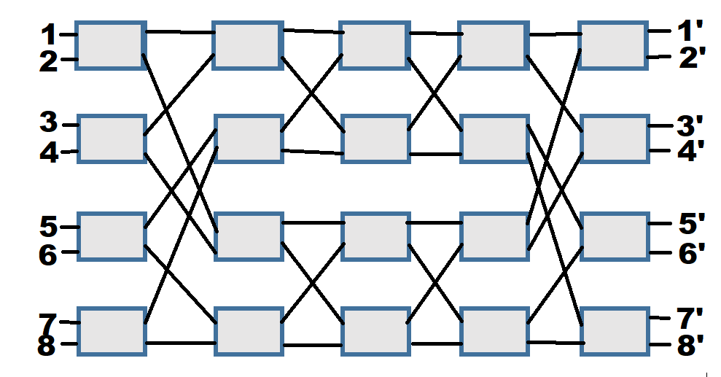
Analysis of benes network and its implementation in c++
Name of the Presenter: Birju Shaw
Roll No of the Presenter: 20CS4125
Name of the Guide/Supervisor: Dr. Jaydeep Howalder
May, 2022
Fig.1 - 8*8 Benes Network
Department of Computer Science and Engineering
Notes:
NOTE:
To change the image on this slide, select the picture and delete it. Then click the Pictures icon in the placeholder to insert your own image.

Slide 2
Problem Definition / Objective of the work
Shuffling of Ordered Sequence.
Data Oblivious Shuffling.
Shuffling can be categorized as -

Slide 3
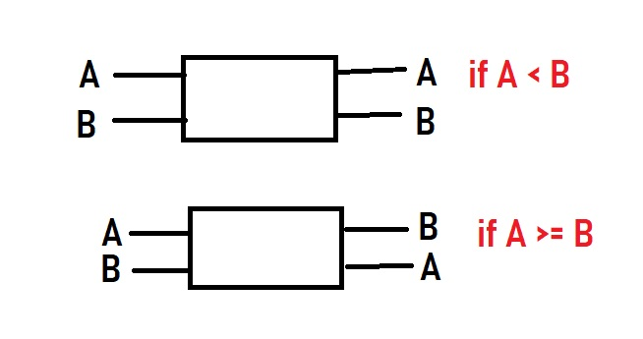
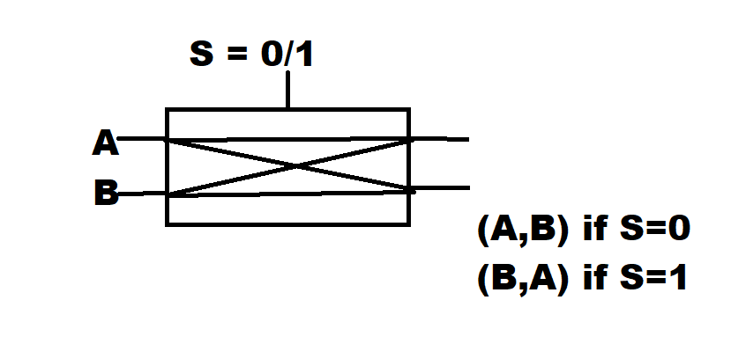
Problem Definition / Objective of the work
Shuffling that depends on order of input like (compare) and Shuffling that does not depends on order of input(swap).
Fig2 - Shuffle that does not depends on input
Fig3 - Shuffle that does depends on input
Used for Comparision
Used for Sorting

Slide 4
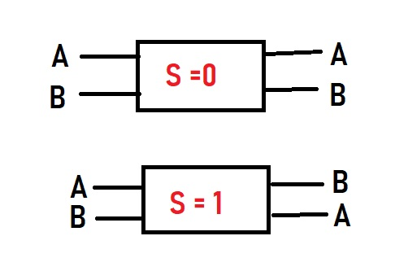
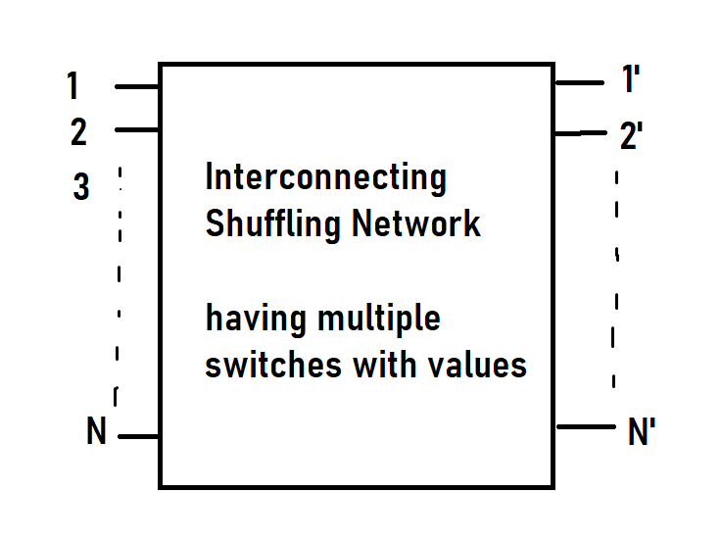
Problem Definition / Objective of the work
Permutation Network- We pass the input information though the interconnecting Shuffling Networks and from the output we will get the permuted value.
Fig4 – Shuffling that does not depend on input
Used for Shuffling
Fig 5 – Permutation Network

Slide 5
Problem Definition / Objective of the work
We are using Benes network routing algorithm to route our data from input to output.
In 8*8 Benes Network we want to see how many ways 8 input will get permuted and what will be the output (permuted value) on the different configuration matrix.
For each switch we have two values (0/1) and we have total 20 switch. So, The size of configuration matrix is 2^20. For each configuration matrix we will get one output.
The permutation of 8 will be 8! (40320) and for the same input value we will check for all configuration matrix. i.e. it will run for 2^20. So, we will get multiple permuted value.
We want to reduce the redundancy in the Benes Network.
Fig 6 - 8*8 Benes Network

Slide 6
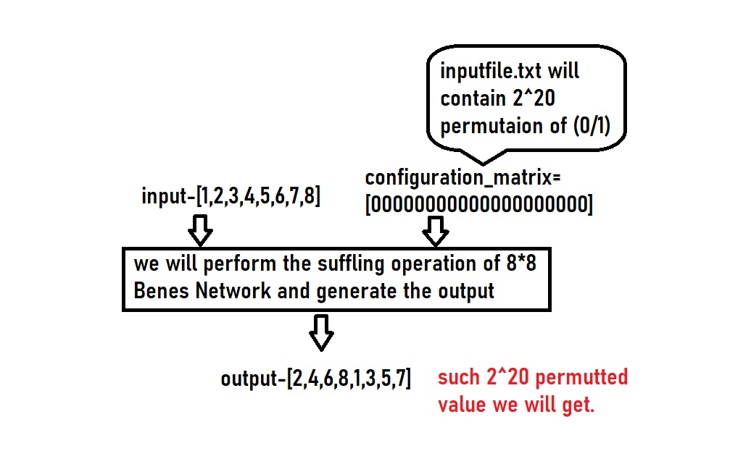
Contribution of my work: Algorithm/Methodology/Flowchart etc.
First we have implemented 8*8 Benes Network using C++ program.
input
output
Fig 8 - 8*8 Benes Network
Fig 7 – Algorithm

Slide 7
Contribution of my work: Algorithm/Methodology/Flowchart etc.
Properties of 8*8 Benes Network-
Dynamic, Multistage
Interconnecting Network
Diameter – 2logN +1
Switch Size – 2 x 2
Number of Switches – 2* N Log N
Congestion - 1
input
output
Fig 9 - 8*8 Benes Network

Slide 8
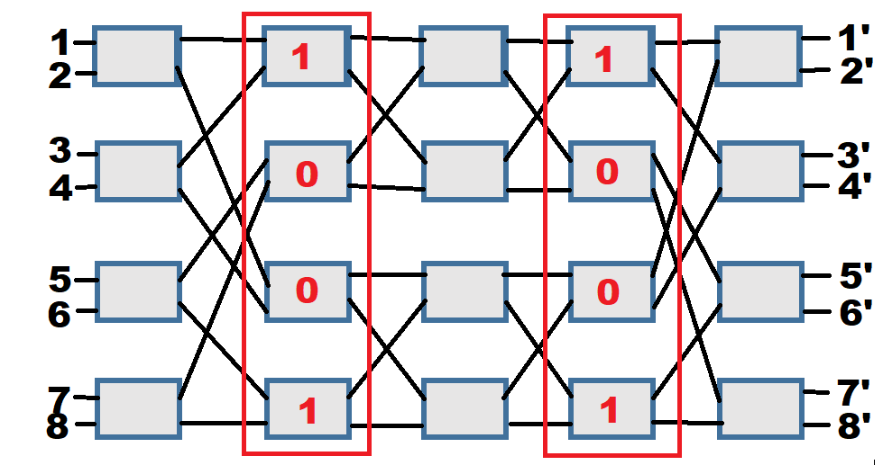
Contribution of your work: Algorithm/Methodology/Flowchart etc.
input
output
Heuristics-
If the configuration matrix’s column 2 and column 4 are mirror images of each other, the permuted value will be the same.
Fig 9 - 8*8 Benes Network

Slide 9
Outcome of the work: Performance analysis, Comparative discussion.
Permuted output | No. of times
16 | 14336
32 | 12288
8 | 8192
64 | 2816
40 | 2048
128 | 512
256 | 127
257 | 1
Permuted output | No. of times
16 | 13312
32 | 12544
8 | 9216
64 | 512
56 | 256
256 | 80
192 | 32
65537 | 1
Table 1 - of all the permuted output of 8*8 Benes Network in column 1 and count in column 2.
Table 2 - After applying Heuristic- table of all the permuted output of 8*8 Benes Network in column 1 and count in column 2.

Slide 10
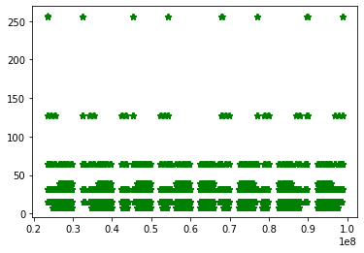
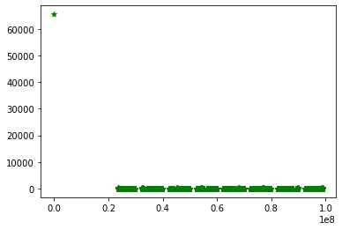
Outcome of the work: Performance analysis, Comparative discussion.
Fig 10 - Plot of all the permuted output of 8*8 Benes Network on x-axis and count on y- axis.
Fig 11 - After applying Heuristic- plot of all the permuted output of 8*8 Benes Network and x –axis and count on y- axis.

Slide 11
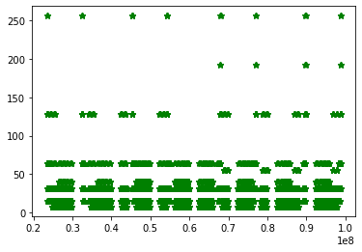
Outcome of the work: Performance analysis, Comparative discussion.
Fig 10 - Plot of all the permuted output of 8*8 Benes Network on x-axis and count on y- axis.
Fig 12 - After applying Heuristic- plot of all the permuted output of 8*8 Benes Network and x –axis and count on y- axis.

Slide 12
Conclusion:
We have observed that Benes network has redundancy.
We have applied Heuristic to reduce its redundancy.

Slide 13
Thank you

