Slide 1
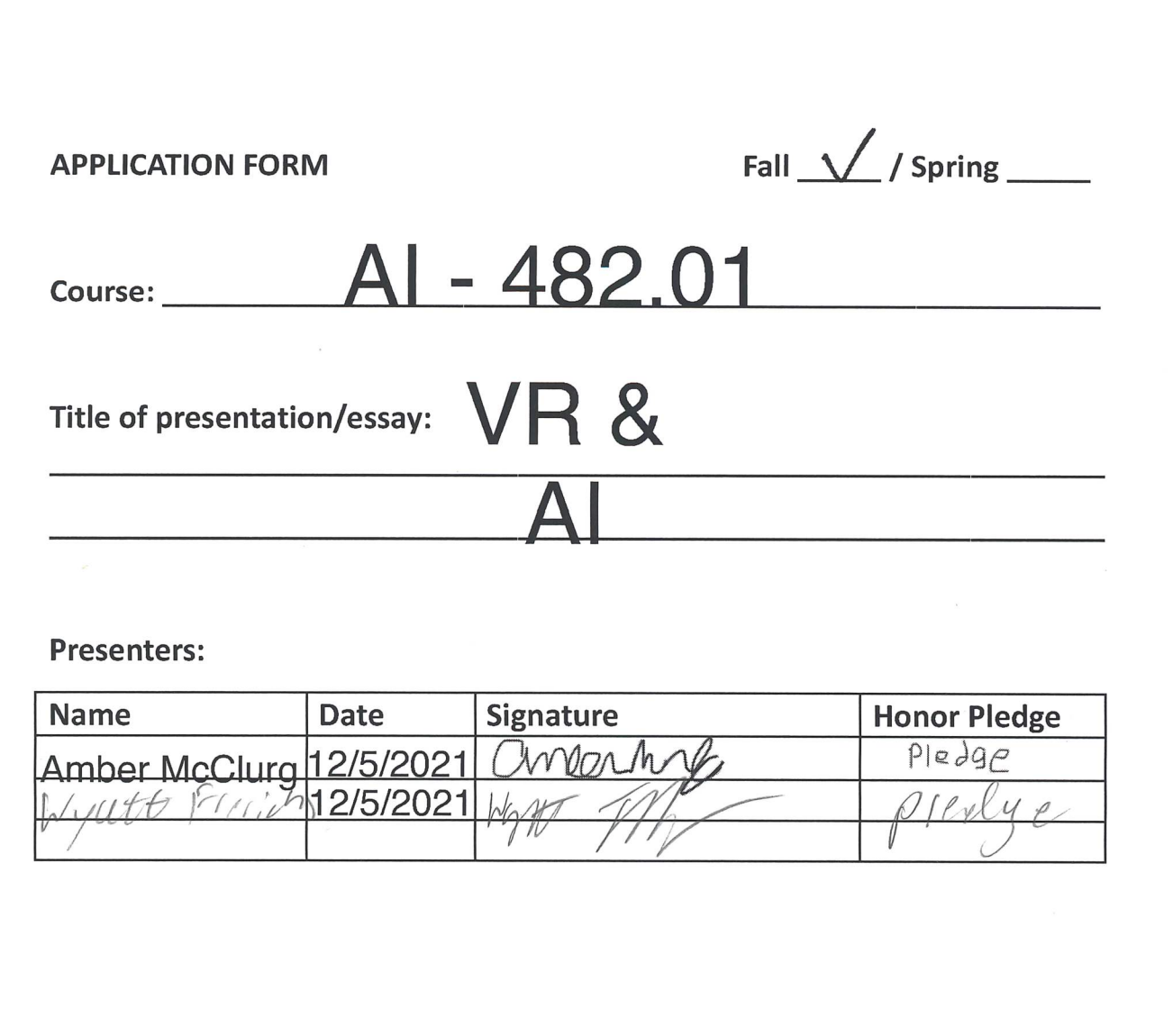

Slide 2

VR & AI
Wyatt Frerichs
&
Amber McClurg

Slide 3
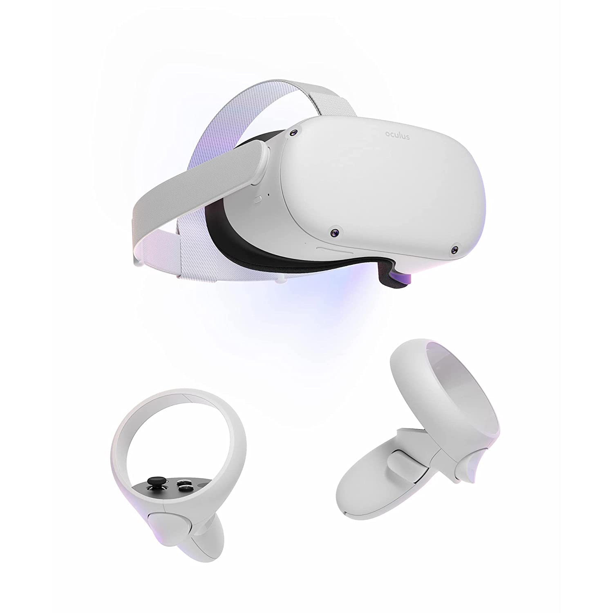
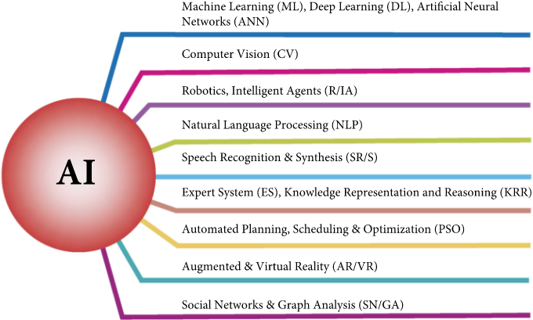
What are VR and AI?
Virtural Reality uses technology to create simulated environments that we can submerge ourselves into.
Artificial intelligence entails that the machines are capable of carrying out so-called “smart tasks” and make independent and complex decisions.

Slide 4
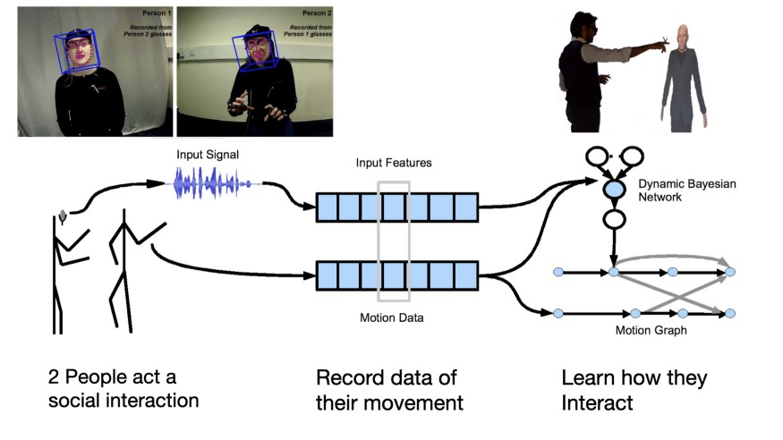
Body language
Gillies (2020)

Slide 5
Machine Learning
Enables machines to improve themselves as time goes by and as algorithms become more and more sophisticated.
“Tacit Knowledge” is like how we just know how to breath or ride a bike. It makes it very difficult to program computers to recognise movements, because we ourselves don’t know the rules that define these movements.
Using machine learning we can design movement interactions systems by giving examples of movement rather than coding. We design interactions by moving. This can make it possible to design much more natural interactions. Gillies (2020)

Slide 6
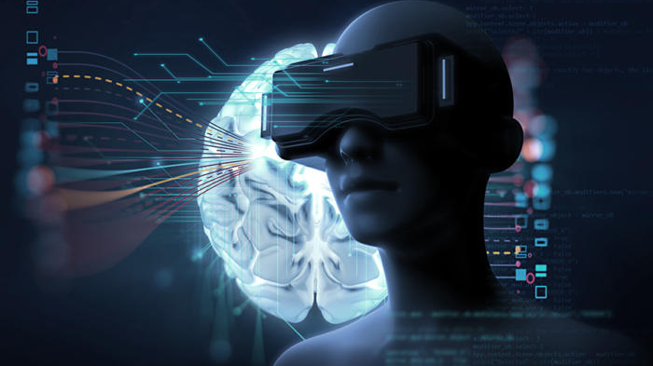
Research Question
What are the benefits to VR with AI?

Slide 7
Types of VR
Factory Training
VR allows potential workers train in real-life simulations to prevent any real danger.
Immersive Shopping
a shopper who is interested in buying furniture can use VR to test out couches and chairs they’re interested in, while AI can introduce a virtual sales associate who could make recommendations, answer questions, and even complete a sale.

Slide 8
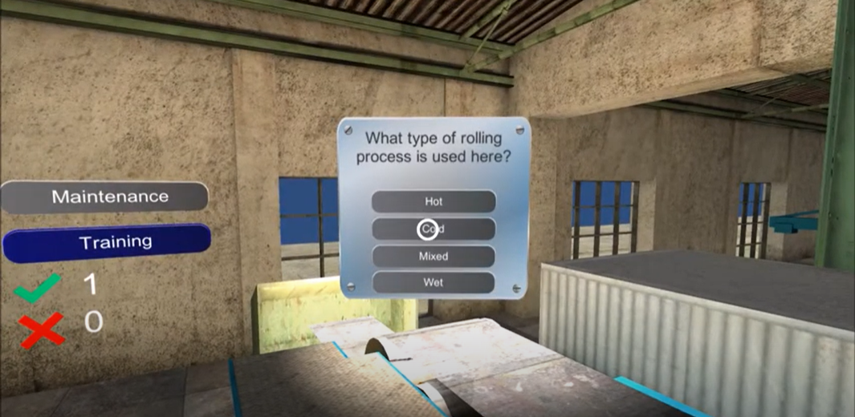
Factory use
Incorporating user interaction with the environment and content thanks to VR technology.
In any factory situation there is danger this particular one sells and moves steel in the Europe Union. With VR the factory managed to achieve three goals:
Train more people within the short period of time in a cost-effective and interactive way
Enable people to learn about their workplace environment and machines without jeopardizing their life
Safety, the simulations helped those very workers master using expensive machines before they try them out directly. Arvrtech (2017)

Slide 9
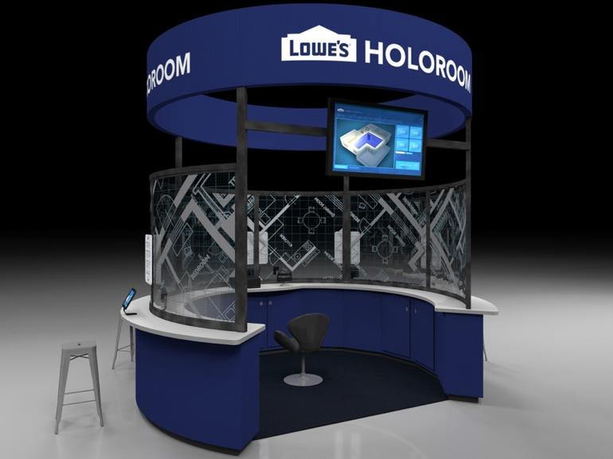
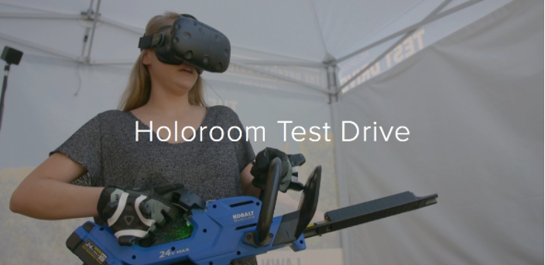
Immersive Shopping
In 2014, the Lowe’s Innovation Labs launched the Holoroom, “a virtual reality home improvement design and visualization tool that empowers homeowners with an immersive, intuitive experience in the room of their dreams.” Trout (2017)

Slide 10
Immersive Shopping
The number of active VR users is forecast to reach 171 million by 2018, according to a 2015 Statista survey,
John Vary, innovation manager at retailer John Lewis, states: “VR will bring the catalogue and rooms to life. Putting people in the center of environments makes e-commerce more immersive, and will have a big impact on selling bigger items like furniture, as it will give them confidence to purchase.”
Arthur (2016)

Slide 11
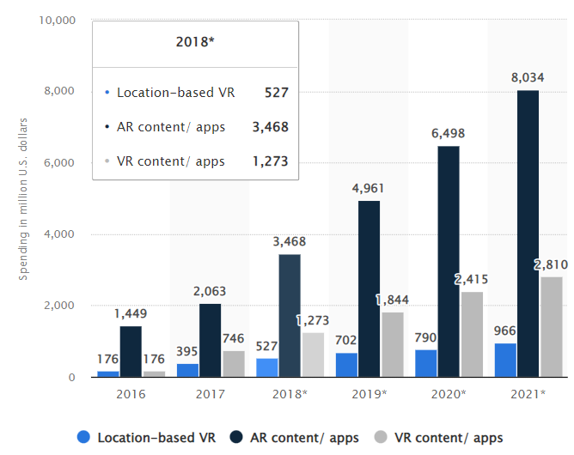
Consumer spending on augmented and virtual reality (AR/VR) content and apps worldwide from 2016 to 2021
(in million U.S. dollars)
Liu S. (2020)

Slide 12
Cost
Meta Quest 2 (VR headset and controllers): Around $300
Games for the VR: Free - $60

Slide 13
Benefits found
Safety
Gets more people involved
Interactive AI is new and interesting

Slide 14
Citations
Panigrahi, D. (2021, April 7). Incorporating the Usage of 3D Artificial Intelligence With AR and VR Technology. Total Retail. Online: mytotalretail.com
Gillies, M. (2020, May 8). Virtual Reality and Artificial Intelligence - Machine Learning for All. Medium. Online: medium.com
Fade, L. (2019, July 2). VR and AI: Two Technologies Set to Merge. VR Vision Group Online: vrvisiongroup.com
Arvrtech (2017, July 24th) How to use VR for training and maintenance in factories of the future?, Events. Online: arvrtech.eu
Trout M. (2017, April 25) Lowe’s: VR, the Future of Retail. High. Online: digital.hbs.edu
Arthur R. (2016, June 15) Future Of Retail: Artificial Intelligence And Virtual Reality Have Big Roles To Play. Medium. Online: forbes.com
Liu S. (2020, March 24). Global AR/VR consumer content and apps market 2016-2021. High. Online: statista.com

