Slide 1

The use of Genetic Algorithms in AI Applications
Sprint Review
Sonny Pham
Dat O

Slide 2

So far...
We wanted to figure out what we knew about AI and what we wanted to learn during this semester.
We formed a group and discussed different topics and applications of AI. The ones that interest us the most include applications that made use of genetic algorithms.

Slide 3

What we know
Genetic Algorithms exhibits the process of natural selection.
Searches for the best solution and seeks the best path for optimization.
Used in Financial Mathematics, climatology, game theory, robots, etc.

Slide 4
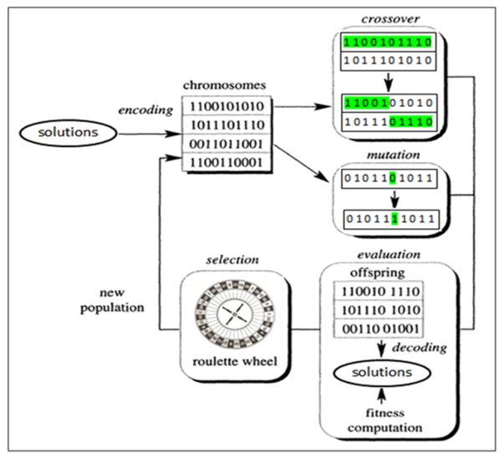
What we hope to learn (In-Depth)
Functionality
Efficiency
Practicality
Other Uses

Slide 5
What we like to achieve
To be better prepared next in the next Sprint review over our project.
To hopefully get a good idea for how we can display a genetic algorithm in an AI application.
To learn from other projects to see the different ideas and solutions that we might use to build upon our project

