Slide 1


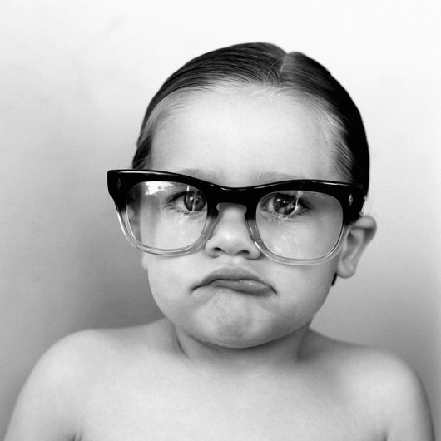
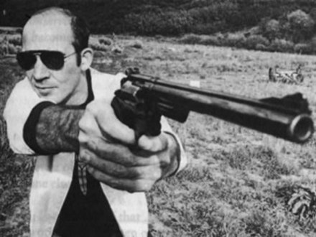
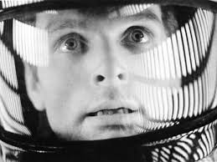
Organisational Storytelling
“Igniting action in knowledge-era organisations” - Steve Denning
Marcus Birkenkrahe

Slide 2

What’s this about? Stories? Fairy Tales?
YOU MUST BE BLOODY JOKING!?
Watch the “Introduction to Storytelling” from Pixar Animation Studios and let’s discuss if and how this could be relevant for business
in general and for your consulting
report in particular!

Slide 3
Not joking.
Sample story by Richard Buckland
Nancy Duarte: engaging through storytelling
Steve Denning: leading through storytelling
Student examples: video prototypes
Team exercise: make your own prototype

Slide 4
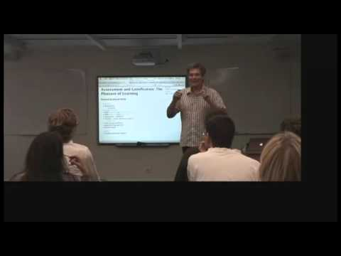
Richard Buckland: let me tell you a story...
Notice what he’s saying and what he’s doing

Slide 5
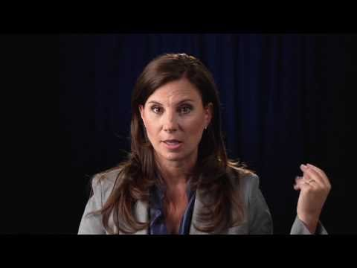
Nancy Duarte: engage readers and viewers
How could you use story to engage in your report?

Slide 6
Now, this was cosy storytelling.
Main organisational purpose: igniting action
Writers with guns
(here: Hunter S. Thompson)

Slide 7
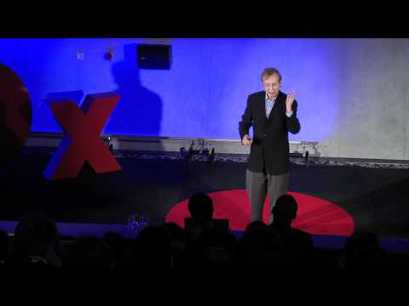
Steve Denning: leaders tell stories
What are the key criteria for leadership storytelling?
«The choice for leaders in business and organizations is not whether to be involved in storytelling —they can hardly do otherwise—but rather whether to use storytelling unwittingly and clumsily,
or intelligently and skillfully.»

Slide 8
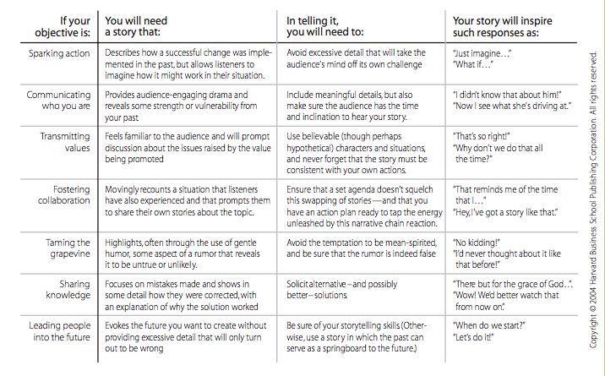
Telling Tales In Companies (Denning, 2004)

Slide 9
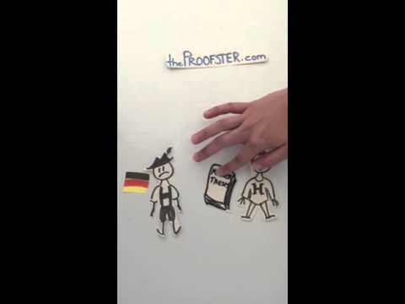
Storytelling and videoprototyping
Story videoprototype for startup process model

Slide 10
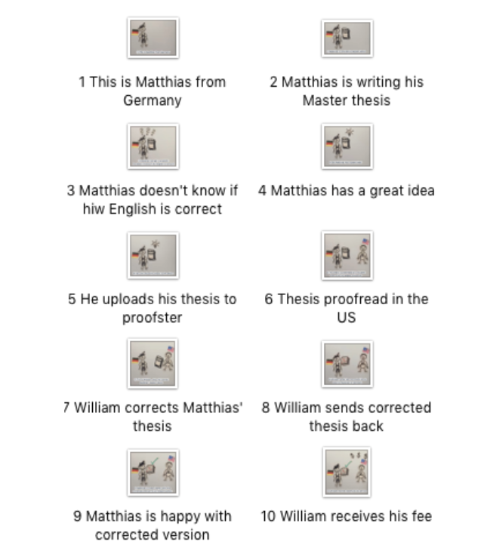
Storytelling

Slide 11
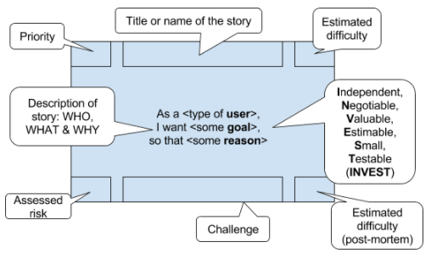
Next: Create User Stories
In agile project management, user stories are used to generate tasks for the team to complete & monitor

Slide 12
Any questions?

