Slide 1

Second Sprint Review
Modeling With Cellular Automata
Jacob Sampley

Slide 2

What I wanted to accomplish
Narrowing of my research topic; “modeling with cellular automata” seems a bit too broad of a subject for the word requirement
Construction of my research methodology
Attempted validation of said methodology
Acquisition of credible sources

Slide 3
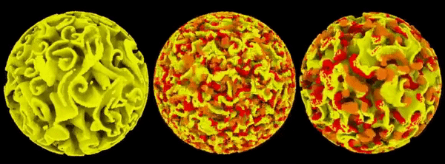
What I have accomplished
Became more familiar with cellular automata
  Conway’s Game of Life can honestly be pretty fun if you have an idea of how it works
Found potential narrower topics into which I could whittle my own
Constructed a “methodology template”
  As I have yet to fully narrow my topic I could not formulate a methodology for a specific idea, so I came up with something I believe would work regardless of how I decide to narrow

Slide 4
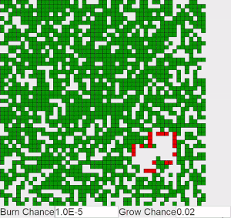
Where I’m stuck
NARROWING MY RESEARCH TOPIC
  There are so many possibilities, but trying to escape my broad idea seems to lead me to topics which are slightly too narrow or specialized for the purposes of this paper. For example, I could write on the applications of cellular automata in seismological modeling, or the modeling of biological microstructures, or simply the flow of rivers, but these topics seem too specific
  Thoughts? Would writing about, say, the applications for cellular automata in studying earthquakes be too narrow, or just broad enough?

Slide 5

Methodology
Regardless of how I choose to narrow my topic, I believe there is a general formula for how I can accomplish this research, as my goal would ultimately be to demonstrate how a concept closer to the field of AI can find usage in modeling.
Examine the literature
  “What is a cellular automaton?”
  Cellular automata are not new, and as a result there is an abundance of literature into their applications in a variety of fields
  Explore how researchers in the chosen field already utilize the automata
Implement, test, and/or demonstrate such a model
  I can talk about it in theory forever, but does it actually work in practice?
Analyze the results of the literature review & test with their implications
  If a model works, is it accurate? Is it a broadly accurate model, or does it also address the details? If I create a functioning simulation of an erupting volcano, but the modeling of the pyroclastic flow is inaccurate, how useful is my model?
  A tool for analysis, or prediction? Both?

Slide 6

That’s all, folks

