Slide 1
OpenSceneGraph
Alexander Birkner (3070106),
Programming of Graphics Shaders,
WS 2020/2021

Slide 2
Agenda
1
What is OpenSceneGraph?
2
Use of OpenSceneGraph
3
Demo
4
Features
5
Conclusion

Slide 3

What is OpenSceneGraph?
3D graphics toolkit
Uses OpenGL for rendering
Open source
Written in Standard C++
Rendering middleware
Based on scene graph theory
Retained rendering system
[1]

Slide 4
What is OpenSceneGraph?
3D graphics toolkit
Uses OpenGL for rendering
Open source
Written in Standard C++
Rendering middleware
Based on scene graph theory
Retained rendering system
3D Application
OpenGL
Graphics Hardware

Slide 5
What is OpenSceneGraph?
3D graphics toolkit
Uses OpenGL for rendering
Open source
Written in Standard C++
Rendering middleware
Based on scene graph theory
Retained rendering system
3D Application
OpenSceneGraph
OpenGL
Graphics Hardware

Slide 6
Scene Graph
Root Node
Group Node
Leaf Node
Notes:
Blätter stellen zu renderende Objekte dar

Slide 7
What is OpenSceneGraph?
3D graphics toolkit
Uses OpenGL for rendering
Open source
Written in Standard C++
Rendering middleware
Based on scene graph theory
Retained rendering system

Slide 8
Immediate and Retained Mode
Immediate Mode
Retained Mode
Drawing
Commands
Build
Scene
Drawing
Commands
Application
Graphics Library
Application
Graphics Library
Update
Update
Scene (Model)
Based on [2]
Scene (Model)
Based on [2]
+ More flexibility
+ Simpler to use
(Library does initialization, state maintenance, cleanup)

Slide 9
Agenda
1
What is OpenSceneGraph?
2
Use of OpenSceneGraph
3
Demo
4
Features
5
Conclusion

Slide 10
OpenSceneGraph Libraries
Core
Node Kits
osg
osgDB
osgViewer
osgAnimation
osgFX
osgManipulator
Open
Threads
osgUtil
osgParticle
osgText
osgVolume
…
Notes:
Über Cmake oder Pre Build Libraries

Slide 11
„Hello World“
„Hello World“ Demo

Slide 12
OSG Node Types
Node
Group
Transform
Switch
LOD
LightSource
Geode
Matrix-Transform

Slide 13
OSG Node Types
Node
Group
Drawable
Geode
Geometry
ShapeDrawable

Slide 14

StateSet
OVERRIDE
PROTECTED
INHERITAT
Node
StateSet
e.g.
GL_BLEND
StateAttribute
GLModes
BlendFunc

Slide 15

Traversing a Scene Graph

Slide 16
Types of Traversals
Event traversal (process mouse and keyboard events)
Update/Application traversal (modify scene graph)
Cull traversal (test whether node is within viewport)
Draw/Rendering traversal (issues low-level OpenGL API calls)

Slide 17
Agenda
1
What is OpenSceneGraph?
2
Use of OpenSceneGraph
3
Demo
4
Features
5
Conclusion

Slide 18
Agenda
1
What is OpenSceneGraph?
2
Use of OpenSceneGraph
3
Demo
4
Features
5
Conclusion

Slide 19
Features
View Frustum Culling,
LOD Nodes,
…
Collada, Lightwave, …
Performance
Database Loaders
OSG
Linux, Windows, Android, iOS, …
Portability
Node Kits
Particle Systems,
Terrain Rendering,
Volume Rendering, …
[1]
C++, Java, Lua, Python
Mulit-language Support
Scalability
Multiple Graphic Context,
Multi Threading

Slide 20
Agenda
1
What is OpenSceneGraph?
2
Use of OpenSceneGraph
3
Demo
4
Features
5
Conclusion

Slide 21
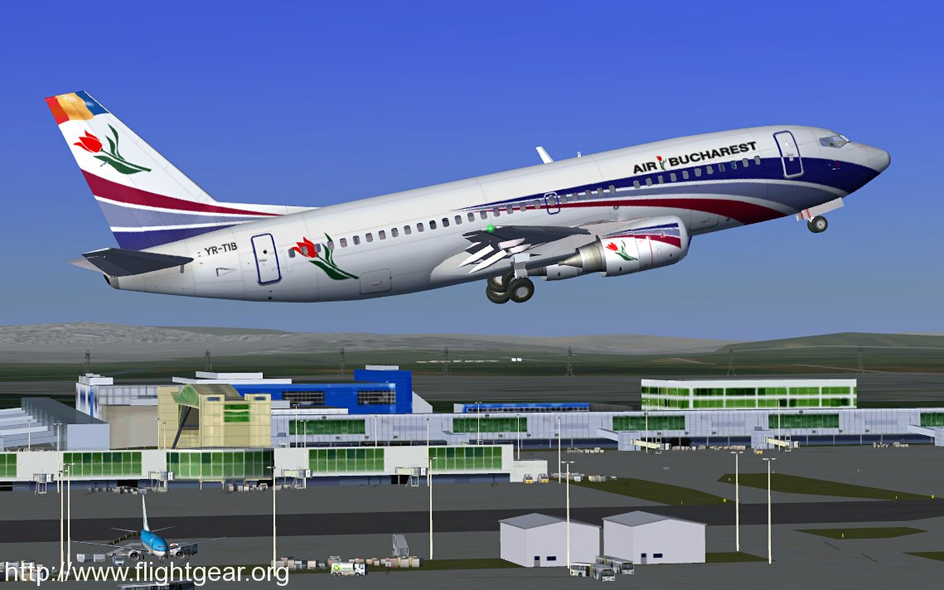
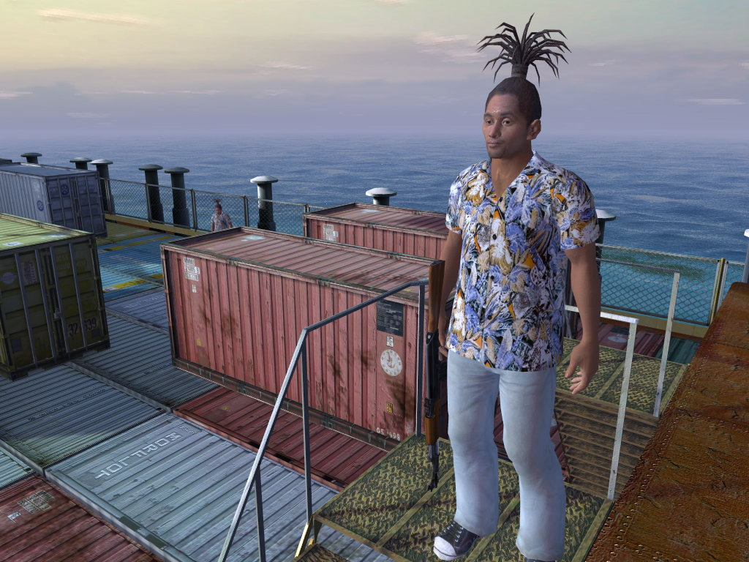
Conclusion
[3]
[4]
Notes:
Pirates of the XXI century" is the main project of !DIOsoft company (Kyiv, Ukraine)

Slide 22
Conclusion
Difficult to represent very large and complex scenes in a single scene graph
It is often necessary to map different types of relationships between objects (spatial, semantic or rendering order)
-> Not possible (or only via hacks) to do in a scene graph
-> Multiple structures are used for that

Slide 23
Conclusion
+ Flat learning curve
+ Object oriented concept
+ Use of smart pointers
+ Amount of available functionallity
- Documentation seems quite old

Slide 24
Agenda
?
1
What is OpenSceneGraph?
2
Use of OpenSceneGraph
3
Demo
4
Features
5
Conclusion

Slide 25
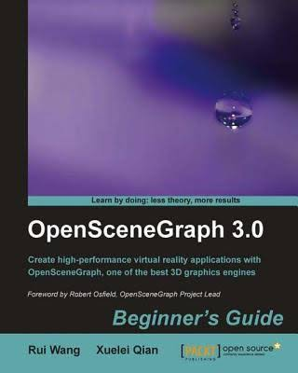
Sources

Slide 26
Sources
[1] OpenSceneGraph, The OpenSceneGraph Project Website. [Online]. Available: http://​www.openscenegraph.org​​ (accessed: Jan. 22 2021).
[2] Quinn Radich and Michael Satran, Retained Mode Versus Immediate Mode. [Online]. Available: https://​docs.microsoft.com​/​en-​us/​windows/​win32/​learnwin32/​retained-​ mode-​versus- ​immediate-​mode (accessed: Jan. 09 2021).
[3] FlightGear, Introduction to FlightGear. [Online]. Available: https://www.flightgear.org/about/ (accessed: Jan. 09 2021).
[4] OpenSceneGraph, DIOSoft Pirates. [Online]. Available: http://www.openscenegraph.org/index.php/gallery/use-cases/77-diosoft-pirates​ (accessed: Jan. 09 2021).
[5] Tom Forsyth, Scene Graphs - just say no. [Online]. Available: http://​tomforsyth1000.github.io​/​blog.wiki.html​#%5B%5BScene%20Graphs%20- %20just%20say%20no%5D%5D (accessed: Jan. 09 2021)

Slide 27
Rendering Middleware
3D Application
OpenGL
Graphics Hardware

Slide 28
Rendering Middleware
3D Application
OpenSceneGraph
OpenGL
Graphics Hardware

Slide 29
Bericht
OpenSceneGraph
Historie
Rendering Middleware
Retained Rendering
Szenen Graph
Nutzung von OpenSceneGraph
Bibliotheken
Knoten Klassen
StateSets
Demo
Funktionsumfang
Architektur
Einzelne Beispielfunktionalitäten näher beschreiben
Stärken von OpenSceneGraph
Fazit

Slide 30

„Hello OSG“ Demo
.osg
root
osg::Node (root)
osgDB
osg::Node
osgViewer::Viewer
osg::Node
osg::Node

Slide 31
Traversing the Scene Graph
Start at a defined node (e.g. root)
Move down recursively to child nodes until leaf (or node with no children) is reached
Backtrack to most recent node that doesn´t finish exploring and repeat above step

Slide 32
Demo „OSGPlayground“
osgGA::GUIEventHandler
osg::NodeVisitor
OsgImGuiHandler
GraphOption
+displayGraphOption()
TreeGeneratorNodeVisitor
+selectedNode: osg::ref_ptr<Node>
+selectedNodeIsGroup: bool
+selectedNodeIsGeode: bool
+selectedNodeIsDrawable: bool
+apply(group: osg::Group&)
+apply(geode: osg::Geode&)
+apply(drawable: osg::Drawable&)
PlaygroundImGuiHandler
-viewer: osgViewer::Viewer
-root: osg::Node
#drawUi()
StateSetOption
+displayStateSetOption()

