Slide 1
What is the business problem?
The Telco company have many customers who churn every month, so the executives of the company asked us to conduct an analysis to determine what causes they are losing customers. Their marketing and customer service team are really interested by the output of the analysis.

Slide 2
Who are the stakeholders impacted by the problem?
The executives of the company
The marketing team
The customer service team

Slide 3
Why is this problem important to the organization?
By losing clients the enterprise is also losing profits, besides the company cannot have new customers if they don't fix the issue of the clients who are churning sooner or later they will lose all their clients. This is why this problem is important to the organization.

Slide 4
We have been hired for two majors tasks:
To identify the type of customers who churn
To predict which customers will churn next month
To do so they offer a file of 7 000 customers. First thing we'll do will be to analize the dataset for a better understanding of the different variables, will be using all the methods in EDA (exploratory data analysis. We will also clean the datas and turning into numerical values the categorical ones.

Slide 5
To identify the type of customers who churn we used some statistic methods, we used visualization for better understand and we create a customer profile to identify churns at higher rates.
And to predict the customers who will churn we used machine learning specially the logistic regression method to build a model that allows to predict churn at 80%

Slide 6
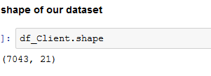
How much Churn is affecting the Business?
Our dataset contains 7043 rows each rows represent a client.

Slide 7
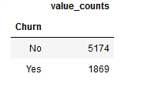
This month 1869 customers churned, what represents 26,54% of the total.

Slide 8
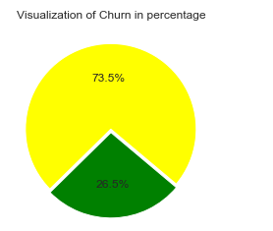
This graph shows the percent of churn

Slide 9
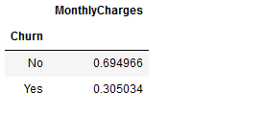

In term of profit the company has lost 139,130.85 $, what represents 30% of the monthly charges that won’t be there next month.

Slide 10

Churn explained by demographics
There’s no big difference between male and female, both gender churn at the same rate so gender cannot predict if a customer will churn or not.

Slide 11

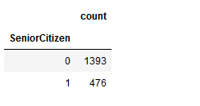
However, Senior Citizen can explain churn since the youngers churn more than the adults. Indeed 1393 customers who are not senior citizen churned what represents 74.54% of the churn.

Slide 12
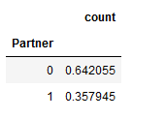
64% of the churn are customers without partners

Slide 13
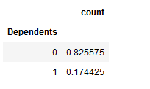
82% of the churn are customers who don’t have people they are taking care of.

Slide 14
Churn explained by Service used
The graphs bellows explain churn by service used such as: Phone service, multiple lines, Internet service, Online security, Device protection, tech support, streaming TV and streaming movies.

Slide 15
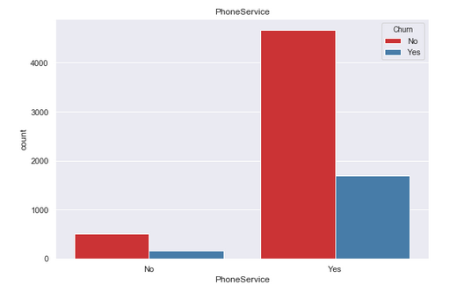

Slide 16
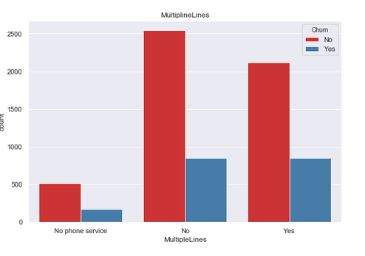

Slide 17
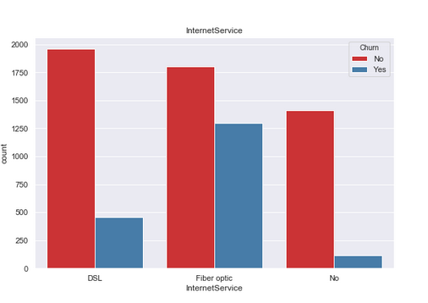

Slide 18
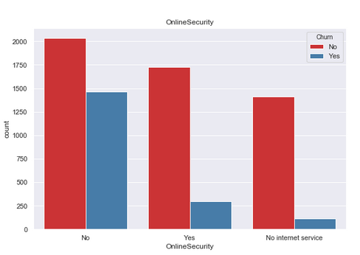

Slide 19
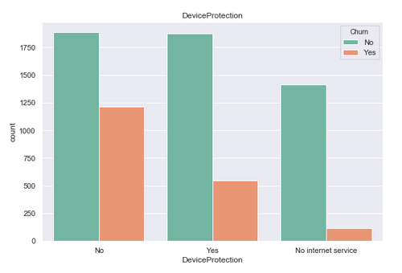

Slide 20
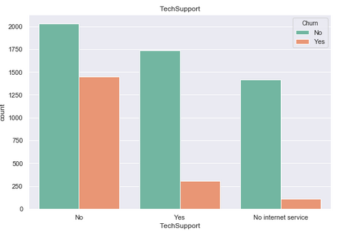

Slide 21
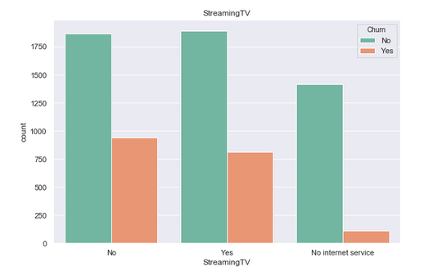

Slide 22
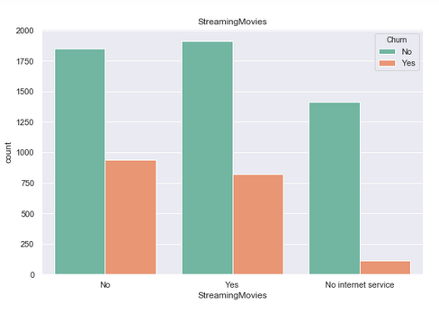

Slide 23
Churn explained by Billing Information
The graphs bellows explain churn by service used such as Contract, Paperless Billing, Payment Method.

Slide 24
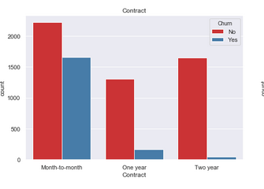

Slide 25
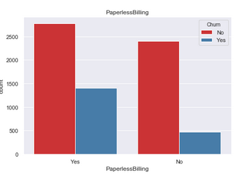

Slide 27
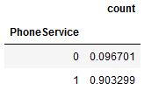
What services are typically purchased by customers who churned?
Phone service, multiple lines, fiber optic as internet service, streaming TV are the services usually purchased by customers who churned.
90% customers with a phone service churned

Slide 28
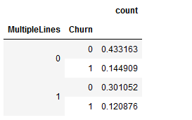
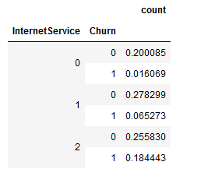
30% of churned had multiple lines
18% with optic Fiber churned
N.B: 1: DSL
2: Optic Fiber

Slide 29
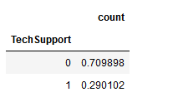
Are Any services especially helpful in retaining customers?
Services such as tech support, Online Security, Streaming movies, device protection might be helpful in retaining customers.
29% of customers use TechSupport

Slide 30
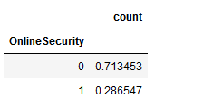
28% of customers use Online Security

Slide 31
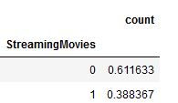
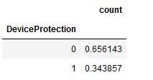
38% of customers use Streaming movies
34% of customers use Streaming movies

Slide 32
Bonus
HOW LONG WILL IT TAKE FOR THE COMPANY TO LOSE ALL ITS CUSTOMERS?
WHICH DEMOGRAPHICS WILL THEY LOSE FIRST?
It will take about 2 years and 4 months for the company to lose all its customers.
And the demographics they will lose first are any male or female who are not senior citizen with no partner, with no dependents.

Slide 33
Customer Profile
Are there types of people who churn at higher rates?
Typically the customers who churn are male or female: they are not senior citizen, they don’t have partner or dependents, they have a phone service, they use optic fiber. Here are below two radar charts that represents the customer profile for male and female.

Slide 34
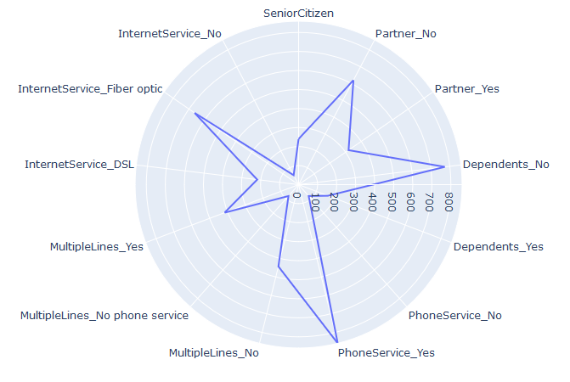
Radar chart by gender female

Slide 35
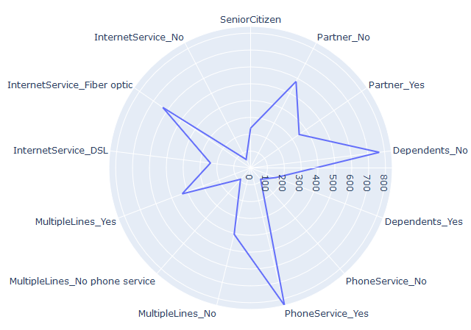
Radar chart by gender male

Slide 36
Recommendations
Do you have any recommendations on how to reach groups of people who churn at high rates
The marketing and the customer service team should work together in order to find a solution. They should conduct surveys to ask the customers who are still with the company what can do to improve the services for them and for those who are churning what they dislike and need to be changed.

Slide 37
Recommendations
The customer service team should come with services that are susceptible to interest those who are not senior citizen, who don’t have partner or dependents. The marketing service should develop advertisements to promote their services maybe some customers who are churning would have not churned if they knew about other services.

Slide 38
Prediction
Prediction of the current customers who will churn next month
Using logistic regression as model of prediction, we could predict with an accuracy of 80% the customers who will churn next month.

Slide 39
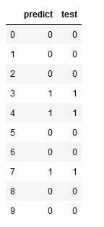
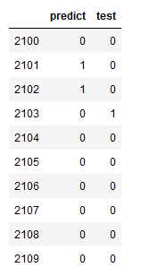
Here are a portion size of our prediction vs a portion size of the test. Notice that we have an error of prediction at index 2013 . Other errors like that certainly occurred since our model have an accuracy of 80%.

Slide 40
References & Appendices

