Slide 1







Second Workshop
Avoiding Hazardous Environments via V2X
Berlin | 06.07.2021 Critical Infrastructure and Design Team

Slide 2
Workshop agenda
Intro
Mobility, Telecommunication and Critical Infrastructure
2. Tools
SUMO – Eclipse MOSAIC – CID Toolbox
Case study – Barnim – Avoiding Hazardous Environments via V2X
3. Group work
Tasks
Simulation + Discussion
4. Conclusions
Notes:
Goal + Relevance
Urban Hydrology + Blue-Green Infrastructure - A glance (10/15 min) + Qs
EPA SWMM - Fundamentals (10)
Case study - Bellinge, Implementing Blue-Green Infra in EPA SWMM
(30 plus 10 min break in the middle) + Qs
Simulation + Group discussion (30 in groups +10 min conclusions)
Introducing potential assignment for final report (10 mins)

Slide 3
Intro
Mobility, Telecommunication and Critical Infrastructure
Notes:
Goal + Relevance
Urban Hydrology + Blue-Green Infrastructure - A glance (10/15 min) + Qs
EPA SWMM - Fundamentals (10)
Case study - Bellinge, Implementing Blue-Green Infra in EPA SWMM
(30 plus 10 min break in the middle) + Qs
Simulation + Group discussion (30 in groups +10 min conclusions)
Introducing potential assignment for final report (10 mins)

Slide 4
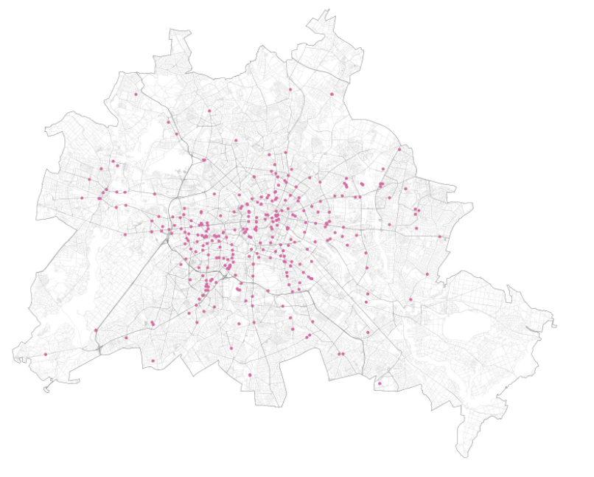
Mobility, Telecommunication and CI
Background:
“Cities are home to over 70 % of the EU population and account for some 85 % of the Union's GDP.”[1]
An increasing demand for urban areas created a not sustainable situation:
Severe congestion
Poor air quality
High levels of noise and CO2 emissions
An initiative of the European Commission:
Urban Mobility Package: Mobilizing Intelligent Transport Systems for EU cities
EV charging stations in Berlin, 2021 [2]

Slide 5
Mobility, Telecommunication and CI
Urban Mobility Package:
Brussels, 2013
An increasing demand for urban areas created a not sustainable situation:
Severe congestion
Poor air quality
High levels of noise and CO2 emissions
An initiative of the European Commission:
Urban Mobility Package: Mobilizing Intelligent Transport Systems for EU cities
EV charging stations in Berlin, 2021 [2]

Slide 6
2. Tools
SUMO – Eclipse MOSAIC – CID Toolbox
Case study – Barnim – Avoiding Hazardous Environments via V2X
Notes:
Goal + Relevance
Urban Hydrology + Blue-Green Infrastructure - A glance (10/15 min) + Qs
EPA SWMM - Fundamentals (10)
Case study - Bellinge, Implementing Blue-Green Infra in EPA SWMM
(30 plus 10 min break in the middle) + Qs
Simulation + Group discussion (30 in groups +10 min conclusions)
Introducing potential assignment for final report (10 mins)

Slide 7
3. Group work
Tasks
Simulation + Discussion
Notes:
Goal + Relevance
Urban Hydrology + Blue-Green Infrastructure - A glance (10/15 min) + Qs
EPA SWMM - Fundamentals (10)
Case study - Bellinge, Implementing Blue-Green Infra in EPA SWMM
(30 plus 10 min break in the middle) + Qs
Simulation + Group discussion (30 in groups +10 min conclusions)
Introducing potential assignment for final report (10 mins)

Slide 8
Contents

Slide 9
Mobility, Telecommunication and CI
Wiudaidopüwks
Wdiaushdfsdfsdfdsfdj
Woiduasfgh
oiwgdjskjfhkjsdjfk

Slide 10
Mobility, Telecommunication and CI
What we have been

Slide 11
Chapter separation

Slide 12
I am a quote, statement or
anything else.
Reference

Slide 13
Contact
Name Surname
T +49 (0) 123 456 789 012
M contact@ide3a.net
www.ide3a.net

