Slide 1
Quickstart to Neural Networks (with Keras)
Matías Gárate

Slide 2
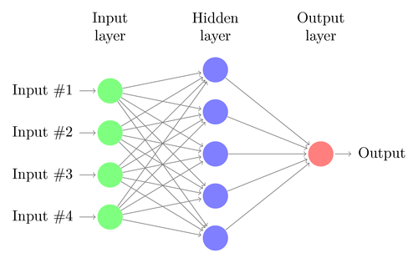
A neural networks receives multiple features and delivers and output.

Slide 3
Applications
Face recognition
Pattern recognition
3D Reconstruction
Medical Diagnosis.
Recommendation for movies, series, etc.
Prediction of time sequences.
Classification (in general)

Slide 4
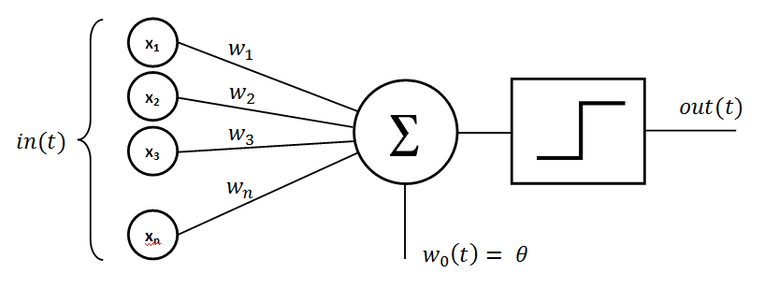
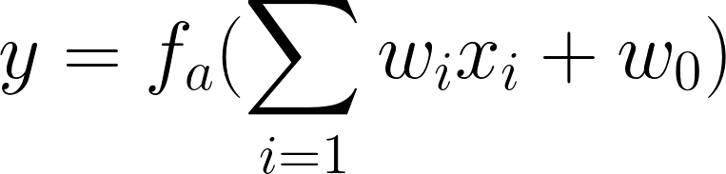
How does a single neuron works? Perceptron.

Slide 5
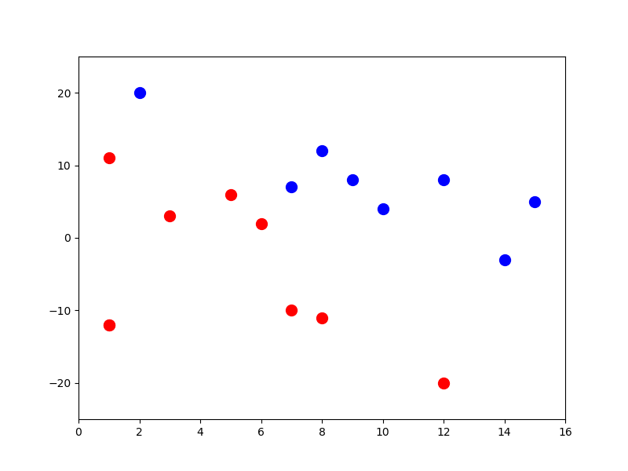
A simple classification example.

Slide 6
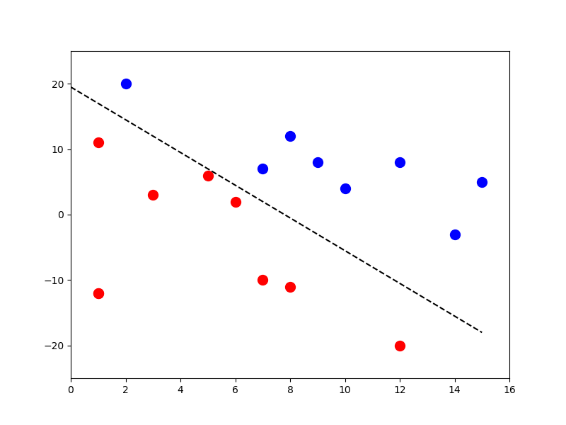
A simple classification example.

Slide 7
A Neural Network is composed of Layers, each layer has:
Neurons (Perceptron)
Weights
Activation function
The output of each neuron becomes an input feature for each of the neurons in the next layer.

Slide 9
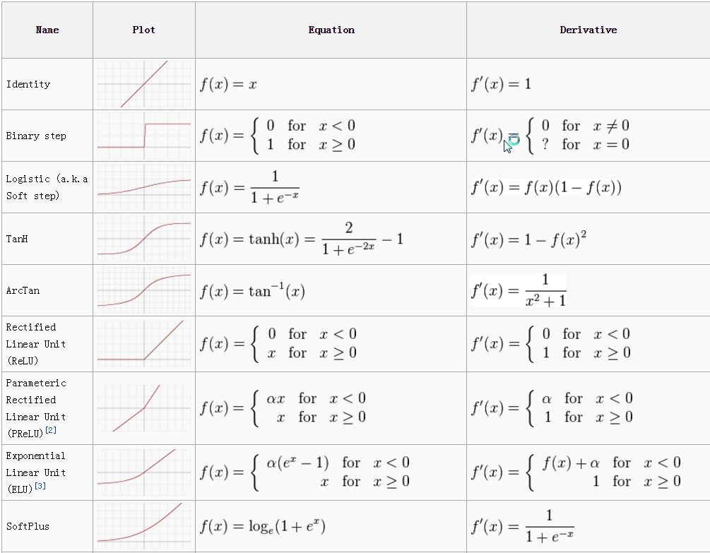
Some activation functions.

Slide 10
Some activation functions.

Slide 11
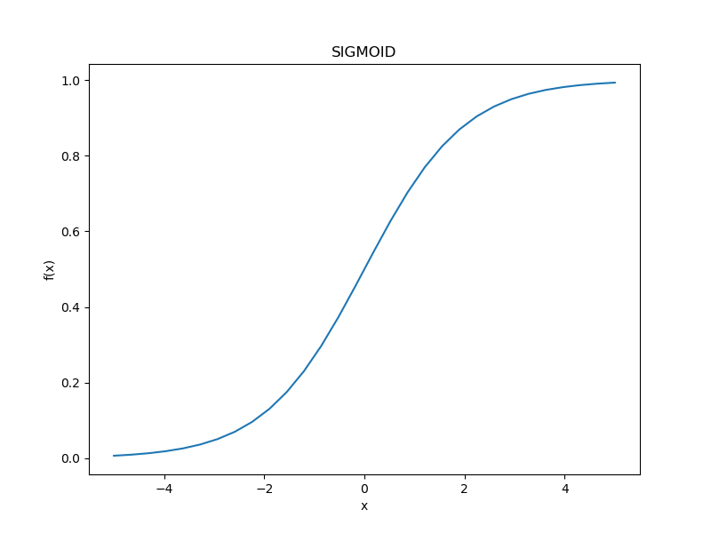
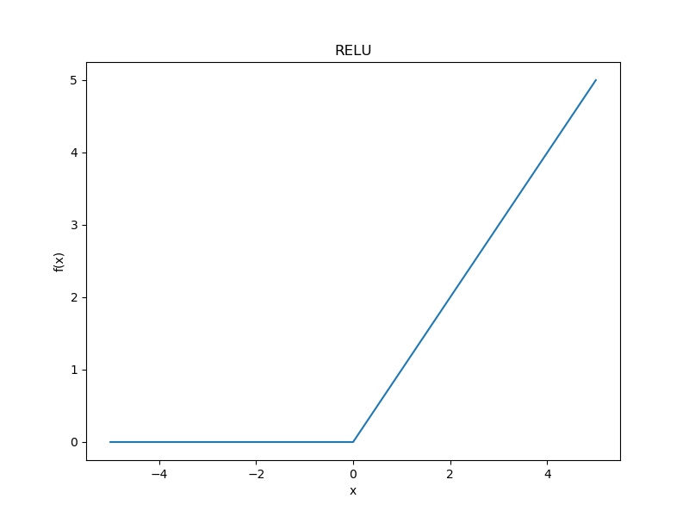
Some activation functions.

Slide 12
Finally, to train the network you need to define:
A loss function (that you want to minimize)
An optimizer (that finds the weights that minimize the loss)
A metric (to measure how well your network is doing.)

Slide 13
Finally, to train the network you need to define:
A loss function – Binary Crossentropy
Ly(p): Loss function
y: Label (0 , 1). Example: survived = 1, died = 0
x: Input features
p: probability that the input x is marked with the class y = 1

Slide 14
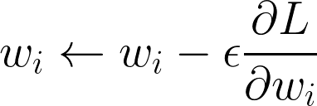
Finally, to train the network you need to define:
An optimizer: Gradient Descent
Each iteration, the weights are updated by the learning rate ε, to minimize the loss.

Slide 15
How to classify images? Convolutional Neural Networks
Instead of weights now we operate with filters.
Each filter convolution produced a “Feature Map”.
Each Feature Map is passed to the next layer

Slide 16
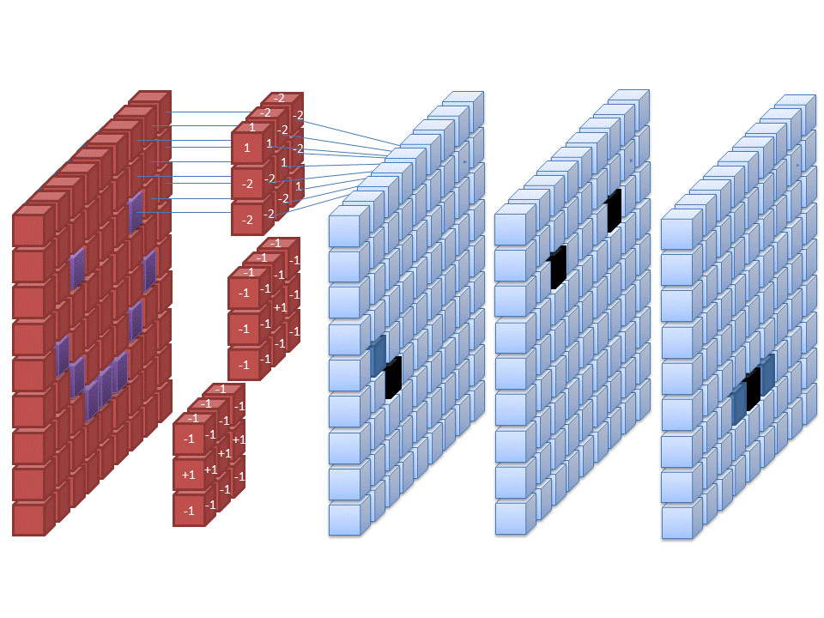
How to classify images? Convolutional Neural Networks
Instead of weights now we operate with filters.
Each filter convolution produced a “Feature Map”.
Each Feature Map is passed to the next layer

Slide 17
Caveats
You rarely know what the network is doing (or learning)
Perform extremely well (on data with the exact format/features/etc than the training set)
Most questions have the same answer: “it just works that way”

Slide 18
Kaggle: Resources and tutorials
On Kaggle you can find competitions, tutorials, and huge datasets to experiment machine learning algorithms.
https://www.kaggle.com/competitions
https://www.kaggle.com/matgarate

