Slide 1
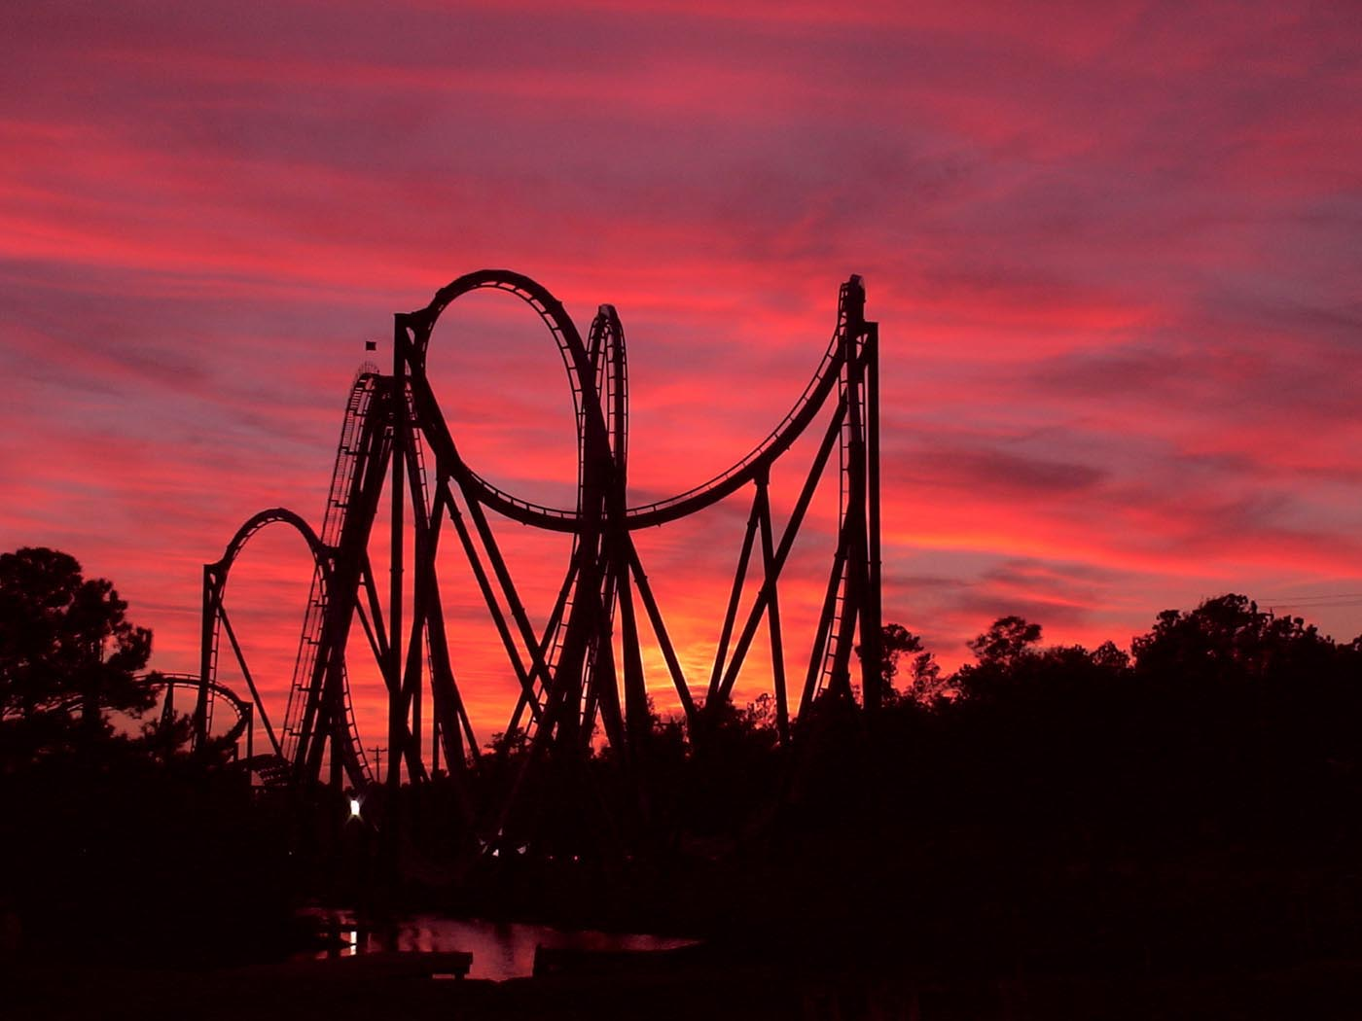
Roller Coaster!

Slide 2
Roller Coaster!
Requisitos...

Slide 3
/ Montanha Russa \
| |entrada| |
| | #ooooooooo_________________________________________ |
| | |\/\/\/\/\/\/\/\/\/\/\/\/\/\/\/\/\/\/\/\/\/\/\/\/\/ |
| |_____| |_____| |_____| |_____| |_____| |
|-----------=========o===o===o===o===o===o===o===o===o===o=========---|
| |saida| | |
| |_________| |
\ /
Estado Inicial – 5 carros parados

Slide 4
/ Montanha Russa \
| |entrada| |
| | #ooooooooo_________________________________________ |
| | |\/\/\/\/\/\/\/\/\/\/\/\/\/\/\/\/\/\/\/\/\/\/\/\/\/ |
| |_____| |_____| |_____| |_____| |_____| |
|-----------=o===o===o===o===o===o===o===o===o===o=================---|
| |saida| | |
| |_________| |
\ /
Carro na posição de carga

Slide 5
/ Montanha Russa \
| |entrada| |
| | #ooooooo___________________________________________ |
| | |\/\/\/\/\/\/\/\/\/\/\/\/\/\/\/\/\/\/\/\/\/\/\/\/\/ |
| |ooo__| |_____| |_____| |_____| |_____| |
|-----------=o===o===o===o===o===o===o===o===o===o=================---|
| |saida| | |
| |_________| |
\ /
Carregando...

Slide 6
/ Montanha Russa \
| |entrada| |
| | #oooo______________________________________________ |
| | |\/\/\/\/\/\/\/\/\/\/\/\/\/\/\/\/\/\/\/\/\/\/\/\/\/ |
| |ooooo| |_____| |_____| |_____| |_____| |_____| |
|---o---o---=========o===o===o===o===o===o===o===o===o===o=========---|
| |saida| | |
| |_________| |
\ /
Saindo

Slide 7
/ Montanha Russa \
| |entrada| |
| | #oooo______________________________________________ |
| | |\/\/\/\/\/\/\/\/\/\/\/\/\/\/\/\/\/\/\/\/\/\/\/\/\/ |
| |_____| |_____| |_____| |_____| |_____| |
|-----------=========o===o===o===o===o===o===o===o===o===o=========---|
| |saida| | |
| |_________| |
\ /
Passeando

Slide 8
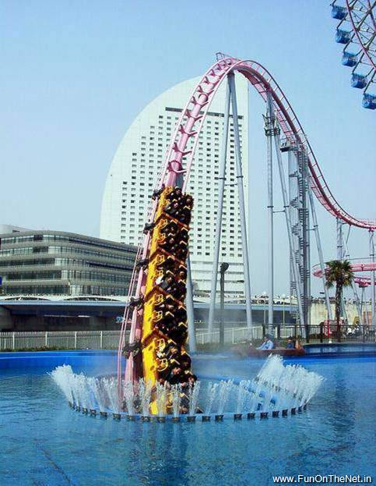
Passeando...
Durante o passeio,
Os carrinhos “somem”

Slide 9
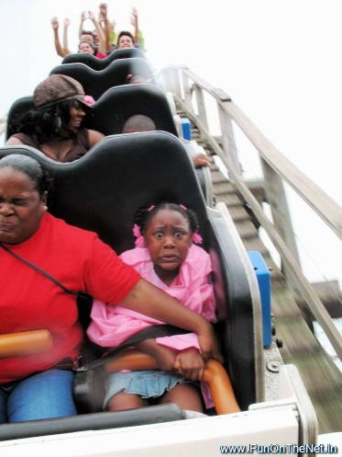
Passeando...

Slide 10
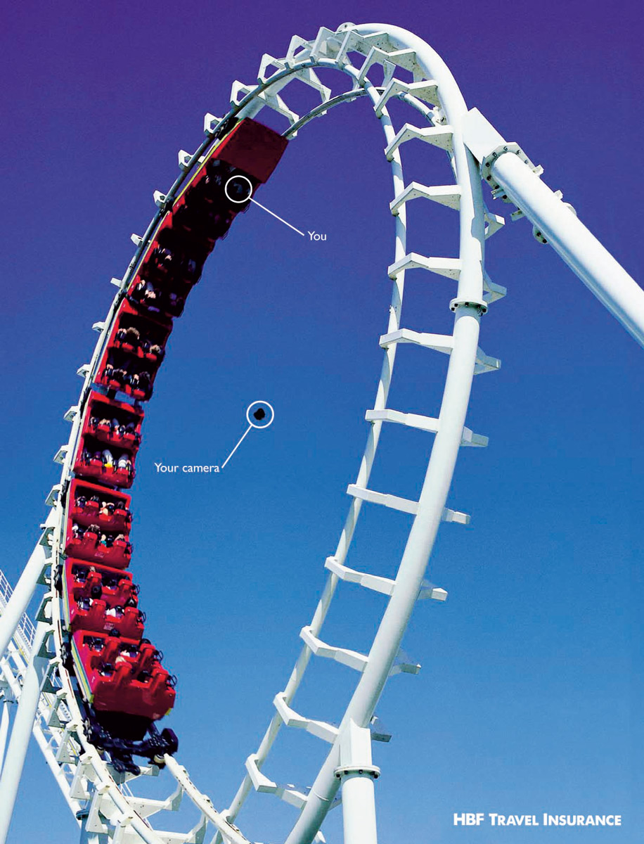
Passeando...

Slide 11
Passeando

Slide 12
Passeando
Durante o passeio,
Os carrinhos “somem”

Slide 13
Passeando
Durante o passeio,
Os carrinhos “somem”

Slide 14
/ Montanha Russa \
| |entrada| |
| | #ooooooooo_________________________________________ |
| | |\/\/\/\/\/\/\/\/\/\/\/\/\/\/\/\/\/\/\/\/\/\/\/\/\/ |
| |_____| |_____| |_____| |_____| |_____| |_____| |ooooo| |
|-----------=o===o===o===o===o===o===o===o===o===o===o===o===o===o=---|
| |saida| | |
| |_________| |
\ /
Chegando

Slide 15
/ Montanha Russa \
| |entrada| |
| | #ooooooooo_________________________________________ |
| | |\/\/\/\/\/\/\/\/\/\/\/\/\/\/\/\/\/\/\/\/\/\/\/\/\/ |
| |_____| |_____| |_____| |_____| |_____| |_____| |ooo__| |
|-----------=o===o===o===o===o===o===o===o===o===o===o===o===o===o=---|
| |saida| | |
| |____oo___| |
\ /
Indo embora

Slide 16
Roller Coaster!
As variaveis podem ser facilmente mudadas no define...

Slide 17
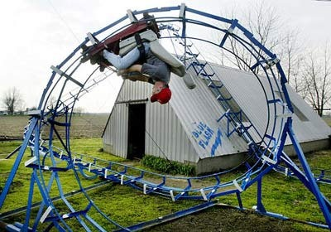
Roller Coaster!

Slide 18
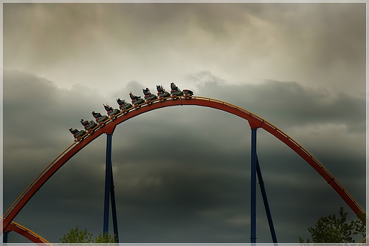
FIM!

Slide 19
/ Montanha Russa \
| |entrada| |
| | #ooooooooo_________________________________________ |
| | |\/\/\/\/\/\/\/\/\/\/\/\/\/\/\/\/\/\/\/\/\/\/\/\/\/ |
| |ooooo| |_____| |_____| |_____| |_____| |_____| |_____| |_____| |
|---o---o---=o===o===o===o===o===o===o===o===o===o===o===o===o===o=---|
| |saida| | |
| |_________| |
\ /
backup

