Slide 1
Topics on nonlinear optimization

Slide 2
Contents
Introduction
Gradient based methods
  Newton's method
  Gauss-Newton's method
  Steepest Decent
  Levenberg-Marquardt's method

Slide 3
Introduction

Slide 7
Linear problem
Nonlinear problem

Slide 8
Linear problem
Nonlinear problem

Slide 9
Linear problem
Nonlinear problem

Slide 10
Linear
problem

Slide 11
minimum

Slide 12
The minimum can be computed in a single step

Slide 13
Or iteratively, from a given initial approximation

Slide 15
In this case, the minimum is estimated in a single step from the given initial approximation

Slide 16
On the other hand, in a nonlinear problem, the minimum is estimated after several steps from the initial approximation

Slide 17
Approximate the nonlinear function around the initial approximation

Slide 18
Approximate the nonlinear function around the initial approximation
This approximation also has a minimum

Slide 19
Compute a new approximation around this minimum

Slide 20
And so on ...

Slide 21
Level curves

Slide 22
Initial approximation

Slide 26
Estimated minimum

Slide 27
Given a point, it is needed to define a direction and the step length

Slide 29
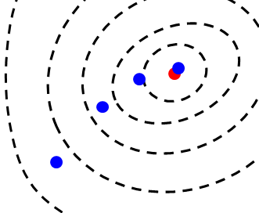

Slide 30
Direction

Slide 31
Step length

Slide 32
The direction and step length may be defined by using the gradient

Slide 36
Difference between the methods

Slide 37
Newton
Gauss - Newton
Difference between the methods
Steepest decent
Levenberg - Marquardt

Slide 38
Method | Convergence
Steepest Decent | 0
Levenberg - Marquardt | 1
Gauss - Newton | 2
Newton | 3
0 – slow 3 – fast

Slide 39
Method | Initial approx
Steepest Decent | Can be distant
Levenberg - Marquardt | Can be distant
Gauss - Newton | Must be close
Newton | Must be close

Slide 40
Method | Direction/ Step length
Steepest Decent | Defined by the gradient
Levenberg - Marquardt | Defined by the Hessian and gradient
Gauss - Newton | Defined by the Hessian and gradient
Newton | Defined by the Hessian and gradient

Slide 41
Method | Computational cost
Steepest Decent | 0
Levenberg - Marquardt | 2
Gauss - Newton | 1
Newton | 3
0 – low 3 – high

