Slide 1
One metadata model for every province
Moving annual housing data from manual, province-by-province handling to one maintained mapping database
Demo: notebooks/walkthrough.ipynb · housing_metadata_demo repo
Notes:
This deck goes with the housing_metadata_demo repo and its walkthrough notebook. The ask: stop treating each province's metadata as its own manual project, and maintain one mapping database that a single generic process uses every year.

Slide 2
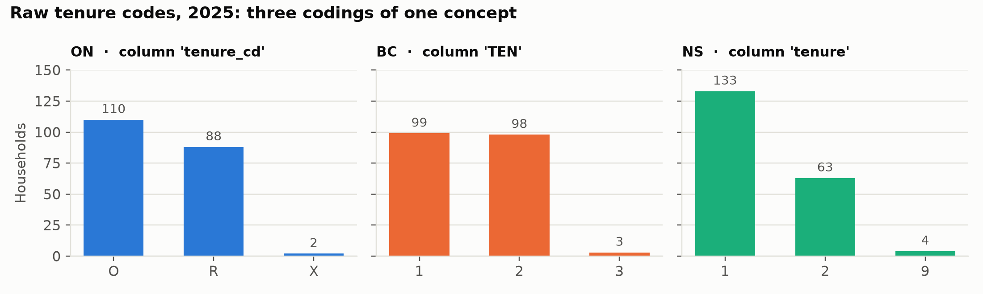
The same concept arrives three different ways
Names differ
Tenure is tenure_cd, TEN or tenure
Codes differ
O/R/X vs 1/2/3 vs 1/2/9
Names change
Ontario renamed shelter cost in 2025
Extras appear
BC sends a column nobody asked for
Notebook §1 · The problem
2
Notes:
Notebook section 1. Three provinces, one concept (tenure), three column names and three coding schemes. To draw even this simple chart without the model, the notebook has to hard-code which column to read for each province. That dictionary is exactly the kind of logic that piles up in our current scripts.

Slide 3
Today: each province is its own project
How the work is split up now
What this costs us
ON
Own script
Own recodes
Own yearly fixes
Manual: renames and recodes are re-done by hand each year
Spread out: knowledge sits in separate scripts, spreadsheets and people
Inconsistent: each province is checked differently; problems surface late
Hard to audit: no single record of what mapped to what
Hard to grow: a new province means a new code path
BC
Own script
Own recodes
Own yearly fixes
NS
Own script
Own recodes
Own yearly fixes
…repeated every year, and again for every new province
3
Notes:
This is how the work has usually been done. Each province gets its own script, its own recodes and its own yearly fixes, often held by different people. None of it is shared, so every year we repeat the work three times over, and a new province means starting again.

Slide 4
Proposed: one process, driven by metadata
ON files
Mapping database
One generic load
Consistent output
What each province calls each variable, and how its codes translate. Small, dated tables, with production versions kept in OneLake.
The same steps for every province and every year. No province names anywhere in the code.
One labelled model with full lineage and built-in quality checks.
BC files
NS files
Province differences become rows of data, not branches in code. The yearly job is editing a few reviewed rows.
Notebook §3 · Build
4
Notes:
The alternative: put everything province-specific into a small mapping database, and run one generic load against it. The code never mentions a province. In the notebook, section 3 is a single call, build.build(con, META, RAW), and it loads every province and year the same way.

Slide 5
Proposed data model: a starting point
Mapping
what each province calls it
Reference
what we mean
Production
what was loaded
Open for discussion
code
dataset
This is the model the demo uses. Expect changes as we test it on real deliveries.
codeset_id
code
label_en
valid_from / to
dataset_id
source_system
reference_year
source_path
source_column_map
source_system
source_column
variable_id
valid_from / to
An “ignore” option for known extra columns
Recode when queried, rather than at load
More than one record type (person, dwelling)
Production metadata tables kept in OneLake
codeset
dataset_column
codeset_id
codeset_name
description
dataset_id
source_column
variable_id
source_code_map
source_system
variable_id
source_value → code
valid_from / to
variable
record_value
variable_id
label · role · type
codeset_id
unit
valid_from / to
dataset_id · record_id
variable_id
source_value
value
Lines join tables on shared ids. variable (teal) is the hub every mapping and value points to.
Notebook §2 · The metadata · README · The model
5
Notes:
This is the data model the demo uses: eight tables in three groups. It's a proposal, not a final design. The structure is what makes the process generic: variable is the hub, the mapping tables are the only place province differences live, and the production tables are written by the load. The panel on the right lists changes we already expect to discuss. In the demo the reference and mapping tables are CSV files; in production they would be maintained tables, with the production versions saved in OneLake.

Slide 6
Everything province-specific is a row
Reference what we mean
codeset · code · variable
Owned by subject-matter experts
A column rename is two dated rows
prov | source_column | variable | from | to
ON | shelter_cost_mth | SHELTER_COST | 2020 | 2024
ON | monthly_shelter_cost | SHELTER_COST | 2025 | –
Mapping what each province calls it
source_column_map · source_code_map
Owned by the data team
A code translation is one row per value
prov | variable | source value | code | from
ON | TENURE | O | 1 Owner | 2020
ON | TENURE | R | 2 Renter | 2020
ON | TENURE | X | 9 Not stated | 2020
Production what was loaded
dataset · dataset_column · record_value
Written by the pipeline
Nova Scotia already uses our codes, so it needs no code-map rows at all.
Notebook §2 · The metadata
6
Notes:
Three groups of tables. Reference says what we mean, mapping says what each province calls it, and production is written by the pipeline. On the right are real rows from the demo's metadata/source_column_map.csv and source_code_map.csv (CSV in the demo; maintained tables in OneLake in production). Ontario's 2025 rename is two dated rows, not an if-statement. Nova Scotia already uses our codes, so it has no code-map rows and its values pass straight through.

Slide 7
Yearly changes become small metadata edits
70
When this happens… | …you edit this
A new province joins | Add its column (and code) mapping rows
A province renames a column | End the old row, add a new one
A new variable is collected | Add a variable row, plus a mapping per province
A province sends a new code | Add a code-map row (QA tells you when)
A code is retired | Set an end year on the code row
rows of metadata hold every
province-specific fact
0
lines of province-specific
code
One rule handles time: a row applies when the reference year is between its valid_from_year and valid_to_year.
Notebook §2 · The metadata · §8 · The annual cycle
7
Notes:
The whole sample model is 70 rows of metadata, and no province-specific code. The table on the right is the maintenance playbook from the README. Time is handled by one rule: a row applies when the reference year falls inside its valid_from / valid_to range.

Slide 8
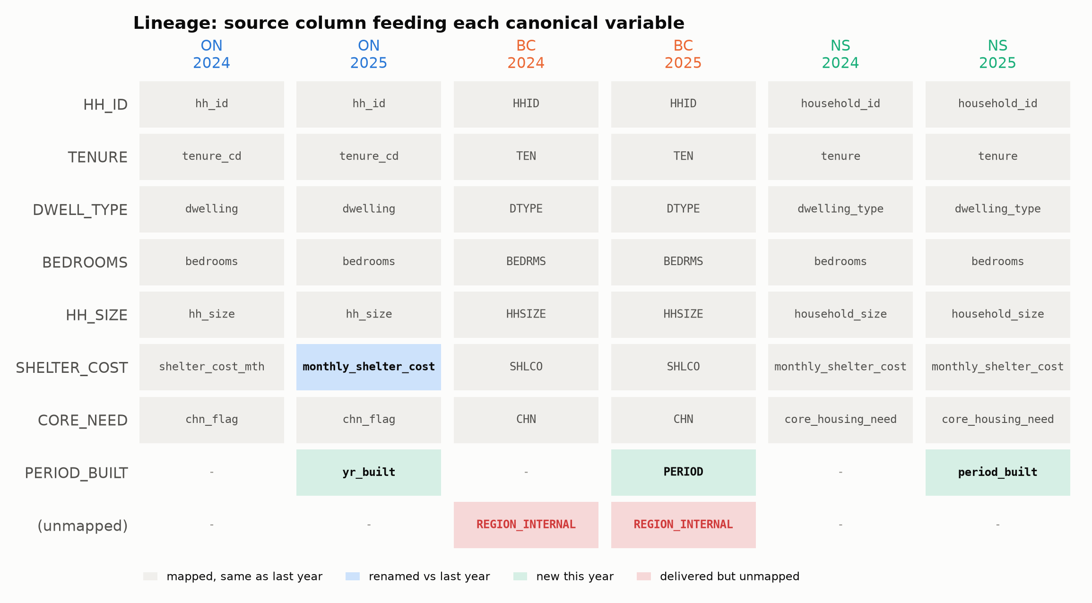
We can see where every value came from
Recorded automatically on every load, for every province and year
Blue: a renamed column (Ontario, 2025)
Green: a new variable (period built, 2025)
Red: delivered but not mapped (BC)
Notebook §4 · Lineage
8
Notes:
Notebook section 4. Every load records each physical column it saw and what it mapped to. This map is drawn straight from that table. Highlighted cells are the churn the mapping tables absorbed: Ontario's rename, period built arriving in 2025 under three different names, and BC's unmapped column.

Slide 9
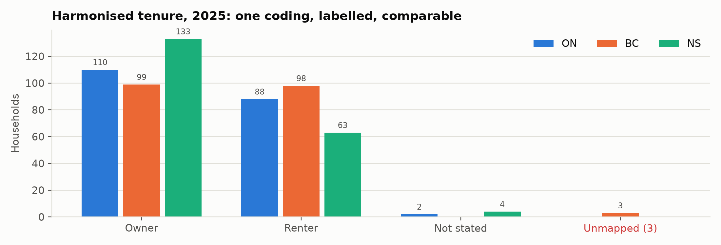
One labelled standard for every province
Three codings in
O/R/X, 1/2/3 and 1/2/9 become Owner, Renter and Not stated
Nothing lost
Each value keeps what the province sent, for audit
Nothing guessed
A code with no mapping is flagged, not forced into a category
Notebook §5 · Harmonised output
9
Notes:
Notebook section 5. The same chart as slide 2, now drawn from the harmonised view. The query only says variable_id = 'TENURE'; there's no province dictionary. The original value is kept next to the canonical one for audit. BC's code 3 had no mapping, so it's shown as unmapped rather than guessed.

Slide 10
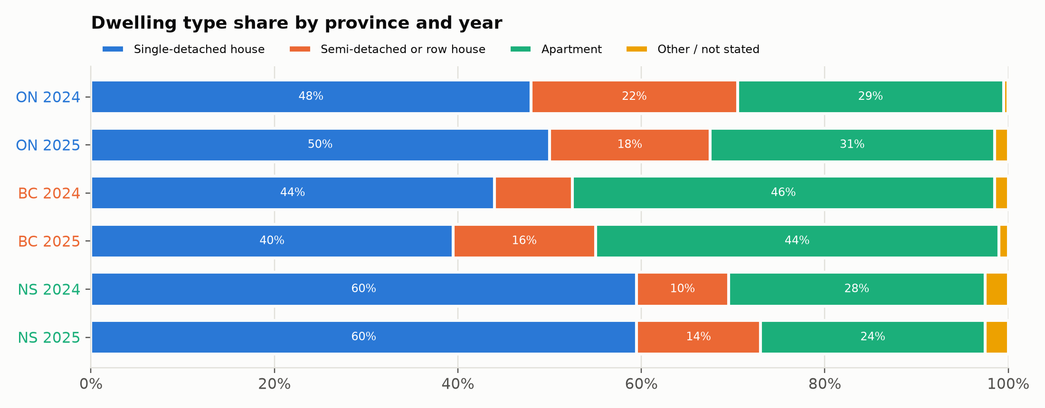
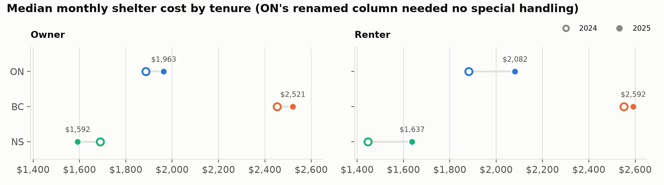
Analysis no longer needs province logic
The whole query
SELECT source_system,
value_label,
count(*)
FROM v_record_labelled
WHERE variable_id
= 'TENURE'
GROUP BY ALL
No CASE province WHEN … anywhere.
Ontario's renamed column and BC's numeric codes needed no special handling.
New provinces and years appear automatically.
Notebook §6 · Analysis
10
Notes:
Notebook section 6. Every chart here runs one query over all provinces and years, using only canonical names and the code tables. Ontario's 2025 column rename and BC's integer codes needed no special handling. When 2026 and a new province arrive, they just show up in the same chart (slide 13).

Slide 11
Quality checks say exactly what to fix
Check | Fires when | Fix
Unmapped columns | A province sent a column nobody mapped | Add a column-map row
Missing variables | An expected variable isn't in the file | Usually a rename: end the old row, add a new one
Unmapped values | A province sent a code with no mapping | Add a code-map row
Invalid codes | A value isn't in our code list for that year | Fix the target code or its dates
Bad numerics | A number column has values that don't parse | Raise with the province
Read together, they explain themselves: an unmapped column plus a missing variable in the same file is almost always a rename.
Notebook §7 · QA
11
Notes:
Notebook section 7. Because the load is generic, so are the checks. Every build runs all five. Each one points at a specific metadata edit, so QA results turn straight into a to-do list. In the sample data two planted problems are caught: BC's extra column and BC's unmapped tenure code.

Slide 12
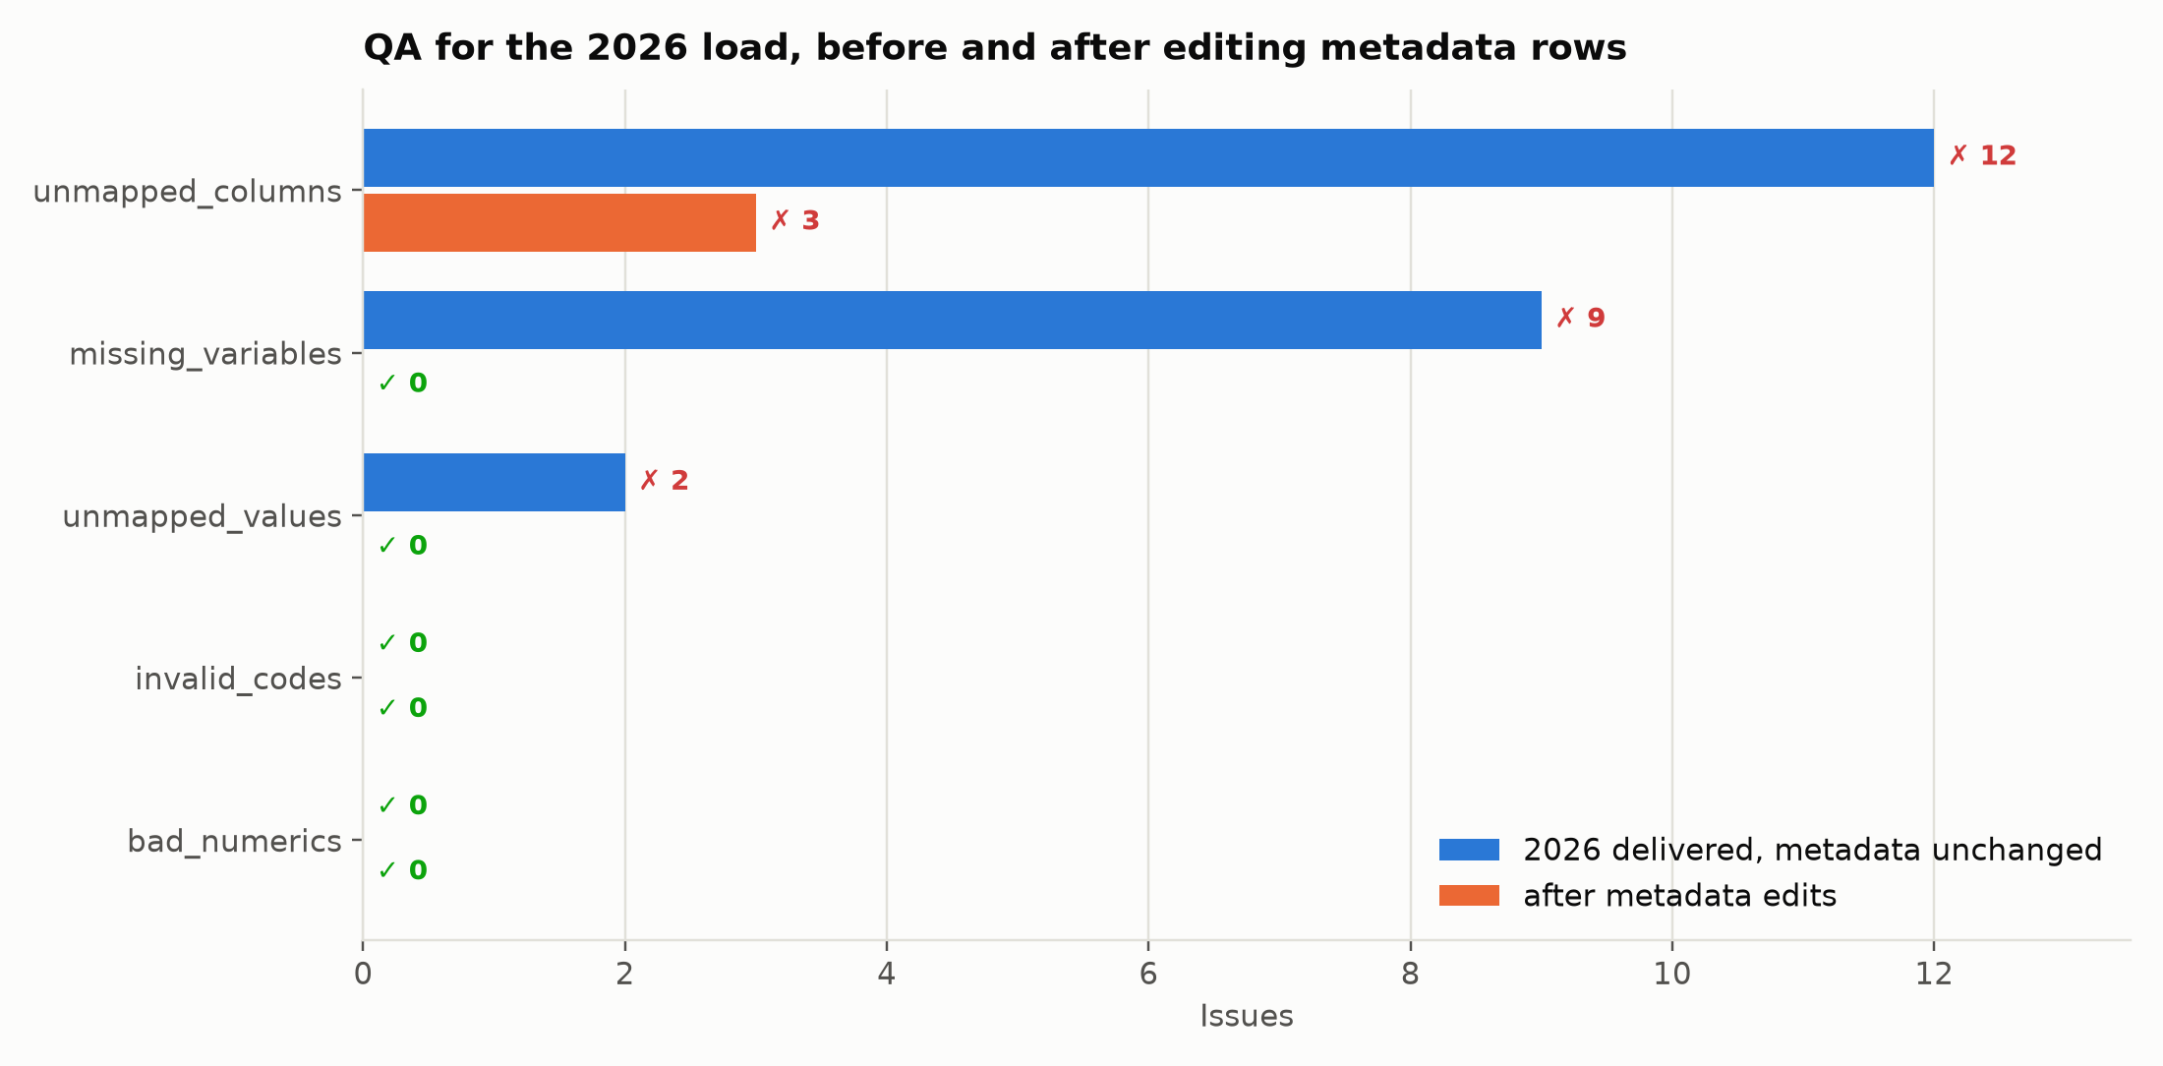
The 2026 cycle, in practice
1
Load
2
Read QA
3
Edit rows
4
Reload
Drop in the new files and run the build
Each failing check names what to map
Update the mapping tables; save the reviewed version to OneLake
Run again until QA is clean
24
metadata rows changed
0
lines of Python changed
Ontario rename · BC new code · Manitoba joins
Notebook §8 · The annual cycle
12
Notes:
Notebook section 8 simulates a realistic 2026: Ontario renames tenure, BC still sends its new code, and Manitoba joins with its own names and codes. The first load doesn't crash; QA lists every gap. After 24 metadata rows, everything is clean except BC's internal column, which needs a decision (see next steps). No Python changed.

Slide 13
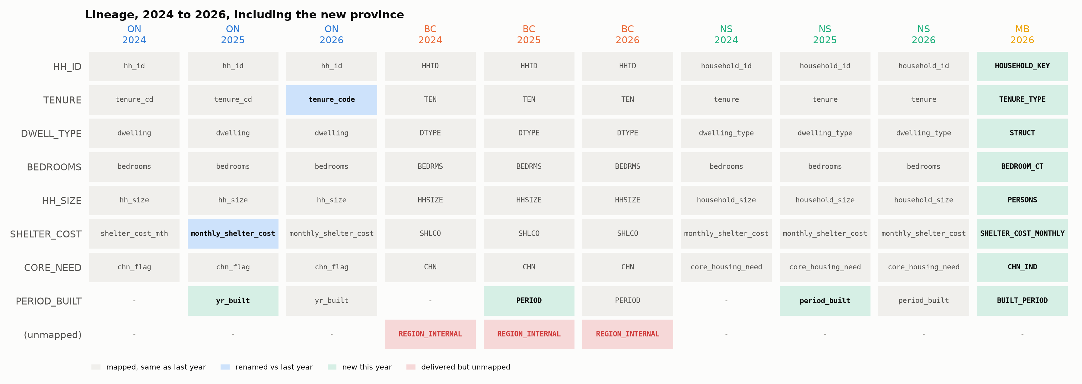
A new province, without new code
Manitoba: its own column names and codes, handled with 8 column mappings and 12 code mappings. It then appears in every view, chart and check.
Notebook §8 · The annual cycle
13
Notes:
The lineage map after the 2026 edits. Manitoba arrived with completely different column names and codes. It took 8 column mappings and 12 code mappings, and from then on it flows into every view, chart and QA check like the others.

Slide 14
What changes for the team
Today: per province, by hand | With the model: one consistent process
A separate script and recodes for each province | Mapping rows in one shared database
Renames handled with year-specific code | A dated row: valid from / valid to
New province = a new code path | New province = new mapping rows
Knowledge spread across people and files | One maintained set of tables, kept in OneLake
Problems found late, by analysts | Problems flagged at load, with the fix
Lineage rebuilt by hand | Lineage recorded on every load
14
Notes:
The summary. Left is how the work has typically been done: per province, by hand, with the knowledge spread out. Right is the same work as a maintained database that is handled the same way for every province, every year.

Slide 15
Next steps
1
Port Move the model into our local repo with the real metadata folders
2
Prove Load one year of real deliveries and compare with current outputs
3
Decide Agree the data model, including ignored columns, reload rules and multi-file deliveries
4
Automate Run the QA checks in CI so a failing check blocks a release
5
Own Keep production metadata in OneLake, with a named owner and a review step
Try it: uv sync --group demo, then open notebooks/walkthrough.ipynb
Notes:
Proposed next steps. The design points in item 3 come from the review in the README, under Known limitations: an explicit 'ignore this column' mapping, reloading earlier years when a mapping change reaches back, and provinces that send several files per year.

