Slide 1
FAST: Fragment Assisted Storage for efficient query execution in read-only databases
- Vivek Hamirwasia (IIIT Hyderabad), Kamalakar Karlapalem (IIIT Hyderabad), Satyanarayana R Valluri (Oracle)

Slide 2
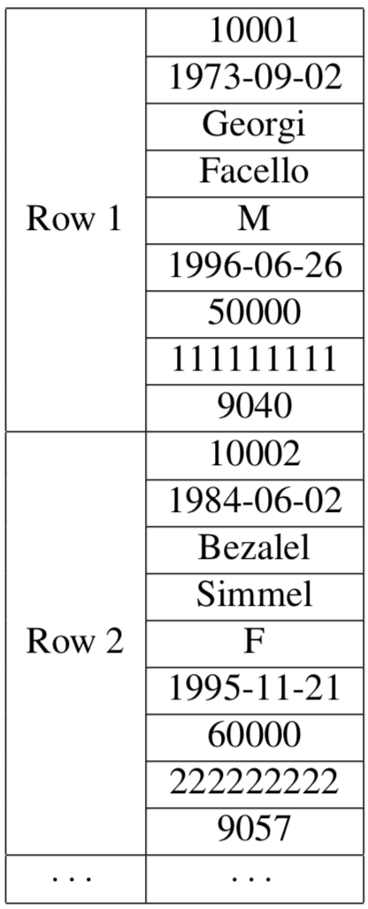
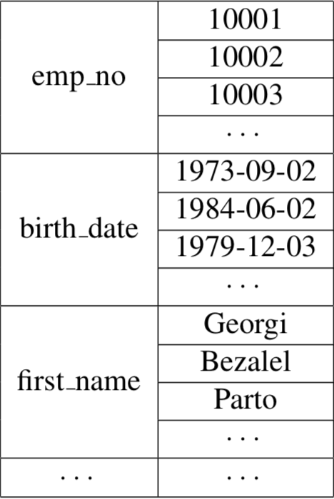
Background
Row Store
Column Store
In-Memory Databases
Redis
SAP Hana
MonetDB
Design and layout of data is the key for these systems
‘row-stitching’ cost is significant for high number of attributes
High number of cache misses
Notes:
- Reading row-by-row brings all attributes into the cache irrespective of query using them
- Reading column-by-column => high join cost
- Goal: Attain a middle ground between the two storage structures, leverage the main memory trends without increasing complexity of implementation

Slide 3
Contributions of our work
Provide a read-optimized hybrid storage model with algorithms to
Co-locate attributes that are accessed together into vertical fragments
Given a fixed amount of main memory space, allocate these fragments efficiently
Given a query, choose those fragments that minimize the average response time for the query
Relatively easy to implement on top of existing DBMS due to low coupling.
Notes:
To lay out the specific contributions of the work
subset of attributes together so that it's somewhere between a pure row store and a pure column store

Slide 4
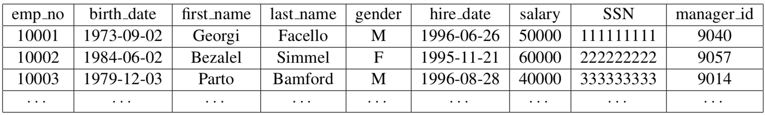
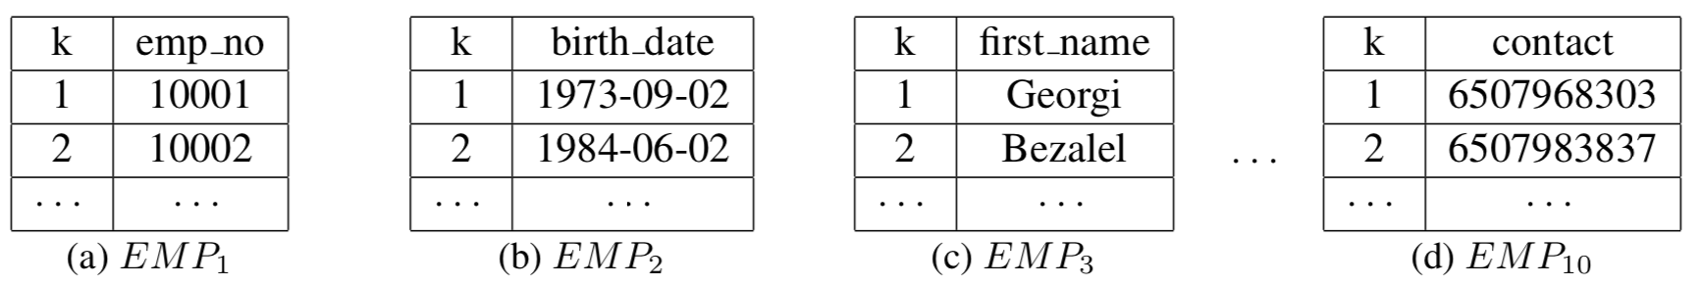
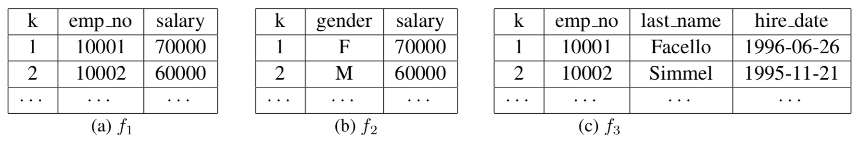
Architecture
Relation
Secondary Storage
Main Memory
Notes:
SS: Ensures that I/O cost is minimum if and when we have to access secondary storage - We will refer to these are vertical fragments

Slide 5
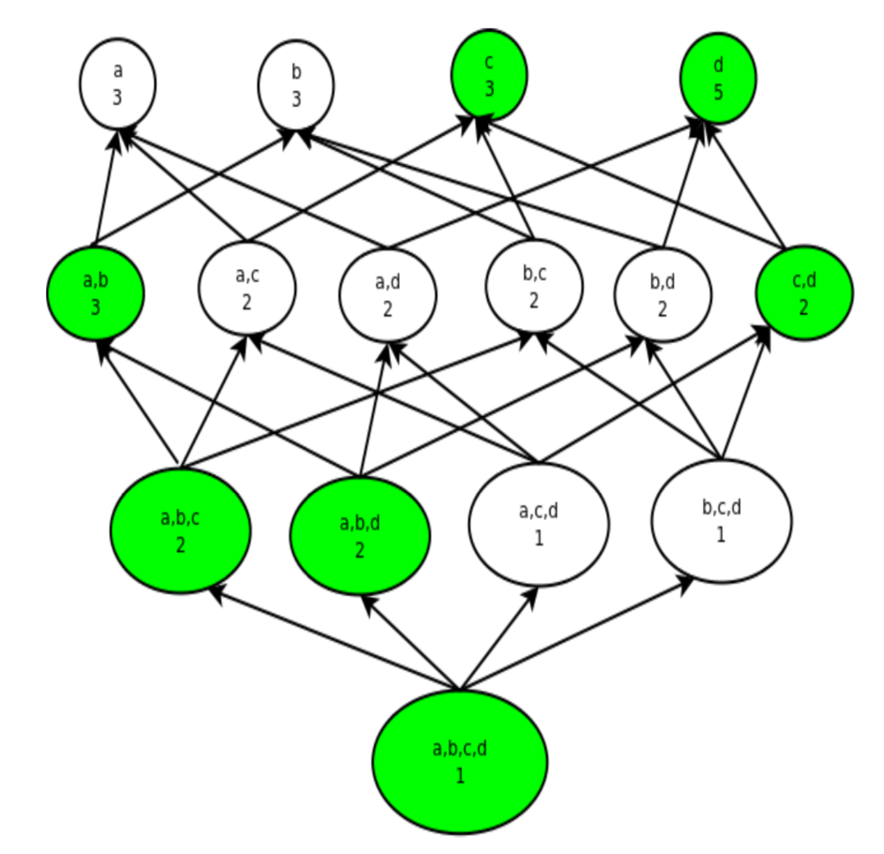
Fragment generation
Possible number of vertical fragments is exponential – impractical to exhaust the search space
Frequent Closed Itemset Mining
Itemset is frequent (i.e support count is at-least X)
No super-set with equal or higher support count
DBV-Miner algorithm
Notes:
If we consider the attributes in a relation as the items, then the set of attributes accessed by a query is the itemset

Slide 6
Fragment allocation
Average number of block/page accesses
CostSS_{fi} = (Yao(N, Bss_{fi}, Sel_{fi}) ∗ T_{ss} + CostJ_{fi}) ∗ SC_{fi}
CostMM_{fi} = Yao(N, Bmm_{fi}, Sel_{fi}) ∗ T_{mm} ∗ SC_{fi}
V_{fi} = CostSS_{fi} − CostMM_{fi}
W_{fi}
Time to read one block/page
Cost of joining attributes from individual columns
Support count of the fragment
Space occupied by the fragment
Goal: Maximize sum of values with the constraint that sum of weights is not more than M
Notes:
Quantify the value of the fragment
Essentially gives us the benefit of materializing this fragment in main memory

Slide 7
Fragment allocation - continued
When fragments are mutually disjoint
Similar to 0/1 knapsack which runs in pseudo-polynomial time
To completely utilize M, we allow fractional fragments
Reduces to the problem of fractional knapsack, which chooses fragments with higher value-to-weight ratio in a greedy manner
When fragments have overlap
SC_{f(i,j)} ≥ SC_{fi} +SC_{fj} , f(i,j) is a closed itemset!
Use this observation to remove f(i,j) from the two fragments, resulting in three disjoint fragments
Apply the algorithm for the mutually disjoint case

Slide 8
Incorporating Indexes
Cost(I_{j}^{ss}) = B(I_{j}^{ss}) ∗ T_{ss} ∗ SC(I_{j})
Cost(I_{j}^{mm}) = B(I_{j}^{mm}) ∗ T_{mm} ∗ SC(I_{j})
V(I_{j}^{mm}) = Cost(I_{j}^{ss}) − Cost(I_{j}^{mm}) , W(I_{j})
Sort fragments and indexes by their value-to-weight ratio and choose the best in each iteration until main memory buffer is full
Notes:
Also consider indexes for sharing main memory space
We define a similar value model for indexes, based on the block accesses and frequency of access

Slide 9
Query reformulation & execution
Data Source Selection
Goal: select the right set of fragments from the main memory and columns from disk
Cost associated with each “data source” – dependent on I/O and cache processing
If number of attributes in Q (say p) is small (i.e p < 20), do a quick exhaustive search for all combinations in 2^p
Else
consider each data source to be a set of items
attributes in Q to be the target set
reduces to “weighted set cover” problem - greedy approximation in polynomial time

Slide 10
Query reformulation & execution
Query Reconstruction
SELECT first_name , last_name , gender
FROM EMP WHERE salary >= 50000
SELECT EMP₃.first_name, f₃. last_name , f₂. gender
FROM EMP₃, f₃, f₂
WHERE salary >= 50000 AND EMP₃.k = f₃.k
Query Optimization
Late materialization – operate on bit-vectors returned by indexes and materialize only when producing the result or performing a join
Delegate the query optimization to a Selinger-style optimizer that uses dynamic programming to determine the order of joins
Notes:
We substitute the columns with their data-source counterpart (as inferred previously)
Late materialization can be greatly leveraged
For example, here if an index exists on salary, it would return the bit-vectors and then we would use those to get the actual column values.

Slide 11
Workload-aware reorganization
Goal : Dynamically adapt the main memory to the changes in workload
Two possible strategies:
1. Periodically generate and allocate fragments after some time
Expensive
Blocks query execution
2. Detect changes in workload and incrementally reorganize main memory
Amortize cost over several queries
Can be done in a background process -> does not block query execution

Slide 12
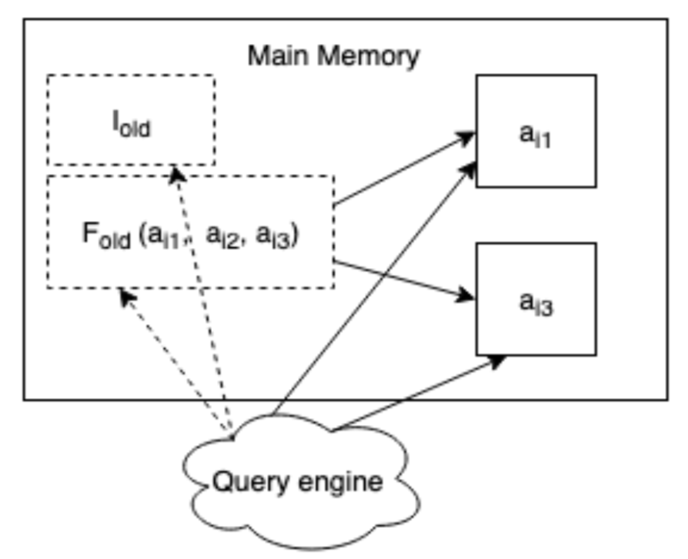
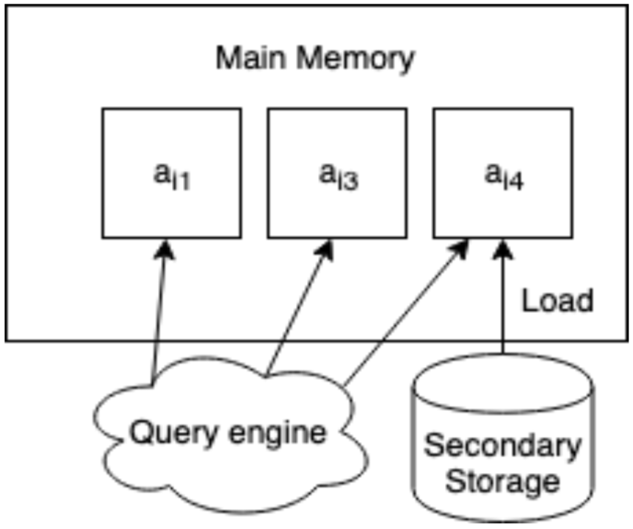
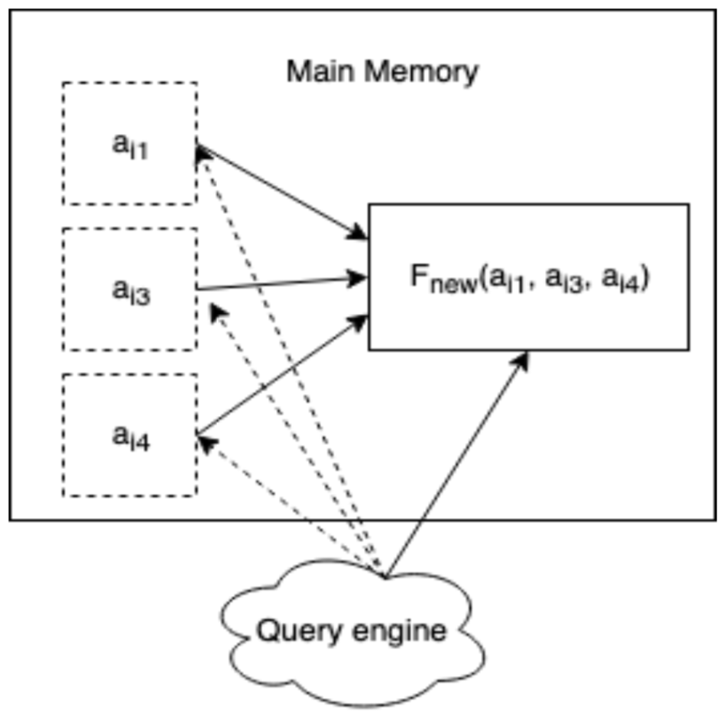
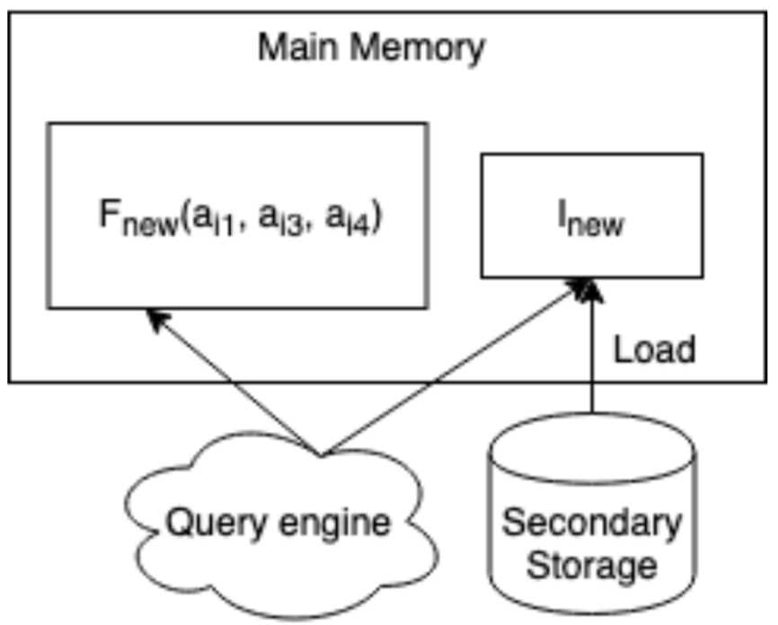
Workload-aware reorganization - continued
Use a lightweight logging framework to measure main memory & disk usage to detect change in workload
Actual reorganization happens incrementally in four independent stages
Split
Load
Merge
Load/Build index

Slide 13
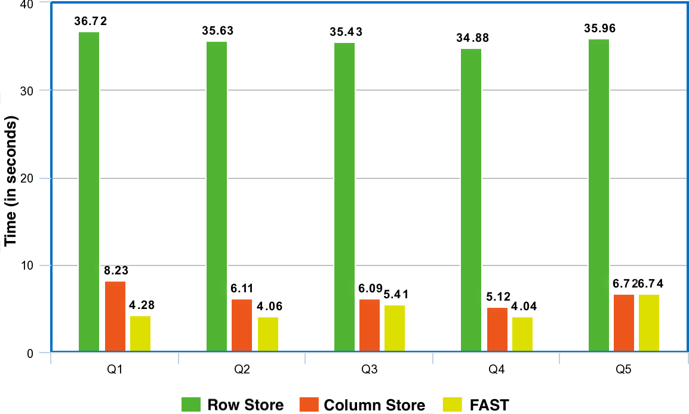
Experiment: Custom benchmark
Single relation A with 50 integer attributes, selectivity of queries is 1%.
30% Q1: SELECT AVG(a0 +a1 +a2 +a3 +a4 +a5 +a6) FROM A WHERE a7 < X
20% Q2: SELECT AVG(a5 +a6 +a8 +a9 +a10) FROM A WHERE a7 < X
20% Q3: SELECT AVG(a11 +a12 +a13 +a14 +a15) FROM A WHERE a16 < Y
20% Q4: SELECT AVG(a15 +a17 +a18 +a19) FROM A WHERE a16 < Y
10% Q5: Remaining queries operating on ≤ 6 random attributes between a20 and a50
F₁(a5, a6), F₂(a15) and F₃(a0, a1) allocated by FAST
More than 7 times faster than row store and 1.3 times faster than column store
Notes:
Compare with row and column stores
10% of relation size is reserved as main memory buffer

Slide 14
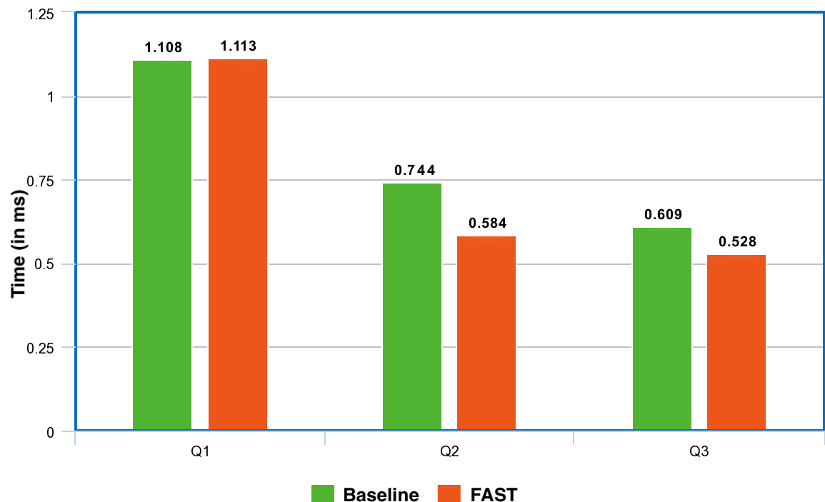
Experiment: Analyzing cache efficiency
Compare fragments allocated by FAST to a baseline fragment: F_{baseline}(a0, a1, a5, a6, a15)
Q1 performs slightly worse due to cost of reconstruction
Q2 and Q3 perform 20% faster than baseline due to less number of irrelevant attributes
Notes:
how queries to baseline fragment compare against fragments by FAST

Slide 15
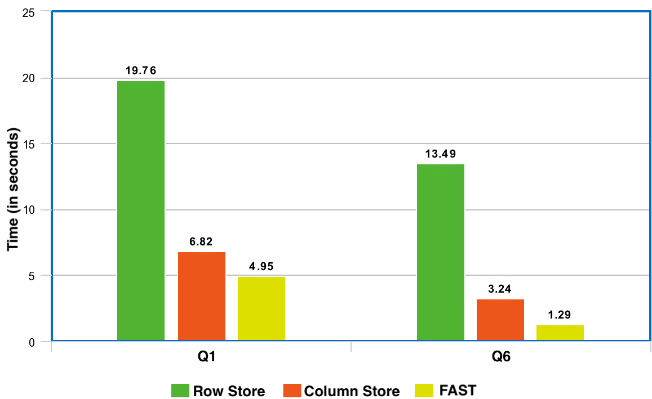
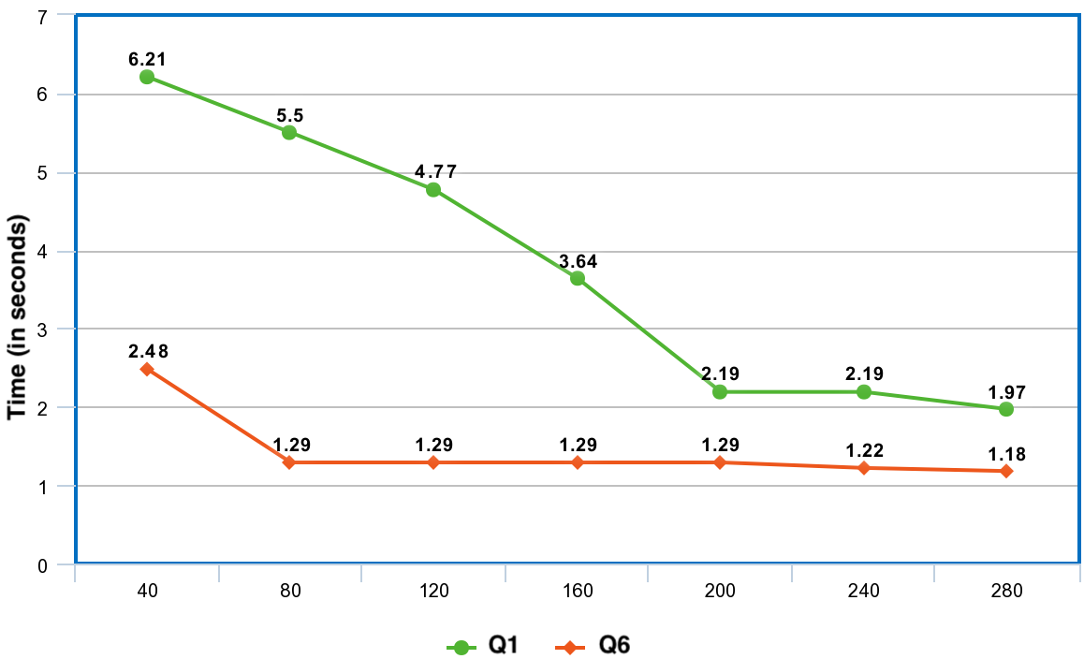
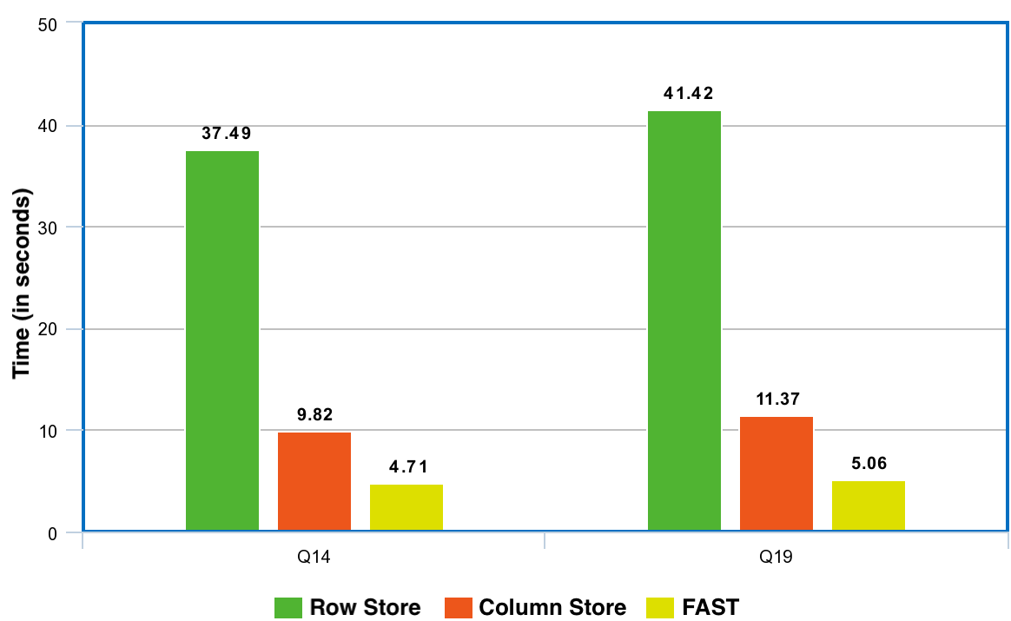
Experiment: TPC-H queries
Main Memory (in MB)
Notes:
Q1 and Q6 operate on a single relation whereas Q14 and Q19 contain joins on multiple relations
FAST performs especially well on Q6, as all attributes are in main memory
On the right,....
Attain near-optimal performance for Q6 pretty soon and then ROI is small
Perf on Q1 steadily improves until 200 MB

Slide 16
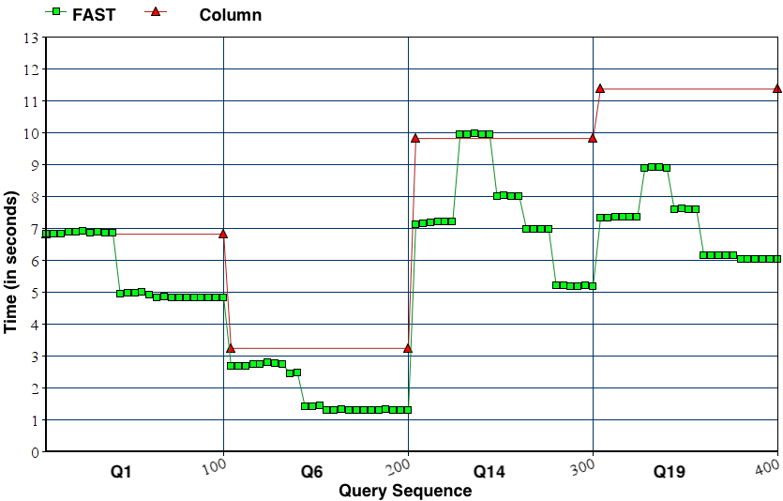
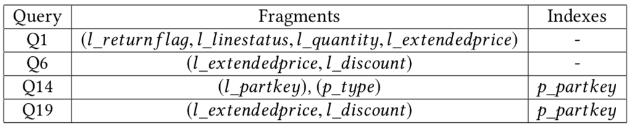
Experiment: Workload-aware adaptation
Sequence of TPC-H queries 1, 6, 14 and 19 - 100 queries of each type
Notes:
in all cases, FAST converges to an optimized main memory layout

Slide 17
Related work
PAX – Ailamaki et al.
Hyrise – Grund et al.
Data Morphing – Hankins and Patel
Flexible Storage Model – Arulraj et al.
Notes:
For eg, PAX proposes a column-based layout for records within a DB page
HYRISE - hybrid main memory storage engine, that uses a highly accurate model of cache misses to create vertical partitions of relations.
Data morphing - create disjoint attribute partitions of relations leading to an adaptive, cache-efficient layout.
FSM - to handle both OLAP and OLTP workloads by creating vertical partitions of closely related attributes through k-means clustering
We want to provide FAST as a commercial off the shelf system

Slide 18
Conclusion
FAST provides sophisticated main memory buffer management
Incorporates the best of row and column stores depending on the workload
Performs better than traditional storage systems for real-world queries where only a fraction of attributes are relevant
Dynamically adapts to an evolving workload without blocking query execution

