Slide 1
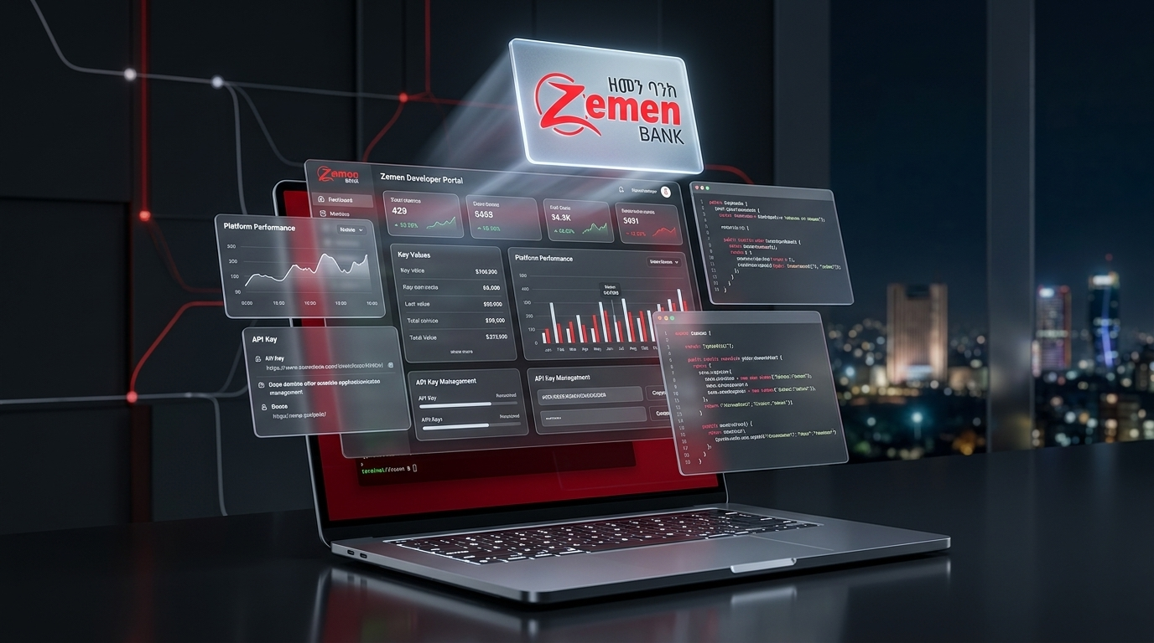

RELEASE 1.0 • BRANCH MAKER & CHECKER BRIEFING
Zemen SuperApp
& Branch Portal
SuperApp 1.0 Core Concepts, Customer Security Lifecycle & Branch Maker–Checker Pre-Demo Walkthrough
Zemen Bank S.C. • Omnichannel Mobile & *844# USSD

Slide 2
1.0 • INTRODUCTION TO ZEMEN SUPERAPP
One Platform. Two Channels. Built for Individuals.
Seamless banking across Smartphone App and *844# USSD — controlled directly by the customer.
RETAIL
Target Customers: Individuals
Zemen SuperApp 1.0
• Designed for individual personal banking customers
• Unified profile across all personal bank accounts
*844# & APP
Mobile App + USSD (*844#) Channels
📱 APP SCREENSHOT AREA
Home / Language & USSD Toggle
Drop screenshot of App Welcome, Language Selector or *844# USSD Switch
• Full Smartphone App (iOS & Android) + USSD (*844#)
• Customers can Enable / Disable USSD inside the Mobile App
MULTI-LANG
Multi-Language Experience
• Launches with English, Amharic & common local languages
• Instant in-app language switching anytime
Zemen Bank SuperApp 1.0 | Introduction & Branch Maker–Checker Demo
02 / 10

Slide 3
1.0 • CUSTOMER IDENTITY & ONBOARDING
Dual Identifiers, Unique Email & Two Ways to Onboard
Customers can sign in with CIF or Phone Number and onboard either at a Branch or via Direct Migration.
IDENTIFIER 01
CIF Number
Unique Core Banking ID accepted at login
IDENTIFIER 02
Phone Number
Unique Mobile Number accepted at login
Login & Onboarding
⚠️ UNIQUE EMAIL RULE & CHANNEL ALERT
• Customer Email must be unique across the SuperApp.
• If an account is opened without an Email, the customer will miss Email notifications & Gmail OTPs.
📱 APP SCREENSHOT AREA
CIF / Phone Login Screen
Drop screenshot of Login (CIF or Phone) or Self-Migration screen
ONBOARDING PATH A
Visit a Branch
Branch Maker registers CIF → Checker approves → Activation sent
ONBOARDING PATH B
Direct Migration
Existing mobile users migrate directly inside the SuperApp
Zemen Bank SuperApp 1.0 | Introduction & Branch Maker–Checker Demo
03 / 10

Slide 4




1.0 • DEVICE BINDING & TWO-FACTOR AUTHENTICATION (2FA)
Self-Service Device Binding & 4 Flexible 2FA Methods
Customers can link/unlink their device on their own when changing phones or reinstalling — and switch 2FA anytime.
🔄 SELF-SERVICE DEVICE LINK & UNLINK
Changed phone or reinstalled the app? Customers verify via 2FA to bind their new device on their own — and can change their preferred 2FA method inside Mobile Settings.
2FA & Device Binding
SMS OTP
Instant one-time code sent to registered phone number
Gmail / Email OTP
Sent to unique customer email address on profile
📱 APP SCREENSHOT AREA
2FA Method Selector Screen
Drop screenshot of 2FA options (SMS, Gmail, Security Q, Google Auth)
Security Question
Customer-defined secret questions & answers
Google Authenticator
Time-based authenticator app code (TOTP)
Zemen Bank SuperApp 1.0 | Introduction & Branch Maker–Checker Demo
04 / 10

Slide 5
1.0 • PIN SECURITY, LOCKOUT & SELF-RESET
PIN Lockout Rules & Self-Service PIN Recovery
Automated protection against brute-force PIN attempts + self-service reset for customers with Security Questions.
1x – 4x
Each Wrong PIN → Instant SMS Alert
For every wrong PIN attempt, the customer receives a real-time Wrong PIN Attempt SMS notification.
PIN Security & Reset
5x PIN
5 Wrong Attempts → Customer LOCKED
On the 5th incorrect PIN entry, the profile is automatically locked to prevent unauthorized access.
📱 APP SCREENSHOT AREA
Self PIN Reset / Forced Change
Drop screenshot of Wrong PIN SMS, Self PIN Reset, or Forced PIN Change
SUSPEND
Multiple Locks or Stolen Account → SUSPENDED
Repeated PIN lockouts auto-suspend the user. Branches can also suspend immediately if a phone/account is stolen.
🔑 SELF-SERVICE PIN RESET (SMS / Gmail OTP + Security Question)
• Available only to customers who have configured their Security Questions.
• Forced PIN Change: After any PIN reset, the app forces the customer to change the system-generated PIN immediately.
Zemen Bank SuperApp 1.0 | Introduction & Branch Maker–Checker Demo
05 / 10

Slide 6
1.0 • CUSTOMER ACCOUNT & APP CONTROLS
Granular Account Linking & In-App Personalization
Customers control which linked accounts are visible, reorder their accounts, and toggle USSD (*844#) anytime.
INDIVIDUAL ACCOUNTS
Granular Account Link & Unlink
Each bank account is managed individually per customer request — customers can remove or add specific accounts according to their need.
My Accounts
App Settings
IN-APP SELF CONTROL
Mobile App Account Visibility
Directly on the mobile app, customers can link or unlink accounts on their own (restricted to their already branch-linked accounts only).
📱 APP SCREENSHOT AREA
Link / Unlink Account
Screenshot: In-app account toggle
📱 APP SCREENSHOT AREA
Arrange Order & USSD
Screenshot: Account order & settings
CUSTOMIZE & ARRANGE
Reorder Accounts & Channel Settings
In Customer Settings, users can arrange the display order of their accounts/app, toggle USSD (*844#) on/off, and switch 2FA methods.
Zemen Bank SuperApp 1.0 | Introduction & Branch Maker–Checker Demo
06 / 10

Slide 7
2.0 • BRANCH ADMIN PORTAL (MAKER & CHECKER)
How Branch Makers & Checkers Power the SuperApp
Every branch action follows strict Four-Eyes (Maker–Checker) governance before taking effect on the mobile app.
01 • BRANCH MAKER
Initiate Request & Attach KYC
Searches CIF/Phone, checks physical ID & signed form, ensures unique email, and submits request.
https://superappadmin.zemenbank.et/overview/checker
02 • MY REQUESTS QUEUE
Track Status & Rejection Notes
Maker monitors Pending / Approved / Rejected requests in real time and can cancel mistakes.
💻 PORTAL SCREENSHOT PLACEHOLDER
Dashboard, My Requests & Pending Approvals
Drop screenshot of Branch Maker Queue or Checker Pending Approvals screen
03 • BRANCH CHECKER
Inspect Documents & Authorize
Checker opens Pending Approvals, views uploaded KYC forms side-by-side, and Approves or Rejects.
Zemen Bank SuperApp 1.0 | Introduction & Branch Maker–Checker Demo
07 / 10

Slide 8
2.1 • BRANCH OPERATIONS: CUSTOMER & ACCOUNTS
Branch Onboarding, Profile Updates & Account Linking
What Makers initiate and Checkers approve when a customer visits the branch for onboarding or account changes.
Register Customer & Approve New
• Maker looks up CIF from FlexCube & verifies Email is present
• Selects initial accounts, attaches KYC form → Checker approves
https://superappadmin.zemenbank.et/customers/create
ONBOARD
LINK / UNLINK
Manage Each Account Individually
• Maker links additional FlexCube accounts or unlinks a specific account per customer request → Checker approves
💻 PORTAL SCREENSHOT PLACEHOLDER
Register Customer & Link Account Screens
Drop screenshot of CIF Lookup, Account Selection, or Checker Approval modal
PROFILE SYNC
Customer Directory & Profile Updates
• Search 360° customer profile by CIF, Name, or Phone
• Sync updated core banking details (phone/email) via Checker approval
Zemen Bank SuperApp 1.0 | Introduction & Branch Maker–Checker Demo
08 / 10

Slide 9
2.2 • BRANCH OPERATIONS: CUSTOMER SECURITY
Unlock, Suspend, PIN Reset & Activation Recovery
How branches assist locked, suspended, or compromised customers under dual Maker–Checker authorization.
UNLOCK
Unlock Customer
Clears 5x wrong PIN lockout so customer can sign in again
SUSPEND
Suspend Customer
Immediate block if phone/account is stolen or compromised
https://superappadmin.zemenbank.et/customers/unlock-customer
UNSUSPEND
Unsuspend Customer
Restores access after multiple PIN locks & branch KYC check
PIN RESET
Branch PIN Reset
Issues system PIN (forces customer to change PIN on app login)
💻 PORTAL SCREENSHOT PLACEHOLDER
Security Requests & Security Approvals
Drop screenshot of Unlock / Suspend / PIN Reset Request & Checker Approval
📲 SEND ACTIVATION CODE + APP MIGRATION SUPPORT
• Re-send activation code when a customer changes devices or onboarding code expires.
• Inspect Migration Whitelist & Step Logs (/customers/migration) to assist migrating users.
Zemen Bank SuperApp 1.0 | Introduction & Branch Maker–Checker Demo
09 / 10

Slide 10
3.0 • LIVE SYSTEM DEMONSTRATION
Live Demo Walkthrough: End-to-End Branch & App Flow
We will now demonstrate the complete customer and branch journey live across the Mobile App and Admin Portal.
Demo 01
Demo 02
Demo 03
Demo 04
SuperApp Mobile Experience
Branch Maker: Onboarding & Linking
Branch Maker: Security & Recovery
Branch Checker: Review & Approve
• CIF & Phone login
• Multi-language & *844# USSD toggle
• 2FA selection (SMS, Gmail, Security Q, Google Auth)
• In-app account link/unlink & order arrangement
• FlexCube CIF lookup
• Unique Email check & KYC document upload
• Linking & unlinking individual accounts
• Tracking in My Requests
• 5x Wrong PIN lockout & SMS alert
• Unlock & Suspend / Unsuspend customer
• PIN Reset & Forced PIN change on login
• Pending Approvals queue
• Side-by-side KYC Document Viewer
• Instant Approval & Rejection with remarks
• Request Archive audit trail
🚀 READY FOR LIVE DEMO — Switching to Zemen SuperApp Mobile & Branch Admin Portal (https://superappadmin.zemenbank.et)
Zemen Bank SuperApp 1.0 | Introduction & Branch Maker–Checker Demo
10 / 10

