Slide 1
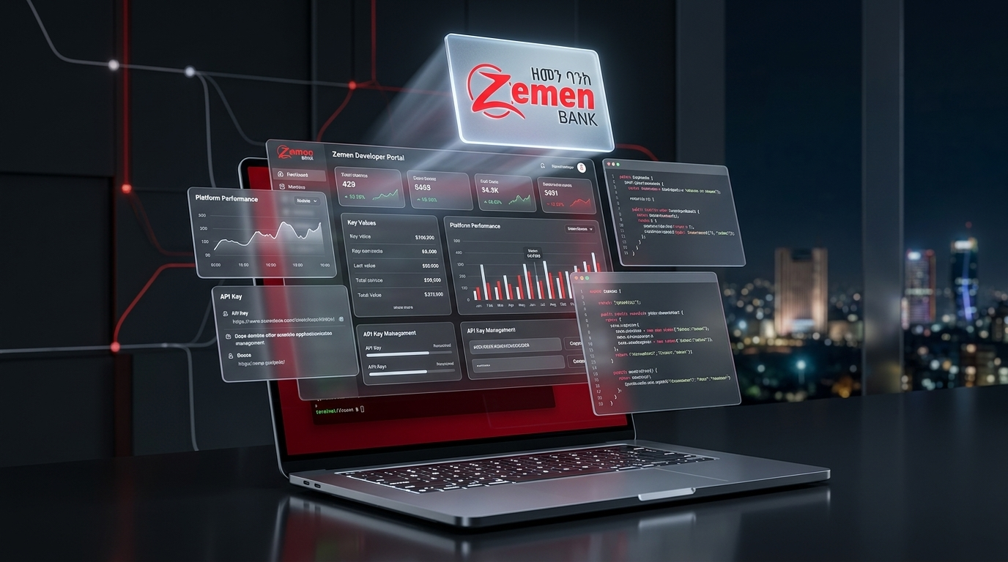

BRANCH OPERATIONS GUIDE • MAKER & CHECKER
SuperApp Admin
Branch Portal Guide
Introducing core features, customer onboarding, account linking, security workflows, and dual-control governance for Branch Makers & Checkers.
Zemen Bank S.C. • Branch Operations & Digital Banking
Role Training & Operational Reference Deck

Slide 2
PORTAL OVERVIEW & AGENDA
Core Branch Modules & Operational Scope
01
Dual-Control Governance
02
Dashboards & Task Queues
Strict Maker-Checker separation of duties across all customer and account actions.
Real-time tracking via My Requests (Maker), Pending Approvals (Checker), and Archive.
03
Customer Onboarding
04
Account Operations
Instant FlexCube CIF lookup, KYC document attachment, and profile update workflows.
Linking and unlinking additional customer bank accounts with core banking validation.
05
Customer Security Controls
06
App Migration & Compliance
Suspend, Unsuspend, Unlock, PIN Reset, and Activation Code issuance & approval.
Supporting customers migrating to the new SuperApp and enforcing audit standards.
Zemen Bank SuperApp Admin Portal | Branch Maker & Checker Guide | Internal Use
02 / 10

Slide 3
GOVERNANCE MODEL
Two Roles. One Secure Workflow. Zero Unauthorized Changes.
Every sensitive customer operation requires initiation by a Branch Maker and independent verification by a Branch Checker.
Step 01
Step 02
Step 03
Step 04
Branch Maker (Initiator)
System Validation
Branch Checker (Authorizer)
Execution & Audit Trail
Verifies customer physical ID and signed request form at the counter, looks up CIF from FlexCube, inputs action details, and uploads supporting KYC documents.
Validates CIF and account eligibility against Core Banking in real time, records Maker user ID and branch code, and queues the item as PENDING.
Opens Pending Approvals, inspects customer details and uploaded KYC documents side-by-side, and either Approves or Rejects with a mandatory reason.
Approved requests execute immediately on the SuperApp backend (SMS/Email sent or status updated) and are permanently logged in the Request Archive.
All 9 branch request types enforce strict Maker–Checker segregation: a user cannot approve a request they initiated.
Zemen Bank SuperApp Admin Portal | Branch Maker & Checker Guide | Internal Use
03 / 10

Slide 4
DASHBOARD & TASK MANAGEMENT
Daily Workspaces: My Requests, Approvals & Archive
Dedicated queues give Makers and Checkers complete visibility over active and historical branch requests.
AUTHORIZER QUEUE
Maker: My Requests
Checker: Pending Approvals
Archive & Global Search
Located under Dashboard & Tasks → My Requests (/overview/maker).
Located under Dashboard & Tasks → Pending Approvals (/overview/checker).
Located under Request Archive (/overview/archive) & Top Header.
✓ Track all requests you submitted
✓ Live status badges (Pending / Approved / Rejected)
✓ View Checker rejection remarks instantly
✓ Cancel pending requests if submitted in error
✓ Unified queue for all 9 branch request types
✓ Built-in KYC Document Viewer modal
✓ Filter by request type or search by CIF
✓ One-click Approve or Reject with reason
✓ Complete log of resolved branch requests
✓ Instant top-bar search by Name, Phone, or CIF
✓ Branch code & timestamp attribution
✓ Full auditability for branch inspections
Operational Tip: Makers and Checkers should review their queues at the start and end of every shift to ensure zero unreviewed customer requests.
Zemen Bank SuperApp Admin Portal | Branch Maker & Checker Guide | Internal Use
04 / 10

Slide 5
CUSTOMER MANAGEMENT
Customer Onboarding & Profile Update Lifecycle
Step 1
Step 2
Step 3
CIF Lookup (/customers/create)
Tier & Document Upload
Checker Registration Approval
Maker enters the customer CIF; the portal fetches verified name, phone, email, and accounts directly from FlexCube.
Maker selects accounts to link, assigns the Customer Category (limit/charge tier), and uploads the signed application form.
Checker reviews /customers/approve-new, inspects the attached KYC document, and approves to send the activation code.
360° View
Update
Verify
Customer Directory (/customers)
Initiate Profile Modification
Approve Updates (/approve-updated)
Search any registered customer by CIF, phone, or name to view profile status, linked accounts, and security state.
When customer details change in FlexCube, the Maker initiates a profile update request from the Customer Directory.
Checker verifies the updated customer fields against core banking records and approves or rejects the change.
Zemen Bank SuperApp Admin Portal | Branch Maker & Checker Guide | Internal Use
05 / 10

Slide 6
ACCOUNT OPERATIONS
Linking & Unlinking Customer Bank Accounts
Enable customers to transact across multiple FlexCube accounts from a single Zemen SuperApp profile.
Link
Approve
Unlink
Confirm
Link Account (Maker)
Approve Linking (Checker)
Unlink Account (Maker)
Approve Unlinking (Checker)
Open Account Operations → Link Account. Search the registered customer by CIF, view eligible unlinked FlexCube accounts, and submit the linking request.
Open Approve Linking (/customers/approve-accounts). Verify account ownership, branch, and currency, then approve to make the account active in the app.
Open Account Operations → Unlink Account. Select the linked bank account the customer wants removed from mobile banking access and submit.
Open Approve Unlinking (/customers/approve-unlink). Verify the request and approve to safely detach the account from the SuperApp profile.
Note: Unlinking an account only removes it from SuperApp mobile visibility; the underlying FlexCube account remains untouched.
Zemen Bank SuperApp Admin Portal | Branch Maker & Checker Guide | Internal Use
06 / 10

Slide 7
CUSTOMER SECURITY — MAKER ACTIONS
Initiating Customer Security & Recovery Requests
01
Suspend Customer
02
Unsuspend Customer
Immediately request temporary suspension (/customers/suspend-customer) when a phone is lost or fraud is suspected.
Request reactivation (/customers/unsuspend-customer) once the customer visits the branch and verifies identity.
03
Unlock Customer
04
Send Activation Code
Clear temporary login/OTP lockouts (/customers/unlock-customer) caused by repeated failed authentication attempts.
Generate a fresh onboarding activation code (/customers/resend-activation) for device replacement or expired codes.
05
Request PIN Reset
06
Physical KYC & Reason
Initiate a secure mobile banking PIN reset (/customers/request-pin-reset) when a customer forgets their PIN.
Always verify original customer ID at the counter and record a clear operational reason before submitting.
Zemen Bank SuperApp Admin Portal | Branch Maker & Checker Guide | Internal Use
07 / 10

Slide 8
CUSTOMER SECURITY — CHECKER APPROVALS
Authorizing Customer Security & Recovery Actions
Checkers validate every security request under Customer Security → Security Approvals before execution.
HIGH PRIORITY
Access Status Approvals
Credential & Recovery Approvals
Checker Verification Checklist
Control whether a customer profile can sign in and transact.
High-frequency branch support approvals for customer access recovery.
Mandatory checks before clicking Approve on any security item.
✓ Approve Suspend (/approve-suspension)
✓ Approve Unsuspend (/approve-unblocked)
✓ Review Maker reason & customer risk context
✓ Immediate effect on active mobile sessions
✓ Approve Unlock (/approve-unlock)
✓ Approve Activation (/approve-resend-activation)
✓ Approve PIN Reset (/approve-pin-reset)
✓ Triggers instant SMS/Email delivery on approval
✓ Confirm CIF & phone match core banking
✓ Inspect attached signed customer request form
✓ Verify Maker identity & branch origin
✓ Provide specific reason when rejecting
Fast Turnaround: Prioritize Activation Code, Unlock, and PIN Reset approvals while the customer is at the branch counter so they can log in before leaving.
Zemen Bank SuperApp Admin Portal | Branch Maker & Checker Guide | Internal Use
08 / 10

Slide 9
APP MIGRATION & WORKSPACE SECURITY
Supporting Legacy-to-SuperApp Customer Migration
Branch staff can monitor customer migration progress and assist users transitioning from legacy mobile banking.
Overview
Whitelist
Diagnostics
Security
Migrated & Overview
Migration Whitelist
Sessions & Step Logs
Portal Session Protection
Open App Migration (/customers/migration) to check whether a customer has completed migration, is in progress, or still on the legacy app.
Use the Migration Whitelist tab to verify or enroll customer CIFs for phased SuperApp migration eligibility during branch visits.
Inspect real-time migration step logs (OTP verification, security questions, device binding) to troubleshoot customer migration issues rapidly.
Your admin account is protected by mandatory MFA, automatic inactivity session timeout, watermarks, and strict password policies.
Every branch action is watermarked and logged under Oversight → Audit Trails for internal control and NBE compliance.
Zemen Bank SuperApp Admin Portal | Branch Maker & Checker Guide | Internal Use
09 / 10

Slide 10
OPERATIONAL EXCELLENCE
Six Golden Rules for Branch Makers & Checkers
100% KYC
No Sharing
< 5 Mins
Verify Physical ID First
Protect Your Credentials
Counter SLA Turnaround
Never initiate or approve registrations, account links, or PIN resets without verifying original ID and signed forms.
Never share Maker or Checker logins or OTPs. Every portal action is permanently tied to your user ID and IP address.
Coordinate between Maker and Checker so walk-in customers receive approvals and activation codes before leaving the branch.
360° Check
Clear Notes
Lock Screen
Search Before Creating
Document Every Rejection
Secure Your Workstation
Always check Customer Directory and My Requests first to avoid duplicate submissions or conflicting security requests.
When rejecting a request, write a clear, actionable reason so the Maker can correct the issue on the first retry.
Always lock your PC or sign out when stepping away from the counter; never leave an authenticated session unattended.
Zemen Bank SuperApp Admin Portal | Branch Maker & Checker Guide | Internal Use
10 / 10

