Slide 1
Chapter 2
Basic Laws

Slide 2
Basic Laws - Chapter 2
2.1 Ohm’s Law.
2.2 Nodes, Branches, and Loops.
2.3 Kirchhoff’s Laws.
2.4 Series Resistors and Voltage Division.
2.5 Parallel Resistors and Current Division.
2.6 Wye-Delta Transformations.

Slide 3
Chapter 2-Introduction
basic concepts such as current, voltage, and power in an electric circuit.
To actually determine the values of these variables in a given circuit requires that we understand some fundamental laws that
govern electric circuits.
These laws, known as Ohm’s law and Kirchhoff’s laws.

Slide 4
Introduction
To govern electrical circuits introduced common two of the Circuit Elements
Resistor: is an element that resists the flow of electricity.
- Resistors provides resistance
- They oppose the flow of electricity
Capacitor: is an element that stores charge for use later.
  They store energy in an electricity field.
  Provides capacitance

Slide 5
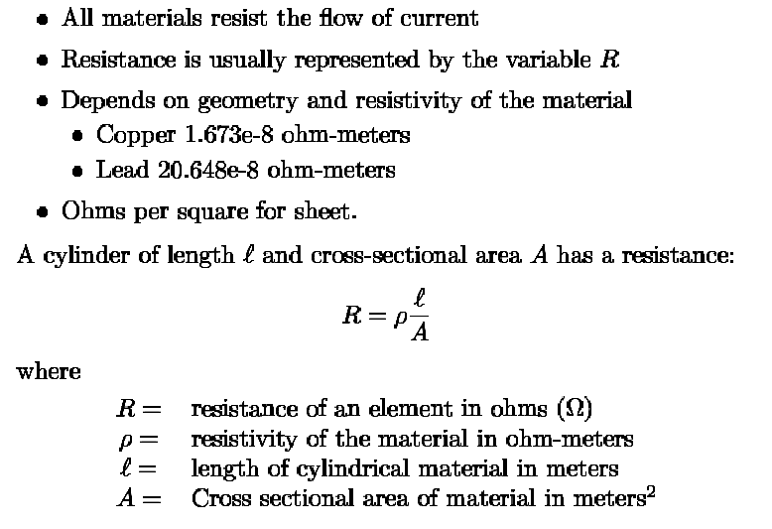
Resistance

Slide 6
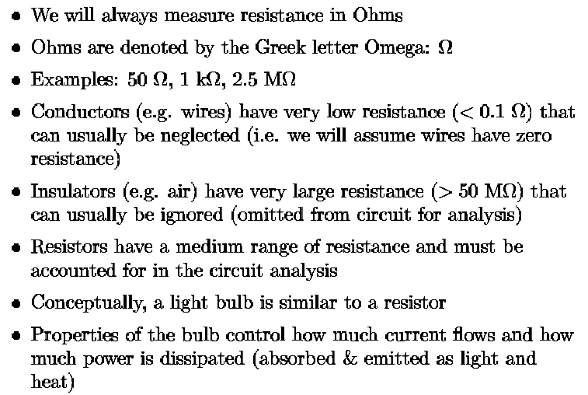
Resistance: Basic Concepts and Assumptions

Slide 7
Resistance
If we increase the voltage, we increase the current.
V is promotional to the I.
The constant of proportionality we call the resistance, R. V= I * R------------ Ohm’s law
Units R= V/I, ohms=Volts/Amp and I= V/R
The amount of resistance does not depends on the voltage or current. V=IR relates voltage to current.
If you double the voltage you will double the current, not change the resistance.
The amount of resistance depends on the material and shape of the wires.

Slide 8
Ohms Law
Materials in general have a characteristic behavior of resisting the flow of electric charge.
This physical property, or ability to resist current, is known as resistance and is represented by the symbol R.
The resistance of any material with a uniform cross-sectional area A depends on A and
its length l.

Slide 9
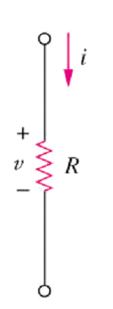
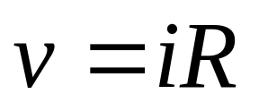
2.1 Ohms Law (1)
Ohm’s law states that the voltage across a resistor is directly proportional to the current I flowing through the resistor.
Mathematical expression for Ohm’s Law is as follows:
Two extreme possible values of R: 0 (zero) and ∞ (infinite) are related with two basic circuit concepts: short circuit and open circuit.

Slide 10
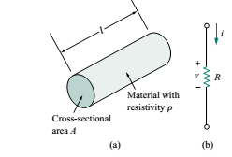

where ρ is known as the resistivity of the material in ohm-meters.
Good conductors, such as copper and aluminum, have low resistivity's While insulators, such as mica and paper, have high resistivity's.

Slide 11
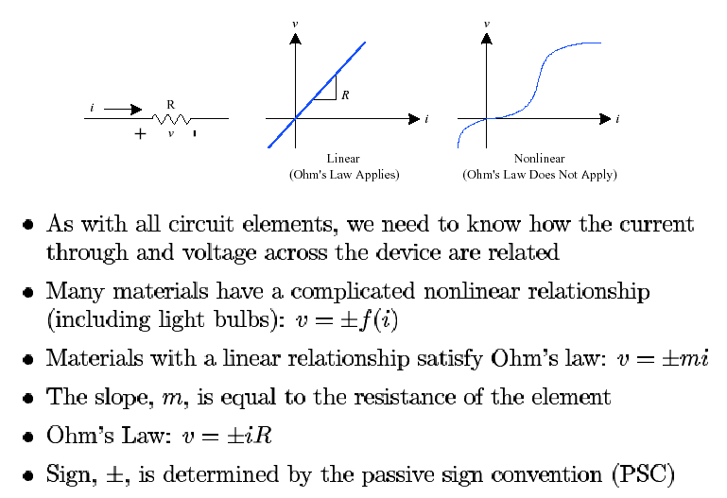
Ohm’s Law

Slide 12
Ohms Law
Ohm’s law states that the voltage v across a resistor is directly proportional to the current i flowing through the resistor. v ∝ I
Ohm defined the constant of proportionality for a resistor to be the resistance, R. (The resistance is a material property which can change if the internal or external conditions of the element are altered, e.g., if there are changes in the temperature.)

Slide 13
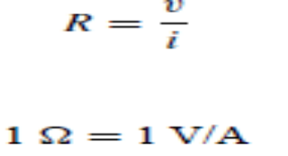
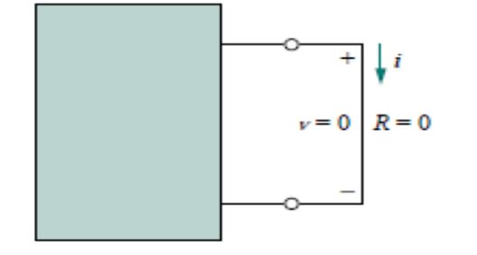
The resistance R of an element denotes its ability to resist the flow of electric current; it is measured in ohms.

Slide 14
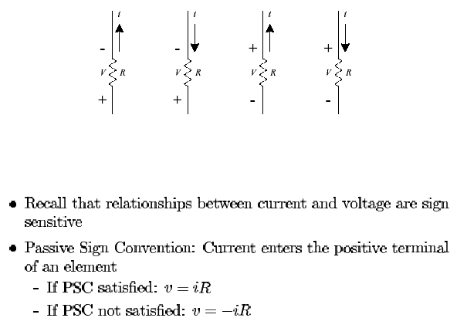
Resistors & Passive Sign Convention

Slide 15
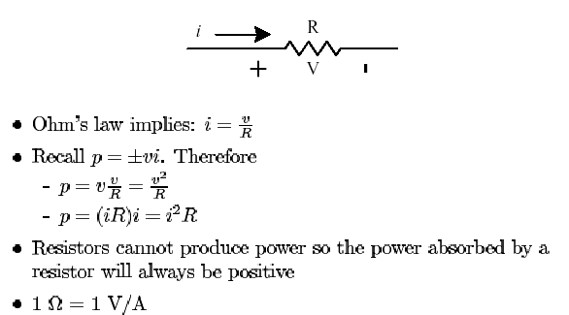
Other Eq. derived from Ohm’s Law

Slide 16
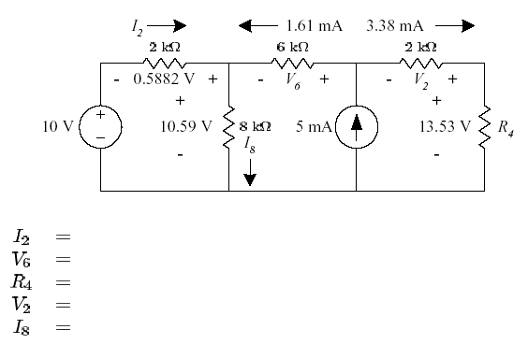
Example: Ohm’s Law

Slide 17

An electric iron draws 2 A at 120 V. Find its resistance.

Slide 18
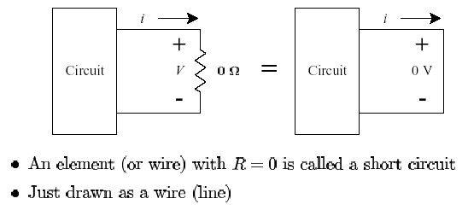
Short Circuit as Zero Resistance

Slide 19
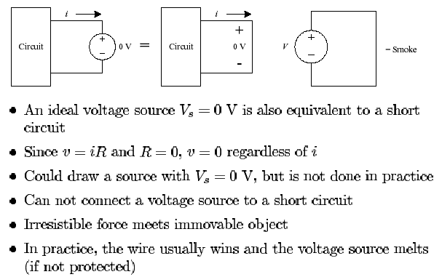
Short Circuit as Voltage Source (0V)

Slide 20
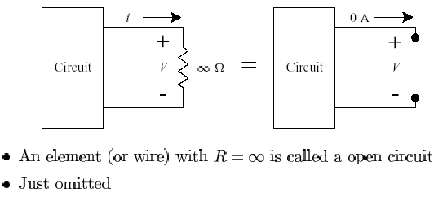
Open Circuit

Slide 21
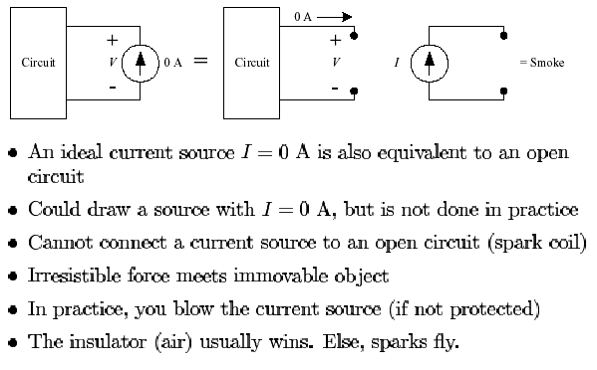
Open Circuit as Current Source (0 A)

Slide 22
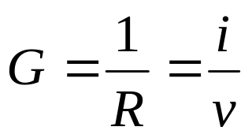
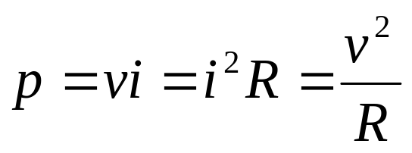
2.1 Ohms Law (2)
Conductance is the ability of an element to conduct electric current; it is the reciprocal of resistance R and is measured in mhos or siemens.
The power dissipated by a resistor:

Slide 23
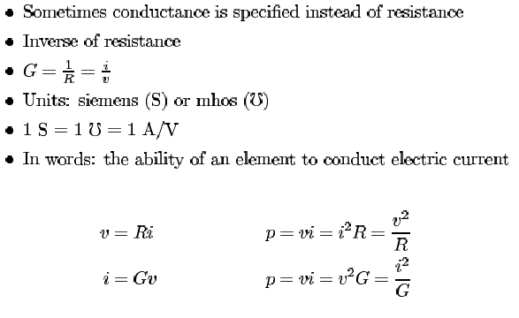
Conductance

Slide 24
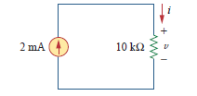

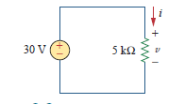
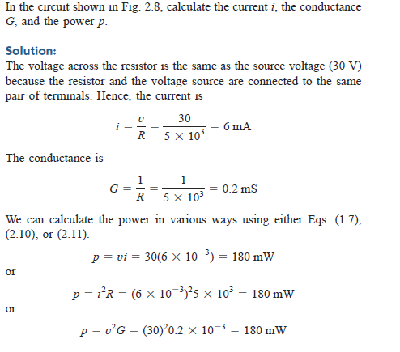

Slide 25

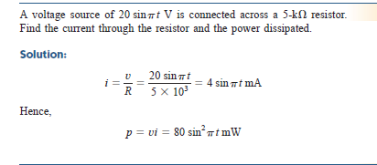

For the circuit shown in Fig. 2.9, calculate the voltage v, the conductance G, and the power p.
G= i/R , V= iR , p=vi
Answer: 20 V, 100 mS, 40 mW.

Slide 26
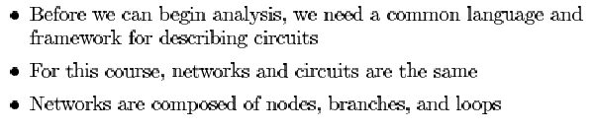
Circuit Building Blocks

Slide 27
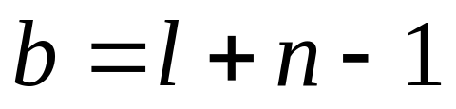
2.2 Nodes, Branches and Loops (1)
A branch represents a single element such as a voltage source or a resistor.
A node is the point of connection between two or more branches.
A loop is any closed path in a circuit.
A network with b branches, n nodes, and l independent loops will satisfy the fundamental theorem of network topology:

Slide 28
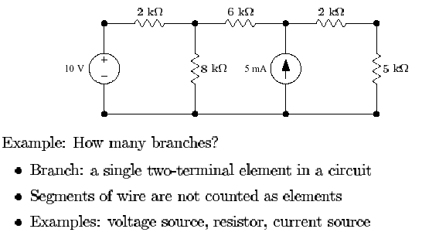
Branches

Slide 29
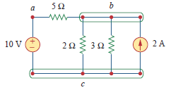

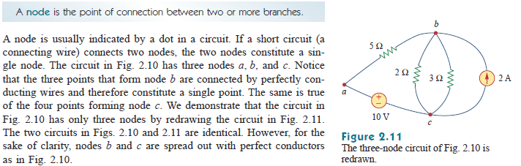

Nodes, branch & loop

Slide 30
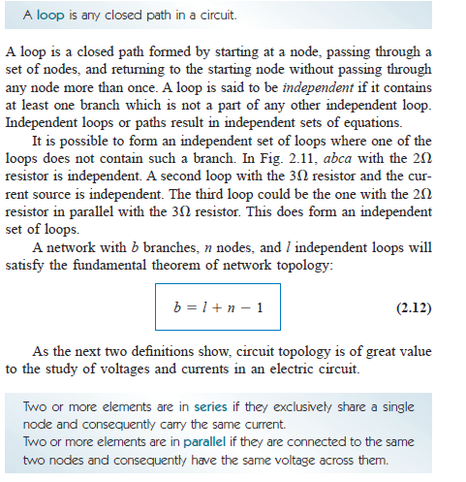
loops

Slide 31
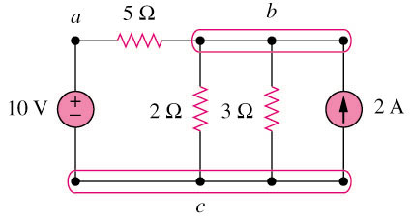
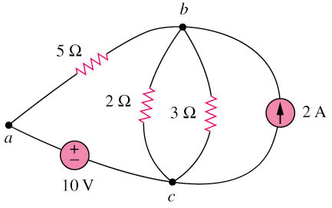
2.2 Nodes, Branches and Loops (2)
Example 1
Original circuit
Equivalent circuit
How many branches, nodes and loops are there?

Slide 32
For example, the closed path abca containing the 2 resistor in Fig. 2.11 is a loop.
Another loop is the closed path bcb containing the 3-resistor and the current source.
Although one can identify six loops in Fig. 2.11, only three of them are independent.

Slide 33
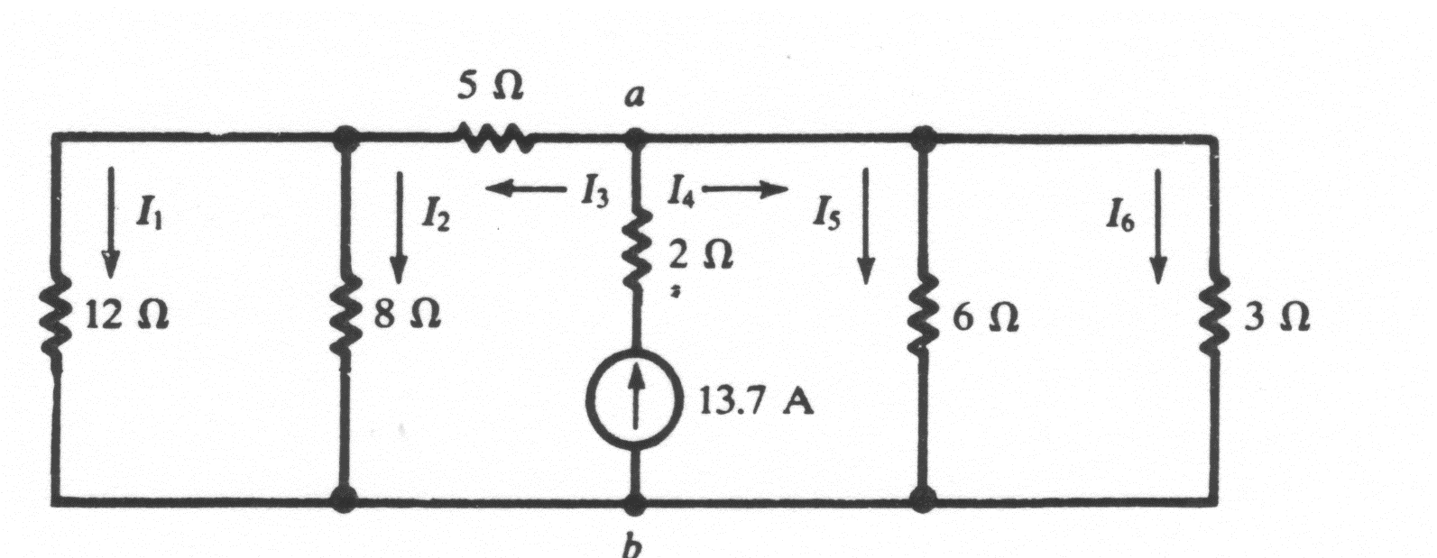
2.2 Nodes, Branches and Loops (3)
Example 2
Should we consider it as one branch or two branches?
How many branches, nodes and loops are there?

Slide 34
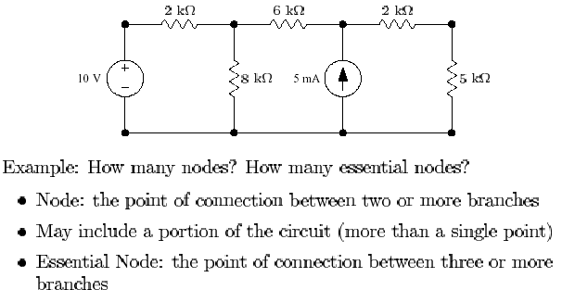
Nodes

Slide 35
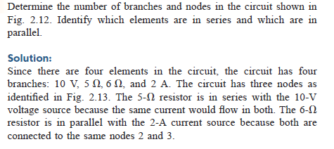
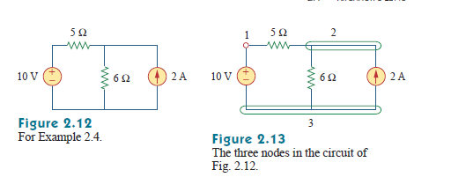

Slide 36
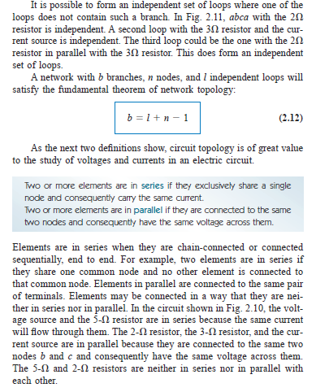

Slide 37
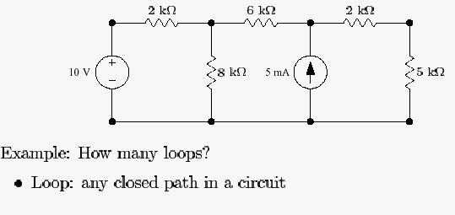
Loops

Slide 38
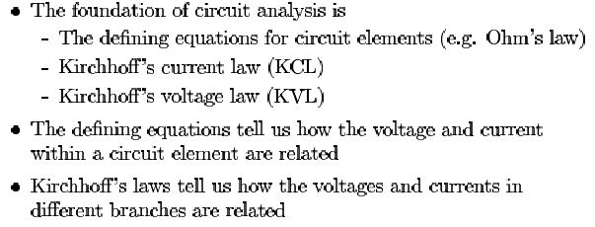
Overview of Kirchhoff’s Laws

Slide 39
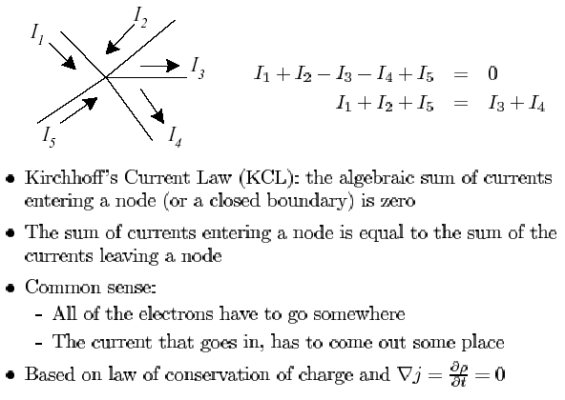
Kirchhoff’s Current Law

Slide 40
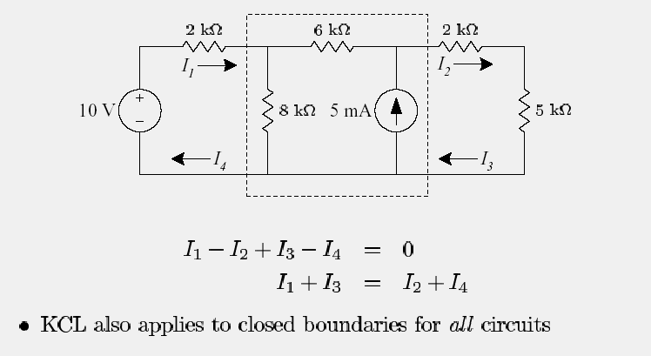
Kirchhoff’s Current Law for Boundaries

Slide 41
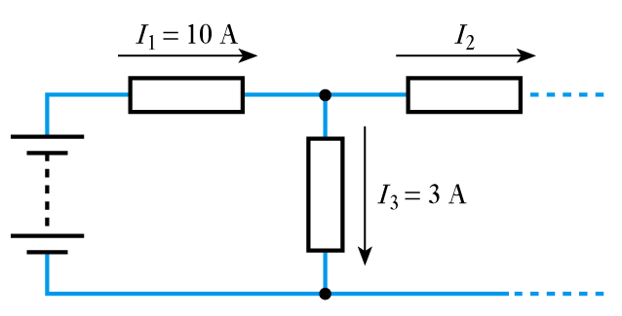
Cont…
At any instant the algebraic sum of the currents flowing into any junction in a circuit is zero
I₁ – I₂ – I₃ = 0
I₂ = I₁ – I₃
= 10 – 3
= 7 A

Slide 42
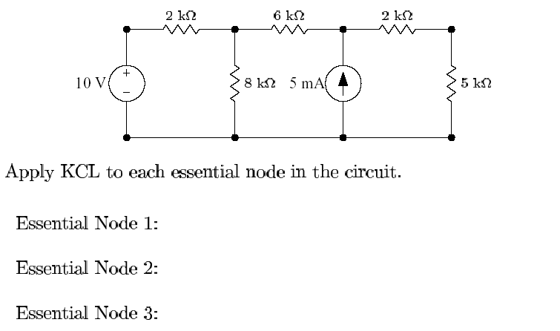
KCL - Example

Slide 43
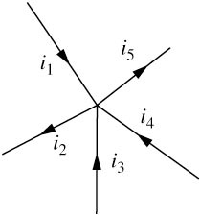
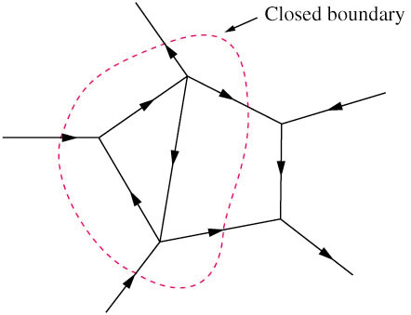
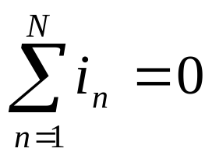
2.3 Kirchhoff’s Laws (1)
Kirchhoff’s current law (KCL) states that the algebraic sum of currents entering a node (or a closed boundary) is zero.
Mathematically,

Slide 44
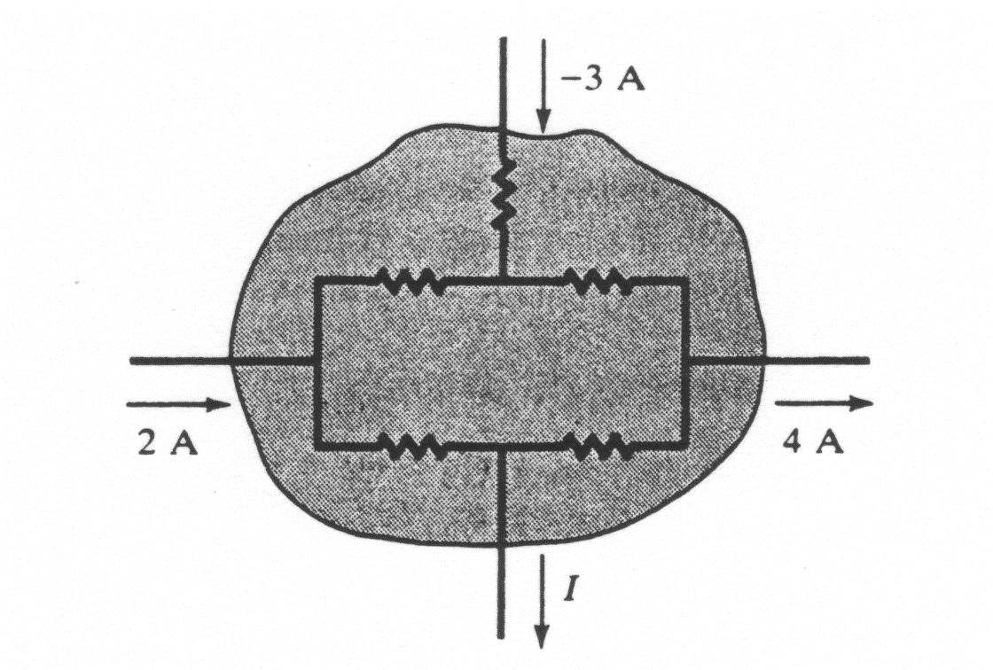
2.3 Kirchhoff’s Laws (2)
Example 4
Determine the current I for the circuit shown in the figure below.
I + 4-(-3)-2 = 0
I = -5A
This indicates that the actual current for I is flowing in the opposite direction.
We can consider the whole enclosed area as one “node”.

Slide 45
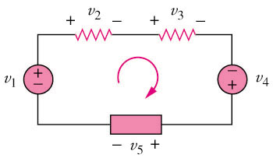

2.3 Kirchhoff’s Laws (3)
Kirchhoff’s voltage law (KVL) states that the algebraic sum of all voltages around a closed path (or loop) is zero.
Mathematically,

Slide 46
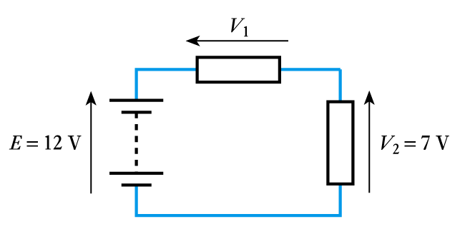
At any instant the algebraic sum of the voltages around any loop in a circuit is zero
For example
E – V₁ – V₂ = 0
V₁ = E – V₂
= 12 – 7
= 5 V

Slide 47
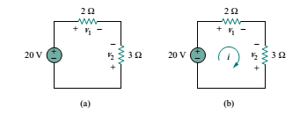
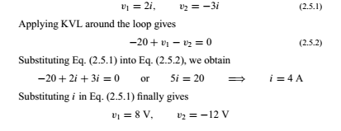
For the circuit find voltage v1 and v2
Solution:
To find v1 and v2, we apply Ohm’s law and Kirchhoff’s voltage law Assume that current i flows through the loop From Ohm’s law,

Slide 48
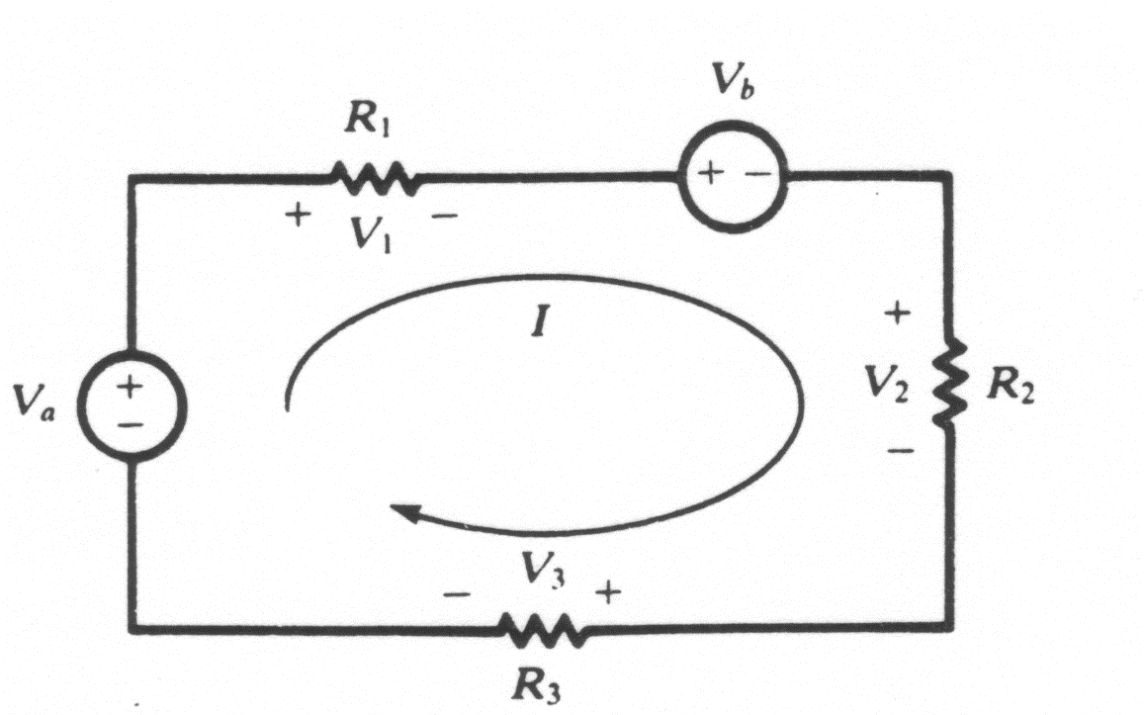

2.3 Kirchhoff’s Laws (4)
Example 5
Applying the KVL equation for the circuit of the figure below.
v_{a}-v₁-v_{b}-v₂-v₃ = 0
V₁ = IR₁ v₂ = IR₂ v₃ = IR₃
v_{a}-v_{b} = I(R₁ + R₂ + R₃)

Slide 49

Find the currents and voltages in the circuit
Solution:
We apply Ohm’s law and Kirchhoff’s laws. By Ohm’s law,
v1 = 8i1 , v2 = 3i2, v3 = 6i3 (2.8.1)
Since the voltage and current of each resistor are related by Ohm’s
law as shown, we are really looking for three things: (v1 , v2, v3) or
(i1 , i2, i3). At node a, KCL gives
i1 − i2 − i3 = 0 (2.8.2)
Applying KVL to loop 1 as in Fig. 2.27(b),
−30 + v1 + v2 = 0

Slide 50


Slide 51


2.4 Series Resistors and Voltage Division (1)
Series: Two or more elements are in series if they are cascaded or connected sequentially and consequently carry the same current.
The equivalent resistance of any number of resistors connected in a series is the sum of the individual resistances.
The voltage divider can be expressed as

Slide 52

Resistors in Series

Slide 53
2.4 Series Resistors and Voltage Division (1)
Example 3
10V and 5Ω are in series

Slide 54


Definition . Series: Two or more elements are in series if they are cascaded or connected sequentially and consequently carry the same current.
Definition Parallel: Two or more elements are in parallel if they are connected to the same two nodes and consequently have the same voltage across them.
Elements may be connected in a way that they are neither in series nor in parallel.
Example How many branches and nodes does the circuit in the following gure have? Identify the elements that are in series and in parallel.

Slide 55


2.5 Parallel Resistors and Current Division (1)
Parallel: Two or more elements are in parallel if they are connected to the same two nodes and consequently have the same voltage across them.
The equivalent resistance of a circuit with N resistors in parallel is:
The total current i is shared by the resistors in inverse proportion to their resistances. The current divider can be expressed as:

Slide 56
2.5 Parallel Resistors and Current Division (1)
Example 4
2Ω, 3Ω and 2A are in parallel

Slide 57

Resistors in Parallel

Slide 58

Resistors in Parallel

Slide 59

Voltage Divider

Slide 60

Current Divider

Slide 61


Slide 62

Delta ←→ Wye Transformations

Slide 63

Delta ←→ Wye Transformations

Slide 64

Example –
Delta ←→ Wye Transformations

Slide 65







2.6 Wye-Delta Transformations
Delta -> Star
Star -> Delta

Slide 66


Slide 67

Circuit Symbols

