Slide 1
Date A-Scientist Project
Machine Learning Fundamentals
Natallia Birukova
December 10, 2018

Slide 2

Table of Contents
Exploration of the Dataset
Question(s) to Answer
Augmenting the Dataset
Classification Approaches
Conclusions

Slide 3
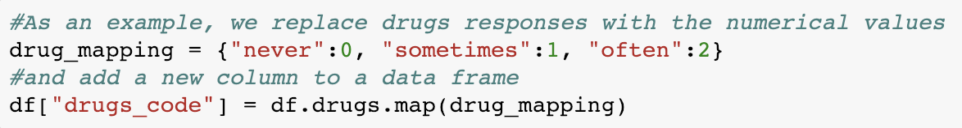
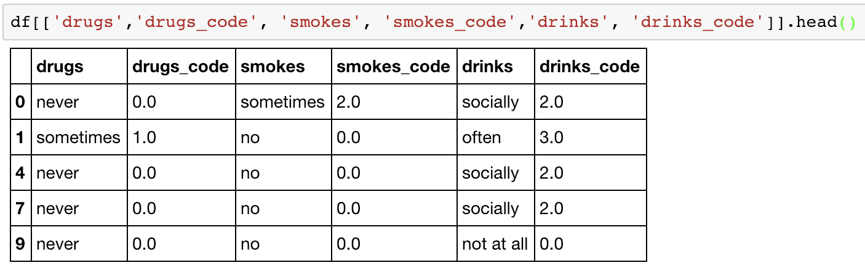
Exploring Data Set
Our data set mostly contains categorical data. To perform future analysis we will add new columns by converting categorical data into numbers.Here is the code and result.

Slide 4
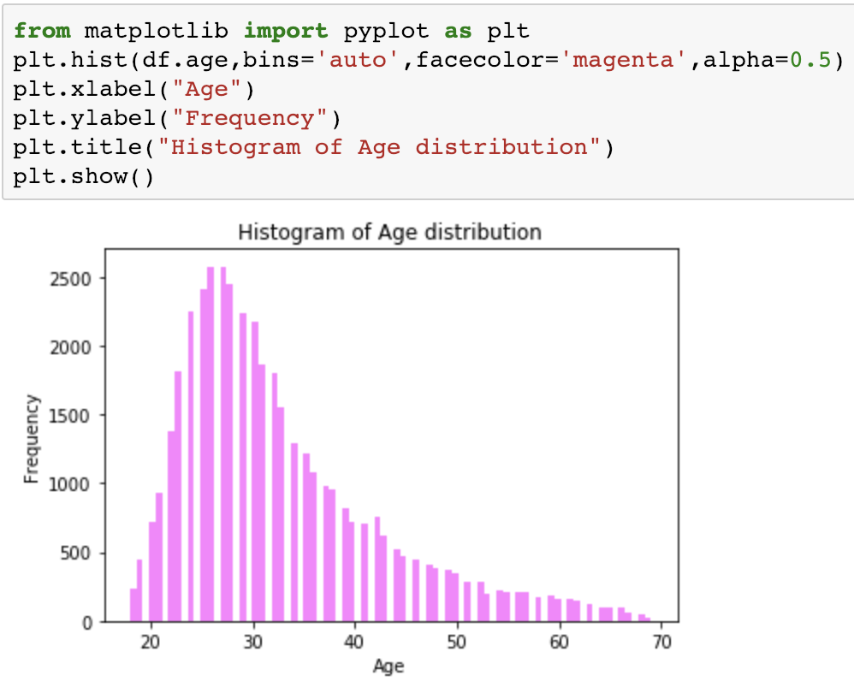
Lets make some graphs
Here we create histogram of Age that shows us that the majority of people in our data set are about 28 years old. Perfect time for dating!

Slide 5
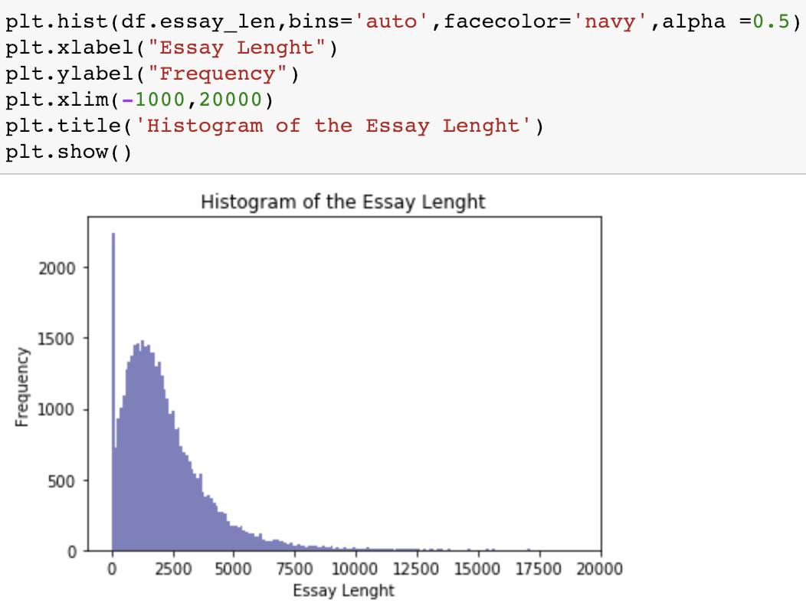
Lets make some graphs
Here we create a histogram of Essays Length that shows us that among people who wrote essays, the essay length was under 2500. Outlier shows as that there were people who didn’t write any essays

Slide 6
Can we predict Gender knowing someone’s Orientation, Diet and Height?
We will use Classification technique - KNN ALGORITHM to answer this question
GENDER = ORIENTATION + HEIGHT + DIET

Slide 7

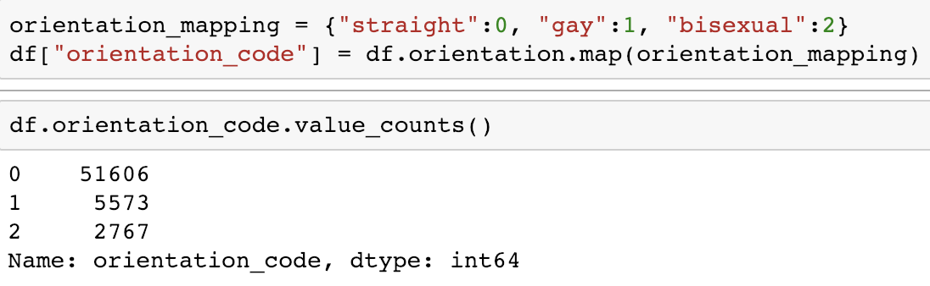
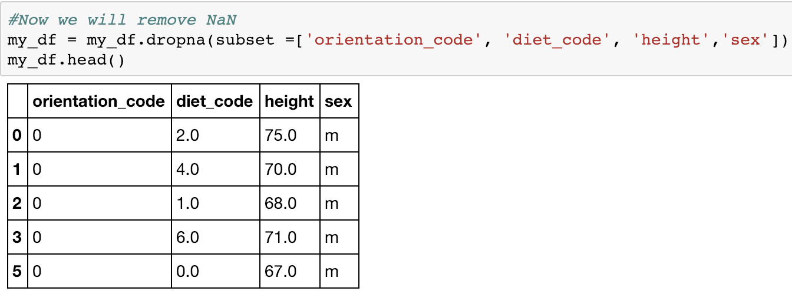
First, we will convert orientation and diet variable into numerical values using mapping
Here we clean our data from NaN values

Slide 8
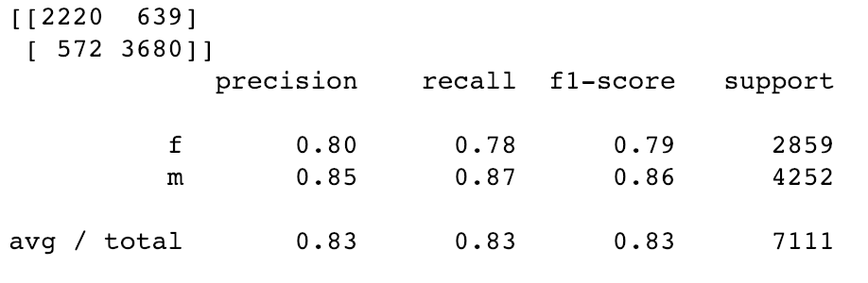
#Here we will split our dataset into its attributes and labels.
X = my_df.iloc[:, :-1].values
y = my_df.iloc[:, 3].values
#Here we create training 80% and test 20% splits
X_train, X_test, y_train, y_test = train_test_split(X, y, test_size=0.20)
#Here we will train our KNN algorithm and make a prediction on the test data with n equal to 3 for now.
classifier = KNeighborsClassifier(n_neighbors=3)
classifier.fit(X_train, y_train)
y_pred = classifier.predict(X_test)
#Now we will evaluate the Algorithm using confusion_matrix and classification_report methods of the sklearn.metrics
from sklearn.metrics import classification_report, confusion_matrix
print(confusion_matrix(y_test, y_pred))
print(classification_report(y_test, y_pred))
#Next, lets plot the K vs Error to see the best
value for K

Slide 9
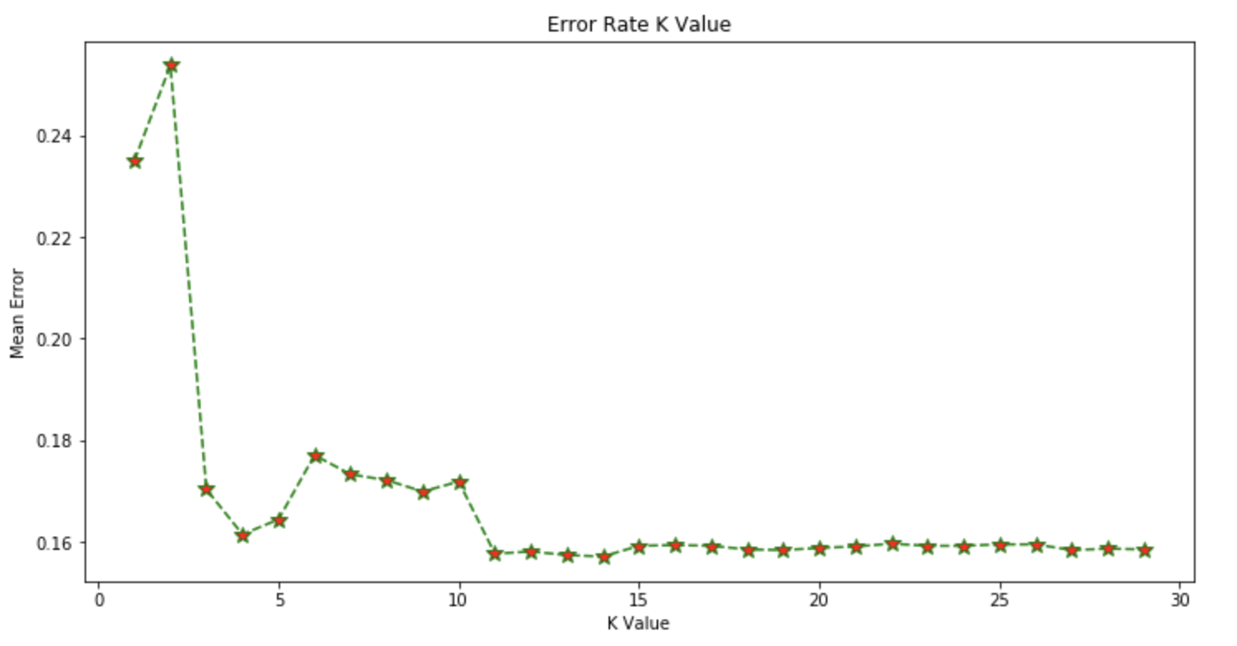

Slide 10
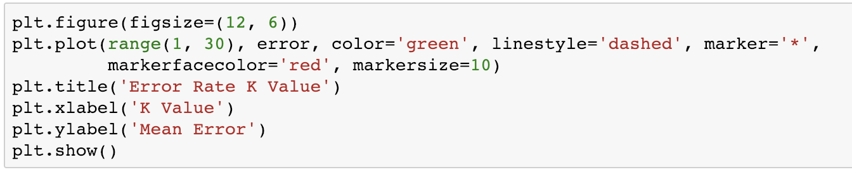
Here is the code that we use to create the plot:
Based on the graph, k=n is not the best option. We are looking for smaller error rate which appears to be when k is equal to 11 or 14. So, we will reran our Classifier with this values to see if the result of algorithm has improved

Slide 11
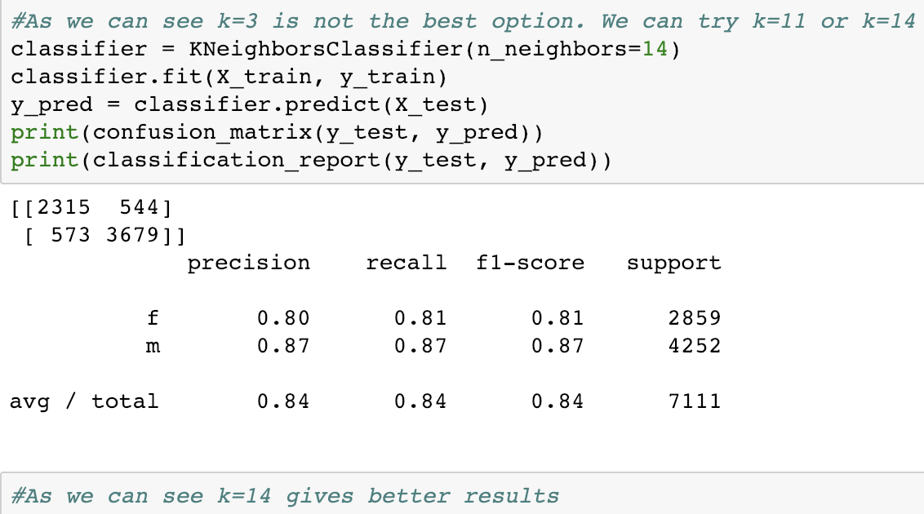

Slide 12
Can we predict Gender knowing someone’s Drug and Smoke Addiction?
We will use Support Vector Machine Algorithm to answer this question
GENDER = DRUGS + SMOKES

Slide 13
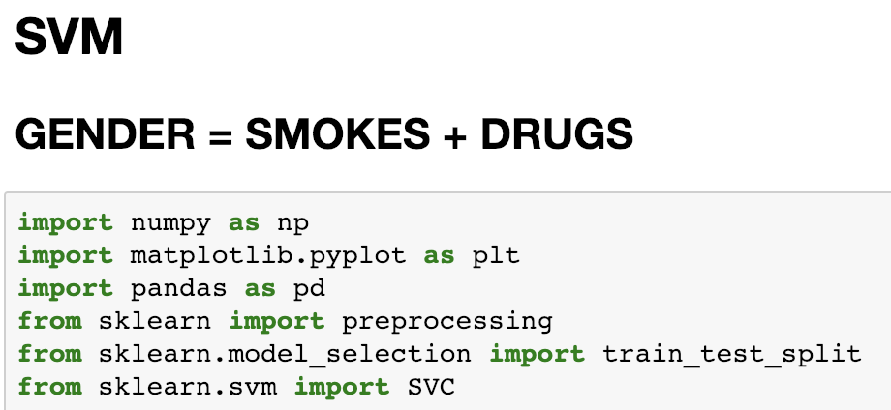
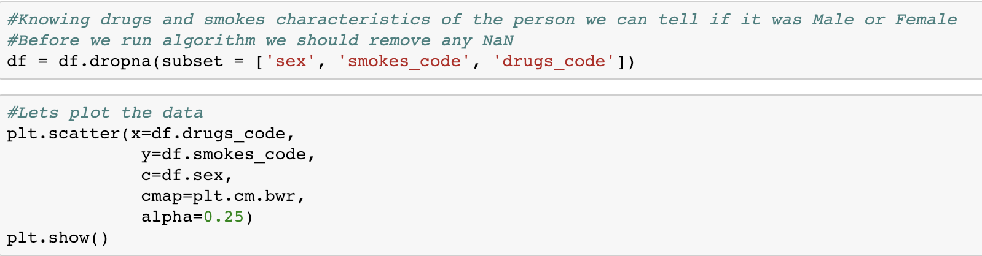
Here is how we start by importing SVC from SKLEARN

Slide 14
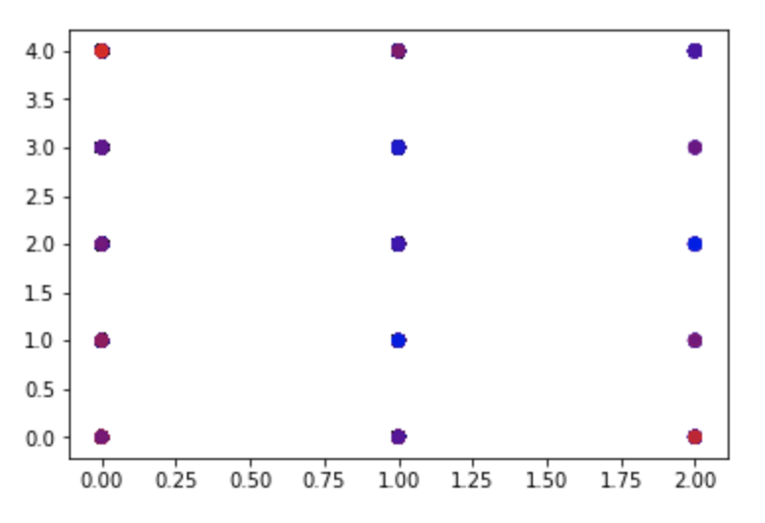
Here is our scatter of drugs _code and smokes_code on the map
Next lets run the SVC algorithm and see its score.

Slide 15
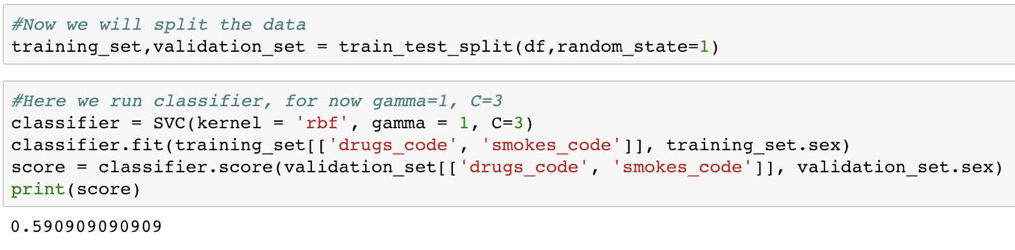
As we can see the score of the model is 0.59 which is not very impressive. We will try to find the best values for gamma and C that should improve the model performance. We will also see if there will any difference in run time.

Slide 16
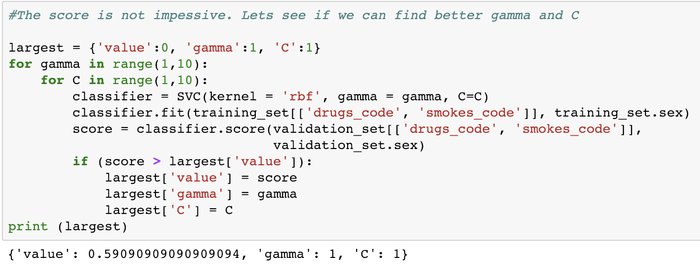
As we see the score almost didn’t change. However, the run time was about 30 min. Probably the range 1 to 10 is too large for my machine. It appears that is not easy to predict gender knowing drug and smoke addiction.

Slide 17
Thank you!

