Slide 1

Hotel Management System
Using MySQL (Relational) and MongoDB (NoSQL)
GROUP 7
ADDIS ABABA SCIENCE AND TECHNOLOGY UNIVERSITY
DEPARTMENT OF SOFTWARE ENGINEERING
May 2026

Slide 2
Group Members
No.
Name
ID
1
Beka Solomon
ETS 0242/17
2
Deborah Mesfin
ETS 0434/17
3
Biruk Molla
ETS 0336/17
4
Abreham Teshale
ETS 0076/17
5
Awach Awach Garang
ETS 1869/17
6
Gakeer Deng
ETS 1865/17

Slide 3
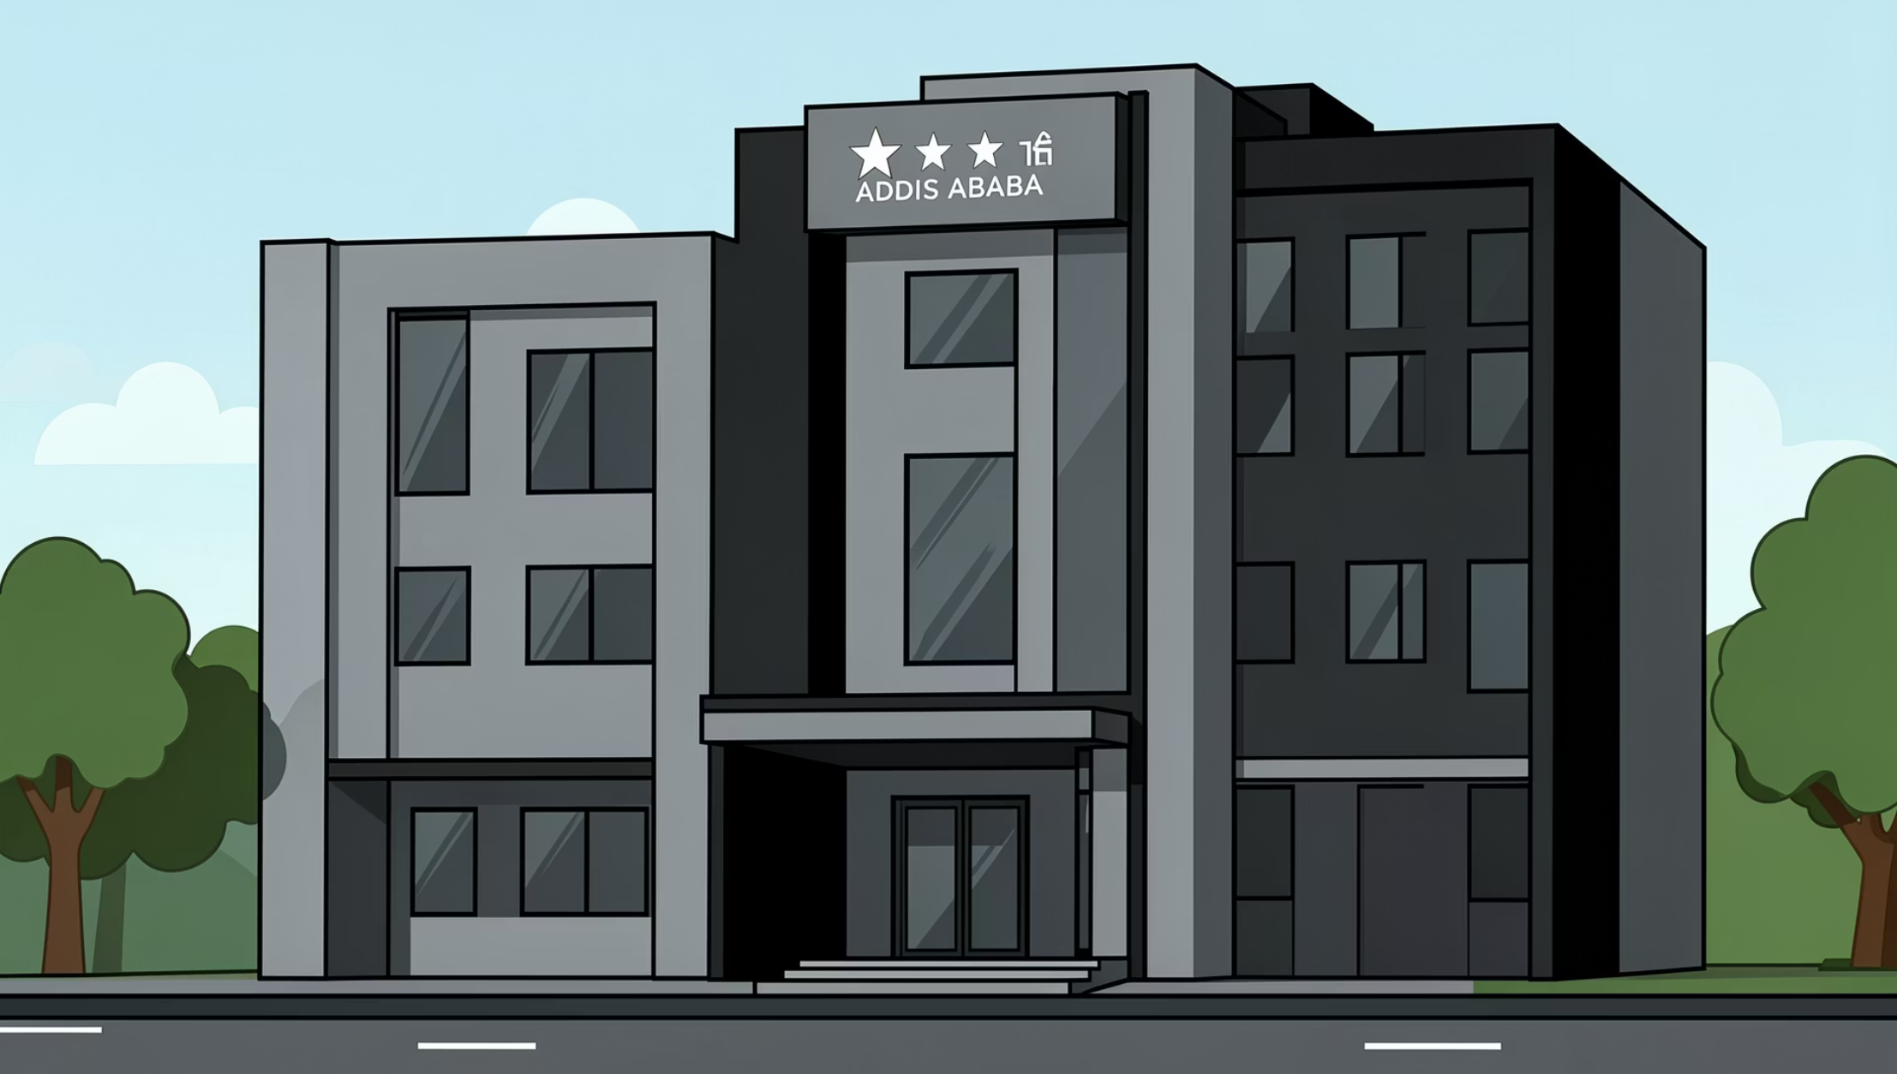
BACKGROUND
Introduction to Addis Grand Hotel
Addis Grand Hotel is a mid-sized 3-star hotel located in Addis Ababa, serving both business and leisure travellers. The hotel offers a range of accommodation options alongside dining and guest services, but currently relies on manual processes for day-to-day operations.
Accommodation
Services
Current System
Approximately 120 rooms across four categories: Single, Double, Deluxe, and Suite
Room service, basic restaurant services, and guest accommodation
Manual record-keeping and spreadsheets — no integrated digital management

Slide 4


Problem Statement
Addis Grand Hotel faces significant operational challenges due to its reliance on manual processes and spreadsheets, resulting in inefficiencies that directly impact guest satisfaction and revenue.
Double Bookings
Frequent booking conflicts due to lack of real-time availability tracking
Billing Errors
Manual errors in billing and payments causing financial discrepancies
Lost Records
Guest records are frequently lost or misplaced without a centralised system
Poor Satisfaction
Inefficient handling of guest feedback and room service orders leads to dissatisfaction and revenue loss

Slide 5
Objectives
General Objective
Specific Objectives
To design and implement a hybrid database system using MySQL and MongoDB for efficient hotel management at Addis Grand Hotel.
Design a normalised relational database in MySQL for structured hotel data
Use MongoDB for flexible, semi-structured data such as reviews and room service orders
Enable real-time room availability checking to prevent double bookings
Generate useful management reports for decision-making
Reduce manual errors and improve overall operational efficiency

Slide 6

System Architecture
The system adopts a hybrid database architecture, leveraging the strengths of both relational and NoSQL databases to handle different types of hotel data efficiently.
MySQL
Structured transactions: Bookings, Rooms, Payments
Hybrid Architecture
Application Layer
MongoDB
Unifies access, enforces business logic
Semi-structured data: Reviews, Room Service Orders
This hybrid approach combines the reliability and ACID compliance of MySQL for critical transactions with the schema flexibility of MongoDB for dynamic content, giving Addis Grand Hotel the best of both relational and NoSQL worlds.
MySQL
MongoDB
Hybrid Approach
Structured & Transactional Data
Flexible & Semi-structured Data
Best of Both Worlds
Bookings
Rooms
Payments
Guest Reviews
Room Service Orders
Relational integrity
NoSQL flexibility
Scalable design

Slide 7
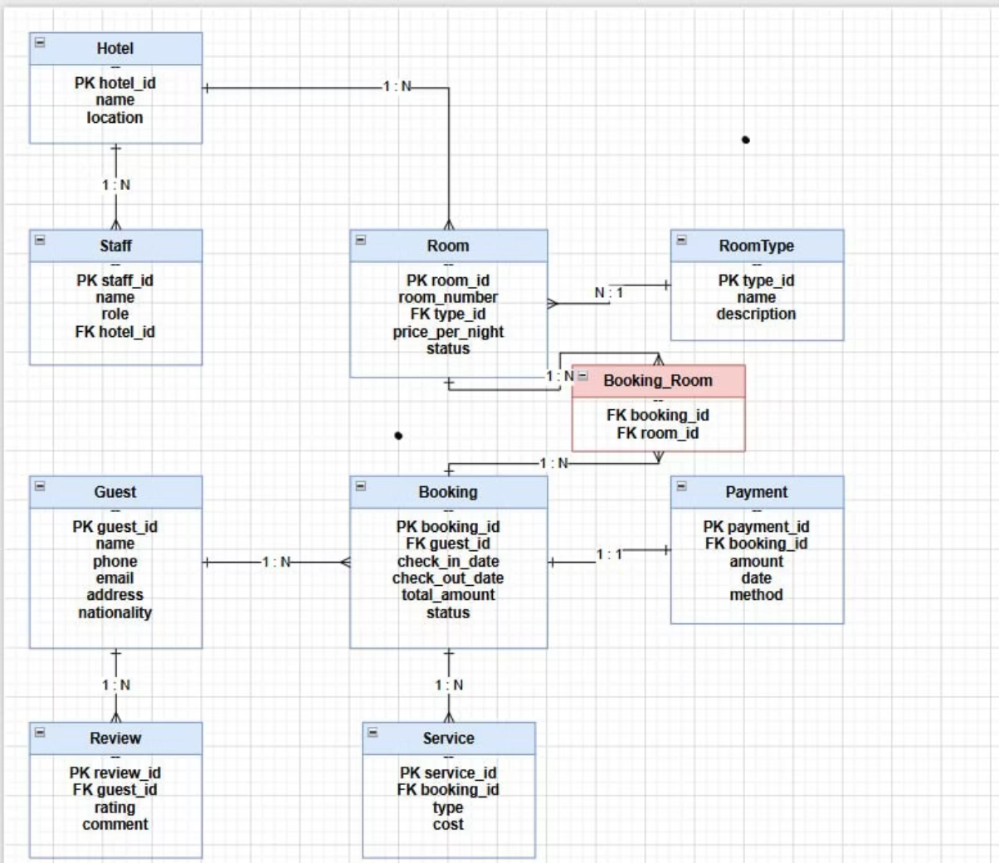
Entity Relationship Diagram
CORE DATABASE DESIGN
Key Entities & Relationships
The ER diagram models the core entities of the hotel management system and their relationships, forming the foundation of the MySQL relational database.
Guest ↔ Booking
Booking ↔ Room
Room ↔ RoomType
Booking ↔ Payment
One guest can have many bookings
Many-to-many via BookingRoom junction table
Many rooms belong to one room type
Each booking is linked to payment records

Slide 8

Database Design — MySQL
Main Tables Implemented
Normalisation
The MySQL database is structured around six core tables that capture all structured hotel data, from room inventory to guest payments.
The database schema is normalised up to Boyce-Codd Normal Form (BCNF), ensuring:
Elimination of data redundancy
Prevention of update, insert, and delete anomalies
Strong referential integrity across all tables
Efficient query performance for management reports
BCNF is a stricter version of 3NF, ensuring every determinant is a candidate key — ideal for transactional hotel data.
01
02
RoomType
Room
Defines categories: Single, Double, Deluxe, Suite
Individual room records linked to RoomType
03
04
Guest
Booking
Guest personal information and contact details
Reservation records with check-in/check-out dates
05
06
BookingRoom
Payment
Junction table resolving many-to-many relationship
Transaction records linked to bookings

Slide 9
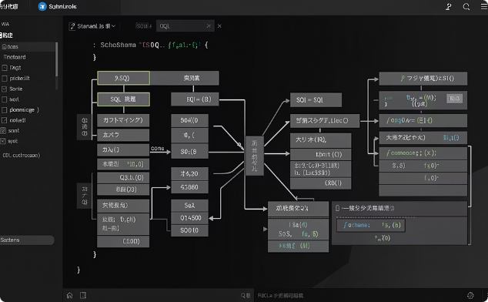
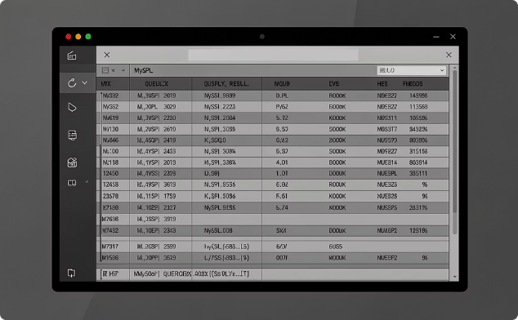

MySQL Implementation
The following screenshots demonstrate the practical implementation of the MySQL database, including table structures, sample queries, and their results.
Table Structure (schema.sql)
Sample Queries & Results
Key Features
Screenshots of the SQL schema showing table definitions, data types, primary keys, foreign keys, and constraints for all six main tables.
Demonstration of key SQL queries including booking lookups, availability checks, and revenue calculations with their output results.
Booking management, revenue reports, and room availability — all powered by structured MySQL queries against the normalised schema.

Slide 10
SLIDE 10
MongoDB Implementation
A NoSQL document database was integrated to handle the hotel's semi-structured and dynamic data needs, complementing the relational MySQL backbone.
Collections
reviews
roomServiceOrders
guestFeedback
Stores guest reviews with ratings, comments, and tags
Tracks ordered items and order status for in-room dining
Captures structured and unstructured guest feedback
Strengths of MongoDB Used
Flexible Schema
Array Support
Fast Aggregation Queries
Reviews can store ratings, comments, and tags without rigid structure
Ordered items in room service are naturally stored as embedded arrays
Efficiently computes metrics like Average Rating across large datasets

Slide 11

SLIDE 11
Sample Results
The hybrid database system delivers meaningful operational insights across both relational and document-based data stores.
MySQL Reports
MongoDB Reports
Revenue Report
Occupancy Report
Average Hotel Rating
Recent Reviews
Aggregated financial data across rooms, services, and bookings
Latest guest feedback with comments, tags, and star ratings
Room occupancy rates, trends, and availability summaries
Real-time aggregated guest rating scores from review documents
Insert relevant screenshots here to demonstrate live report outputs from both database systems.

Slide 12
SLIDE 12
Benefits & Achievements
The hybrid database implementation has delivered measurable improvements across all areas of hotel operations at Addis Grand Hotel.
Real-Time Room Availability
Reduced Double Bookings
Accurate Billing & Reporting
Instant visibility into room status eliminates manual lookup delays
Automated conflict detection prevents reservation overlaps
Structured relational data ensures precise financial records
Better Guest Feedback Management
Improved Operational Efficiency
Flexible MongoDB schema captures rich, varied guest opinions
Streamlined workflows reduce manual effort across departments

Slide 13
SLIDE 13
Conclusion & Future Work
Conclusion
Future Work
The hybrid database system successfully addresses the limitations of the current manual system at Addis Grand Hotel. By combining MySQL's structured reliability with MongoDB's schema flexibility, the solution delivers a robust, scalable foundation for modern hotel management.
01
Web-Based Frontend
Develop a responsive UI for staff and guests
02
User Authentication & Roles
Implement secure login with role-based access control
03
Real-Time Notifications
Alert staff instantly on bookings, requests, and updates
04
Online Payment Gateway
Integrate secure digital payment processing
Thank You! Questions?

