Slide 1
ASSA SYSTEM
Smart Fisheries Monitoring & Digital Fish Market System
A Unified Relational Platform for Resource Enforcement and Digital Fish Commerce
Software Engineering Internship Presentation Presenter: Software Engineering Intern Scope: Lake Tana, Lake Ziway, and Lake Hawassa, Ethiopia
Notes:
Good morning, members of the jury and supervisors. Today, I am presenting my internship project, ASSA. ASSA is an integrated, three-module software ecosystem built to automate ecological regulation, fleet tracking, and seafood trading across three of Ethiopia's primary lakes. During my time, I focused on bringing production-grade security, database reliability, geospatial check validations, and real-time monitoring streams into this platform. Today, I will walk you through the architecture, the technical decisions behind it, my specific contributions, and the real-world engineering challenges I addressed.

Slide 2
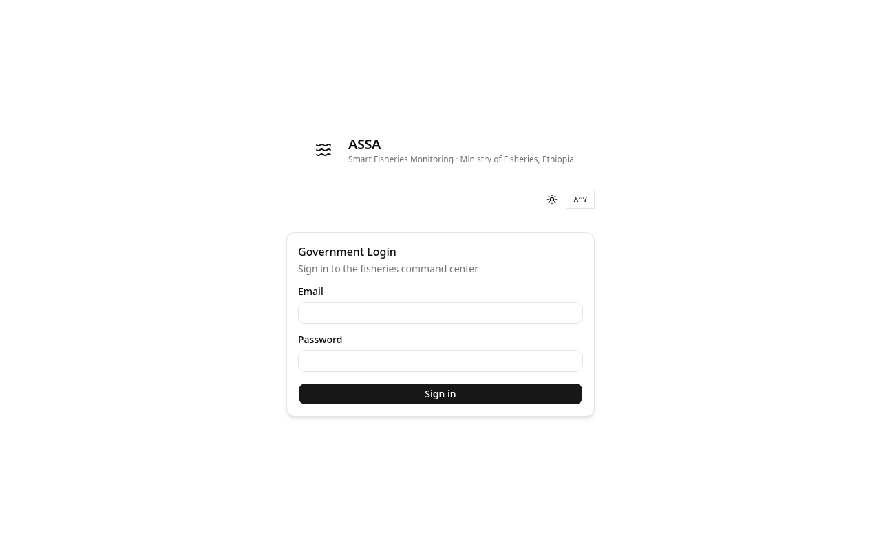
Project & Context Overview
Unified Operations Scope
Coordinating commercial and regulatory monitoring across Lake Tana, Lake Ziway, and Lake Hawassa in Ethiopia.
Admin Command Center (Port 3001)
Central dashboard displaying live telemetry, catches, market metrics, zone rules configuration, and user onboarding.
Fisher Mobile App (Port 3002)
Mobile-first portal for fishers to activate boat trips, log catches with GPS markers, and display license QR keys.
Digital Fish Market (Port 3003)
E-commerce marketplace display showing species listings, price trends, and order bookings.
Modular Express Backend (Port 4000)
REST API and in-memory Server-Sent Events (SSE) broadcaster connecting to a relational datastore.
Notes:
Let's begin with the overall context. The ASSA system consists of three frontend React modules communicating with a central Express API backend. The Admin Dashboard acts as the Command Center for government supervisors. The Fisher Mobile App acts as the field registration portal for fishers on the lake. The Fish Market acts as a transparent, buyer-facing retail system. This architecture ensures that every single stakeholder in the fisheries ecosystem—from the local fisher on a boat to the regional administrator in Bahir Dar—shares a single source of truth in real-time.

Slide 3
Problem Statement
1. Ecological Depletion Risks
Lack of real-time monitoring on species take. Regulatory bodies previously had zero visibility into aggregate monthly limits, risking overfishing of key endemic species.
2. Enforcement Blindspots
Inspectors had no automated means to check if catches were logged in allowed fishing zones or illegally hauled inside protected breeding and ecotourism grounds.
3. Commercial Friction & Price Opacity
Fishers faced highly volatile prices and lacked direct market access, causing delay and inventory loss for their highly perishable catches.
4. Prototype Database & Tracing limits
Early application iterations suffered from SQLite write-locking bottlenecks under high-concurrency loads and lacked trace request correlation for operational debugging.
Notes:
The project addresses four primary problems. First, is ecological overfishing. Without direct catch-limits monitoring, regulatory bodies cannot enforce species quotas effectively. Second, are enforcement blindspots. Inspectors could not verify if a vessel logged its catches from allowed or prohibited breeding zones. Third, is market friction. Fishers lack transparent market access, causing delay and loss of fresh inventory. Fourth, from a systems engineering perspective, early prototypes suffered from database locking, session vulnerability, and lacked logging correlation.

Slide 4
System Objectives
Automate Telemetry & Tracking
Log active boat trips and accumulate continuous coordinate coordinates to trace vessel paths on interactive maps.
Geospatial Boundary Verification
Implement mathematical polygon checks on incoming catch submissions to enforce protected zones automatically.
Enforce Active Species Quotas
Halt catches approval at the application level inside database write transactions if monthly limits are breached.
Production Hardening
Deploy request trace correlation, session capping, failed login lockouts, and deep detailed diagnostic heartbeats.
Notes:
Based on the problem statement, our architectural objectives were clear. We aimed to: build automated fleet telemetry to monitor boats during active trips; develop geospatial validation to verify that catches are logged in allowed coordinates; enforce species limits at the application level to prevent ecological depletion; and secure the entire codebase with correlation log tracing, rate-limit boundaries, and comprehensive uptime diagnostics.

Slide 5
Tech Stack & System Layers
1. UI Presentation Layer
React.js Single Page Applications built on Vite for rapid compilation. Styled with custom modular CSS and Leaflet maps layers.
• Leaflet & OpenStreetMap for telemetry
• i18n Amharic + English localizations
2. Web Server & Connection Layer
Node.js and Express.js backend handling REST JSON communications and persistent SSE (Server-Sent Events) unidirectional data pipelines.
• Pino-HTTP correlation requests tracing
• Helmet production security headers
3. Business Service & Security Layer
Independent service modules managing cryptographic locks, mathematical coordinates checks, and schema transactions.
• Bcryptjs with 12 salt rounds
• HS256 access JWT + SHA-256 rotated refresh tokens
4. Relational Database Tier
PostgreSQL database accessed exclusively through the type-safe Prisma ORM Client, utilizing connection poolers and Cloudinary media buckets.
• Neon/Render serverless PostgreSQL
• Prisma Client atomic transactions
Notes:
The tech stack was selected for modularity and modern production standards. On the frontend, we use React.js built with Vite for quick, optimized bundles, alongside Leaflet for command map rendering. The backend runs on Node.js and Express.js, utilizing a PostgreSQL database connected through the Prisma ORM Client. Security is handled by Bcryptjs, jsonwebtoken, and express-rate-limit. For media assets, such as physical catch pictures, we integrate the Cloudinary API with local disk uploads as a safe fallback.

Slide 6
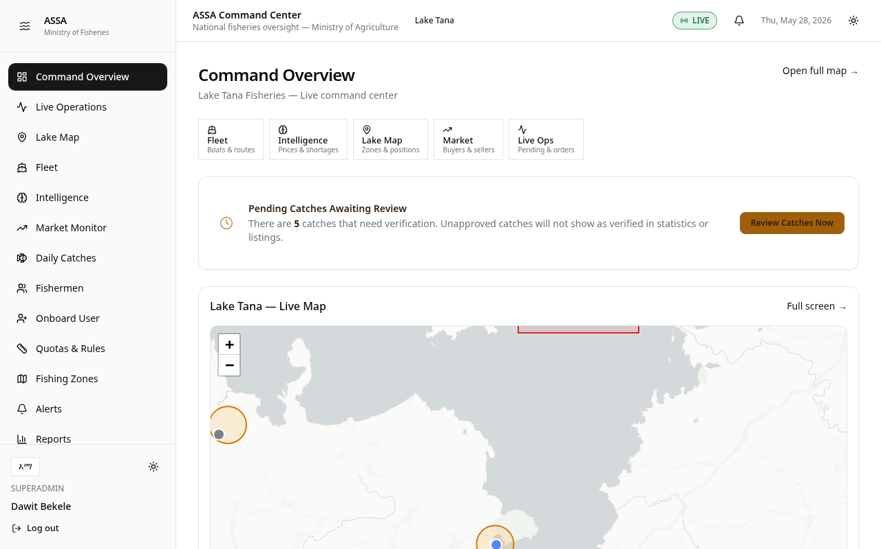
System Data Flow Architecture
Step 1: Active Trip Activation
Fisher registers and activates a boat trip, launching telemetry trackers.
Step 2: Catch logging & Coordinates verification
Fisher submits catch weight, species, and gear. Lat/Lng checked by server before setting status to 'PENDING'.
Step 3: Administrative transaction review
Admin audits details. System runs species quota verification; if allowed, catch is updated to 'VERIFIED' in a single transaction.
Step 4: Real-time listings publishing
Listing is automatically generated. The server broadcasts a 'listing.created' payload instantly to buyers via SSE.
Step 5: E-commerce order checkout
Buyer logs in, places order, decrements listing quantity available, and triggers audit log tracking.
Notes:
This slide illustrates the primary data flow architecture—what we call the 'Catch Lifecycle'. It begins when a fisher initiates a trip. GPS coordinates are logged. Once the catch is captured and logged, the backend evaluates the coordinates in real-time. If clean, it sits as 'PENDING' in the admin's queue. When approved, a database transaction validates the quota, updates the status to 'VERIFIED', creates a marketplace listing, and broadcasts a lightweight Server-Sent Event to all active buyer clients immediately.

Slide 7
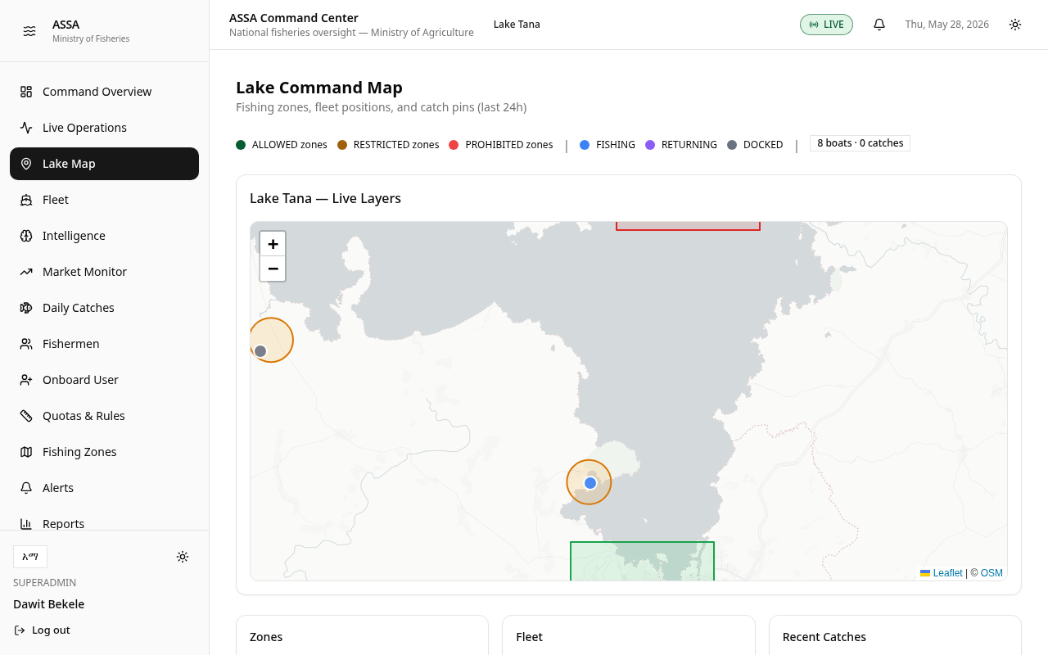
Geospatial Compliance Verification
Ray-Casting Point-in-Polygon Check
Verifies if the submitted device GPS coordinates fall inside designated allowed, restricted, or prohibited zone boundary polygons.
Haversine Trigonometric Fallback
If polygon vectors are absent, checks distance to center coordinates: d = 2R * arcsin( sqrt( sin²(Δlat/2) + cos(lat1)*cos(lat2)*sin²(Δlng/2) ) )
Mismatch & Violation Thresholds
Deviations >3 km trigger a 'GPS_MISMATCH' alert. Catch coordinates logged inside restricted or prohibited zones spawn immediate system alarms.
Notes:
A core technical component of the system is our geospatial compliance verification, located in `geo.service.js`. When a fisher submits a catch, the backend retrieves the zone coordinates. If a polygon is stored in the database, it applies a ray-casting Point-in-Polygon check. If the coordinates fall outside, or if a polygon is missing and the coordinate deviates more than 3 km from the zone center using the Haversine formula, the catch is flagged with a GPS mismatch warning, notifying inspectors of potential illegal boundary violations.

Slide 8
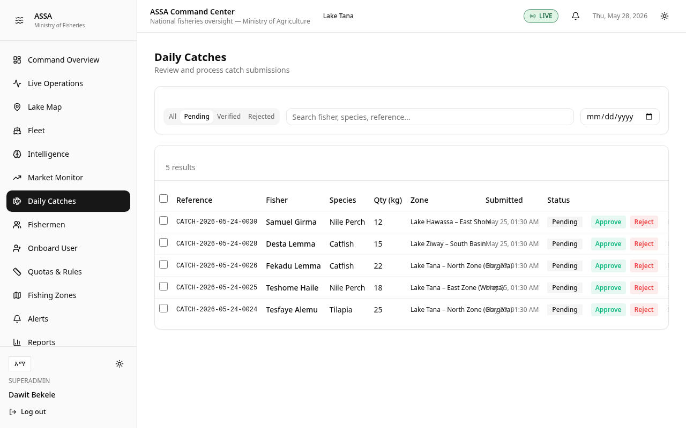
Quota Preservation & Closed Seasons
ACID transactional limits checking
Catches approvals are blocked ('HTTP 409 Conflict') before database commits if aggregate monthly species limit is breached.
Automated species warnings
Emits warnings and broadcasts events once catch weight reaches 90% of the species monthly limit.
Ecological closed-seasons rules
Dynamic zone season rules block approvals of protected species during spawning calendar ranges (e.g. Mecha closed zone rules).
Notes:
To prevent ecological collapse, I implemented application-level quota enforcement. When an admin attempts to approve a catch, the backend runs a projected weight check inside a database write transaction. If approving the catch exceeds the monthly quota limit, the API rejects the request with an HTTP 409 Conflict. Uptime safeguards also trigger warning alerts when a species' take reaches 90%, and lock out further approvals when it hits 100%.

Slide 9
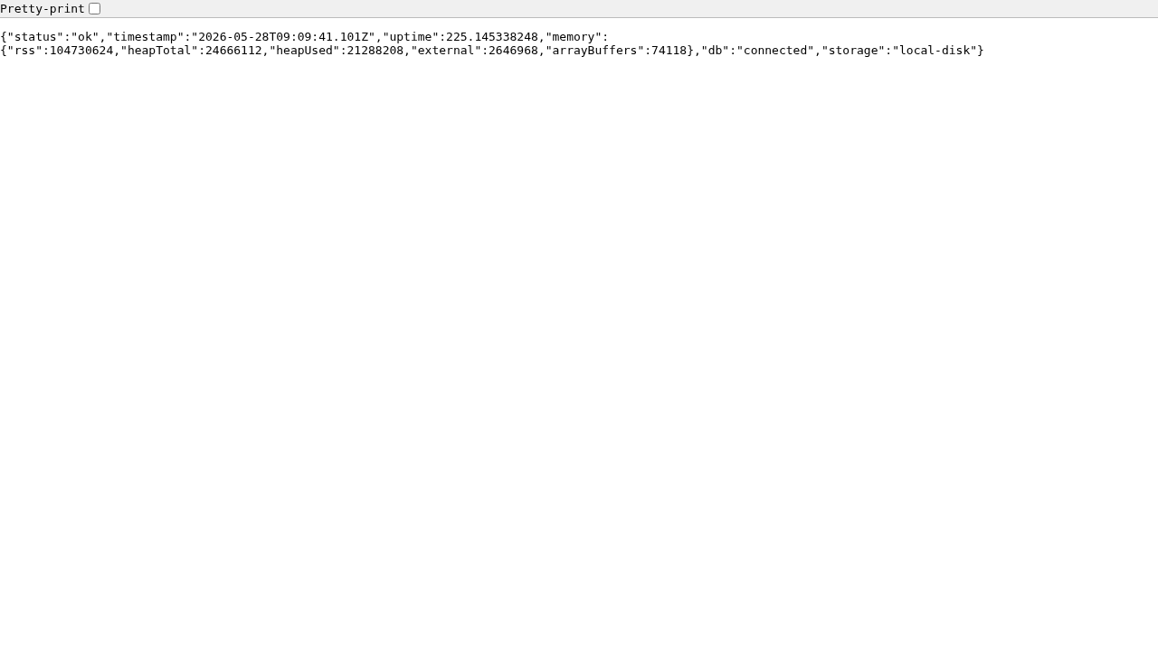
My Personal Contributions
Relational PostgreSQL Schema Migration
Designed, mapped, and executed complete migrations from SQLite to PostgreSQL database tables via Prisma ORM.
Token Rotation & Lockout Security
Coded HS256 JWT access controls and SHA-256 hashed refresh-token rotations, enforcing a cap of 5 active sessions per user and failed attempt lockouts.
Mathematical Geospatial Engine
Developed Point-in-Polygon calculations and Haversine center checking in 'geo.service.js' to identify border mismatch warnings.
Diagnostics endpoint implementation
Wrote '/api/health/detailed' assessing memory footprint, host uptime, server storage directories, and database pings.
Notes:
Here, I have summarized my specific contributions. I designed the PostgreSQL relational schema and handled migrations using Prisma ORM. I implemented the Refresh Token Rotation security pipeline, including brute-force login lockout guards. I coded the math behind the geospatial validation engine in `geo.service.js`. I engineered the ACID database transaction blocks that ensure quota check integrity, and I wrote the deep diagnostic health checks that allow operations teams to monitor memory and databases in real-time.

Slide 10
Technical Challenges Faced
1. Concurrency bottlenecks on SQLite
During live concurrent testing with automated seed inputs, SQLite's single-write locks caused API transaction failures and timeout errors.
2. Unbounded Session token storage footprint
Issuing a refresh token on every login created storage bloat risks over time, calling for a secure session-cap limit.
3. Unstable SSE connection streams
Fishers operating in remote Rift Valley regions faced frequent network drops, triggering client connection resets and missing real-time event alerts.
4. High GIS Database Overhead
Setting up complete PostGIS extensions was heavy and complex for localized lake boundary validation, demanding lightweight computational math.
Notes:
During development, I faced several key engineering challenges. First, our initial SQLite engine suffered from concurrency limits during high-volume testing. Second, issuing infinite refresh tokens created database storage bloat risks. Third, unstable network connections on Rift Valley lakes caused persistent SSE stream drops. Finally, we needed a lightweight method to check coordinate polygons without relying on high-overhead geospatial GIS database extensions.

Slide 11
Solutions Implemented
ACID-compliant PostgreSQL via Prisma
Migrated backend database services to PostgreSQL utilizing Prisma Client connection poolers and transactional write isolations to resolve concurrent timeouts.
Token session capping & lockout rules
Seeded a strict threshold of 5 active sessions per user; newer logins revoke oldest tokens. Lockouts trigger for 15 minutes after 5 failed login attempts.
Self-healing 'Last-Event-ID' stream recovery
Configured SSE stream clients to send a connection header query containing their last processed event ID. Upon reconnection, server queries the database and restream only missed events chronologically.
Runtime Point-in-Polygon check computations
Coded Ray-Casting algorithm directly inside the Node runtime context ('geo.service.js'), allowing lightweight zone validation without PostGIS database dependencies.
Notes:
To resolve these issues, we took four actions. We migrated to PostgreSQL using Prisma Client database transactions. We capped active refresh tokens to 5 per user to limit DB footprint, revoking the oldest ones upon a new login. We resolved SSE network drops by building a self-healing replay registry: if a client reconnects, it sends the last event ID, and the server restreams only the missed events. Finally, we wrote our own point-in-polygon math, eliminating the need for expensive GIS database extensions.

Slide 12
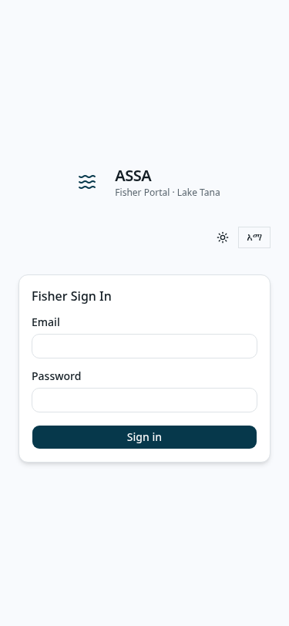
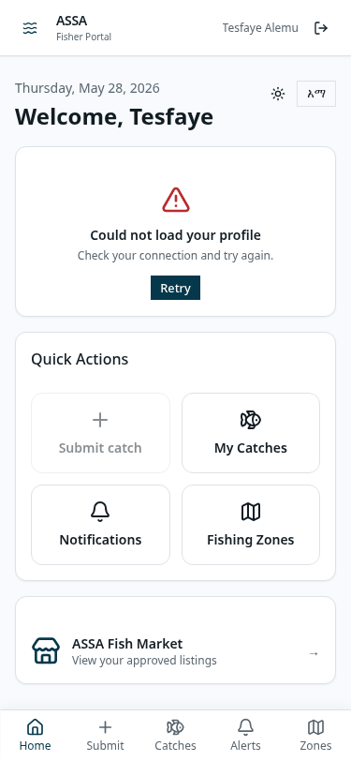
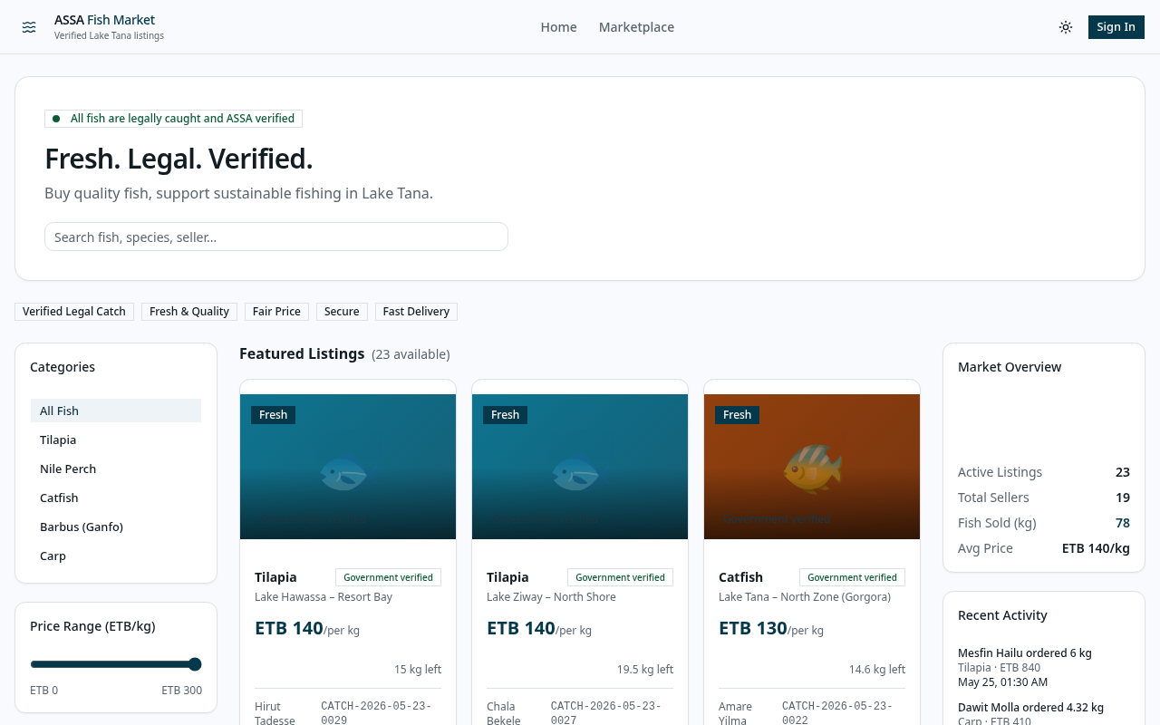
Demonstration Workflow
1. secure Mobile Login
Fisher logs into mobile application using VALID license parameters.
2. Boat trip activation
Active trip is started on the vessel, initiating coordinates loggers.
3. Catch registration
Submit Tilapia catch from Gorgora Allowed zone; Lng/Lat validated.
4. Central Audit & Market
Admin approves catches; digital marketplace listing updates instantly.
Notes:
This slide outlines our standard demonstration workflow. We log in as the fisher to start a trip and log a catch. Instantly, the admin command center alerts update via SSE. The admin reviews the catch, verifies that coordinates match Gorgora allowed zones, and clicks approve. The catch is immediately listed in the marketplace, where a buyer completes an order, triggering the quota deductions and updating our audit trail.

Slide 13
Technical Lessons Learned
Database Concurrency & ACID transaction isolations
Discovered the necessity of absolute write isolation when coordinating multi-row quota balances and listing states simultaneously.
Stateful Connections Management over SSE pipelines
Learned the performance and architectural trade-offs between full duplex WebSockets and lightweight, unidirectional Server-Sent Events (SSE).
Translating Mathematical models into Server code
Implemented geometry polygon containment checks directly inside standard server modules, keeping runtime lightweight.
session limits & hashing best practices
Engineered strict refresh token session caps to prevent unmanaged database growths while protecting sessions using secure SHA-256 hashes.
Notes:
Through this project, I gained invaluable software engineering experience. I learned the critical importance of ACID database transactions when coordinating multiple related writes. I developed a deep appreciation for stateful connection management over unidirectional SSE pipelines, and I learned to write lightweight mathematical engines directly in the server runtime to minimize database overhead.

Slide 14
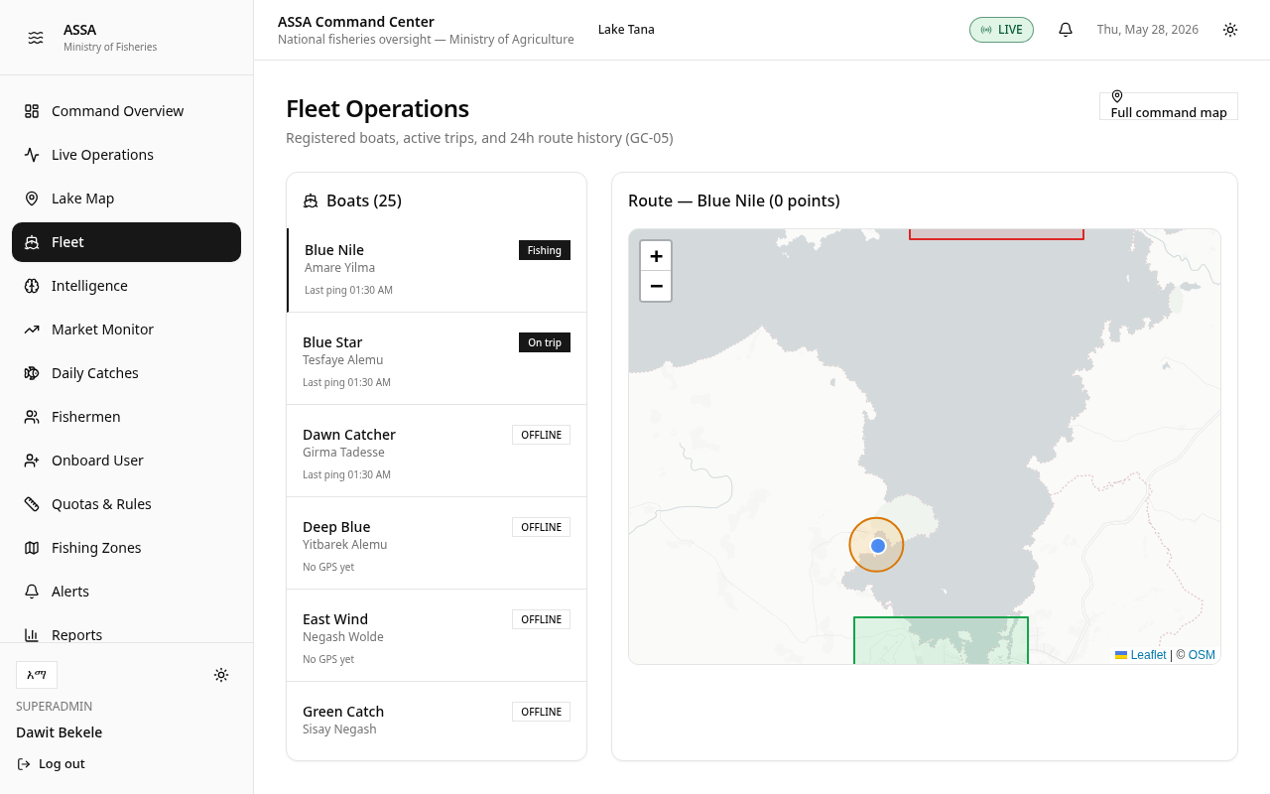
System Limitations & Future Work
Current Limitations (Transparent & Honest)
- In-Memory SSE Registry: Active sockets list runs in-memory; horizontal scaling requires Redis. - Network-Dependent Submissions: Catch logs require active cellular network connections to complete. - In-App Alerts Scope: Quota and mismatch warnings are in-app only, lacking external SMS gateways.
Future Roadmap & Enhancements
- Redis Pub/Sub integration to support multi-instance horizontal scaling. - SQLite offline caching database on the fisher device to support offline synchronization. - Twilio or cellular SMS gateways integration to push alerts directly to inspectors.
Notes:
In the spirit of engineering transparency, I want to highlight the current system limitations. First, our SSE client registry runs in-memory on a single node instance; horizontal scaling across multiple instances would require migrating to a Redis Pub/Sub cluster. Second, fishers currently require network access to submit catches. In the future, I plan to integrate local SQLite buffering on the device for offline sync. Finally, alerts are currently in-app only, and integrating an SMS gateway is a logical next step.

Slide 15
ASSA SYSTEM
Unified Resource Preservation and Digital Fish Commerce
Thank you for your time. I am open to any questions.
Notes:
In conclusion, the ASSA system successfully demonstrates how modern web technologies can automate resource enforcement, secure transactional pipelines, and provide transparent commerce for Rift Valley fisheries. I would like to thank my supervisors and instructors for their guidance throughout this internship. I am now open to any questions you may have about the architecture or implementation details of the project.

