Slide 1




SINA
SUPPLIES AND LOGISTICS
Your Goods, Our Priority
COMPANY
PROFILE
www.sinatrading.et

Slide 2


COMPANY OVERVIEW
SINA Supplies and Logistics PLC is a dynamic Ethiopian company specializing in procurement, logistics coordination, event management, property management, staffing solutions, and integrated business support services. The company was established with the objective of delivering reliable, efficient, and cost-effective operational support to corporate organizations, institutions, and private clients.
With a strong network of suppliers, service providers, and logistics partners, SINA ensures timely delivery, quality assurance, and professional service execution across all areas of operation.

Slide 3

SINA
SUPPLIES AND LOGISTICS
Your Goods, Our Priority
VISION
To become one of Ethiopia’s leading integrated procurement, logistics, and business support service providers, recognized for reliability, professionalism, and customer satisfaction.
MISSION
Provide high-quality procurement and logistics solutions.
Deliver professional event and property management services.
Support organizations with efficient staffing and operational services.
Create long-term value for clients through dependable service delivery.

Slide 4
OUR COMPANY PREMIUM SERVICE
SINA
SUPPLIES AND LOGISTICS
Your Goods, Our Priority
Procurement & Supply Services
Logistics & Delivery Services
Office consumables and supplies
Hospitality and refreshment supplies
Meeting and conference materials
Holiday and celebration items
Supplier sourcing and management
Inventory monitoring and replenishment
Transportation coordination
Delivery facilitation
Distribution management
Vendor coordination
Scheduled delivery services

Slide 5
SINA
CONT...
SUPPLIES AND LOGISTICS
Your Goods, Our Priority
Event Organizing Services
SINA provides complete event planning and coordination services for:
Services include
Venue coordination
Decoration and branding
Catering coordination
Audio-visual setup
Guest management
Transportation arrangements
Event logistics and supervision
Corporate events
Conferences and workshops
Product launches
Graduation ceremonies
Holiday celebrations
Traditional and cultural events
VIP guest hospitality arrangements

Slide 6
SINA
CONT...
SUPPLIES AND LOGISTICS
Your Goods, Our Priority
Property Management Services
Our property management solutions include:
Commercial property management
Residential property management
Facility maintenance coordination
Utility payment management
Cleaning and housekeeping supervision
Security service coordination
Tenant communication support
Routine inspection and reporting
Specialized management for:
Spa facilities
Gym operations
Swimming pool facilities
Recreational service areas

Slide 7
SINA
CONT...
SUPPLIES AND LOGISTICS
Your Goods, Our Priority
Staff Recruitment & Outsourcing Services
SINA recruits and manages qualified personnel for:
Administrative staff
Receptionists
Housekeeping staff
Maintenance personnel
Traditional coffee and tea makers
Event support staff
Spa and wellness staff
Gym and swimming pool attendants
Drivers and logistics assistants
Temporary and contract employees
Additional support:
Payroll administration
Attendance monitoring
Staff replacement coordination
HR operational support

Slide 8
SINA
SUPPLIES AND LOGISTICS
Your Goods, Our Priority
ADDITIONAL SUPPORT SERVICES
Utility expense payment management
Guest meal arrangements
Corporate hospitality coordination
Office operational support
Vendor and supplier negotiation
Monthly operational reporting

Slide 9
SINA
OUR WORKING METHODOLOGY
SUPPLIES AND LOGISTICS
Your Goods, Our Priority
Phase 1
Planning:
Review client requirements and schedules
Phase 2
Sourcing:
Identify qualified suppliers and service providers
Phase 3
Execution:
Procure, organize, recruit, and coordinate services
Phase 4
Delivery & Deployment:
Ensure timely delivery and service implementation
Phase 4
Monitoring & Reporting:
Provide performance updates and operational reports

Slide 10
SINA
SUPPLIES AND LOGISTICS
Your Goods, Our Priority
WHY CLIENTS CHOOSE
SINA SUPPLIES AND LOGISTICS PLC
Reliable service delivery:
Consistent execution and dependable support
Strong supplier and service provider network:
Access to qualified vendors and partners
Quality assurance and accountability:
Standards, checks, and responsible delivery
Fast response and coordination:
Quick communication and issue resolution
Cost-effective operational support:
Practical solutions that help control expenses
Integrated solutions under one provider:
Procurement, staffing, events, and property support

Slide 11
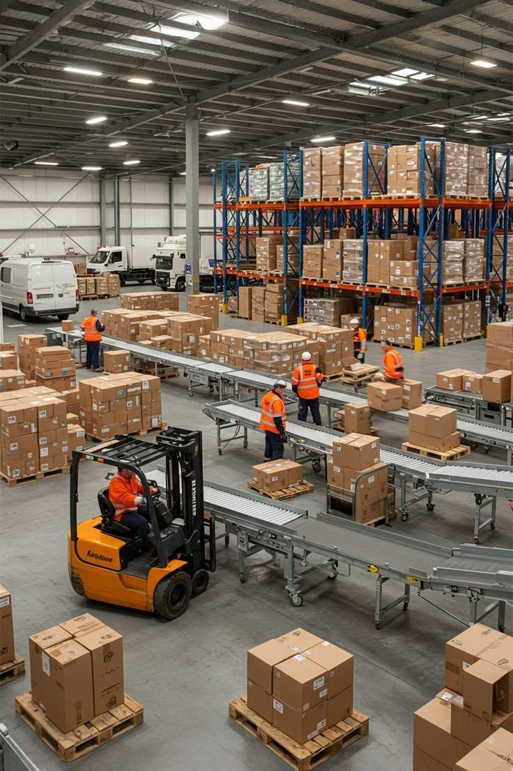
SINA
SUPPLIES AND LOGISTICS
Your Goods, Our Priority
EXPECTED BENEFITS TO CLIENTS
Reduced administrative workload
Improved operational efficiency
Better cost control and procurement management
Professional event execution
Well-maintained facilities and properties
Access to qualified and managed staff
Enhanced employee and guest experience
Timely reporting and service transparency

Slide 12

SINA
SUPPLIES AND LOGISTICS
Your Goods, Our Priority
STRATEGIC FOCUS
SINA Supplies and Logistics PLC is committed to expanding its integrated business support solutions across Ethiopia by investing in technology, strengthening supplier partnerships, enhancing service quality, and developing a highly skilled operational team capable of serving both local and international organizations.

Slide 13





SINA
CONTACT US
SUPPLIES AND LOGISTICS
Your Goods, Our Priority
+25190-969-6932
www.sinatrading.et
sinasupplies@outlook.com
Addis Ababa, Ethiopia Lemi kura Sub-city, W 03, House no. New

