Slide 1
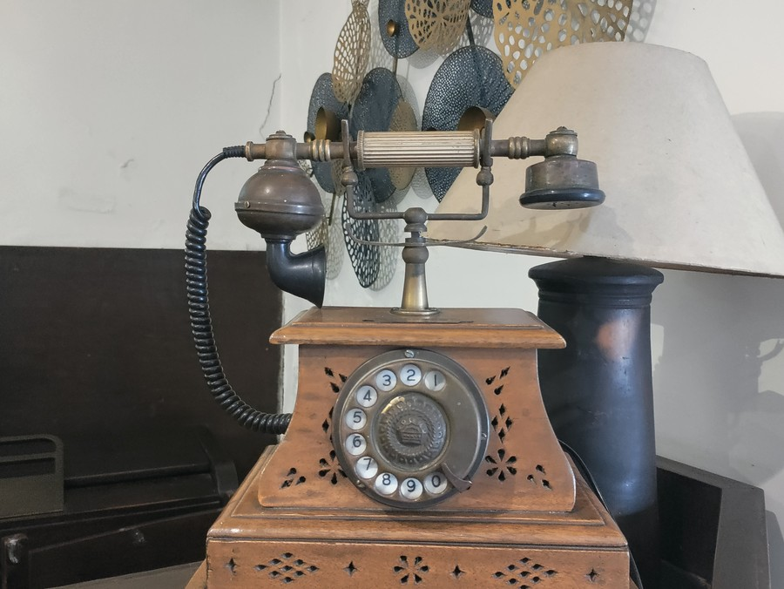
COLLEGE ENGLISH LITERATURE SEMINAR
Telephone Conversation
By Wole Soyinka
A close reading of racial prejudice, everyday discrimination, and the defense of human dignity through irony.
PRESENTED BY
[Student Name]
Department of English Literature • College Seminar Series
Topic: Modern African Poetry & Post-Colonial Literature
A mid-century telephone: bridging communication across racial barriers.
Telephone Conversation — Wole Soyinka | College English Literature Seminar
Slide 1 of 6
Notes:
Good morning everyone, and welcome to today's English literature seminar. My name is [Student Name], and today I will be presenting Wole Soyinka’s celebrated 1962 poem, 'Telephone Conversation.'
Set in London during the post-war era, this poem captures an encounter that feels both painfully realistic and masterfully comic: an educated Black African student phoning a British landlady about a rented room. What begins as a routine housing inquiry quickly spirals into an intense examination of racial prejudice, polite hypocrisy, and the defense of human dignity.
Over the next few minutes, we will look at Soyinka's background, trace the narrative sequence of the telephone exchange, examine its major themes, analyze its literary devices, and reflect on its lasting message for our world today. Let us begin with the author.

Slide 2
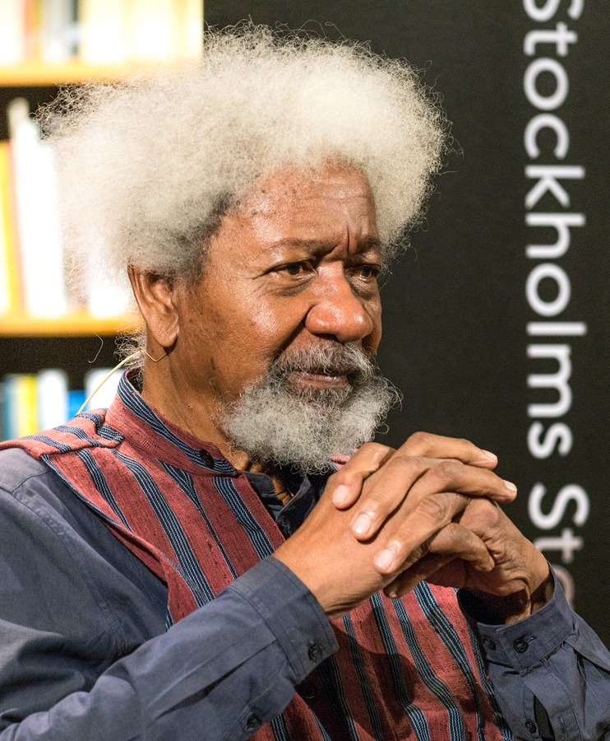
BIOGRAPHICAL CONTEXT
About Wole Soyinka
Nigerian playwright, poet, and champion of human dignity
Nigerian Literary Pioneer
Born on 13 July 1934 in Abeokuta, Nigeria. Soyinka studied at University College, Ibadan, and the University of Leeds. He became one of the foremost dramatists, poets, and cultural critics of modern African literature.
Nobel Prize in Literature (1986)
In 1986, Soyinka made history as the first sub-Saharan African writer to receive the Nobel Prize in Literature, commended for fashioning the drama of existence with wide cultural perspective and poetic resonance.
Lifelong Defense of Human Rights
His literary work fearlessly challenges political oppression, corruption, and social injustice. He endured political imprisonment in Nigeria for opposing war and has continually defended individual freedom and dignity.
Context of 'Telephone Conversation'
Written during his years in England in the early 1960s, the poem reflects the pervasive housing discrimination and subtle 'colour bar' faced by African scholars and immigrants in post-war Britain.
Wole Soyinka (b. 13 July 1934)
Nigerian Poet, Playwright & Nobel Laureate
Telephone Conversation — Wole Soyinka | College English Literature Seminar
Slide 2 of 6
Notes:
To appreciate the poem, we first need to understand the poet behind it. Wole Soyinka was born in Nigeria in 1934 and studied both in Ibadan and at the University of Leeds in the United Kingdom. He is globally renowned as a playwright, novelist, poet, and essayist.
In 1986, Soyinka made history by becoming the very first sub-Saharan African writer to win the Nobel Prize in Literature. The Swedish Academy praised him for his wide cultural perspective and poetic depth.
Beyond his literary genius, Soyinka is known for his moral courage. He has consistently spoken out against tyranny, censorship, and human rights abuses—even enduring nearly two years of solitary confinement during the Nigerian Civil War for his anti-war advocacy.
He wrote 'Telephone Conversation' in the early 1960s, drawing directly upon his lived experiences as a young African scholar in London. At the time, finding housing was a humiliating ordeal for Black students due to widespread racial prejudice among landlords. Now, let’s examine how this narrative situation unfolds in the poem.

Slide 3
TEXTUAL OVERVIEW
Summary: The Flow of the Conversation
A natural sequence of events from inquiry to ironic triumph
01
The Rental Inquiry
The speaker finds a promising rental advertisement in London. Pleased with the reasonable rent and location, he calls the landlady from a public telephone booth to secure accommodation.
02
Pre-emptive Disclosure
Knowing the prevalence of discrimination, the speaker chooses to avoid wasted travel. He politely and frankly discloses his racial identity, stating plainly: 'I am African.'
03
The Abrupt Question
A tense, uncomfortable silence follows. Instead of asking about his profession or character, the landlady coldly demands clarification on his skin shade: 'HOW DARK?'
04
Absurd Classification
Failing to understand the nuance, the landlady bluntly asks if he is 'light or very dark.' The speaker humorously categorizes his complexion as 'West African sepia.'
05
The Ironic Reversal
The speaker playfully explains that his face is sepia, but his palms and feet are lighter. He begs her to inspect him before hanging up—turning racial prejudice into total absurdity.
Key Narrative Movement: The speaker shifts from polite accommodation to intellectual mastery, using humor to expose the landlady's narrow bigotry.
Telephone Conversation — Wole Soyinka | College English Literature Seminar
Slide 3 of 6
Notes:
Let's trace the narrative sequence of the poem step by step. The entire poem takes place within a single phone conversation.
In Stage 1, our speaker is searching for a place to rent in London. He finds an advert with a reasonable price and an indifferent location, and calls the landlady from a public red telephone booth.
In Stage 2, because racial discrimination was so rampant in 1960s Britain, the speaker decides to pre-empt a wasted journey. He politely confesses: 'Madam, I am African.' He chooses complete honesty.
In Stage 3, there is a heavy, awkward silence on the other end of the line. The landlady reveals her prejudice when she asks abruptly: 'HOW DARK?' She completely ignores his manners or suitability as a tenant.
In Stage 4, she repeats the question, asking whether he is light or very dark. Instead of responding with anger, the speaker responds with wit. He compares his complexion to artistic shades like 'West African sepia,' mocking her attempt to categorize human beings like paint samples.
Finally, in Stage 5, the speaker explains that his face is brunette, but the palms of his hands and soles of his feet are lighter, and pleads with her to inspect his backside before hanging up. Through irony, he strips the landlady of her power and exposes the absurdity of racism. Now, let's explore the major themes.

Slide 4
THEMATIC ANALYSIS
Major Themes & Social Message
Exploring racial prejudice, human dignity, and everyday hypocrisy
1. Racial Discrimination
The speaker encounters prejudice during an ordinary housing inquiry. Soyinka illustrates how racism is not just an abstract ideology, but a concrete daily obstacle that denies people equal access to basic necessities like shelter.
2. Human Dignity & Self-Respect
Despite being subjected to intrusive and insulting questions about his physical appearance, the speaker never loses his composure. He maintains his self-worth and moral dignity, refusing to be reduced to a stereotype.
3. Prejudice & Polite Hypocrisy
The landlady adopts a veneer of upper-class politeness, but her polite manner conceals deep-seated bias. Soyinka critiques the hypocrisy of 'respectable' society that practices polite discrimination.
4. Identity & Skin Colour
The poem attacks the irrational obsession with classifying human worth by skin tone. Soyinka demonstrates that judging a person's intelligence, character, or value by pigmentation is fundamentally absurd.
Concluding Insight: A person's character, intellect, and humanity matter far more than their skin colour.
Telephone Conversation — Wole Soyinka | College English Literature Seminar
Slide 4 of 6
Notes:
Moving on to the major themes of the poem, Soyinka weaves several profound social realities into this short dialogue.
First, Racial Discrimination: Soyinka focuses on institutional and everyday racism. It is not overt physical violence, but the quiet rejection that prevents a qualified, polite student from having a roof over his head.
Second is Human Dignity: the speaker refuses to let the landlady's degrading inquiry strip him of his self-respect. Instead of pleading or showing distress, he maintains intellectual superiority and self-command.
Third is Prejudice and Polite Hypocrisy: the landlady hides behind polite diction, but beneath her voice lies cold racial bias. Soyinka reveals how British society often maintained polite appearances while practicing systemic exclusion.
Fourth is Identity and Skin Colour: the poem ridicules the obsession with shade and melanin. Skin colour is an accident of biology, not an indicator of integrity, culture, or worth.
Ultimately, Soyinka reminds us that character and shared humanity matter far more than outward physical markers. Next, let’s see how Soyinka communicates this through literary craft.

Slide 5
POETIC CRAFT
Literary Devices & Techniques
How Soyinka uses irony, satire, and imagery to expose prejudice
Irony
The speaker uses exaggerated courtesy and intellectual vocabulary to address an ignorant question. This exposes the deep irony that the African caller is far more cultured and civilized than the British landlady.
Contrast
A sharp contrast is drawn between the speaker's calm, articulate eloquence and the landlady's blunt, insensitive questions. This subverts colonial stereotypes about who possesses refinement.
Satire
Soyinka relies on biting humor and mockery to attack racism. Rather than delivering an angry lecture, he ridicules the landlady's obsession with skin tones, stripping bigotry of its authority.
Dialogue
The poem is structured as an authentic, overheard telephone dialogue. This gives the interaction immediate dramatic tension and realism, making the audience feel the sting of discrimination firsthand.
Imagery
Vivid sensory details bring the scene alive: the 'red telephone booth,' 'red omnibus,' and shades like 'West African sepia' and 'peroxide blonde.' These images contrast external colours with internal moral reality.
How Poetic Craft Serves the Social Message
By fusing realistic dialogue with sharp irony and satire, Soyinka avoids preaching. Instead, he empowers the speaker to intellectually dismantle prejudice with wit and composure.
Literary Impact: Soyinka turns a humiliating situation into an intellectual victory, proving that humor is a powerful weapon against ignorance.
Telephone Conversation — Wole Soyinka | College English Literature Seminar
Slide 5 of 6
Notes:
Now let’s explore how Soyinka uses poetic craft to communicate his message. Rather than writing a simple protest poem, he uses sophisticated literary techniques.
First is Irony: the speaker speaks with great refinement and politeness, while the British landlady—who considers herself civilized—behaves with crude prejudice. The irony completely flips the supposed social hierarchy.
Second is Satire: Soyinka uses sharp humor and ridicule. When the speaker asks the landlady to inspect the palms of his hands and the soles of his feet, he uses satire to make her obsession with skin color look completely ridiculous.
Third is Imagery: the poem is filled with sensory details—the red telephone booth, the red double-decker omnibus, the smell of rancid breath, and artistic shades like 'sepia' and 'peroxide blonde.' This makes the encounter feel physical and grounded.
Fourth is Contrast: we see a deliberate contrast between the speaker's articulate calm and the landlady's blunt interrogation. This subverts colonial assumptions about intellect and refinement.
And fifth, Dialogue: framing the poem as a phone conversation gives it dramatic immediacy and realism. Together, these devices allow Soyinka to expose prejudice without preaching, turning wit into an instrument of resistance. Let us now conclude our presentation.

Slide 6
SUMMARY & REFLECTION
Conclusion: The Enduring Message
Why Soyinka's poem continues to resonate in contemporary society
Racism Reduces Humanity
Prejudice strips individuals of their intellect, character, and uniqueness, reducing complex human souls to surface physical traits.
Discrimination Denies Dignity
Everyday bias creates unjust barriers, denying people basic human rights such as equal respect, housing, and social inclusion.
Wit as Moral Resistance
Humour and irony can effectively disarm bigotry, exposing the irrationality and foolishness of racial intolerance.
Universal Relevance
Written in the 1960s, the poem remains an urgent reminder for modern societies to judge individuals by character, not appearance.
CORE SEMINAR TAKEAWAY
“Every person deserves equal dignity and respect, regardless of skin colour.”
Human dignity has no colour, and equality is a right, not a privilege.
Thank you for your attention • Questions and seminar discussion are warmly welcomed.
Telephone Conversation — Wole Soyinka | College English Literature Seminar
Slide 6 of 6
Notes:
To conclude our seminar, Wole Soyinka’s 'Telephone Conversation' remains an enduring classic because it speaks directly to our shared humanity.
It exposes the tragedy of prejudice: that someone can be judged entirely by their skin color before anything is known about their character, intellect, or decency. Yet the poem is fundamentally empowering. The speaker refuses to accept the role of a humiliated victim; instead, he uses humour and superior intellect to reveal the absurdity of his oppressor.
As we reflect on this poem in our English seminar today, its moral truth is clear and undeniable: 'Every person deserves equal dignity and respect, regardless of skin colour.' Human dignity has no colour, and equality is a right, not a privilege.
Thank you very much for your time and attention. I would now be delighted to open the floor to any questions, thoughts, or discussion from the seminar.

