Slide 1
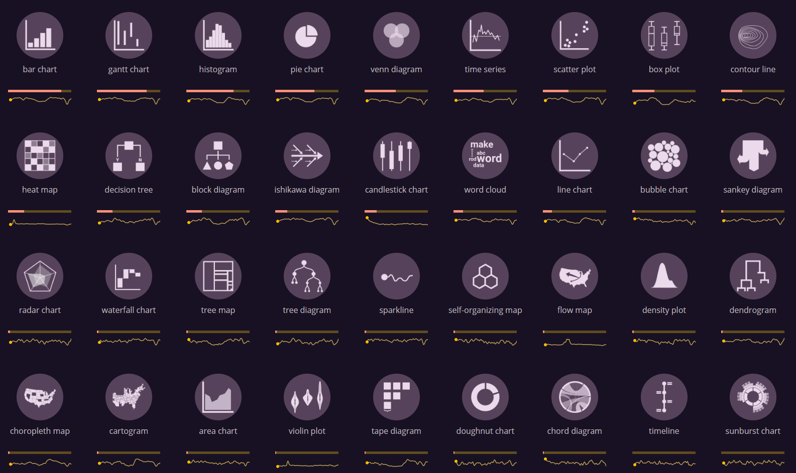

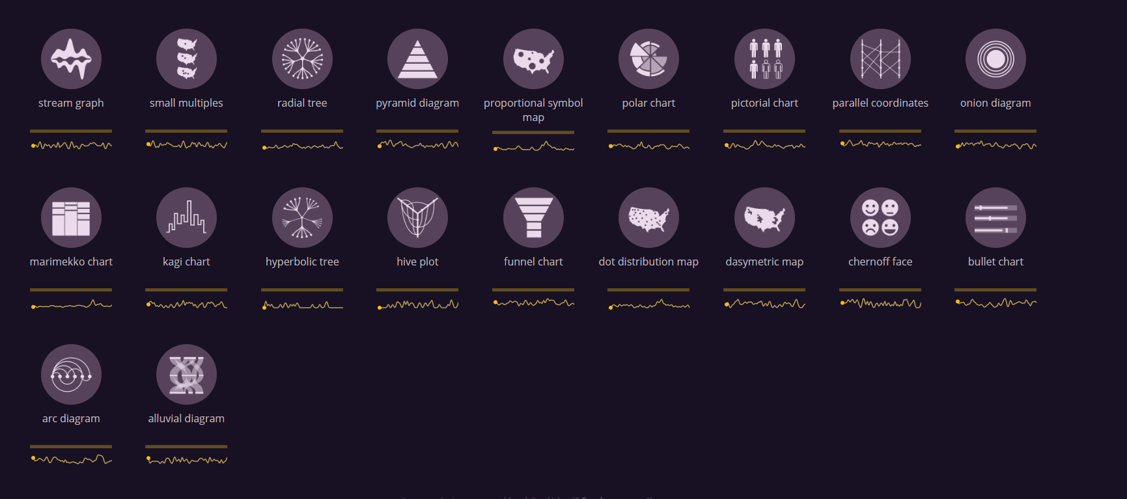
A Chart of Charts
20
15
10
5
0
Line or Step Chart
Parallel Sets (Alluvial Diagram)
Chord Diagram
Hyperbolic Tree or Radial Tree
Cartogram
Projected Map (Dot or Chloropleth)
Bar Chart
Box Plot (Box and Whiskers Plot)
Doughnut Chart
Density Plot
Area Chart
Histogram
Scatter Plot
Pie Chart
Polar Chart
Violin Plot
Heat Map
Contour Lines
Marrimeko Chart
Radar Chart
Bubble Chart
Gantt Chart
Tree Map
Waterfall Chart
Stream Graph
Word Cloud
Pictorial Chart
Sankey Diagram
Decision Tree
Dendrogram
Venn Diagram
Parallel Coordinates or Slope Chart
Idea and design by Cédric Scherer
Pictograms taken from www.visualizationuniverse.com, created by Anna Vital, Mark Vital and Alexander Vushkan with the assistance of the Google News Lab: Simon Rogers and Alberto Cairo for art direction.

