Slide 1
ELEVATOR SPEECH
BIROJIT MONDAL

Slide 2
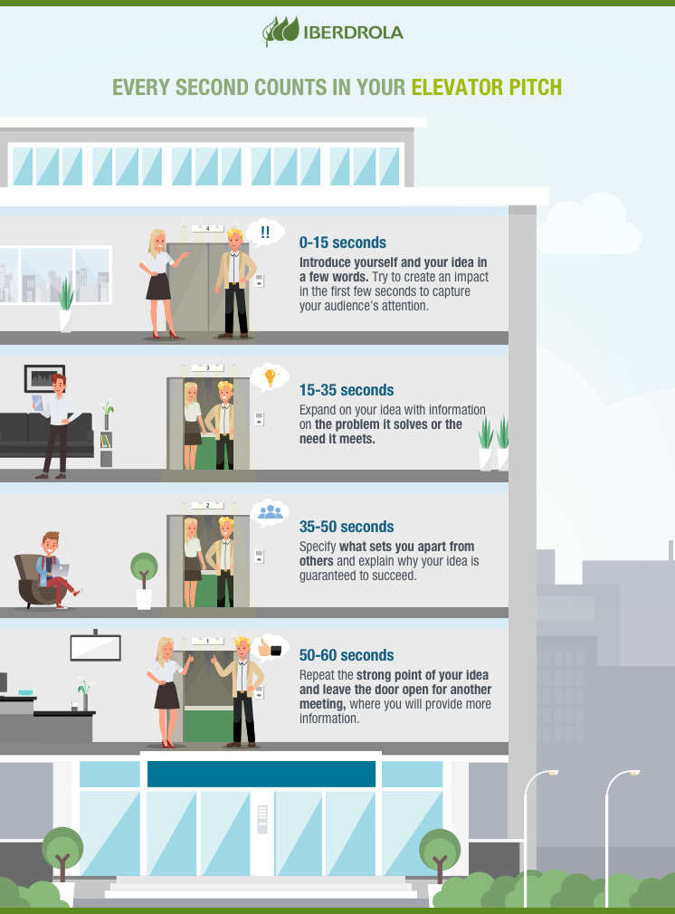

What is a Elevator Pitch?
An elevator speech is a clear, brief message or “commercial” about you. It communicates who you are, what you’re looking for and how you can benefit a company or organization. It’s typically about 30 seconds, the time it takes people to ride from the top to the bottom of a building in an elevator.

Slide 3

Why do we do a Elevator Pitch ?
It doesn’t make them yawn – A Elevator pitch acts as a buffer, giving you the in and shows the value of you or your idea in the smallest timeframe possible.
It Organizes Your Thoughts - It organizes your thoughts and allows you to critique the key points that you think make it/you a success in such a short period of time
It Helps Identify Your Market - An Elevator Pitch allows you to question the language you need to use when talking to those you want to impress, as well as what sort of arguments and ideas will impress them.

Slide 4
How to do an Elevator Speech
The elevator speech should be short and brief.
Mention your goals and action plan which will get things done.
Share your skills if they help to convey your views or points.
Be positive and flexible. Focus only on the essentials.
Do a background check on the person or audience before the elevator speech.

Slide 5
THANK YOU

