Slide 1
Histograms of MSE’s at 2 Hz
Input: Sample of Shanghai crowd videos, 108 avi’s, 5 sec, originally recorded at 50 Hz, divided into
1 clip per avi, 10 frames per clip
Model: pretrained prednet model
Overall: distribution of mean MSE’s for each clip, averaged over frame
Followed distribution of MSE’s for each frame
Please note: the scales for the x-axes and y-axes (MSE’s) are matched (scaled)to more easily compare across frames

Slide 2
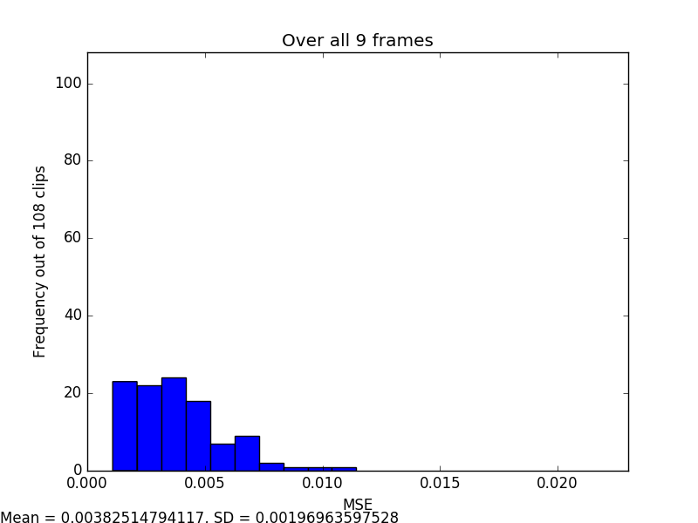

Slide 3
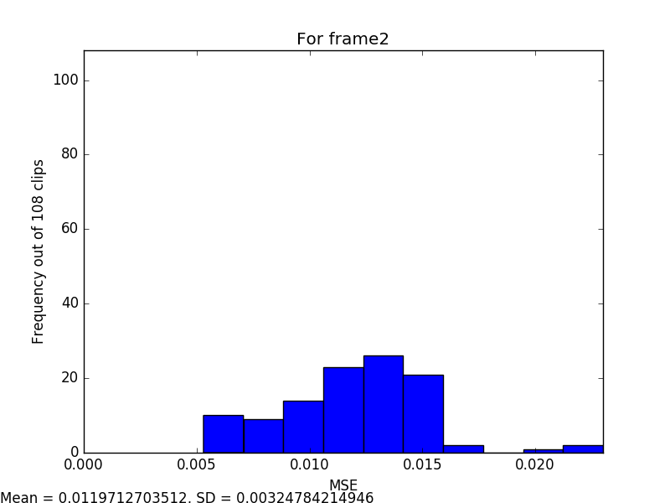

Slide 4
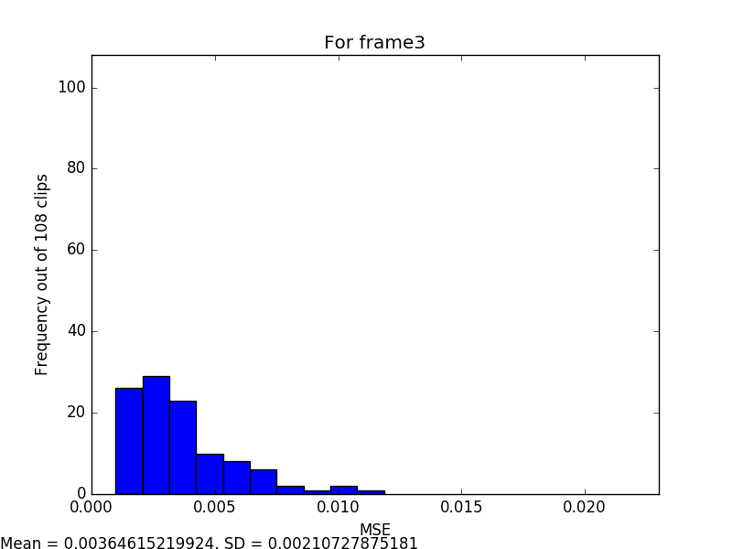

Slide 5
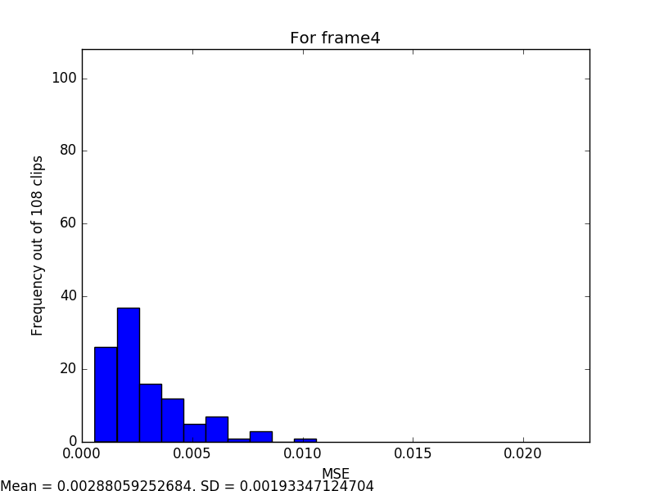

Slide 6
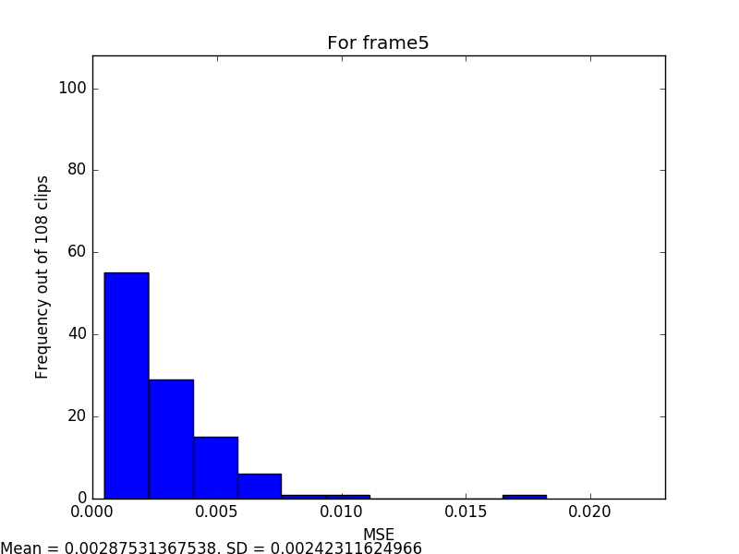

Slide 7
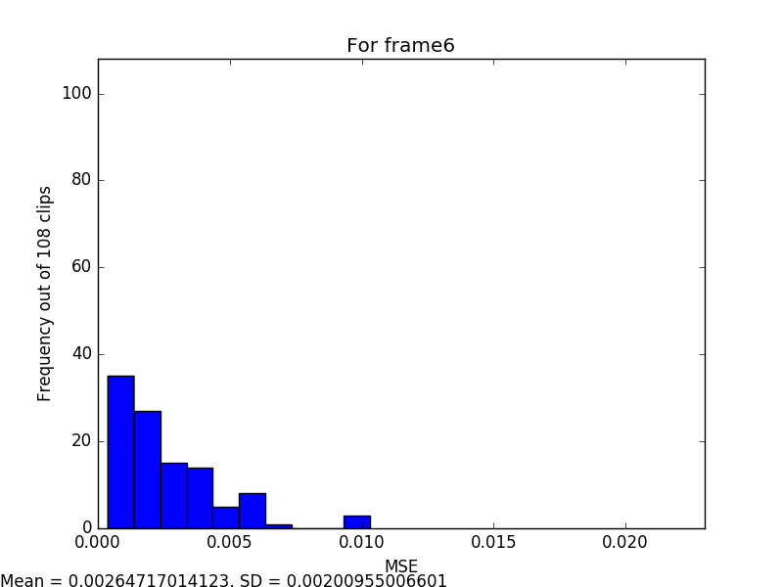

Slide 8
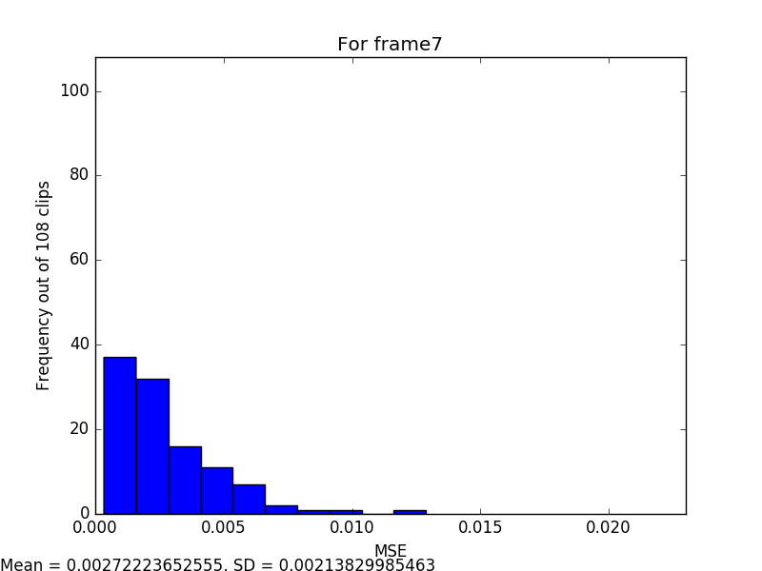

Slide 9
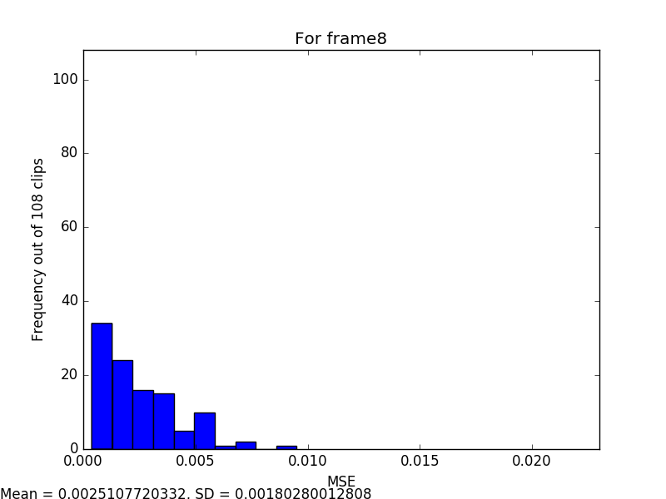

Slide 10
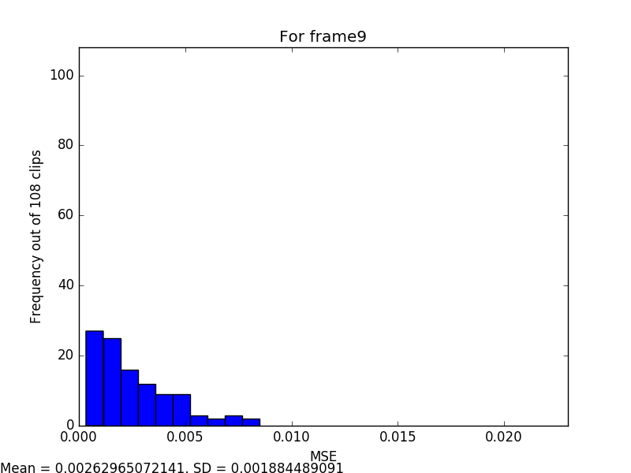

Slide 11
