Slide 1
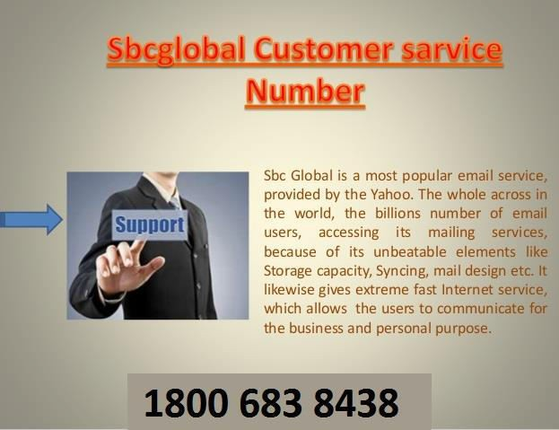
SBCGLOBAL EMAIL CUSTOMER SUPPORT NUMBER – 1-8OO~683~8438
USA-UK-AUS-Canada (TOLL FREE) 1800 683 8438

Slide 2

Get in touch with SBC Global eMail Technical Support
Number Instantly Toll Free at: 1-(800)-683-8438
SBC Global eMail is among the most reckoned and vastly used web e-mail service provider.
The ever increasing storage space as well as interesting and simple to use features of this mail service has made it demandable for its users worldwide.
Moreover it is also preferred by the consumers for the top notch support services proffered by the dedicated and highly committed team of professionals. Though,
in case of immediate troubleshooting and fixation of problems,
users can easily reach out to SBC Global eMail Technical Support Number anytime at
Toll Free No @ 1-(800)-883-3685. The platform is quite a reliable and authentic platform offering error free e-mail services and users try to individually encounter and handle issues with it. This is also one of the foremost reasons that they are not aware of how to get in touch with experts and seek any kind of assistance.

Slide 3

Why You Need Third Party SBC
Global eMail Technical Support?
You might think why you need third party SBC Global eMail support for technical issues and also might think when you contact a SBC Global eMail Technical Support. As a SBC Global eMail user when you are unable to install the application properly or whether there is any problem for setting up your account and or account is not running well, you certainly contact a SBC Global eMail technical support team for resolution. We have expert professionals who are certified and highly experience in technical support providing instant
and easy support anytime you need.

Slide 4

SBC Global eMail technical support Number
1800-683-84385 SBC Global eMail customer service number
You get support by certified technicians.
You get support that is available for 24×7, and even at the odd hours.
You get direct connection to the engineers for instant resolution. You get tool free number to dial from anytime and anywhere. You get complete diagnose as well as resolution.
Get support for complete security.
Get support for installation and setting up of SBC Global eMail account.
You get support for resolving in sending and receiving SBC Global eMail mail. You can configure your mail account and password recovery or forgot support. You get support for retrieving of lost and misplaced mails and data.
You get support for removing spam messages from your SBC Global eMail account.

Slide 5
Contact SBC Global eMail Tech
Support Number @ 18OO-683-8438
In spite of the fact that it is exceptionally uncommon yet frequently, the administration supplier can begin carrying on truly odd and reason issues leaving clients dumbfounded. Indeed,
if a client is using a mail customer, the circumstance could get more basic and there can be issues with POP, SMTP or IMAP administration that is difficult to investigate even in the wake of applying a few mixes. Clients with no specialized comprehension discover it amazingly dreary to determine them. Regardless of the possibility that they attempt to experience the support discussions, may be they don't comprehend the clarification given out there and get confounded further. In such circumstance, it is constantly better to take prompt help from SBC Global eMail Technical Support Number.

Slide 6

Getting service from the different facts of the SBC Global eMail tech support @ 1800-683-8438
The SBC Global eMail tech support team has distinct methods that it utilizes to enable the users of SBC Global eMail Email and other services to reach out to them. SBC Global eMail technical assistance is made accessible to the users for all problems in account that may cause inconvenience. The numerous options that users are offered for seeking help that they need are
chatting is a common way of interacting with people and if you find it easy and often indulge in chatting then it may also prove to be an effective way of seeking help for you since it enables the users to get full information including any sort of navigation guidance etc. Also, it is free of cost so you won't need to pay for anything at all.
call up the SBC Global eMail teach support team @ 1800-883-3685.
SBC Global eMail Support Number (1-800-883-3685) is the helpline number and it is as useful as the chatting method. It is also free of cost and the only difference is that through this option, the users would rather be speaking instead of chatting.
It is easy and prompt because the users can also ask on the spot queries just like the chat medium.

Slide 7

SBC Global eMail helpline phone number 1-800_683_8438 SBC Global eMail customer support phone number
SBCglobal email helpline phone {1800}883)3685] number USA
SBCglobal Email bangalore office contact number,SBCglobal Email dial up support number,SBCglobal Email postmaster phone number,phone number to cancel SBCglobal Email email account,SBCglobal Email billing phone number,SBCglobal Email email address com or net,SBCglobal Email billing contact phone number,SBCglobal Email mail technical support phone number,
SBCglobal Email tech support,SBCglobal Email broadband customer service phone number,SBCglobal Email phone number for password reset,SBCglobal Email USA help contact number,SBCglobal Email tech support cost,SBCglobal Email email contact number USA,SBCglobal Email live customer service phone number,SBCglobal Email tech support get human,SBCglobal Email cancellation phone number USA,phone number for SBCglobal Email dial up,SBCglobal Email customer billing phone number,verizon email customer support number,SBCglobal Email direct contact number,phone number for SBCglobal Email tech support,SBCglobal Email email address finder,SBCglobal Email customer support telephone number,SBCglobal Email password recovery help,
SBCglobal Email lost password phone number

Slide 8

We help you with the following issues:

Slide 9

Setting up of Sbcglobal email account on any Email client (Outlook, Thunderbird, Apple mail, etc.)
Issues related to sending and receiving emails
Sbcglobal email forget password issues. Sbcglobal email password recovery Modification of email server settings
Upgradation to the new Sbcglobal Yahoo homepage Changes of your Sbcglobal email program settings Driver issues and slow computer leading to slow emailing Dealing with stubborn viruses and other online threats.
Troubleshooting of connectivity issues Setting up of wireless network, and more.

Slide 10

SBC Global eMail Customer Service Number
1800~683-8438 SBC Global eMail support number
SBCglobal email helpline phone {1800}883)3685] number USA SBCglobal Email bangalore office contact number
SBCglobal Email dial up support number
SBCglobal Email postmaster phone number
phone number to cancel SBCglobal Email email account SBCglobal Email billing phone number
SBCglobal Email email address com or net SBCglobal Email billing contact phone number
SBCglobal Email mail technical support phone number SBCglobal Email tech support
SBCglobal Email broadband customer service phone number SBCglobal Email phone number for password reset SBCglobal Email USA help contact number
SBCglobal Email tech support cost SBCglobal Email email contact number USA
SBCglobal Email live customer service phone number SBCglobal Email tech support get human
SBCglobal Email cancellation phone number USA phone number for SBCglobal Email dial up SBCglobal Email customer billing phone number verizon email customer support number SBCglobal Email direct contact number
phone number for SBCglobal Email tech support SBCglobal Email email address finder
SBCglobal Email customer support telephone number SBCglobal Email password recovery help
SBCglobal Email lost password phone number

