Slide 1

Using R Shiny and Neo4j to Build the CatMapper Prototype Application
Robert J. Bischoff and Daniel J. Hruschka

Slide 2
CatMapper Shiny Application(s)
Overview
Purpose of application
Why shiny?
How the app works
Lessons learned
Notes:
Today I’ll review the CatMapper application or applications because the CatMapper package is designed to serve multiple applications off of one package. The website Catmapper.org is currently live for testing, but the code is not yet available for release.
I’ll review the purpose of the application, why we chose shiny. Give a live demonstration of the app and talk about some of the lessons we learned along the way. Hopefully I’ll mention a few things that are useful to you. Our primary purpose is not to give a tutorial in how to program in Shiny, there are plenty of those available on the internet already that can do a better job that I can, but I hope this presentation will give you something to think about.

Slide 3
CHALLENGES
Merging categories in a transparent, reproducible way
Building an application with limited resources
Notes:
My co-author Dan is an epidemiologist/anthropologist at ASU. He studies big datasets. The problem is to get the big datasets he first has to join lots of smaller datasets. These datasets contain ways of categorizing people into ethnicities, political districts, languages, and religions. The challenge is that each dataset encodes the names of these entities differently. Combining datasets can take hours, days, or even weeks and involves a number of complicated decisions. There is always the chance of a mistake, but these decisions are rarely documented and shared. This is a serious barrier to transparent, reproducible research and open science. I’ll give you some examples of what this looks like.

Slide 4
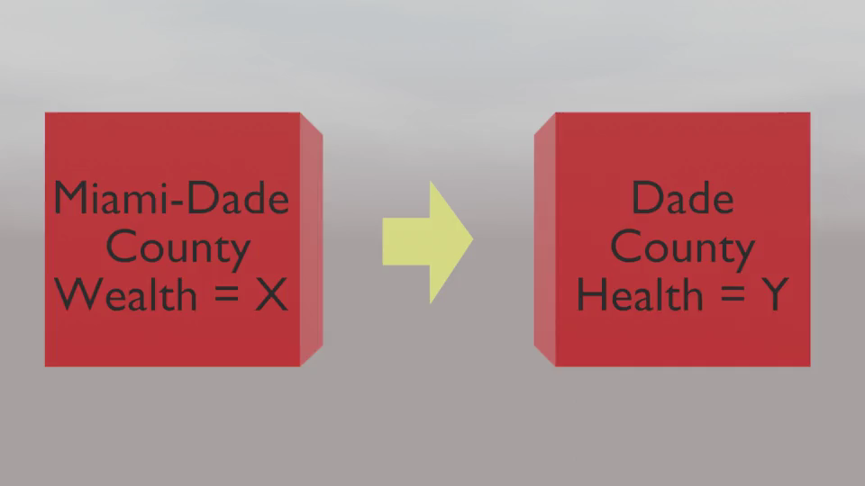
Notes:
This represents one row from two datasets. One dataset has information on Miami-Dade County wealth and the other dataset has information about Dade County Health. We learn that both these counties are in Florida and that Dade county changed its name to Miami-Dade county. Therefore we can merge these datasets.

Slide 5
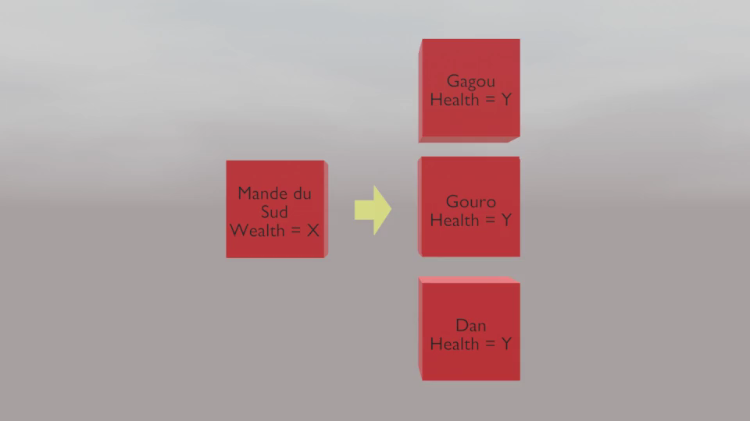
Notes:
It can be time-consuming, but not so hard when there is a one to one relationship, like in the last slide, but sometimes it’s not so simple. Here we have a row in one dataset that has wealth data for the Mande du Sud ethnic group. On the right we have three rows from a dataset with health data on different ethnic groups. After some investigation, we learn that these three ethnic groups are subgroups of the Mande du Sud, so we can merge these rows to get an equivalent unit. Then we can merge the datasets.

Slide 6
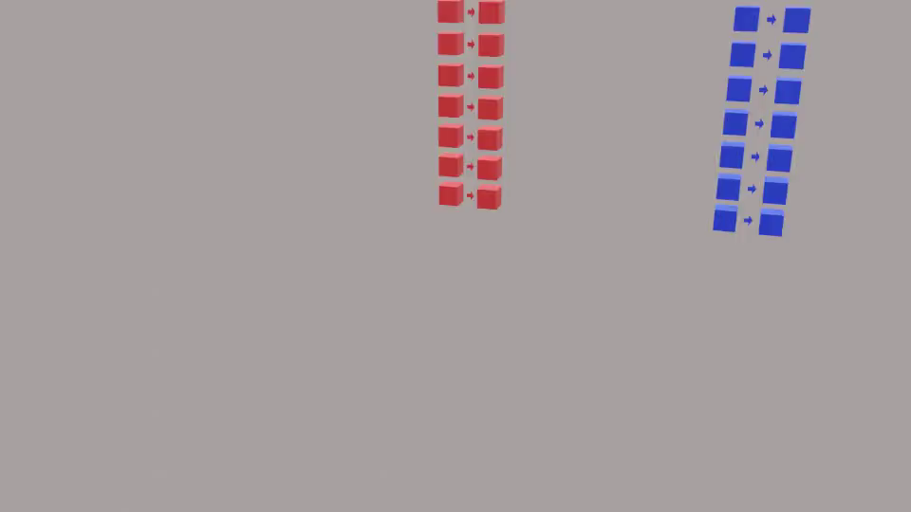
Notes:
Making these decisions becomes more and more challenging as the scale of the data increases. We become more likely to make mistakes and the resources required to analyze data at fine-grained scales becomes more and more difficult.

Slide 7
CHALLENGES
Merging categories in a transparent, reproducible way
Building an application with limited resources
Notes:
With this challenge in mind, the idea for CatMapper was born. As an archaeologist, I recognized that we deal with the same types of problems merging archaeological datasets, thus we created two applications: SocioMap and ArchaMap, with more to follow.
We have received startup grant funds; however, these are limited and I have been the primary developer. Without the funding to hire dedicated software developers, we needed something to build a prototype that didn’t take a lot of time and resources. Given my background in R and Shiny, this is where we decided to start and indeed why I was brought on board in the first place.

Slide 8
Walk through
Catmapper.org

Slide 9
SOFTWARE USED
R
Rstudio
Neo4j
Git
Docker
Shiny server
Linux
Bash
Nginx
AWS S3
Notes:
While R was our primary tool, there is a lot of other software that is either required for the successful deployment of an app, or that will make your life easier. It took me a while to figure out how to use Docker containers, but I have become a huge fan. I don’t have time to say much about them, but I can tell you that they are a way to containerize your app and we use it for our database as well so that all dependencies are completely controlled. I don’t have to worry at all about some update breaking my app. It’ll just keep running until I decide to make a change and deployment to the server is much easier.

Slide 10
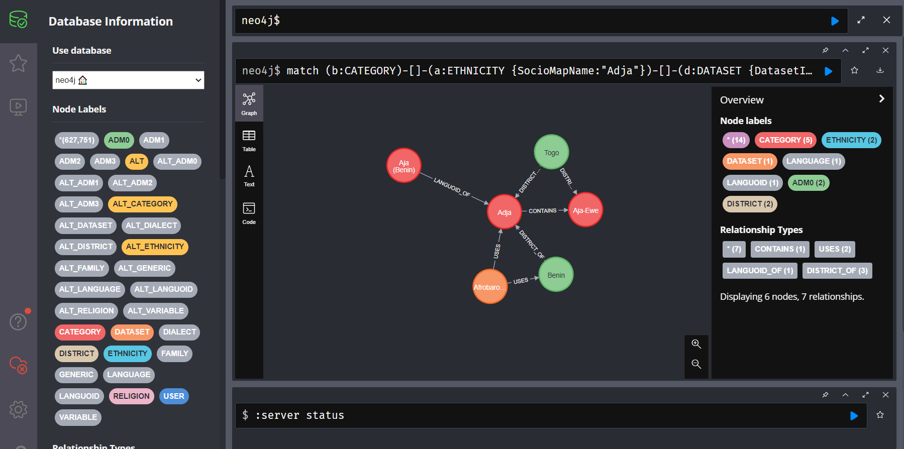
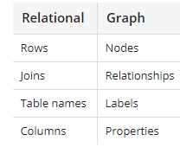
NEO4J
Notes:
Neo4j is our database backend. Graph databases still aren’t very common. They work just like a network graph. You have nodes with relationships between them. If you think in terms of relational databases then each row in a relational database is a node, joins are relationships, table names are labels and columns are properties.
So why use a graph database? Graph databases do not require joins. This speeds up queries and provides better performance. Remember how joins are relationships. Each relationship in a graph database can have properties. This makes it a lot easier to describe the connections between entities and provides a more natural data model. Neo4j provides a free community edition that is sufficient for our project and that is what we are using. I would say the biggest reason we use it is that our data is best described as a series of hierarchical relationships, and the graph structure of the database naturally retains this relationship, whereas a relational database does not.

Slide 11
PACKAGES USED
Depends:
magrittr,
dplyr,
tidyr,
tidyselect,
purrr,
stringr,
tibble
Imports:
readr,
rlang,
here,
aws.s3,
neo2R,
gtools,
tictoc,
rio,
glue,
shiny,
huxtable,
leaflet,
visNetwork,
sf,
mapview,
DT,
janitor,
igraph,
shinyjs,
shinycssloaders,
sodium,
shinyauthr,
uuid,
callr
Notes:
I prefer a tidyverse approach to R. There are a lot of packages we used to make this app run. Shoutout to all of the maintainers, with a particular thank you for the neo2R package which is our link to the Neo4j database.

Slide 12
ADVANTAGES AND CHALLENGES OF R AND SHINY
Advantages
Did not need to learn a new language
Huge ecosystem of packages, tutorials, and knowledge base
Open source
Challenges
Learning to rely on the database instead of R
Figuring out the right package layout
Reusing the same code for two applications
Running the application through shiny server and nginx
Lots of bugs that can be difficult to trace

Slide 13
LESSONS LEARNED
Helpful
Package layout
Utilize database language
Modularize
Focus on functionality
Use package files to simplify code and enable multi-application support
Avoid
Try to do everything in R
Prioritize aesthetics
Hard coding anything you don’t have to

Slide 14
PACKAGE LAYOUT
server.R and ui.R scripts kept in home folder
Copied to corresponding scripts under apps folder
All other package data kept in the assets folder under inst
Everything under inst is installed with the package
Must install the package to be able to access files using system.file
## CatMapper
## ├── inst
## │ ├── apps
## │ │ ├── ArchaMapApp
## │ │ └── SocioMapApp
## │ └── assets
## │ └── www
## ├── man
## └── R

Slide 15
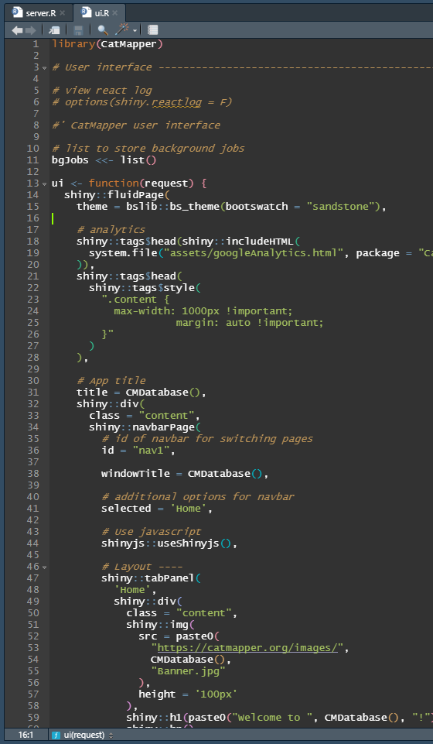
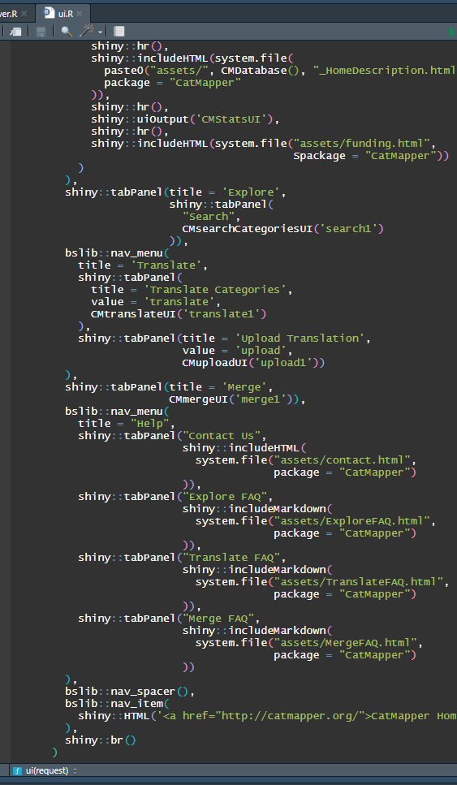
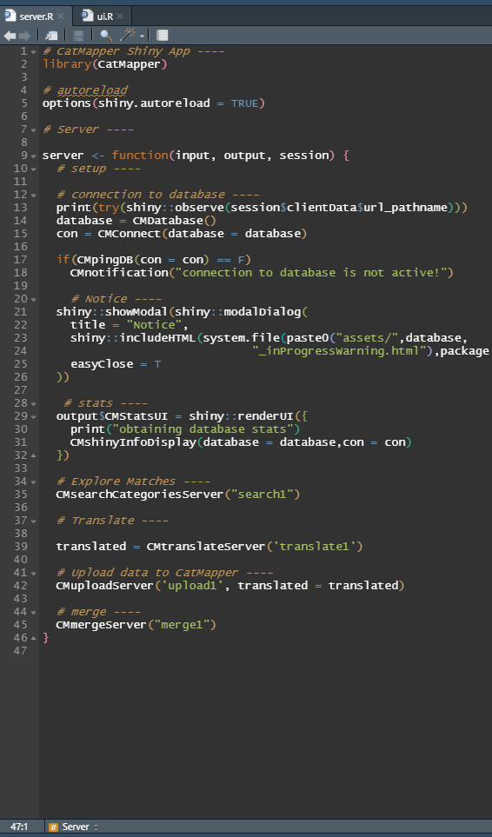
Notes:
I just wanted to give you an idea of how our UI and server files were structured. The UI code is much longer, but still fairly simple. None of the actual text is hard coded into the app, it’s all kept in separate files that are called via the system.file command.
The server file only has 46 lines of code including spaces. This is the advantage of using shiny modules, it makes it a lot easier to keep everything separate and neat

Slide 16
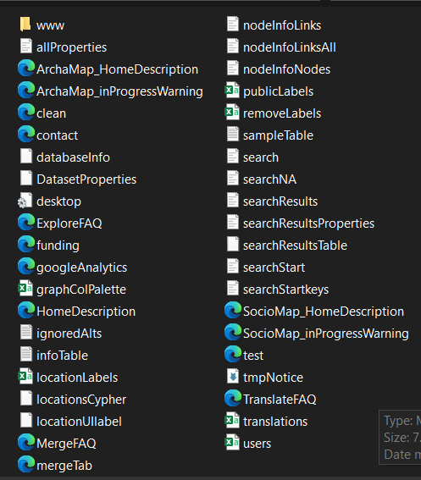
MULTI-APPLICATION SUPPORT
The app knows which version to run based on the folder name
Dependent database variables like SocioMapID and ArchaMapID are constructed simply using paste0(database,”ID”)
More complex elements are loaded from the assets folder either by file name or by a lookup table

Slide 17
LESSONS LEARNED
Helpful
Package layout
Utilize database language
Modularize
Focus on functionality
Use package files to simplify code and enable multi-application support
Avoid
Try to do everything in R
Prioritize aesthetics
Hard coding anything you don’t have to

Slide 18
ACKNOWLEDGEMENTS
Project lead: Daniel Hruschka (Daniel.Hruschka@asu.edu)
co-PI: Sharon Hsiao (ihsiao@scu.edu)
co-PI: Mohamed Sarwat (msarwat@asu.edu)
Advisor: Matt Peeples (matthew.peeples@asu.edu)
Lead developer: Robert Bischoff (rbischoff@asu.edu)
Funding: Early development of CatMapper has been supported by:
ASU’s Institute for Social Science Research seed grant
School for Human Evolution and Social Change interdisciplinary research grant
National Science Foundation (BCS-2051369) through the Human Networks and Data Science and Cultural Anthropology programs.

