Slide 1
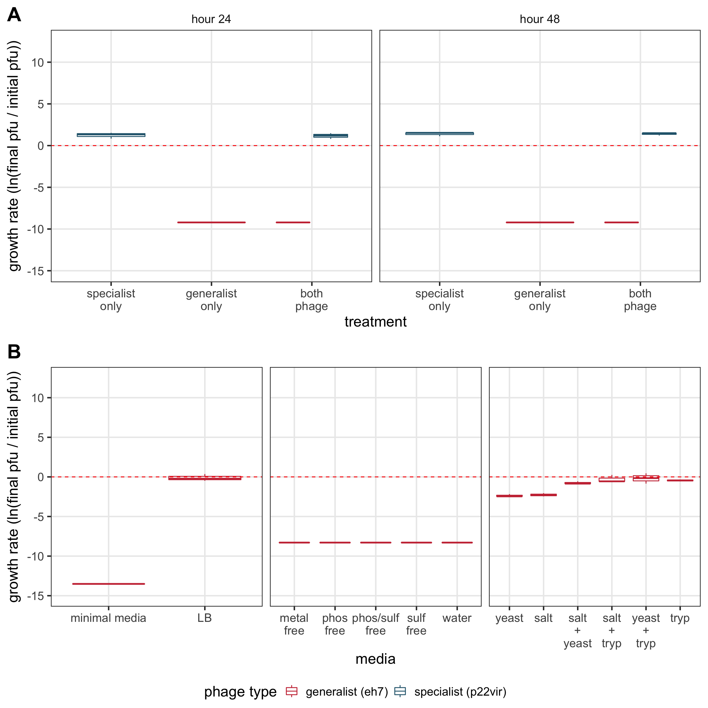
ns
ns
***
**
ns
ns
ns
ns

