Slide 1
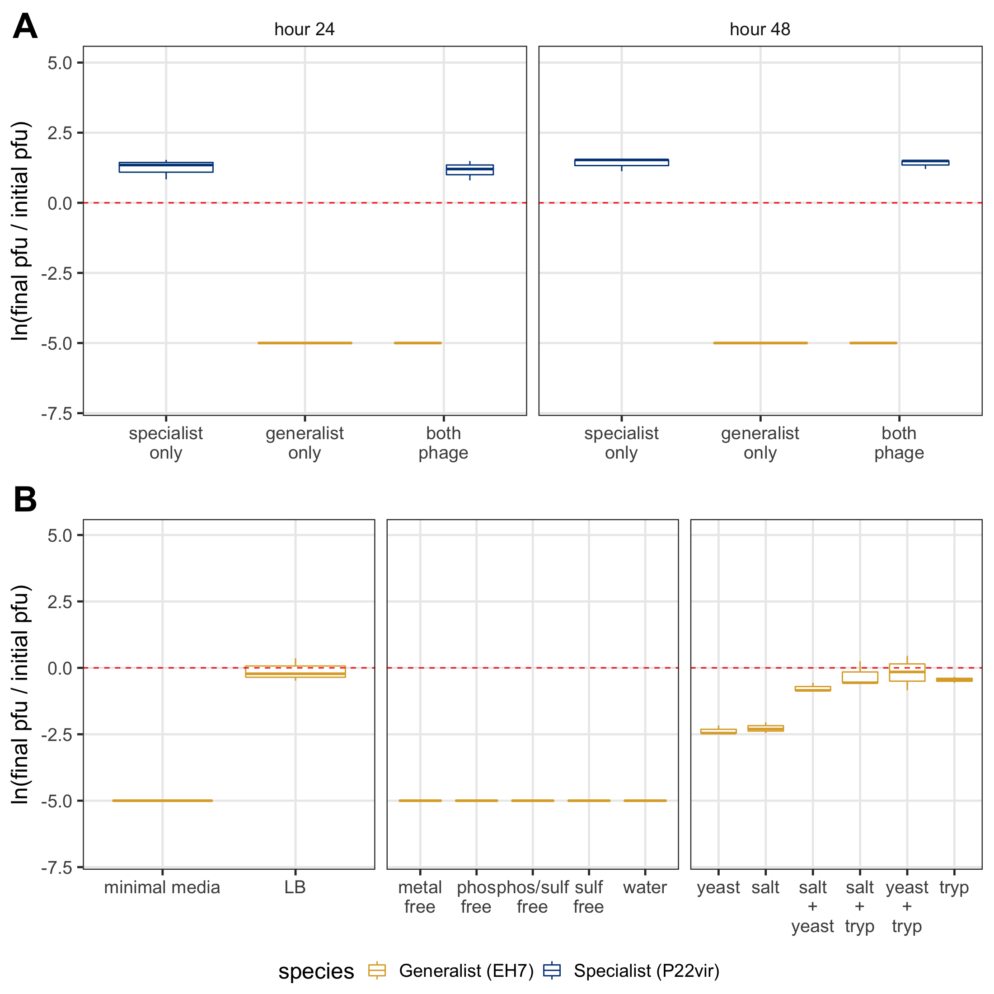

ns
ns
***
ns
**
ns
ns
ns

