Slide 1
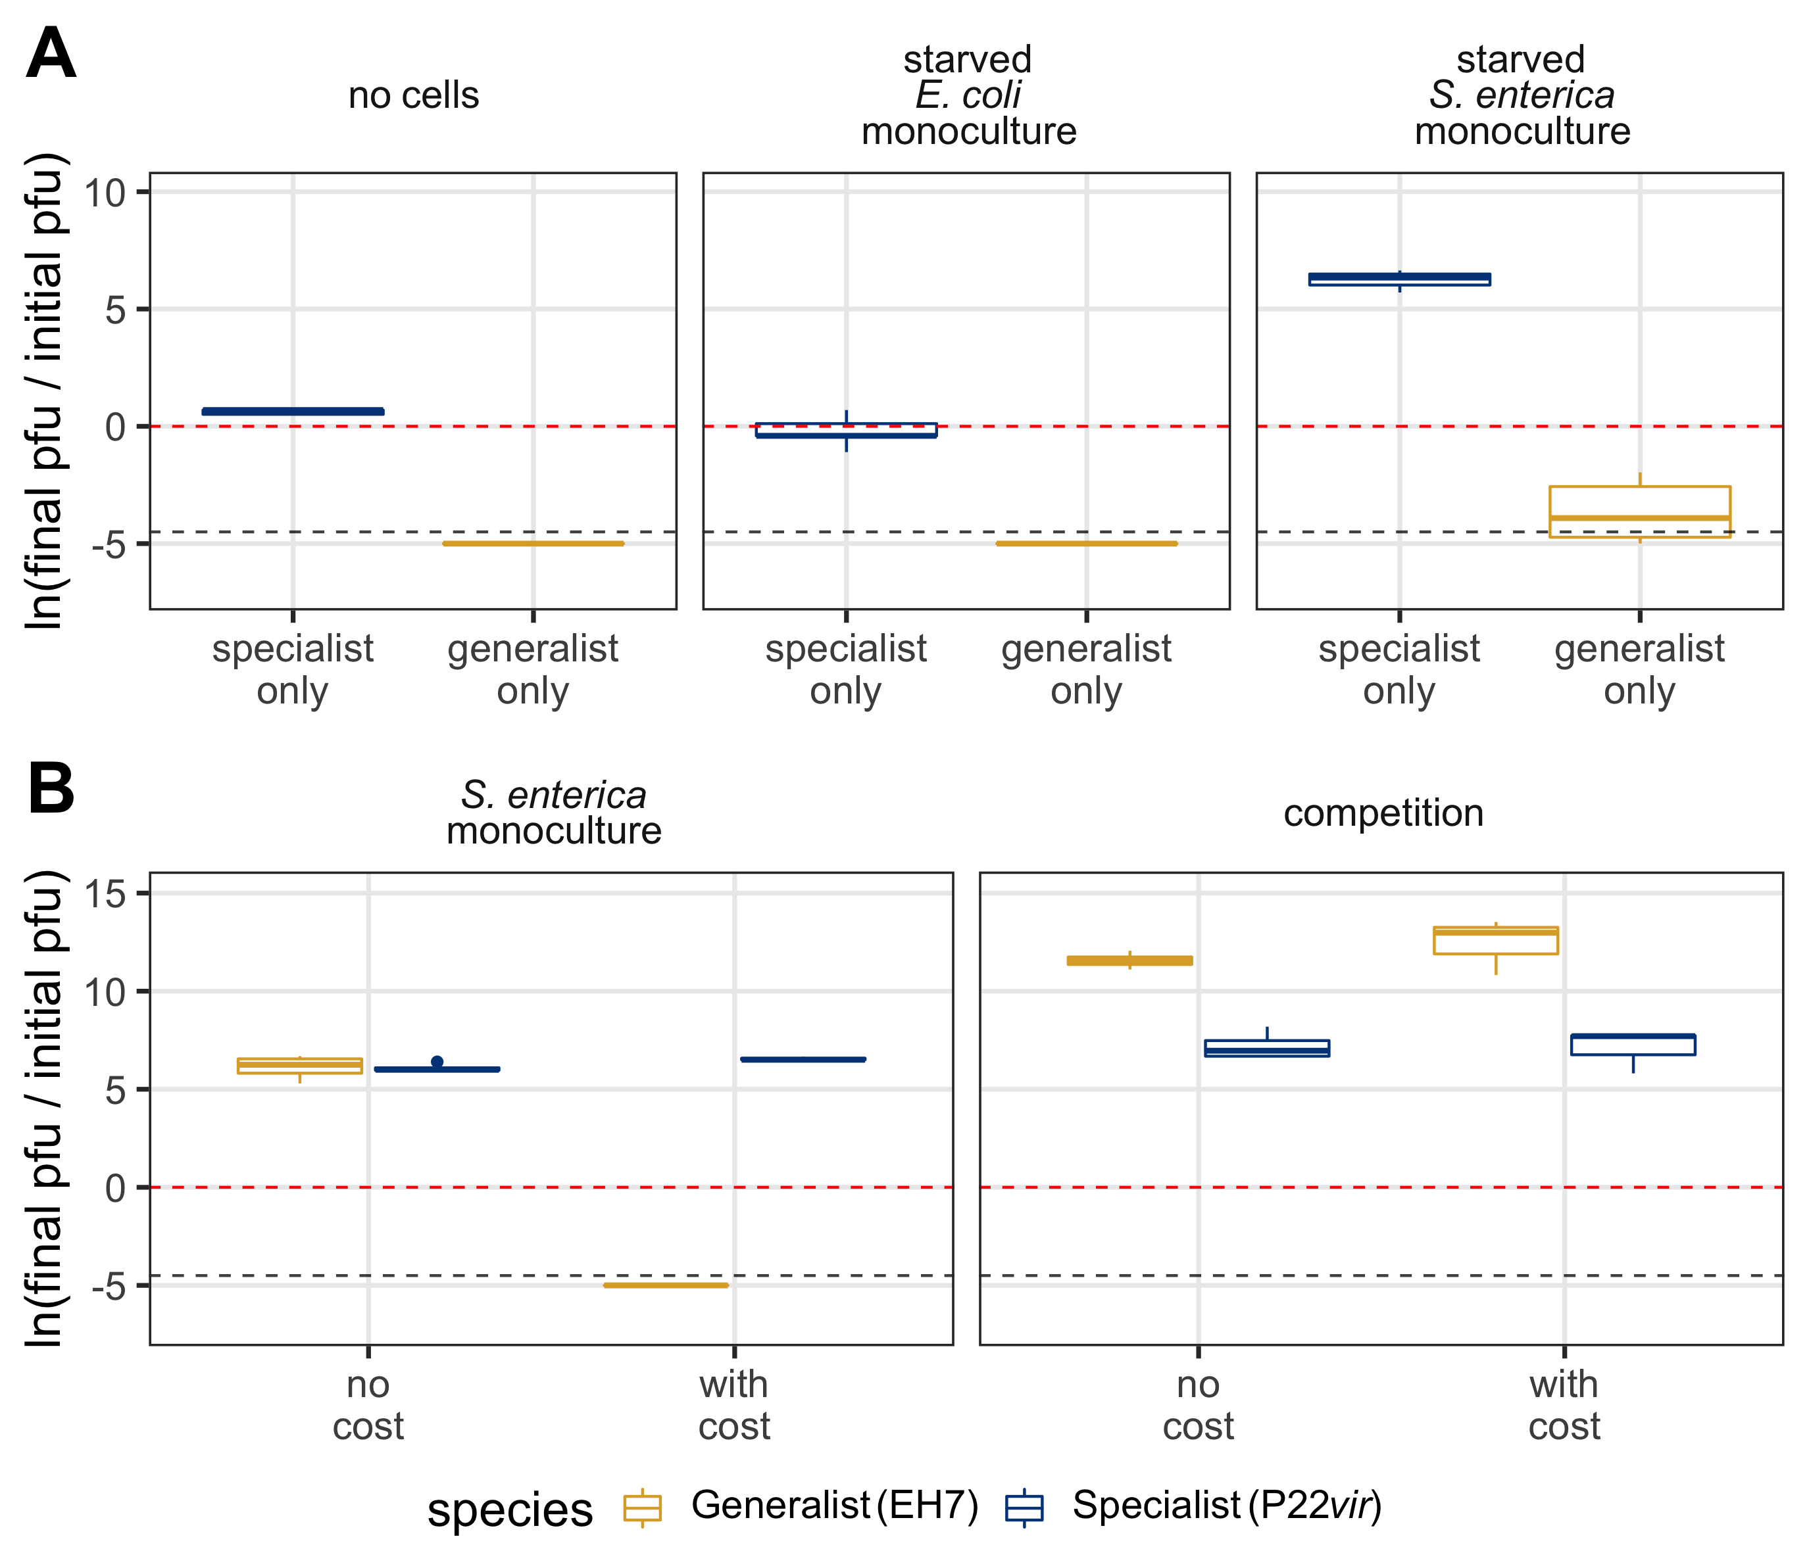
***
LOD
***
***
ns
ns
ns
ns
LOD

Slide 2
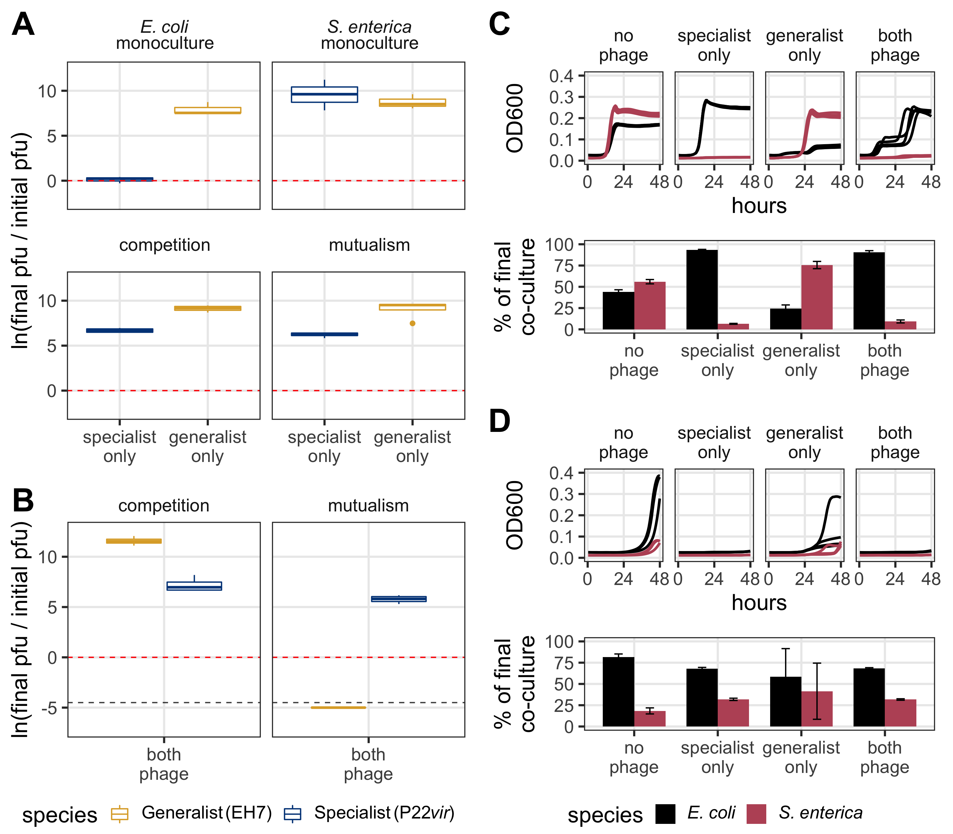
***
ns
ns
***
***
***
LOD

Slide 3
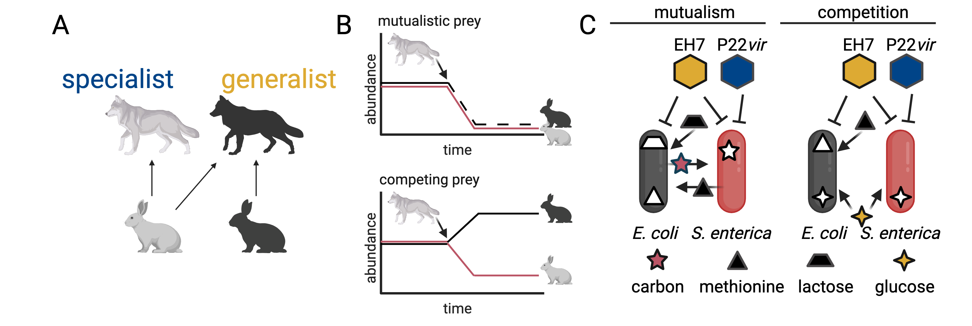
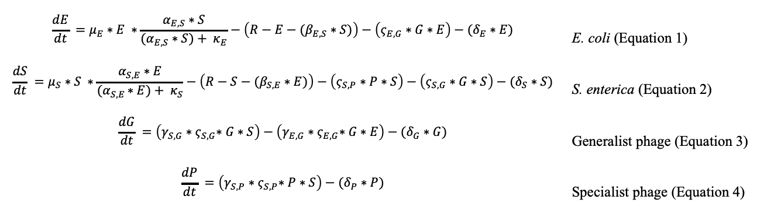
A
B
C
D
$$\frac{dE}{dt} =μ_{E}∗E ∗\frac{α_{E,S}∗S}{{(α}_{E,S} ∗S)+ κ_{E}}−\left(R−E−(β_{E,S}∗S)\right)−\left(ς_{E,G}∗G∗E\right)−(δ_{E}∗E)$$ | E. coli (Equation 1)
$$\frac{dS}{dt} =μ_{S}∗S ∗\frac{α_{S,E}∗E}{{(α}_{S,E }∗E)+ κ_{S}}−\left(R−S−(β_{S,E}∗E)\right)−\left(ς_{S,P}∗P∗S\right)−\left(ς_{S,G}∗G∗S\right)−(δ_{S}∗S)$$ | S. enterica (Equation 2)
$$\frac{dG}{dt} =\left(γ_{S,G}{∗ς}_{S,G}∗G∗S\right)−\left(γ_{E,G}{∗ς}_{E,G}∗G∗E\right)−(δ_{G}∗G)$$ | Generalist phage (Equation 3)
$$\frac{dP}{dt} =\left(γ_{S,P}{∗ς}_{S,P}∗P∗S\right)−(δ_{P}∗P)$$ | Specialist phage (Equation 4)

