Slide 1
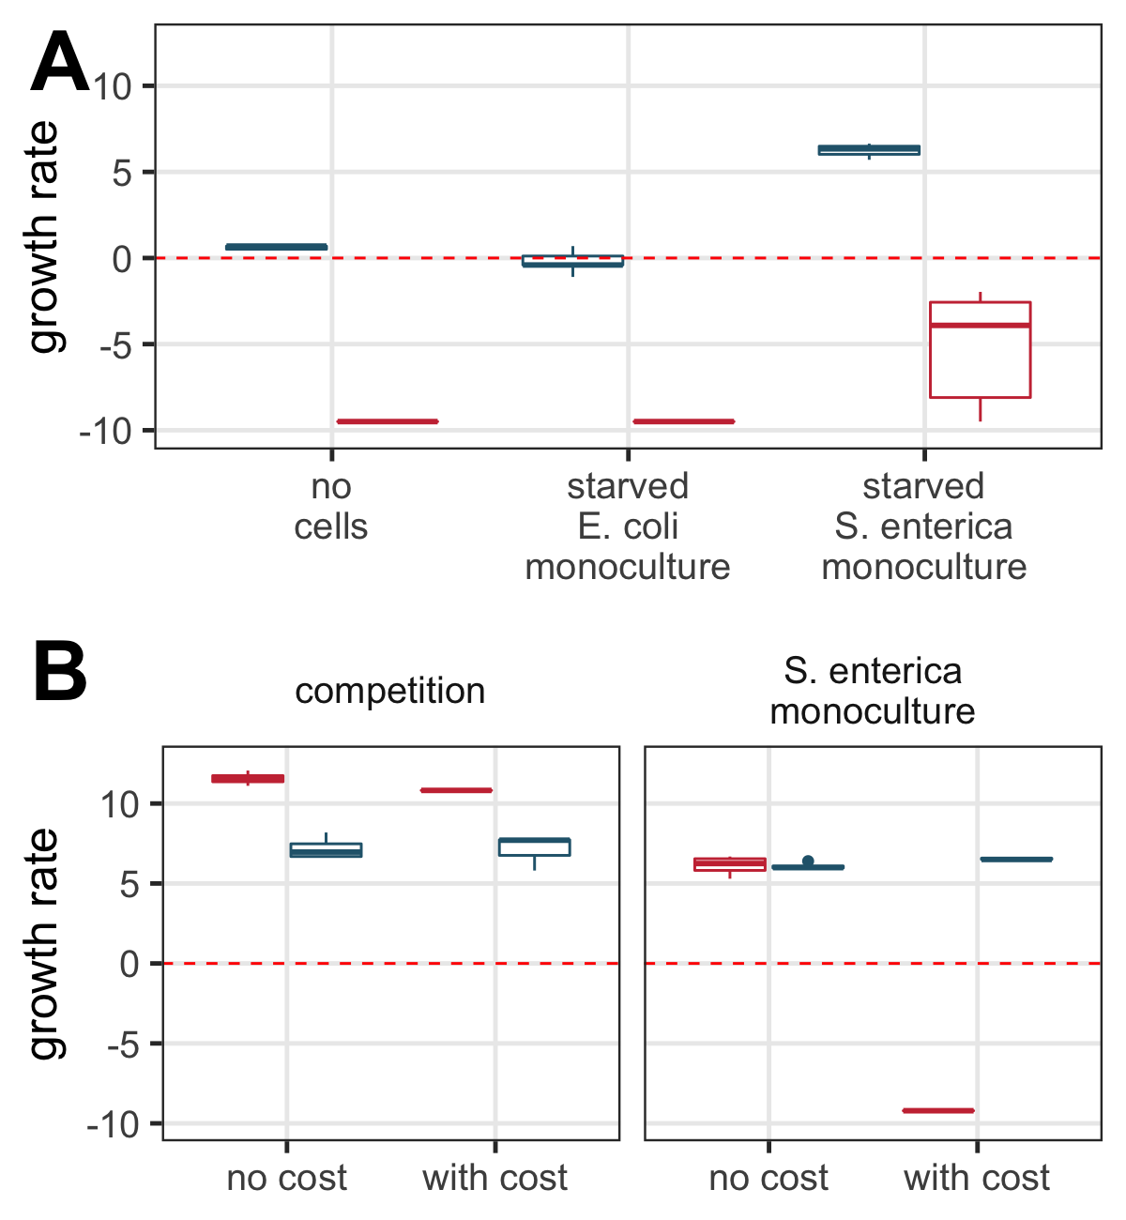
***
***
***
ns
ns
***
***
ns
ns

Slide 2
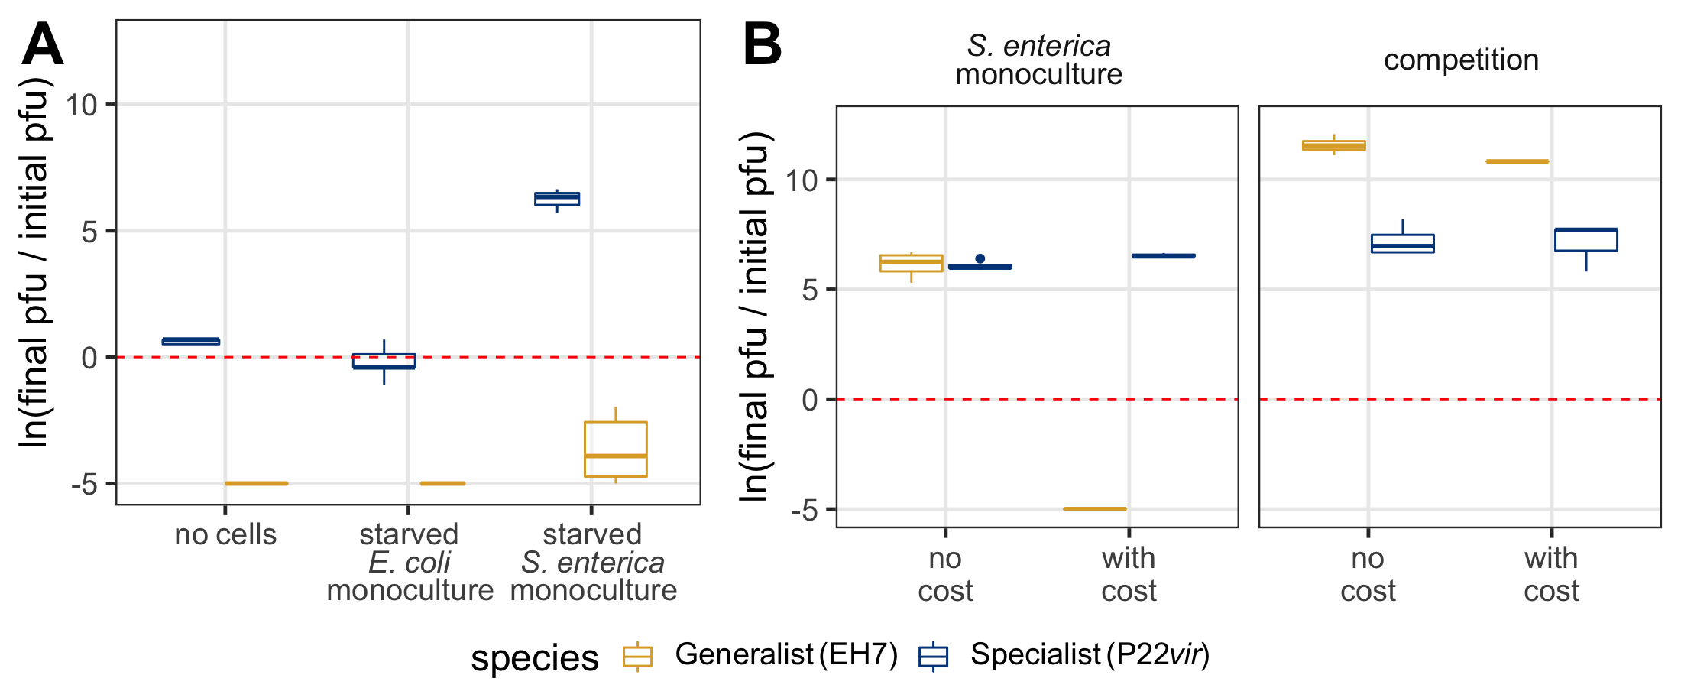

***
ns
ns
ns
ns
ns
Increase in titer
Decrease in titer
Increase in titer
Increase in titer
Decrease in titer
Decrease in titer

Slide 3
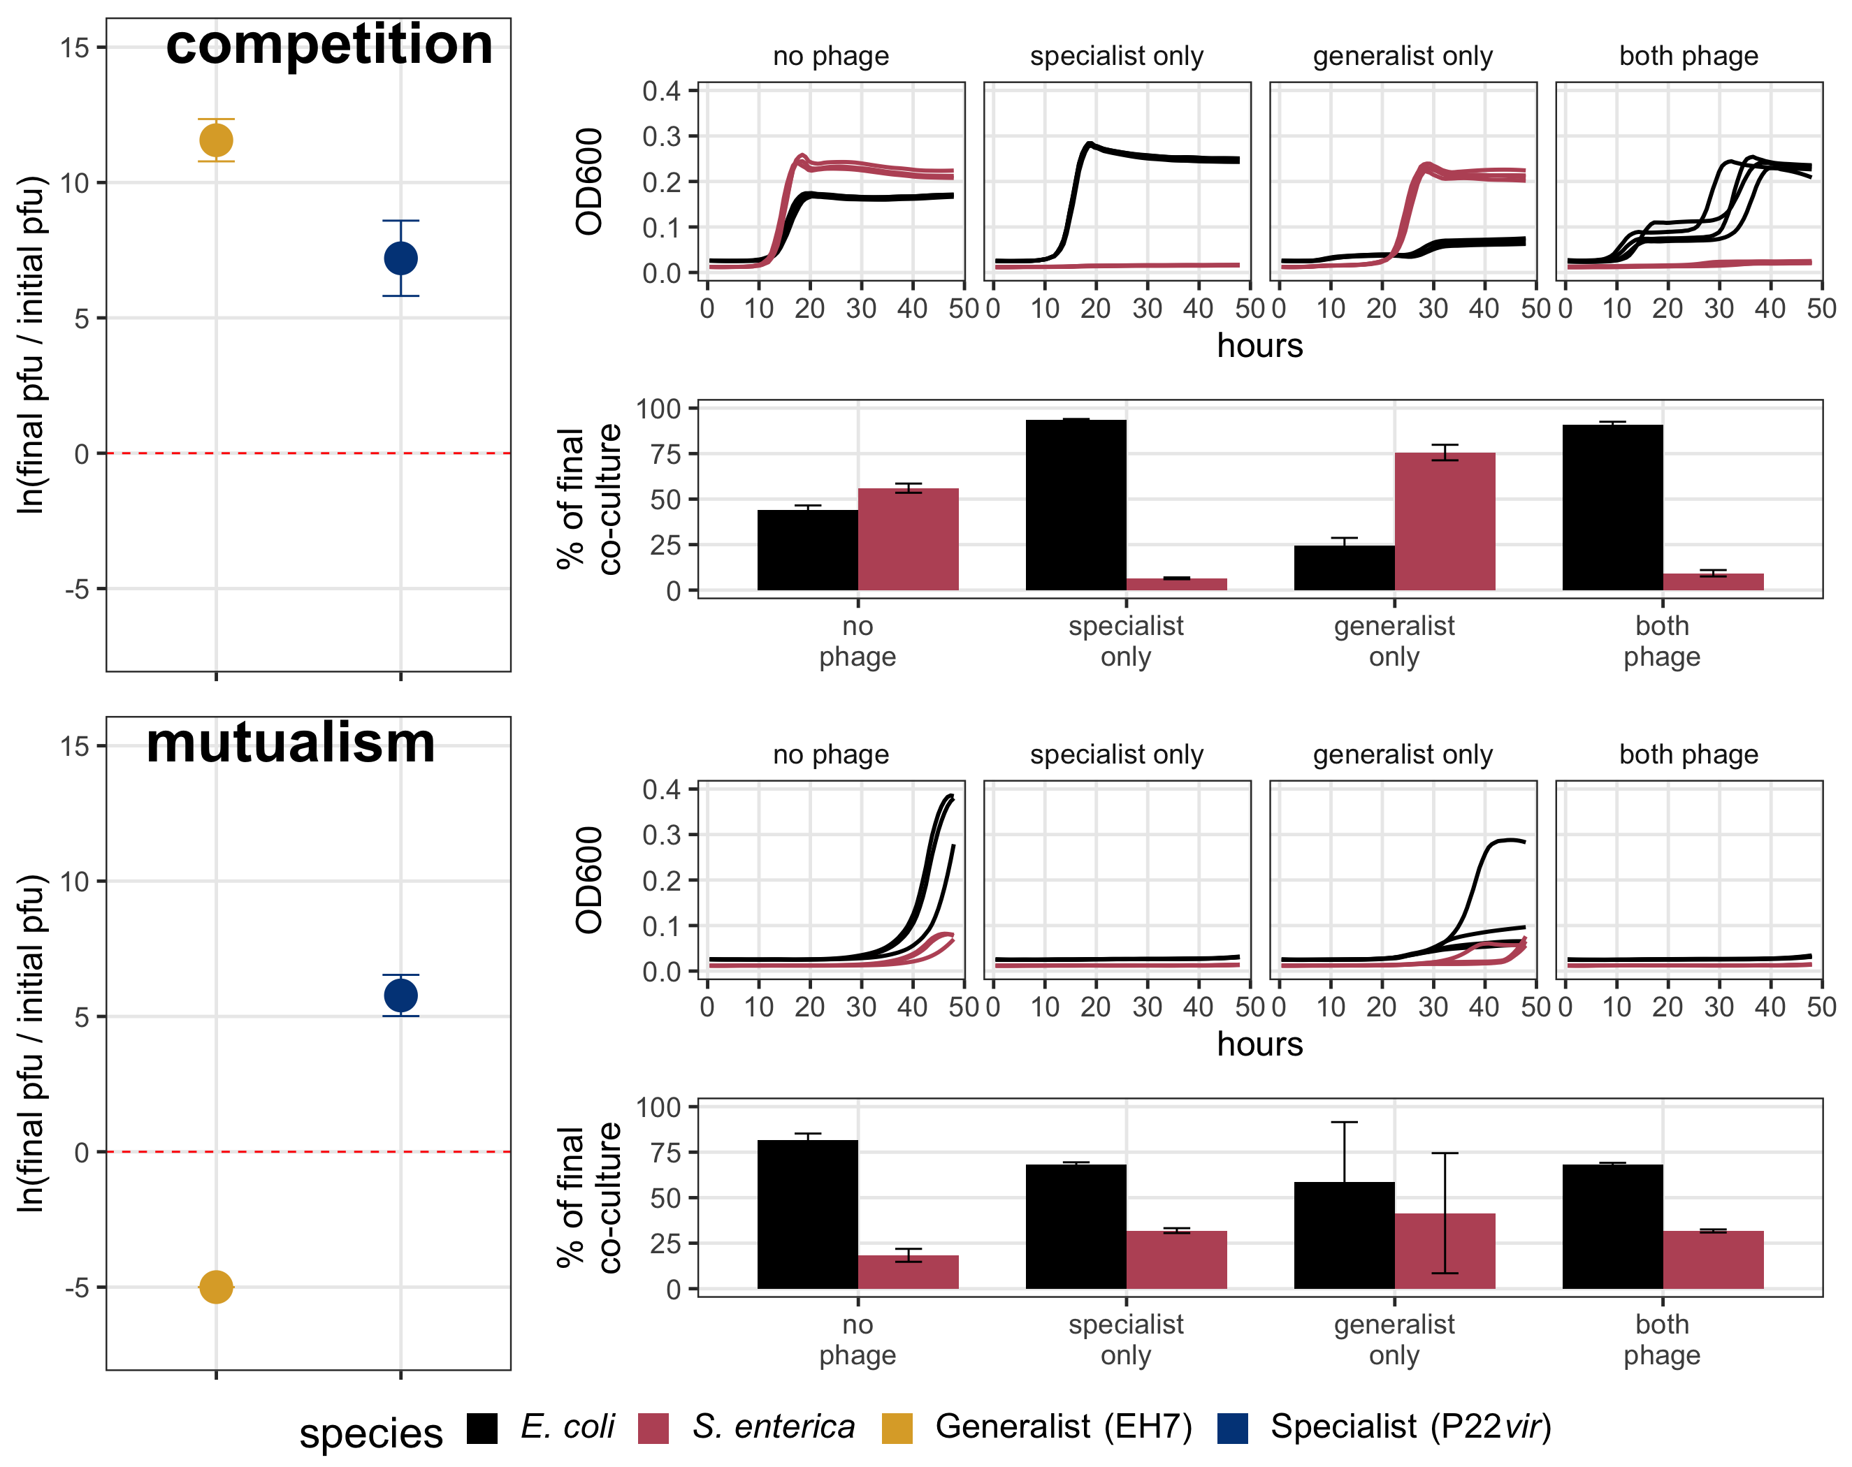
***
Increase in titer
ns
Decrease in titer
***
Increase in titer
Decrease in titer
Below the limit of detection

