Slide 1
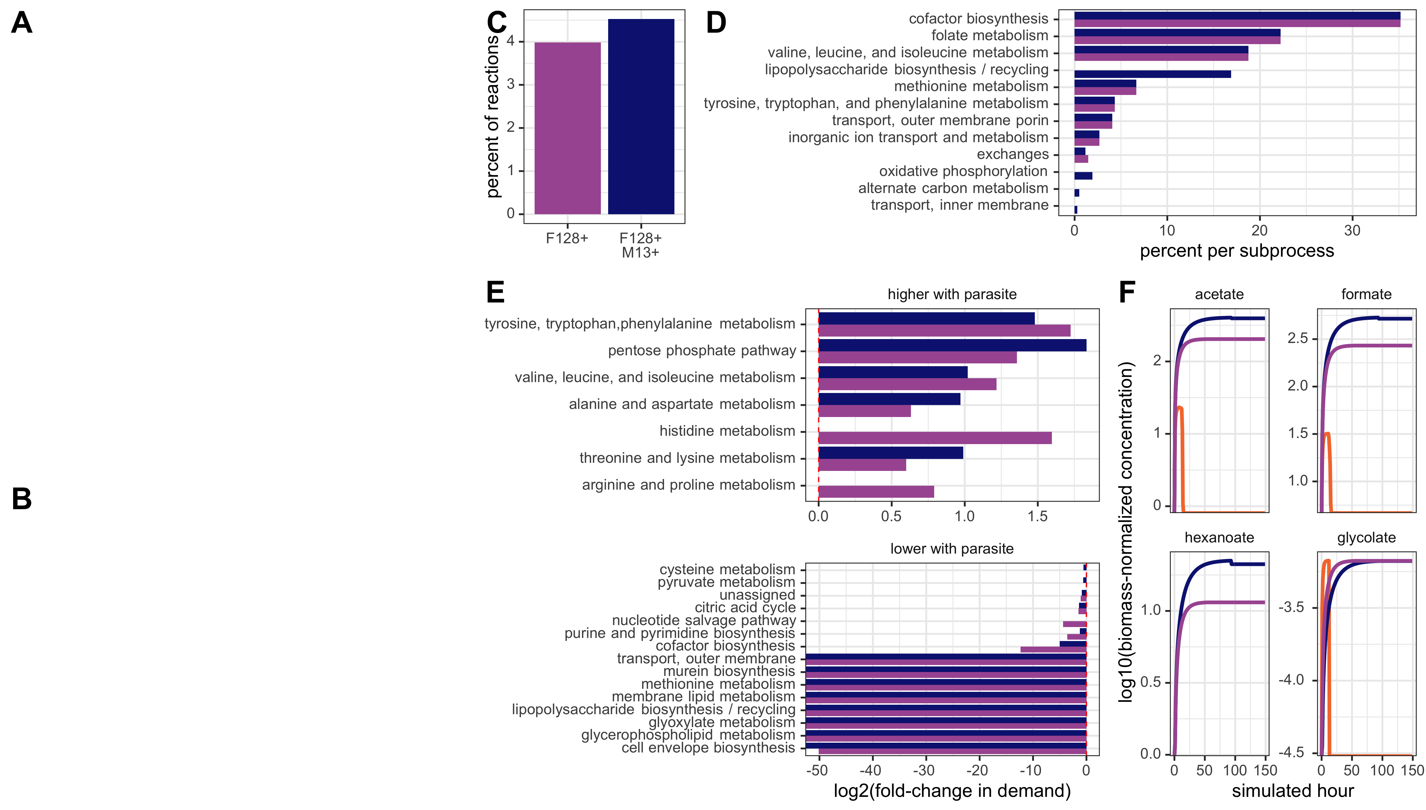

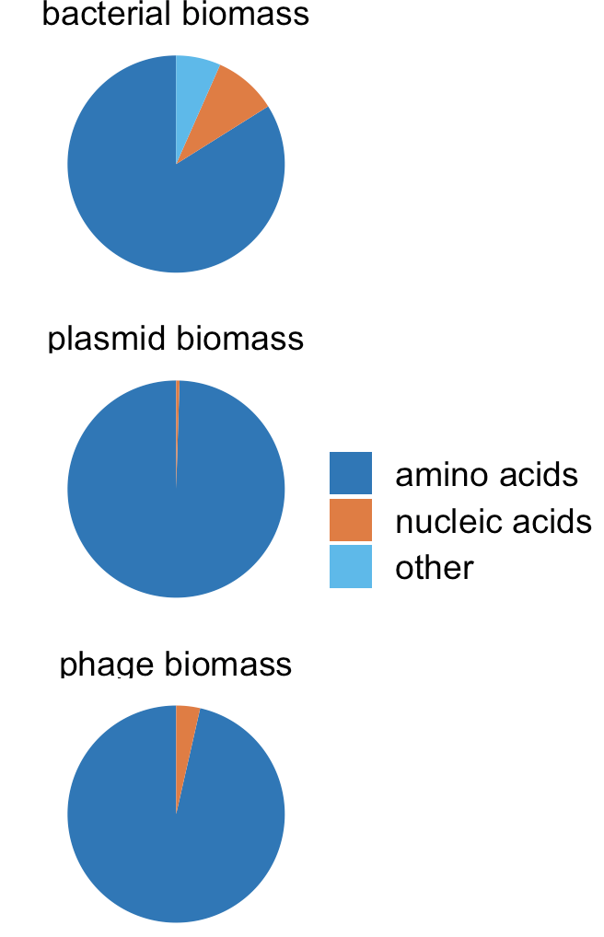







Methylamine
M
NH₄⁺
S
M. extorquens ∆hprA
S. enterica
NH₄⁺
Carbon
Methionine
Lactose
E
E. coli ∆metB
E
F128+
F128+ M13+
Uninfected E. coli
F-infected E. coli
F-infected, M13-infected E. coli
Bacterial biomass
uninf
Bacterial biomass
Plasmid biomass
F128+
Bacterial biomass
Plasmid biomass
F128+
M13+
Phage biomass

