Slide 1
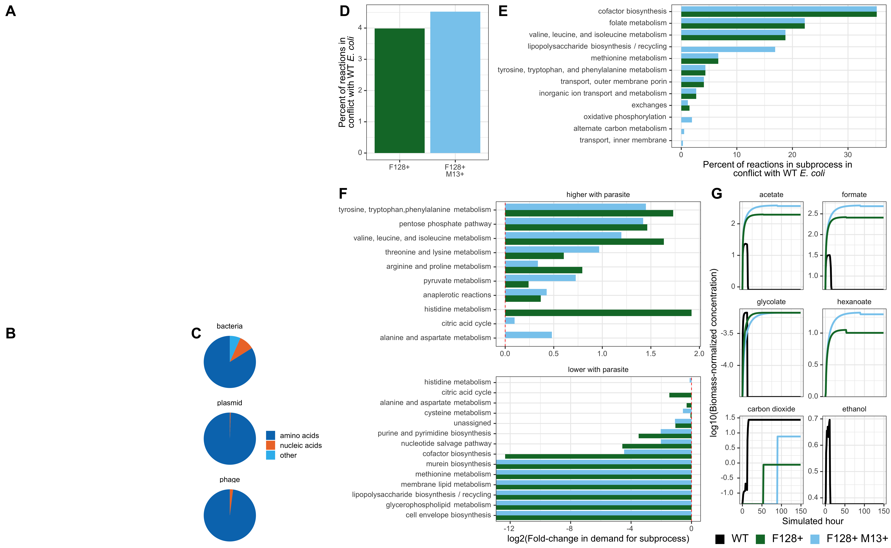








Methylamine
M
NH₄⁺
S
M. extorquens ∆hprA
S. enterica
NH₄⁺
Carbon
Methionine
Lactose
E
E. coli ∆metB
E
F128+
F128+ M13+
Wild-type E. coli
F-positive E. coli
F-positive, M13-positive E. coli
Bacterial biomass
WT
Bacterial biomass
Plasmid biomass
F128+
Bacterial biomass
Plasmid biomass
F128+
M13+
Phage biomass

