Slide 1

Internship CSE4056
Presented by:
Md. Isteak Uddin
ID: 2016000000232
Batch: 42
Program: BSc. in CSE Southeast University
Co-Supervised by:
Md. Sohrab Uddin CEO
Aajhat.com

Slide 2
Internship Title:
“Web Design And Development”

Slide 3
Outline
Where, Why and When?
Who supervised me?
What I did?
What I learn?
How I learn?
Demonstration
Limitations
Achievements

Slide 4
Where, Why and When?
Aajhat.com
Friendly Environment
Flexible working hour
Opportunity to learn lot of things
Lots more…..
Position
Junior Software Developer
Started working from June 1, 2020
Internship Period: 3 Months
Remote Job
40 hours/week

Slide 5
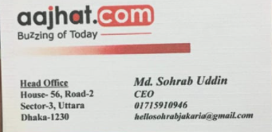
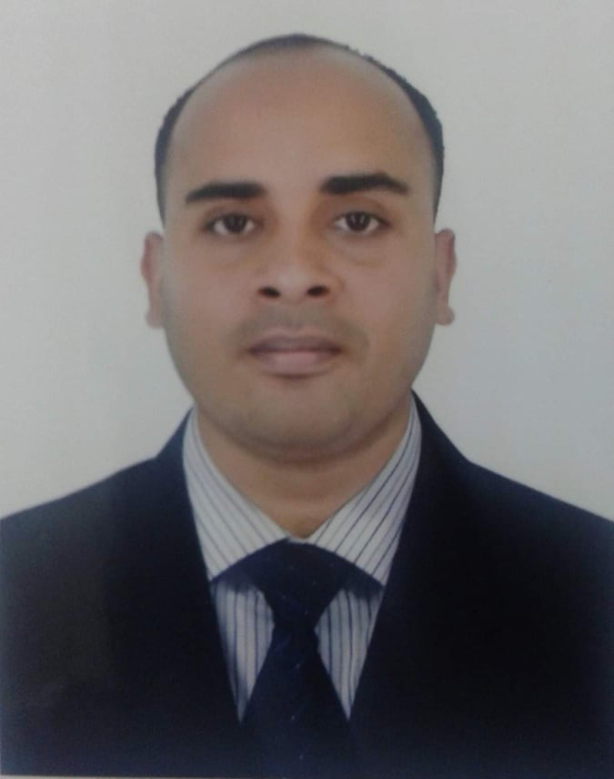
Who Supervised Me?
Visiting Card
Co-Supervisor
Md. Sohrab Uddin
CEO
Aajhat.com

Slide 6
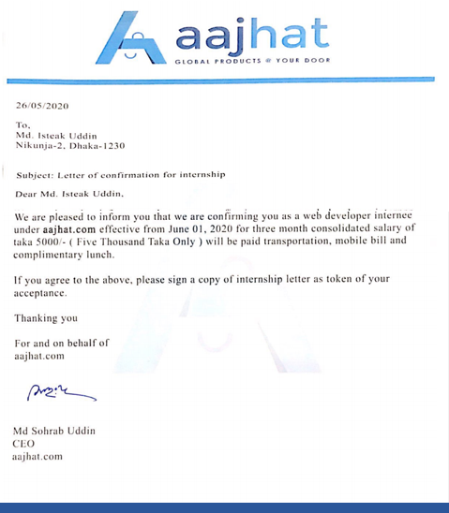
Letter of Appointment

Slide 7
About The Company
Aajhat.com is a new modern brand and digital marketing agency in Bangladesh.
They try to create a platform of E-commerce website selling and also provide a best service for them.
They have expertise in branding, innovation, design, digital marketing and Social Media and analytics to drive measurable results for aajhat.com.
They provide a holistic suite of market-leading services marketing solutions for small businesses to bespoke brand strategies, branding systems and fully integrated digital campaigns for larger enterprises.

Slide 8
What I did?
What I learnt?
How I learnt?
YouTube Channels
TutorialsPoint
W3Schoo website
University Classes
Meeting with colleagues
HTML,CSS,JAVASCRIPT
NODE.JS
MongoDB

Slide 9
Internship Details
Building a Responsive web application which serves a number of services to the consumer.
The app my company was developing at that time was called LUXXU
The web app can communicate with the users by sending feedback
It can take user input and serve the user as needed

Slide 10
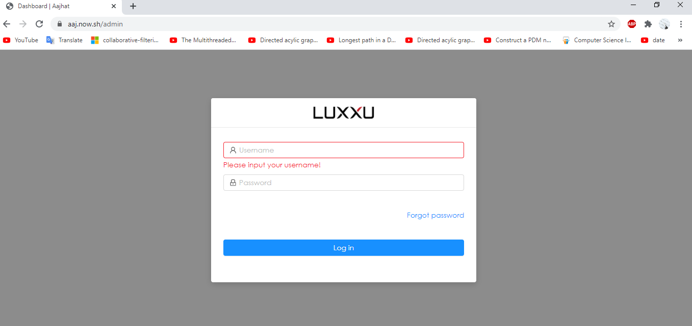
Ongoing project
Notes:
Now the demonstrate part, here is the jHipster Registry. First question what is jHipster, JHipster is a development platform to generate, develop and deploy Spring Boot + Angular Web applications and Spring microservices. Microservices means small parts like Student information is a Microservices which microservice returns me student data. Similarly course is a Microservices which microservice returns me course data. Why we choose Microservice Architecture, think I need to update a student module so to update one module I will have to stop full application and update that module which is like as Monolithic Architecture. But in microservices I can simply update or scale up any service without hampering any other service. So need a Registry which can register all of the service that is the work of this service.

Slide 11
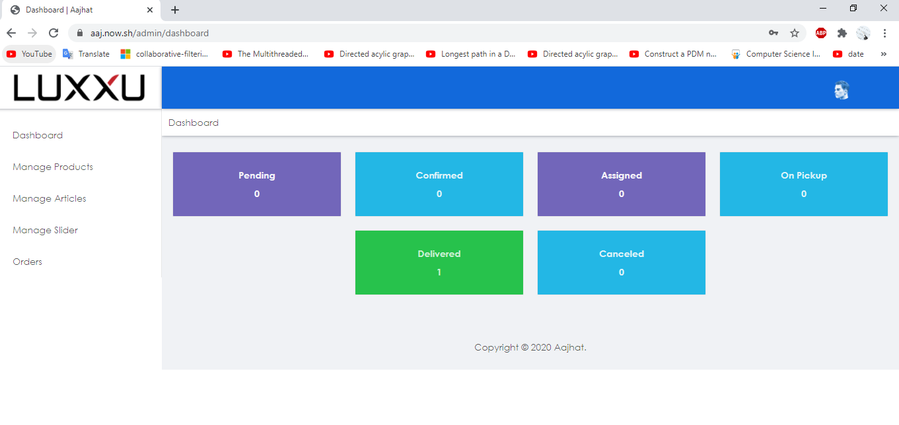
Ongoing project

Slide 12
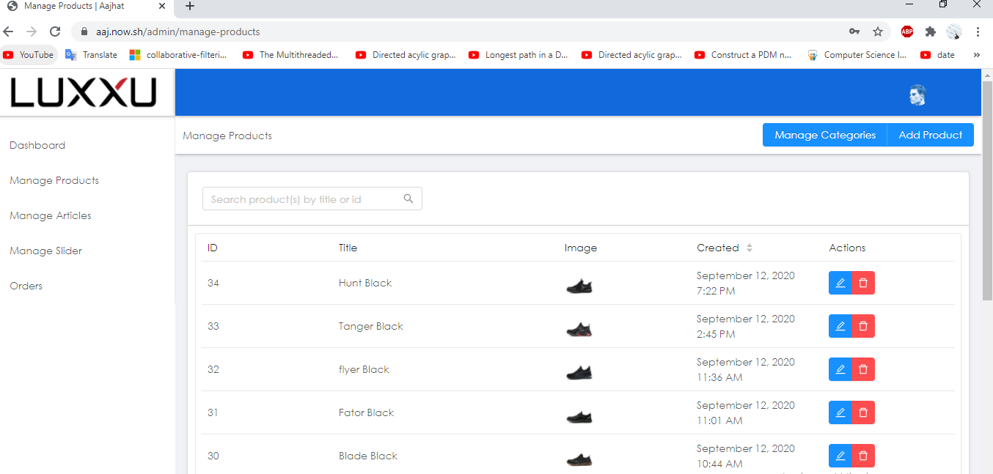
Ongoing project

Slide 13
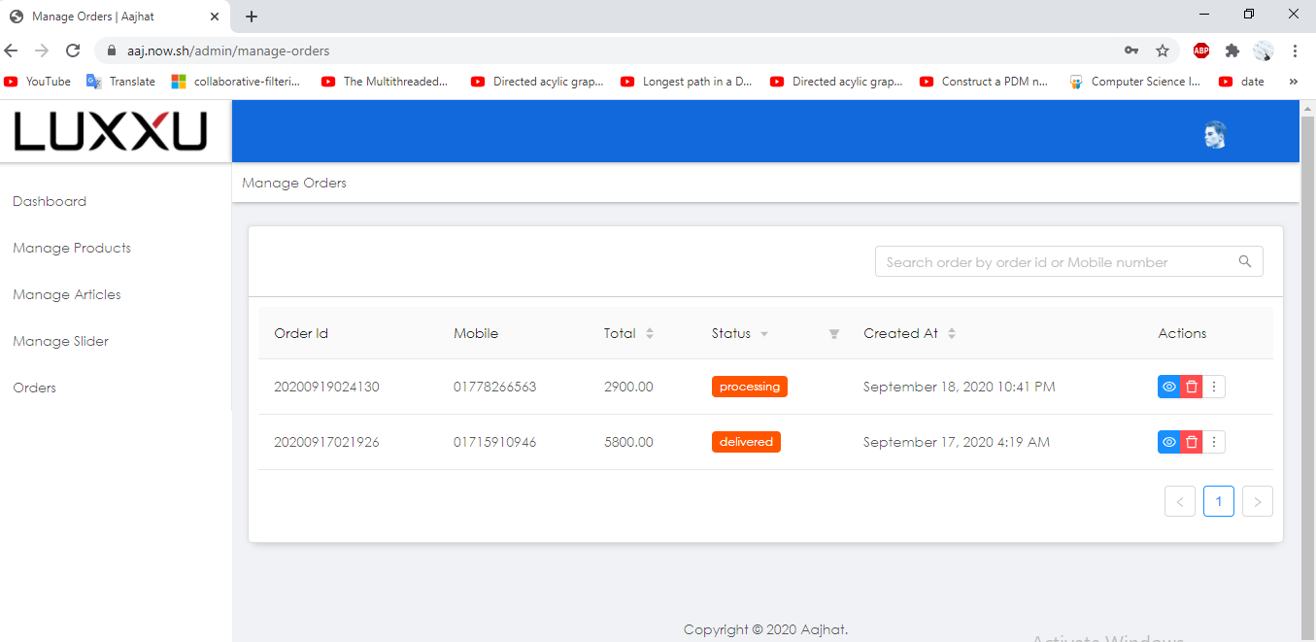
Ongoing project

Slide 14
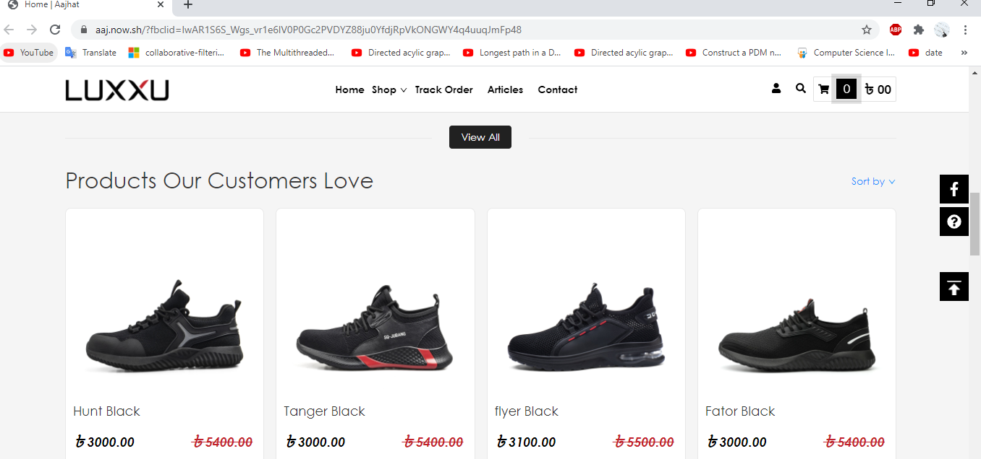
Ongoing project

Slide 15
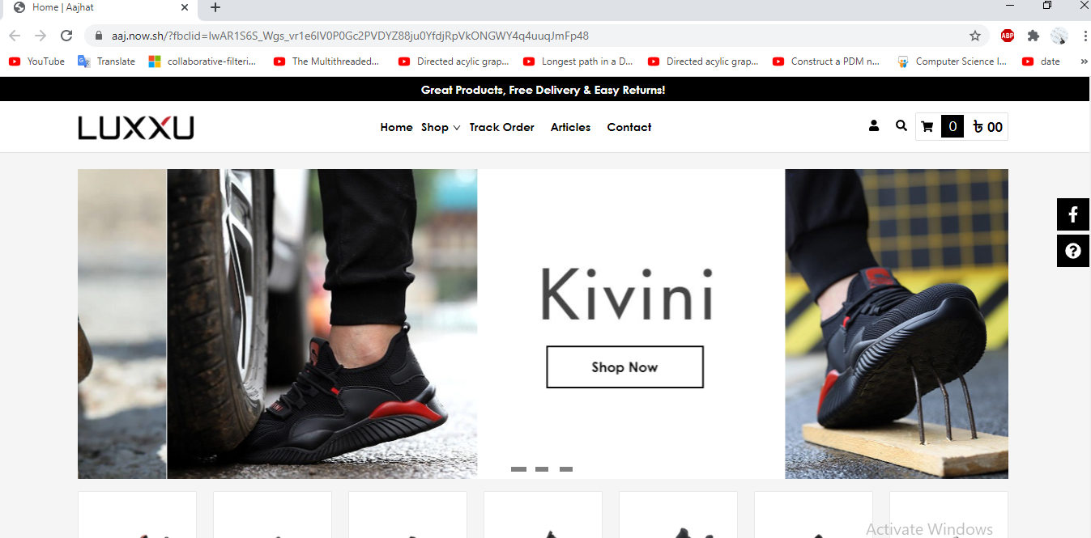
Ongoing project

Slide 16
Achievements
Team Work
Lot of Experience
Requirement Analysis
...and more

Slide 17
Limitations
Since I had to work remotely from home because of the Coronavirus Pandemic, I could not get intoduced to the full official environment.
Communications with my colleagues were not easy,as most of the communications were done over phone.
Notes:
So, now what is the limitation of my work. First ISDT is very new department of SEU so there office decoration and others thing was not ready on exact time. All platform is new to full team, it takes lot of time to learn and implement. You see that there are lot of Microservice need to learn so we need high configuration PC which I don’t have.

Slide 18
..Thank You..

