Slide 1

SOUTHEAST UNIVERSITY
Presentation Session of Internship
Final Examination

Slide 2

Work portion
Web Design And Development

Slide 3
Presented By:
Supervisor:
MD. Ashraful Hoque
Lecturer & Coordinator
Department of CSE
Southeast University
Shimul Chandra Shil
2017000000139
Batch: 45th
Bishajit Chakraborty
2018000000010
Batch: 48th

Slide 4
Outline
What is Freelancing ?
About The Fiverr Marketplace
Technologies
What we Do ?
Fiverr Achievement
Future Goals

Slide 5
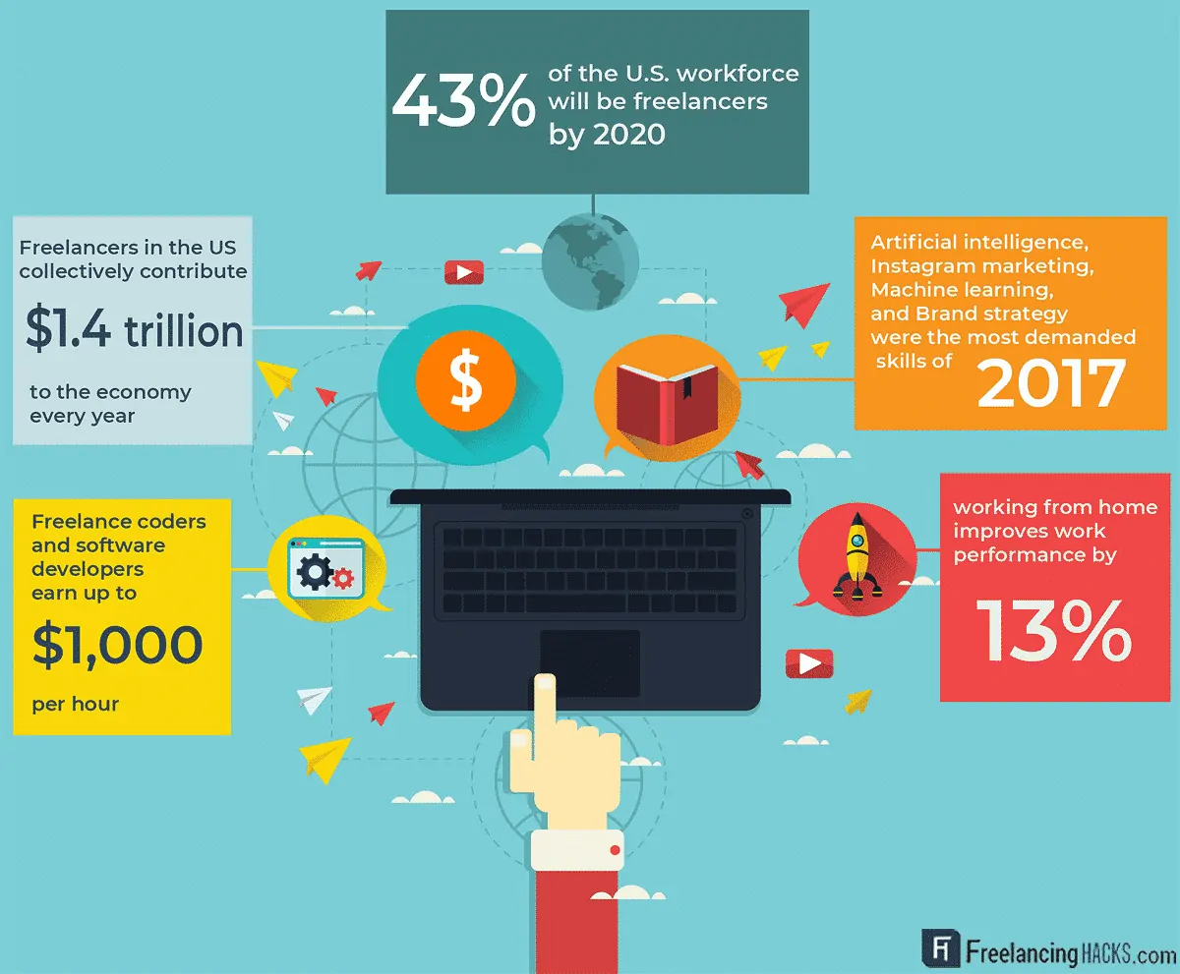
What is Freelancing ?
Freelancing is a contract-based profession where instead of being recruited in an organization , the person uses his skills and experience to provide services to a number of clients.
In simple terms, freelancing is when we use our skills, education, and experience to work with multiple clients and take on various assignments without committing to a single employer. The number of assignments or tasks that we can take just boils down to our ability to deliver on them as asked from them.

Slide 6

About The Fiverr Marketplace
Fiverr is the world's largest marketplace for digital services where individuals or companies can go to find freelancers with a skill that suits their needs, and it is considered a "micro-task" site, where you can do relatively quick, small one-off tasks which they call gigs.

Slide 7

Seller levels at Fiverr
seller level is based on monthly performance. Superb service, high buyer satisfaction, and on-time delivery can earn a top-level status on Fiverr, and help get more traffic and orders.

Slide 8


What we learned from Fiverr ?
How to survive the competition
How to manage a client
Client Communication

Slide 9



Work Portion
Javascript
Wordpress
Wix

Slide 10
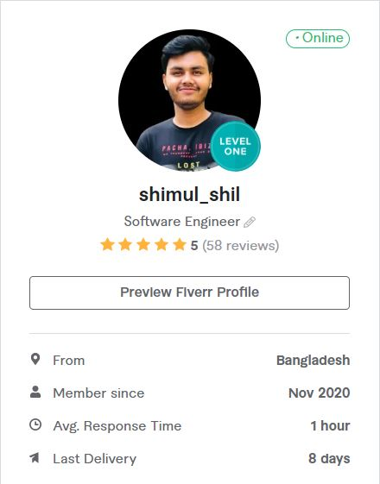
Fiverr Profile
COMPLETED 81 Project
5Star 58 Reviews

Slide 11
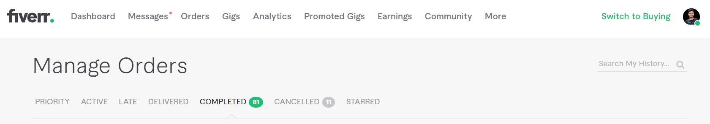
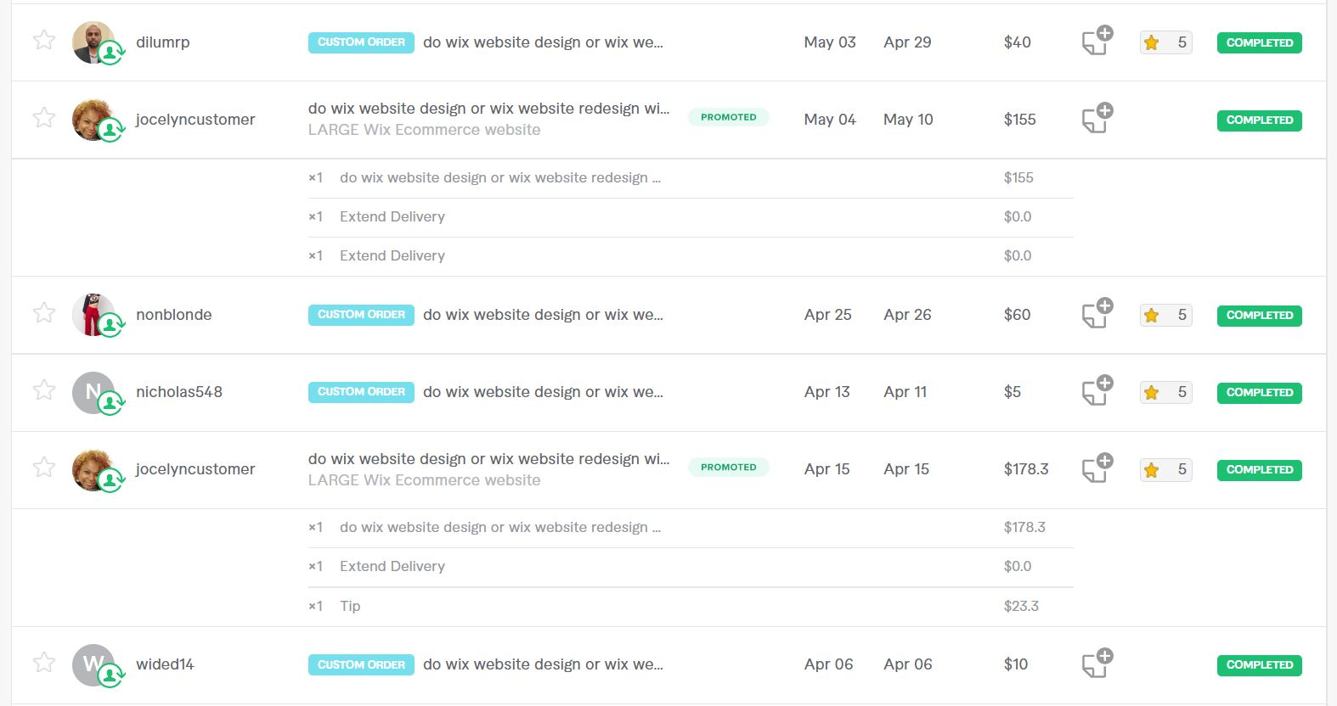
Work History

Slide 12
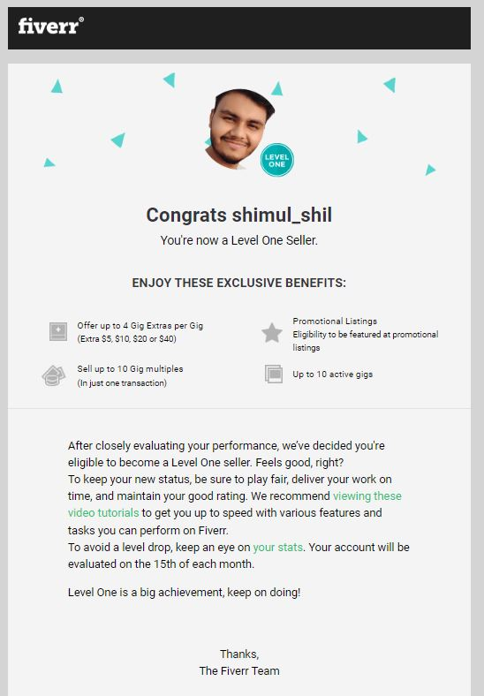
Great Achievement From Fiverr

Slide 13
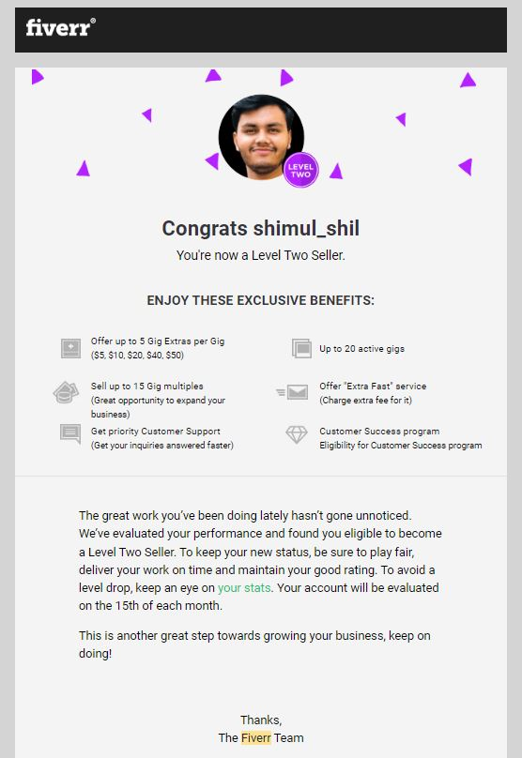
Great Achievement From Fiverr

Slide 14
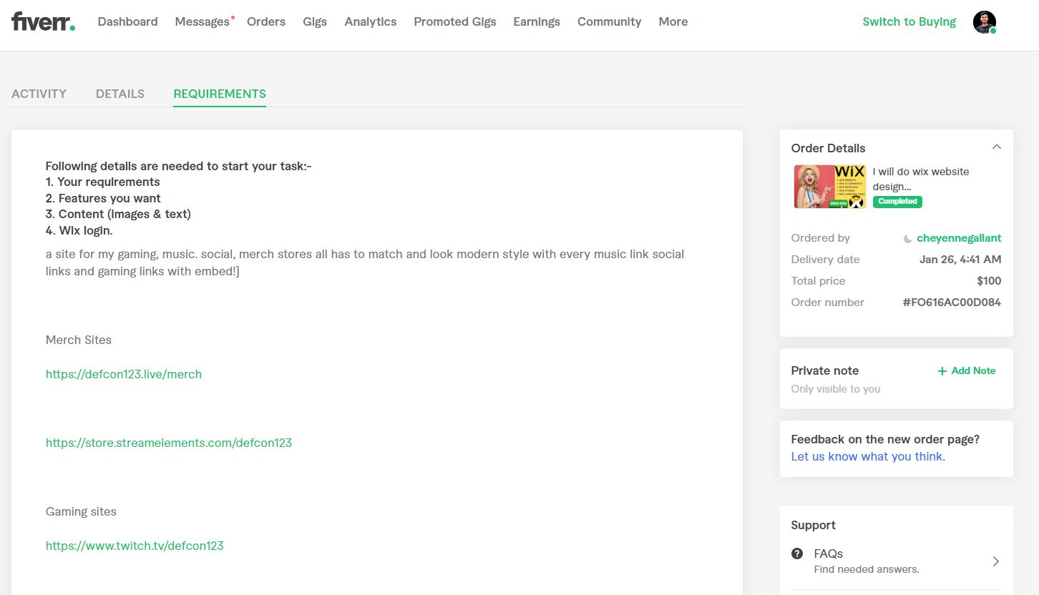
Project Requirements from client

Slide 15
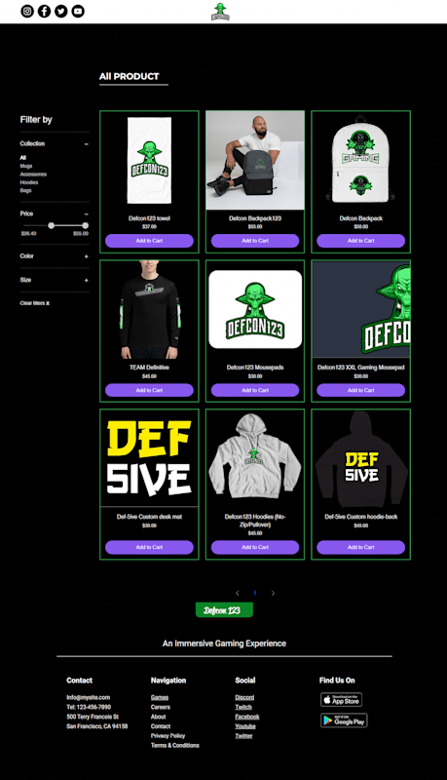
Project Development

Slide 16
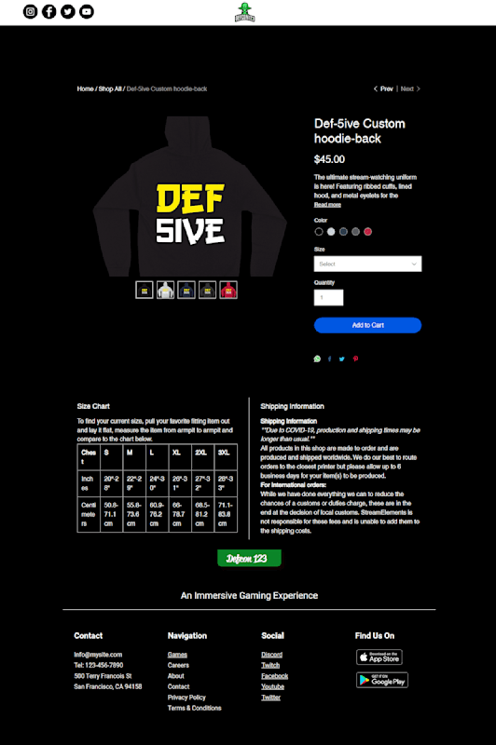
Project Development

Slide 17
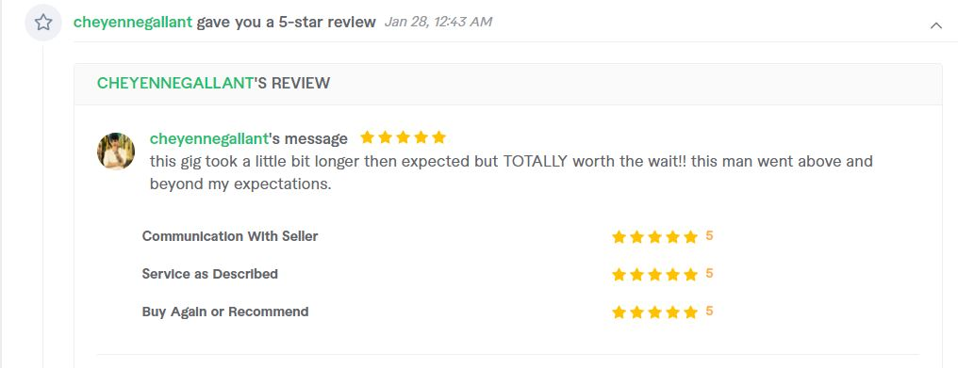
Client Feedback

Slide 18
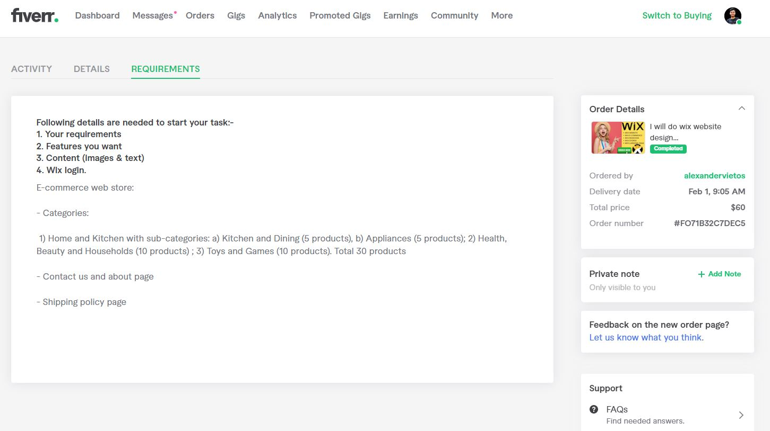
Project Requirements from client

Slide 19
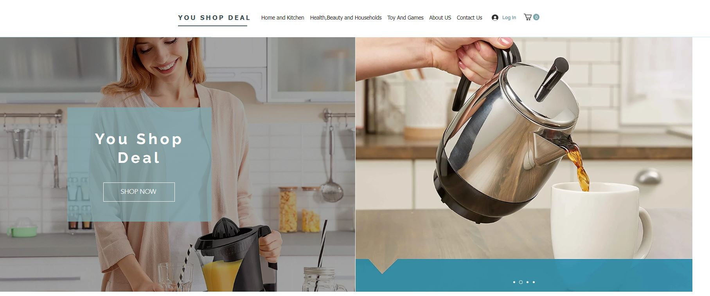
Project Development

Slide 20
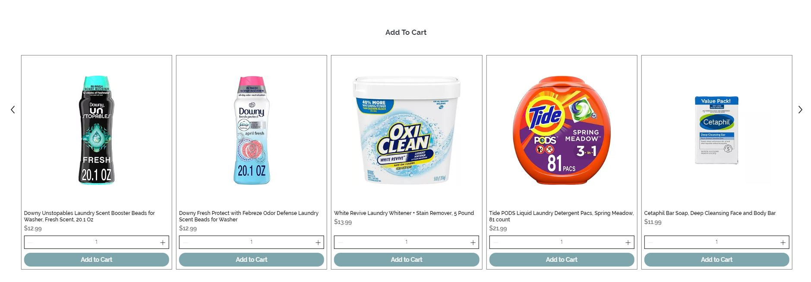
Project Development

Slide 21
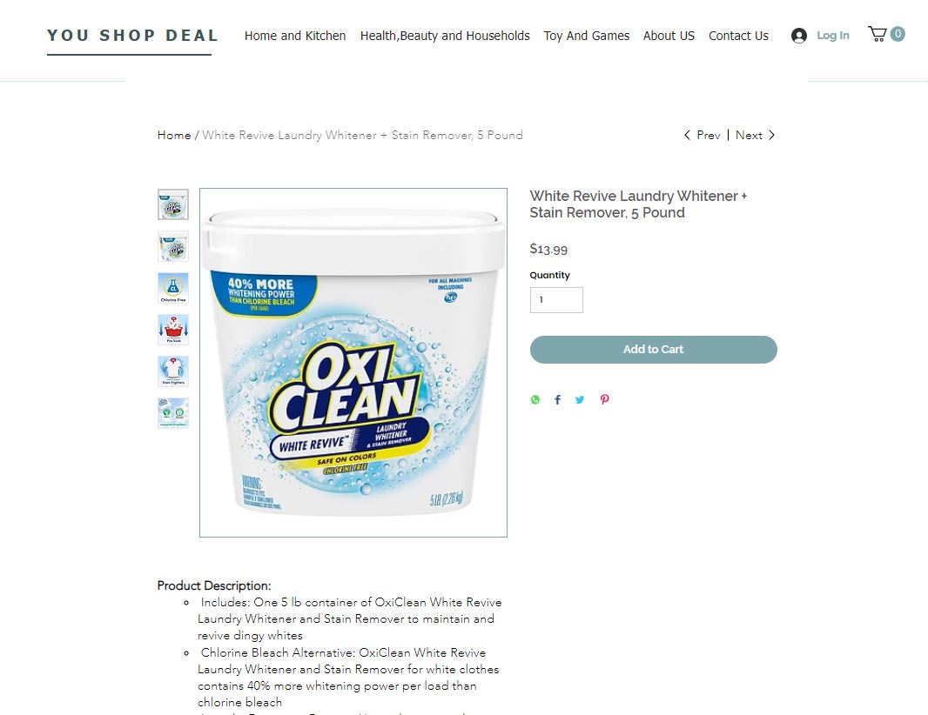
Project Development

Slide 22
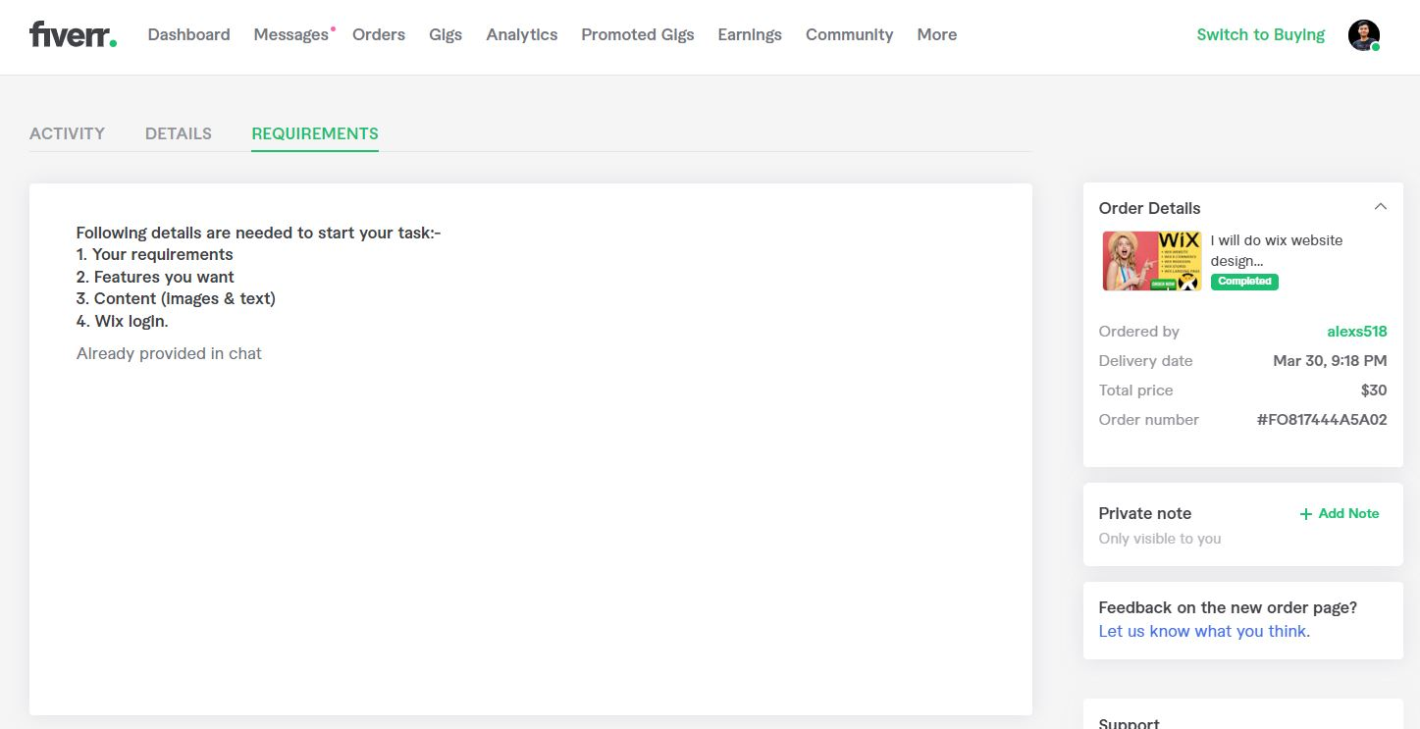
Project Requirements from client

Slide 23
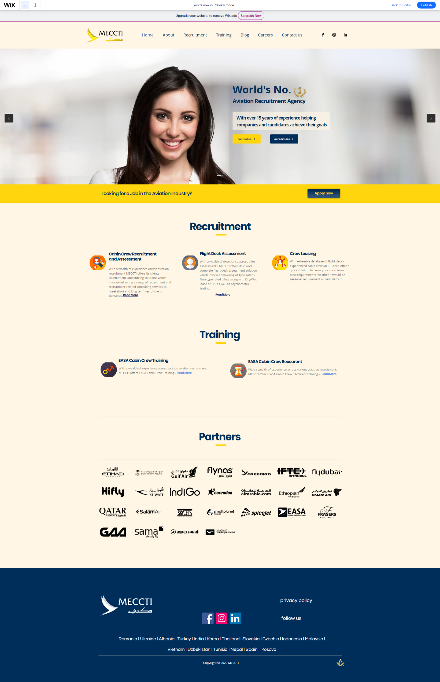
Project Development

Slide 24
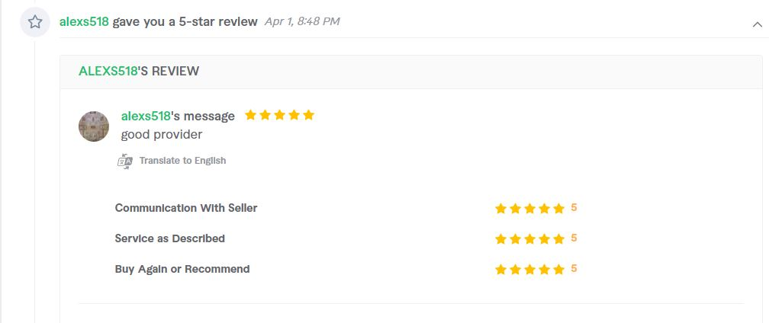
Client Feedback

Slide 25
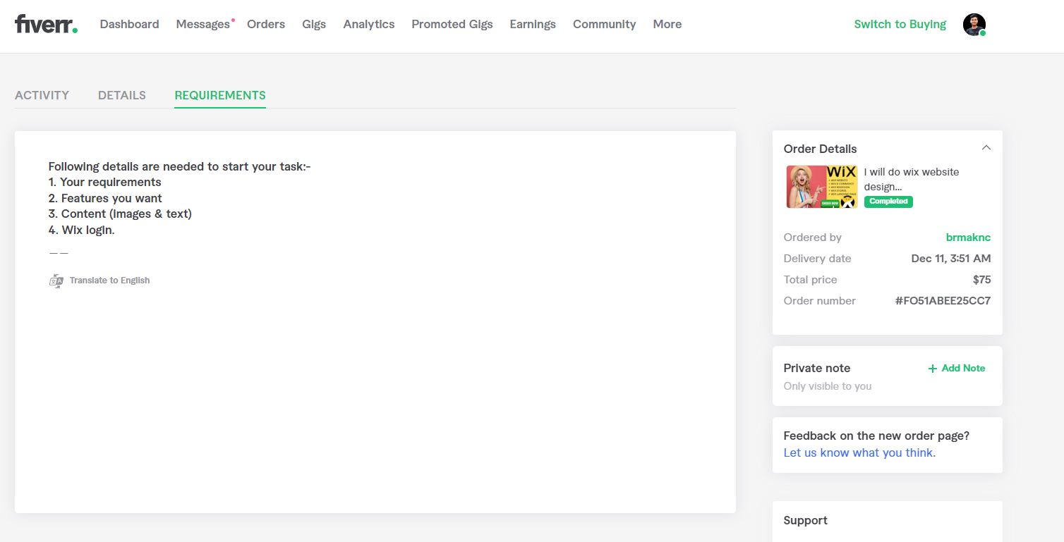
Project Requirements from client

Slide 26
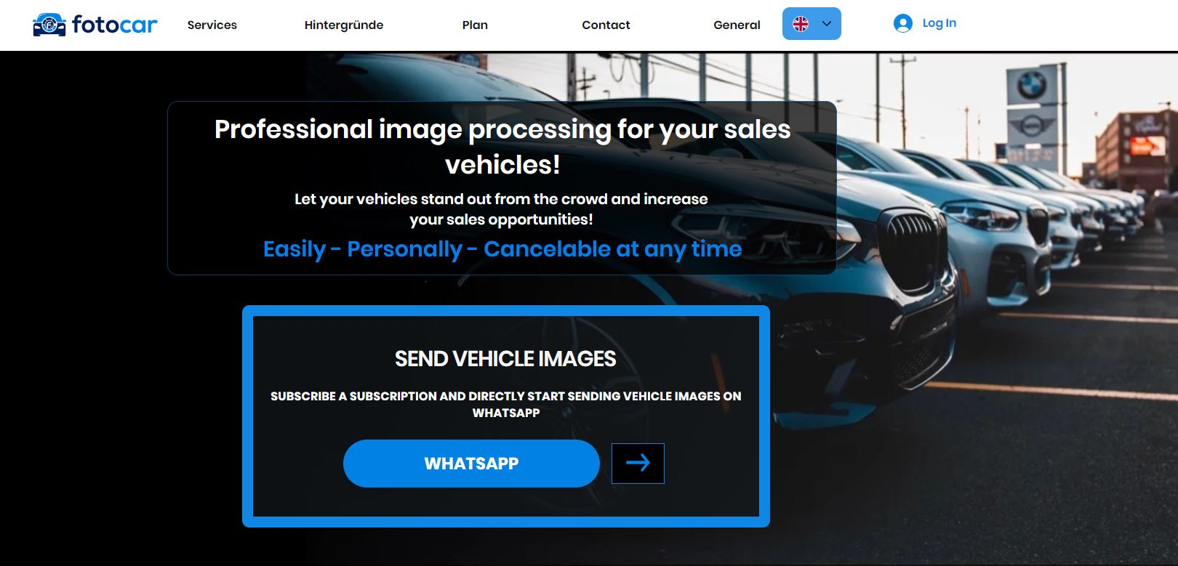
Project Development

Slide 27
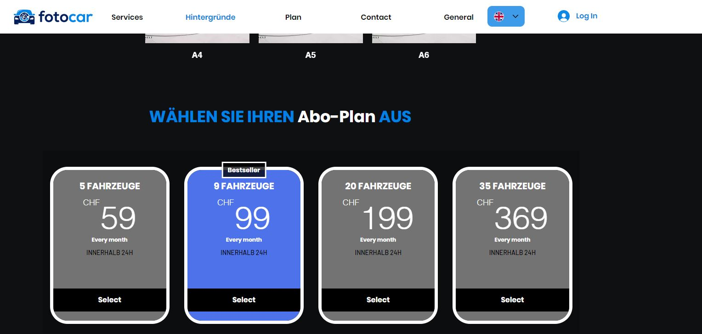
Project Development

Slide 28
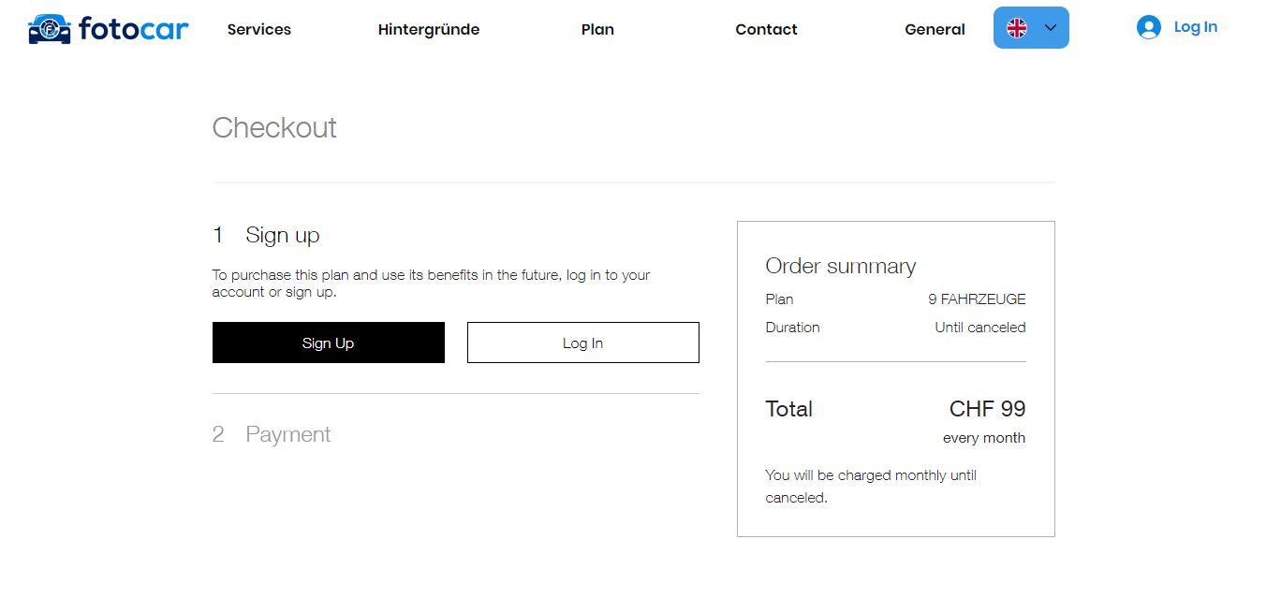
Project Development

Slide 29
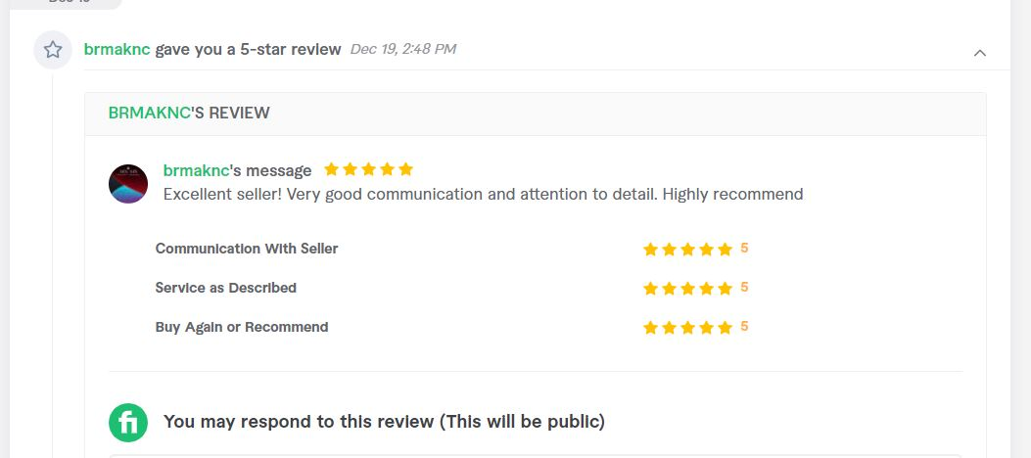
Client Feedback

Slide 30

Future Goals
We want to provide employment to many people in the future! So we dream of a software agency.

Slide 31


