Slide 1
Student Success : Factors & Insights
ISE-201 Math Foundations for Decision and Data Sciences
Name: Bishakha
SJSU ID: 019178354

Slide 2
Understanding the Problem Statement
Objective
The performance of students may be affected by several factors such as parental involvement, access to resources, extracurricular activities, sleep hours, motivation, and socio-economic background. There can be a wide variety of factors , unique to each student. The goal of the EDA Project was to understand which factors contribute most to the academic success of students at mass level.
Dataset: https://www.kaggle.com/datasets/anassarfraz13/student-success-factors-and-insights

Slide 3
EDA Plan Review
Understanding the dataset
Exploring and Inspecting dataset
Handling the Missing values / Duplicates
Exploring Patterns in data ( Box Plots, Histograms, Count plots , scatter plot )
Handling the outliers
Transform the data ( Scale, Encode , Derive ratios/Columns)
Finding the Correlations
Insights ( Finding the answers and conclusion )

Slide 4
Understand , Inspect and clean the dataset
Shape : 6607 X 20
Categorical Features: "Parental_Involvement","Access_to_Resources","Extracurricular_Activities",
"Motivation_Level","Internet_Access","Family_Income","Teacher_Quality","School_Type","Peer_Influence","Learning_Disabilities","Parental_Education_Level","Distance_from_Home","Gender"
Numerical Features: "Hours_Studied","Sleep_Hours","Previous_Scores", "Physical_Activity", "Tutoring_Sessions", "Exam_Score", "Attendance"
dtypes: int64(7), object(13)
Check for duplicate rows : no duplicate rows found
Check for columns with Null Values
  Teacher quality : 78 rows
  Parental Education level : 90 rows
  Distance from home : 67 rows
  Use mode value to fill na values

Slide 5
Exploring Patterns in dataset
Look at the distribution of data using different plots
Used Box Plots , histograms for numerical features
Count plot diagram for categorical features
Features | Mean | Max | Std Dev. | Distribution
Hours_Studied | 19.975329 | 44.000000 | 5.990594 | Symmetric normal distribution
Attendance | 79.977448 | 100.000000 | 11.547475 | Symmetric normal distribution
Sleep_Hours | 7.02906 | 10.00000 | 1.46812 | Symmetric normal distribution
Previous_Scores | 75.070531 | 100.000000 | 14.399784 | Symmetric normal distribution
Tutoring_Session | 1.493719 | 8.000000 | 1.230570 | normal distribution with little right skewed
Physical_Activity | 2.967610 | 6.000000 | 1.031231 | normal distribution with little right skewed
Exam_Score | 67.235659 | 101.000000 | 3.890456 | normal distribution with little left skewed

Slide 6
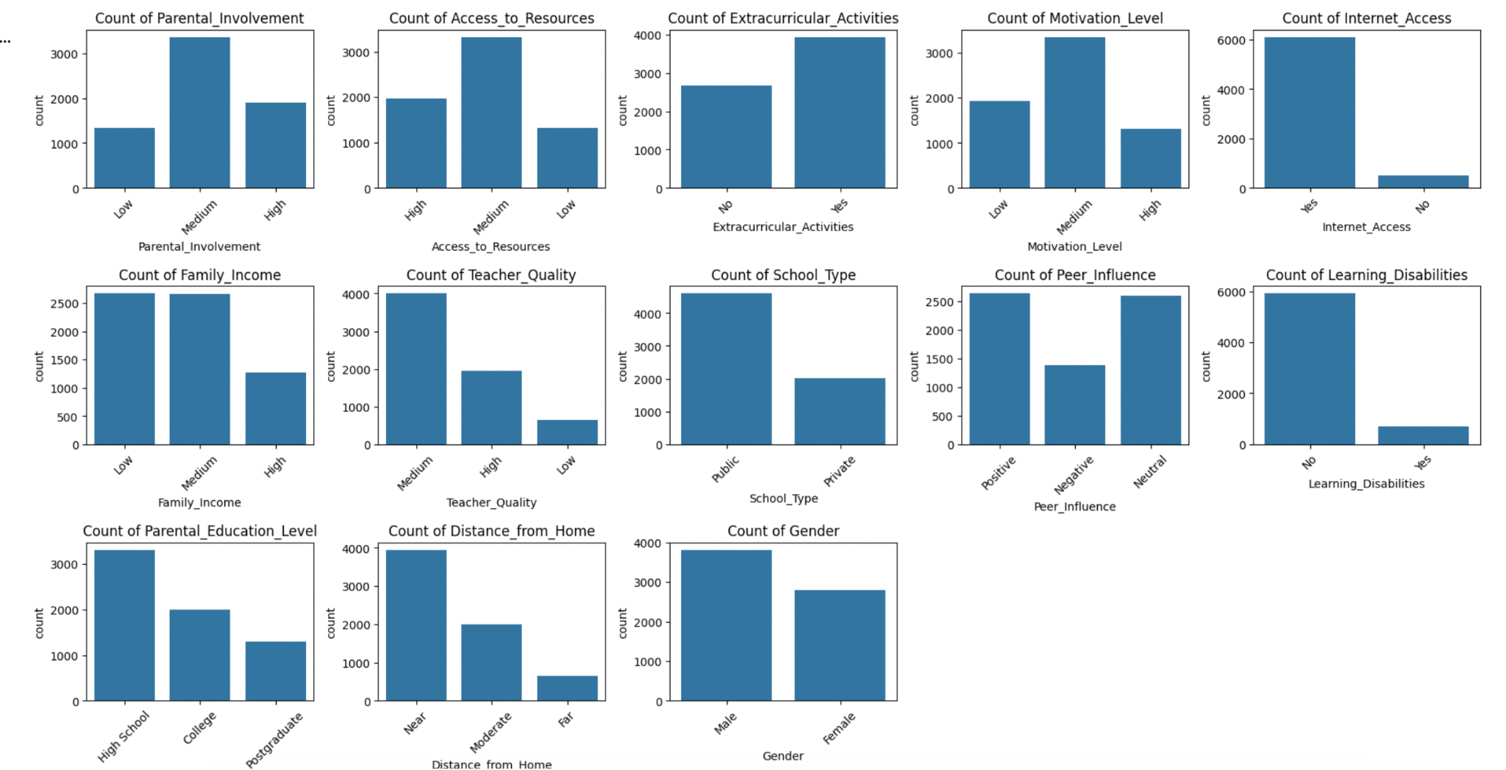
CountPlot for Categorical Features
Normally distributed
Few features Skewed to left and right

Slide 7
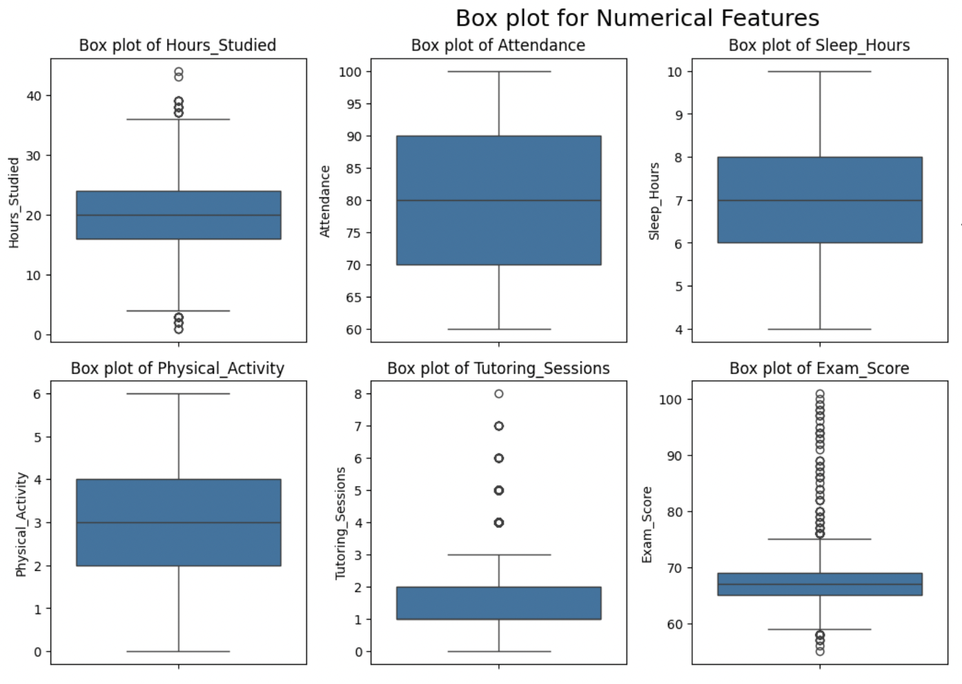
Box Plot for Numerical Features
Finding the outliers

Slide 8
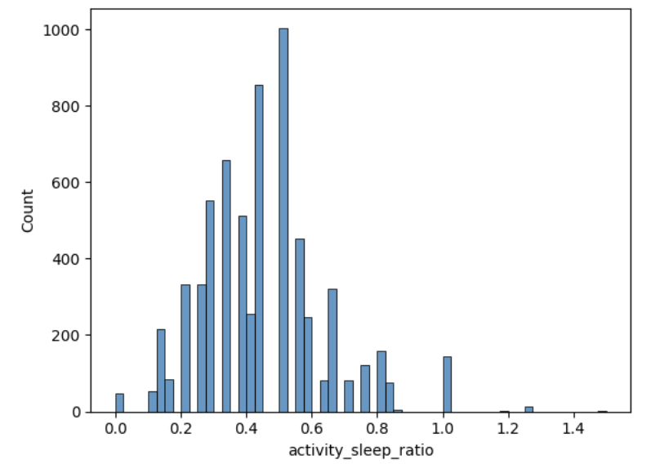
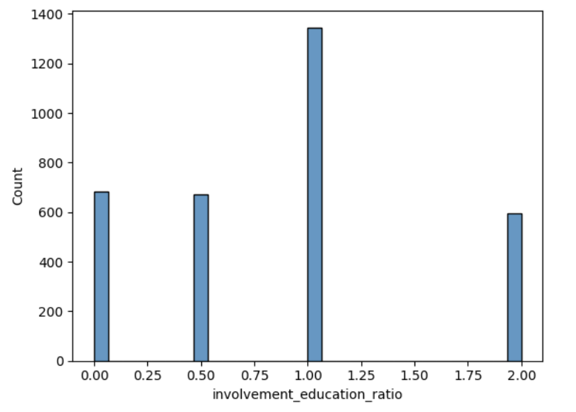
Handling the outliers
Outliers identified using box plots
  Exam Score : 1 student with 101 score , set to 100
  Tutoring Session : 1266 , no need to correct
  Hours Studied : May vary too much , so no need to handle
Transform the data
Scaling : No features holds large values.
Encoding : Ordinal encoding for most categorical features.
Ratios : Activity_to_Sleep_ratio , Parental_Education_Level_to_Parental_Involvment_ratio

Slide 9
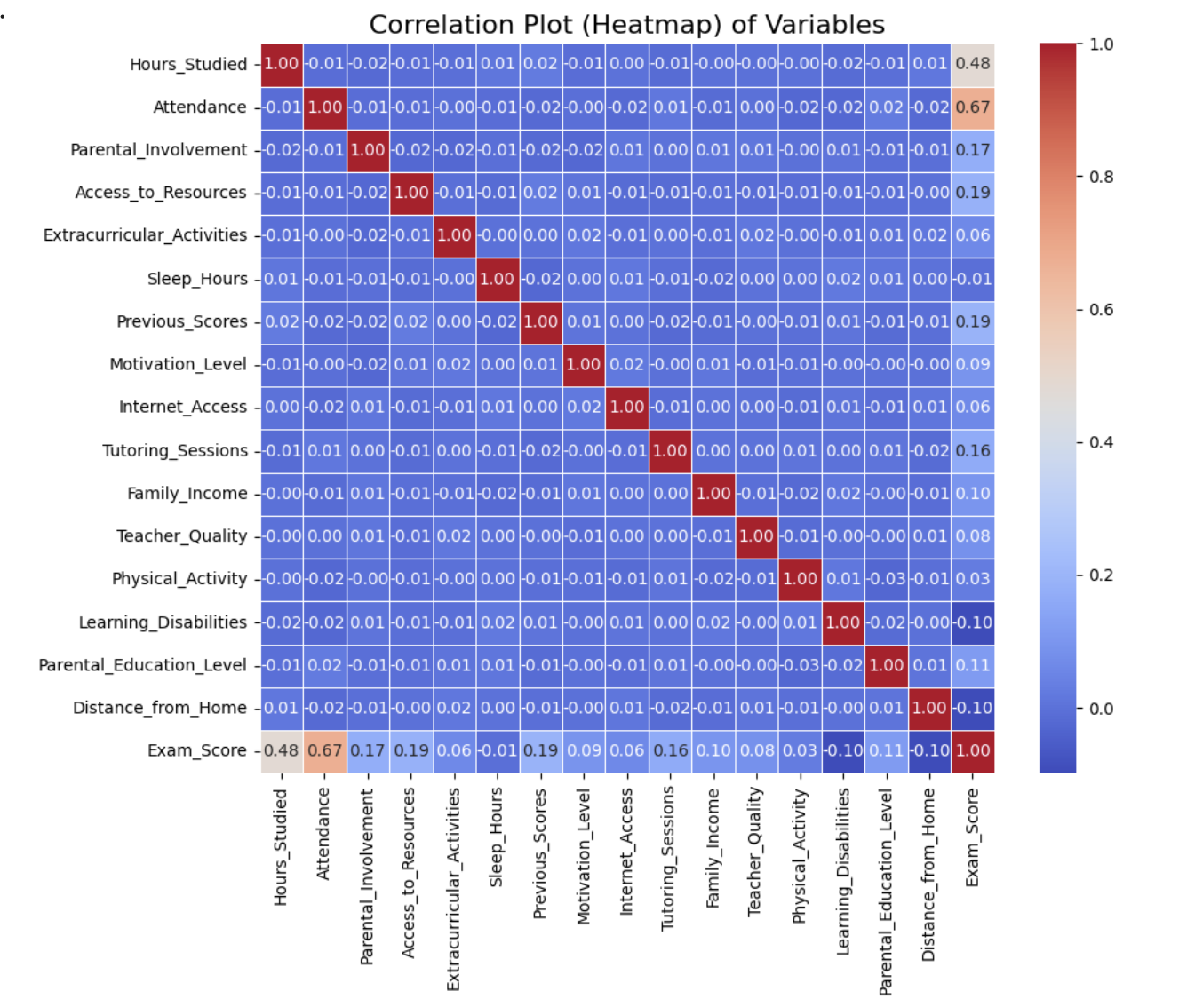
Finding the Correlations
Used corr(method="spearman")
Used sns.heatmap to plot the correlation
Attendance , hours_studied have highest
correlation
Parental_Involvment , access_to_resources,
Previous_Scores, Tutoring_Session,
Parental_Education_Level also have
significant correlation with Exam_Score
Distance_From_Home and Learning_Disability
have -ve correlation with Exam_Score

Slide 10
Insights
The data for most of the Numerical features is normally distributed , with a few skewed
towards right for eg : Tutoring_Session, Physical_Activity
Few categorical Features are also Right-Skewed , For eg: Parental education level ,distance from home , teacher quality.
Most of the students score between 65-75 in Exam
Most of the students have 3-4 hours of physical activity
Most of the students sleep for 7-8 hours, which is pretty good.
Most students, close to 6000 have internet access.
Almost 2/3rd Students go to the public school.
The activity to sleep ratio the ratio is almost distributed normally with little skewed to the
Right.
Looking at the correlation and Scatter plot between activity_sleep_ratio and exam_score , we can see that correlation is not significant. But in the distribution chart we see that most of the top scorers have either a balanced or sedentary lifestyle , which makes sense .

Slide 11
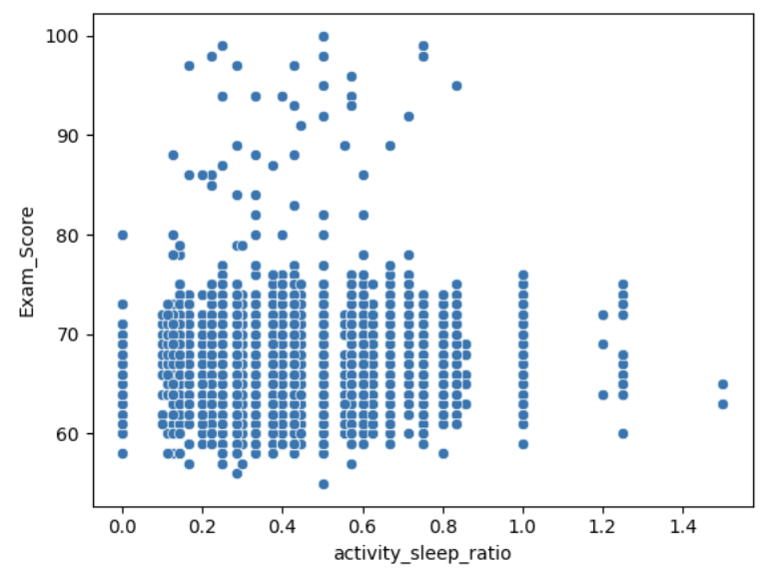
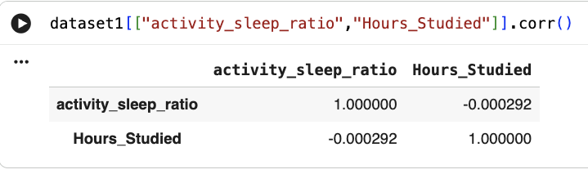
Scatter Plot b/w Exam_Score and activity_sleep_ratio
Correlation b/w activity_sleep_Ratio and Hours_Studied

Slide 12
The correlation between activity_sleep_ratio and Hours_Studied is a -ve value. Though the value is not significant , it suggests that as the activity_sleep_ratio increases , which means physical activity increases, the hours studied decreases . This also holds true in a practical sense.
Attendance and Hour studied have the highest correlation with exam score.
Distance from home and learning disability has negative correlation with exam score, which indicates that as the learning disability increases , the exam score decreases , which holds true for real life. Also as the distance from home increases , the exam score decreases ,because students may be travelling for long time which affects their performance.
Parental Involvement , Access to Resources , Previous Score, Tutoring Session , Family Income , Parental Educational Level also have significant correlation with exam score, which clearly indicates that all these factors contribute to the success of a child in academics .
Parental Involvement and Parental Educational Level have -ve correlation ,which means that parents with higher degrees spend less time with kids.

Slide 13
Learning Beyond Original Questions
After going through the dataset and performing the EDA , it looked like the dataset is realistic , but not enough . More samples of the dataset is needed to get bigger and accurate numbers. Also there is no clarity about whether the sample represents the targeted population.
Also I found that it's hard to relate , process and combine categorical features. It's hard to interpret these columns and reach a conclusion. For eg in case of involvement_to_education ratio , both these columns were ordinal encoded , still the ratio didn’t make any sense.
Though the direction of the numbers supports my hypothesis about the factors affecting students performance and the summary of the EDA seems real and authentic , more dataset is needed to reach precise and clear conclusions.

Slide 14
Suggestions
Quality of sample matters and it should represent the targeted population.
Number of sample matters too, more the data , the more clear and precise the answers.
Quality of data matters too. Dataset should have more numerical values and less ordinal or nominal values , as they can be hard to relate and conclude.
Taking multiple samples from the same population can give even more accurate results and conclusions.
Data should be cleaned properly , including decisions like whether to drop rows with na or fill the null values with mean or mode , depending upon the criticality of data .
Removing the duplicity in data and also scaling the dataset , to remove inclination towards features with larger values.
Proper encoding method should be used for encoding the ordinal and nominal features if they have to be used.
All these points are very important and should be taken care when selecting a dataset and performing EDA.

