Slide 1
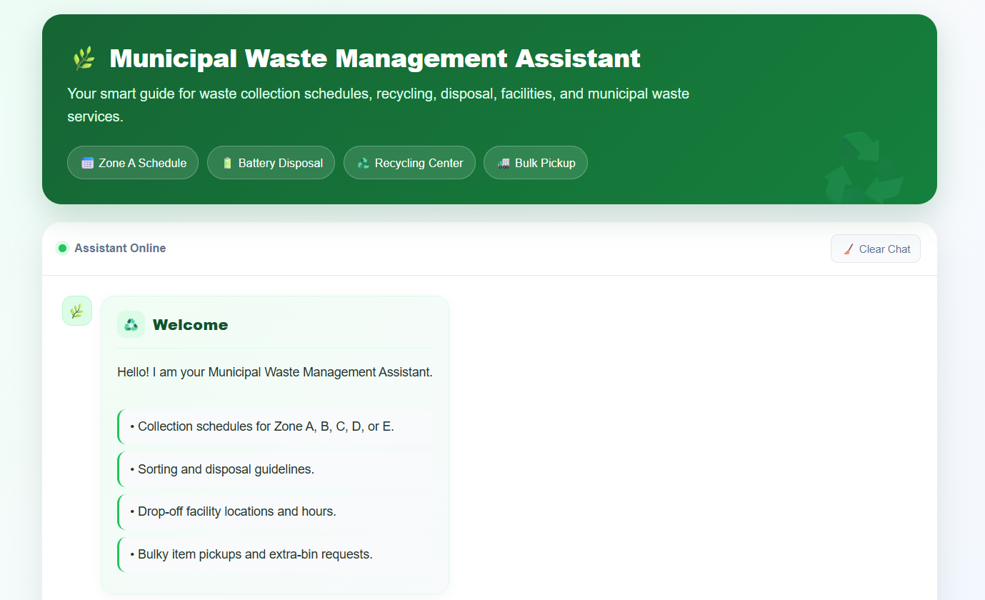
Municipal Waste Management Assistant
AI-Based Waste Segregation Assistant
1M1B AI for Sustainability Virtual Internship
Project Details
Your Name: Bishakha Manna
College Name • MCKV Institute of Engineering
Stream: CSE, B.Tech
1

Slide 2
2. Problem Statement
Why waste segregation needs a simple AI assistant
Problem Statement
“How might we use AI to identify and classify everyday waste so that waste disposal and recycling can become more sustainable?”
People Affected
• Students
• Households
• Schools and colleges
• Offices
• Local communities
• Waste-management workers
The Problem
• People may be unsure which bin an item belongs to.
• Incorrect segregation can contaminate recyclable material.
• Disposal rules can be confusing for everyday users.
2

Slide 3
3. SDG Alignment
Primary sustainability goal
SDG 12 — Responsible Consumption and Production
EcoSort AI supports responsible waste handling by helping users make better segregation decisions.
Project contribution:
• Responsible waste disposal
• Better waste segregation
• Recycling awareness
• Sustainable consumption habits
Secondary connection — SDG 11
Sustainable Cities and Communities
The concept can support cleaner communities through better waste awareness.
Why this matters
Waste segregation is an everyday action. A simple AI assistant can turn a confusing disposal decision into a clear, explainable recommendation.
3

Slide 4
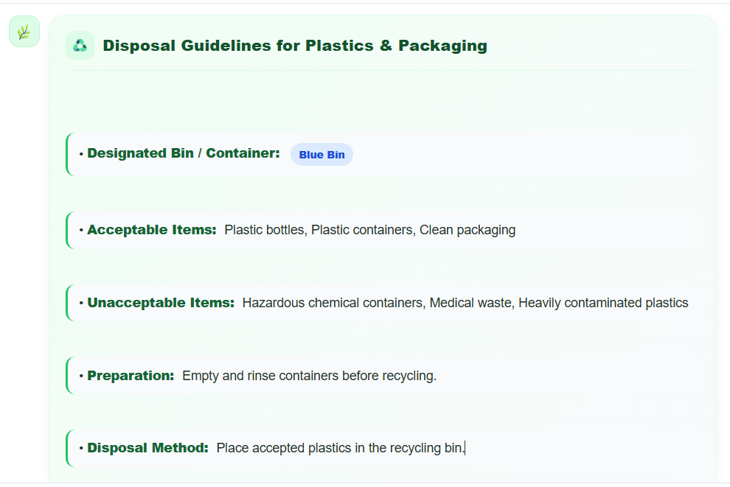
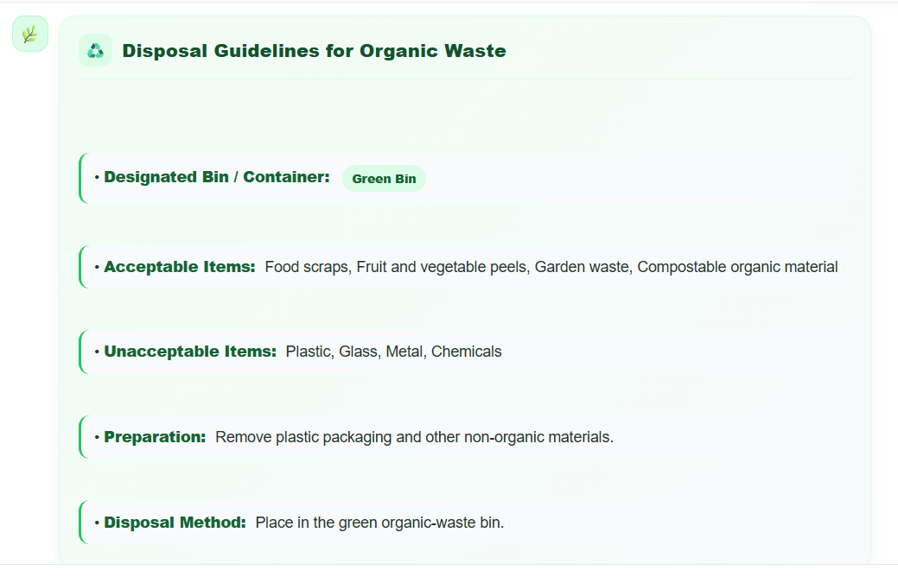
4. Proposed Solution
Municipal Waste Management Assistant
What the assistant does
1. Accepts a waste item as text.
2. Identifies the item.
3. Classifies the waste.
4. Suggests an appropriate disposal category.
5. Gives a short environmental tip.
Example
User: “Banana peel”
AI classification: Organic / Wet Waste
Recommendation: Compost or use the local organic-waste collection.
Tip: Organic waste can potentially be composted.
Note: Users should follow local waste-management rules.
4

Slide 5
5. How AI Is Used
Simple AI workflow — no complex model training required
INPUT
Waste item
AI ANALYSIS
Understands item
CLASSIFICATION
Categorizes waste
RECOMMENDATION
Suggests disposal
AI functions demonstrated
Classification • Pattern recognition • Information retrieval • Decision support • Conversational interaction
5

Slide 6
6. System Workflow
End-to-end prototype flow
1. User
Enter the item
AI Process
The AI sits across the analysis and classification stages, then produces an explainable recommendation.
Output
Clear category
+ disposal guidance
+ environmental tip
2. Waste Item
Text
3. AI Analysis
Identify and understand
4. Classification
Organic / Recyclable / General / Hazardous
5. Recommendation
Disposal category + tip
6

Slide 7
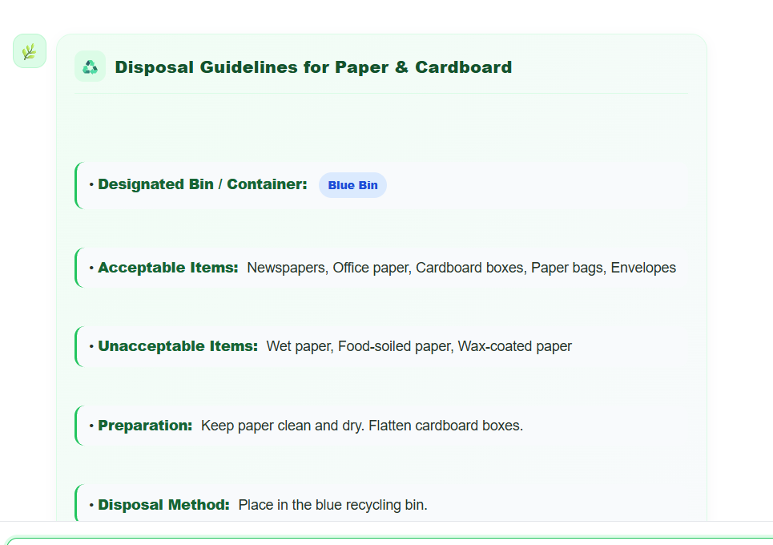
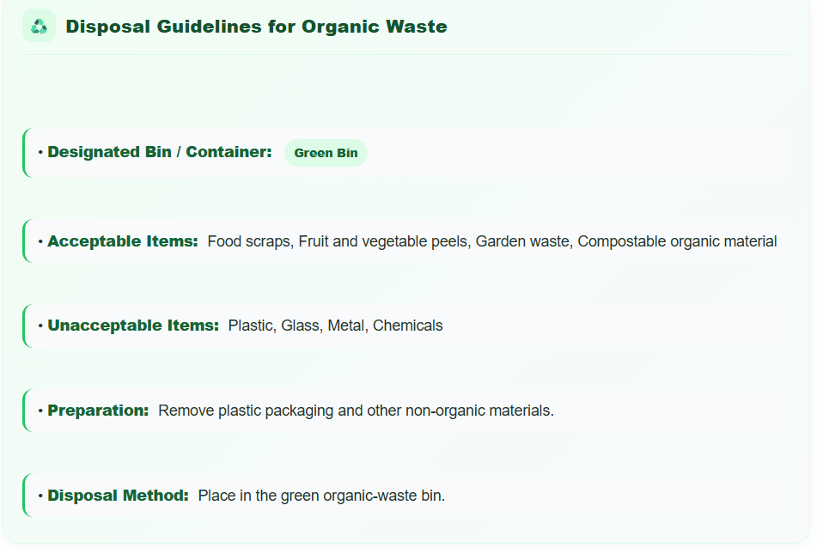
7. Prototype / Demo
Sample AI outputs
Example 1 — Banana Peel
User input:
Banana peel
AI output:
Category: Organic / Wet Waste
Recommended disposal: Compost or organic-waste collection.
Environmental tip: Organic waste can potentially be composted.
Example 2 — Used Newspaper
User input:
Used newspaper
AI output:
Category: Recyclable / Dry Waste
Recommended disposal: Place with recyclable/dry waste.
Environmental tip: Recycling paper can reduce the need for new paper materials.
7

Slide 8
8. Test Results
Sample test cases for the prototype
Waste Item | AI Classification | Recommended Category
Banana peel | Organic / Wet | Compost / organic
Used newspaper | Recyclable / Dry | Dry / recyclable
Plastic bottle | Recyclable / Dry* | Dry / recyclable
Cardboard box | Recyclable / Dry | Dry / recyclable
Vegetable peels | Organic / Wet | Compost / organic
Glass bottle | Recyclable / Dry* | Dry / recyclable
Used tissue | General / Non-recyclable* | General waste
Aluminium can | Recyclable / Dry | Dry / recyclable
Food leftovers | Organic / Wet | Compost / organic
Used battery | Hazardous | Hazardous-waste collection
*Disposal categories may vary by location. Always follow local waste-management guidelines.
8

Slide 9
9. Responsible AI
Four principles considered in the project
FAIRNESS
Use diverse waste examples.
Avoid biased assumptions about people or locations.
TRANSPARENCY
Clearly explain the classification and recommendation where possible.
ETHICS
Avoid unsafe or misleading disposal instructions.
Do not encourage harmful practices.
PRIVACY
Do not collect unnecessary personal information such as names, addresses or photos of people.
9

Slide 10
10. Expected Impact & Future Scope
From a simple prototype to a practical sustainability assistant
Expected Impact
Environmental:
• Better waste segregation
• Increased recycling potential
• Reduced contamination
• More awareness
Social:
• Easy guidance for students and households
• Improved environmental awareness
Economic:
• Potentially better recycling efficiency
• Better separation of recyclable materials
Future Scope
• Mobile application
• Image-based waste recognition
• Local-language assistant
• Integration with local waste-management rules
• Voice-based assistant
Long-term goal:
Make correct waste segregation simple, explainable and accessible.
10

Slide 11
11. GitHub Repository
Project source code and resources
Municipal Waste Management Assistant
GitHub Repository
Paste your GitHub repository link here
https://github.com/bishakhamanna2-pixel/Municipal-Waste-Management-Assistant
Project: Municipal Waste Management Assistant • AI-Based Waste Segregation Assistant
11

Slide 12
Thank You
Making correct waste segregation simple, explainable and accessible.
♻
12

