Slide 1
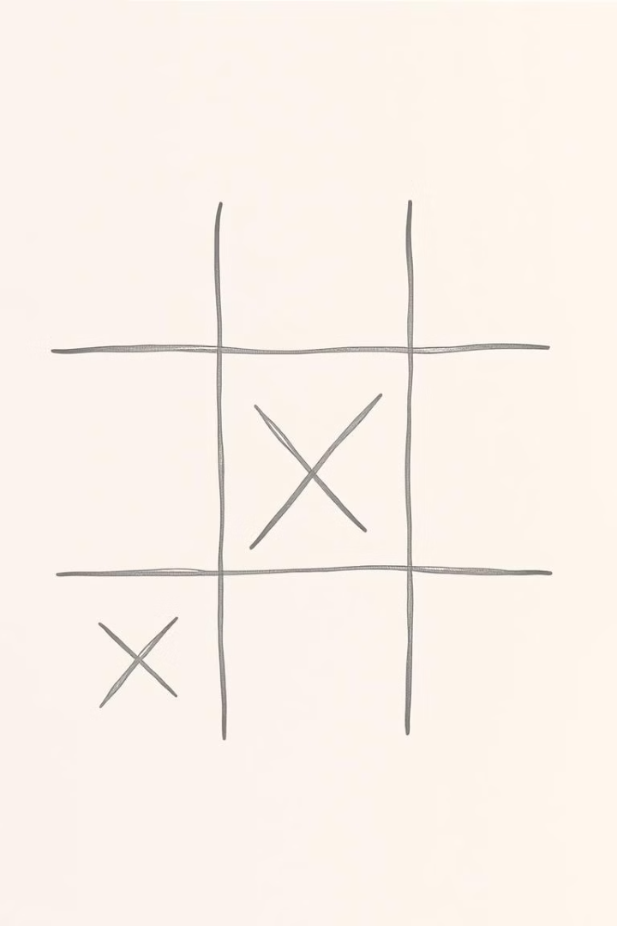
Tic-Tac-Toe Game in C++
A classic game implemented in C++. This project showcases basic game development skills. It also uses fundamental programming concepts.
by Group - 5

Slide 2
What is Tic-Tac-Toe?
Classic Strategy Game
Objective
A two-player strategy game on a 3x3 grid.
Get three marks in a row. This can be horizontal, vertical, or diagonal.

Slide 3
Key Project Features
1
Two-Player Mode
2
Input Validation
Allows two players to compete against each other.
Prevents overwriting existing moves.
3
Game Board Updates
4
Win/Draw Checks
Visually updates the board after each move.
Determines win or draw conditions efficiently.

Slide 4
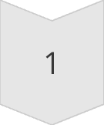
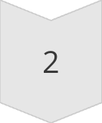
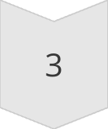
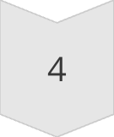

Implementation Steps
Initialize Board
Create a 3x3 grid with numbered positions.
Display Board
Show the grid after each move.
Player Input
Take input and update the board.
Check Win/Draw
Validate the board after each move.
Switch Players
Alternate between Player 1 (X) and Player 2 (O).

Slide 5

Code Snippet: Main Loop
while (true) { displayBoard(); playMove(); }
This loop keeps the game running. It continues until a win or draw is detected.

Slide 6
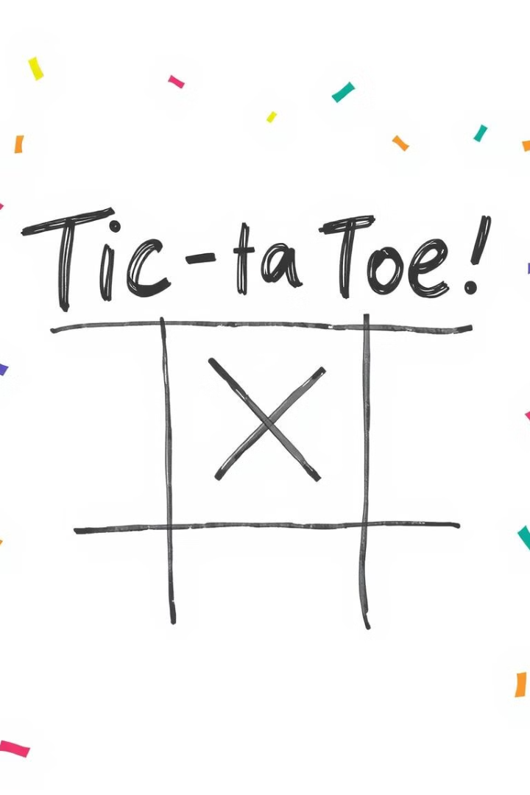
Game Demo & Output
An example game output showing player 1 winning.
X O X O X O O X X Player 1 Wins!

Slide 7

Challenges & Improvements
Handling Invalid Moves
1
Ensuring accurate move validation.
2
Efficient Win Checks
Optimizing the winning condition logic.
Future Enhancements
3
Adding AI, GUI, and network multiplayer.

Slide 8

Conclusion & Q&A
The project demonstrates fundamental concepts. These include game logic and user input handling. Future improvements include adding AI and GUI.

