Slide 1

Asansol Engineering College
INNOVATIVE MODEL MAKING COMPETITION
CELL PHONE DETECTOR
BY TEAM-
POLES OF POWER

Slide 2
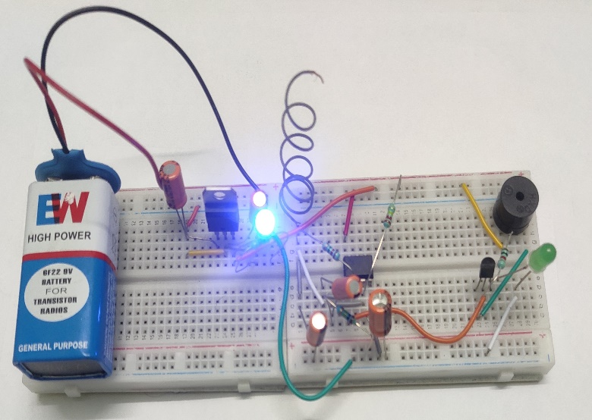
About Cell phone detector
Cell phones are widely used in the world. While people have to be connected to one another, there are situations or places where there usage is to be prohibited either due to security reasons or it may cause health hazards. Cell phone detection has been on investigation for a long time. There are techniques which have been formulated or proposed on how cell phones can be detected. Most of them use the features such as audio system, radio frequency (RF) system and common materials of the phones and try to look into how they can be used as basis to detect mobile phones. This paper utilizes the RF system of the cell phone as the feature to be used to detect its presence. A circuit that detects signals of the range 0.9GHz to 3GHz is used to detect a cell phone when in use. When the signal is detected, a light emitting diode (LED) blinks to indicate the usage of a cell phone within a radius of 1.5metres.

Slide 3
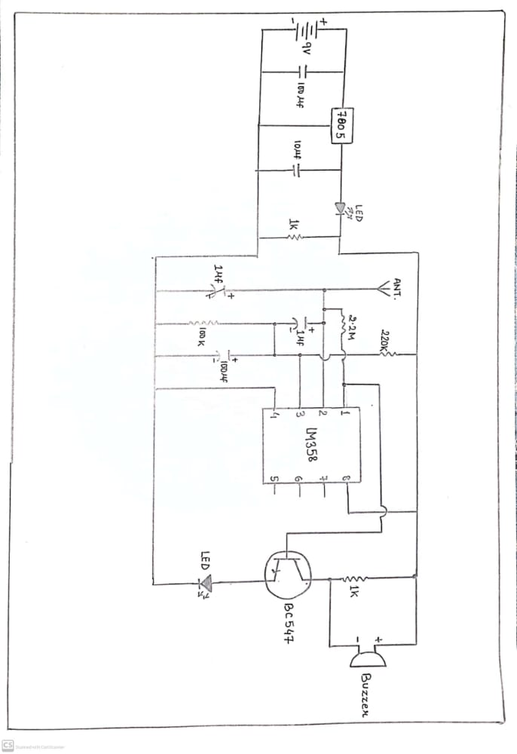
CIRCUIT DIAGRAM

Slide 4
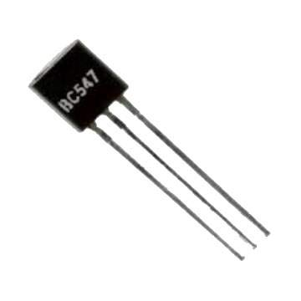
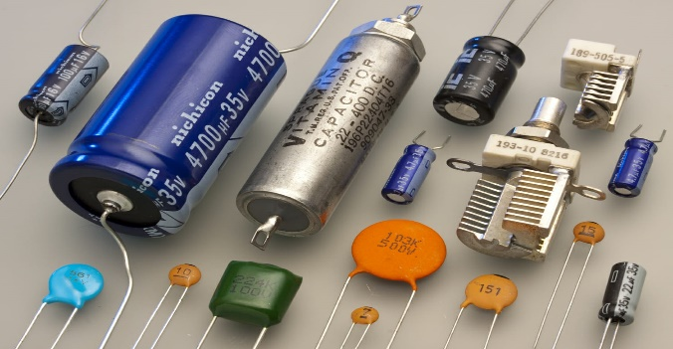
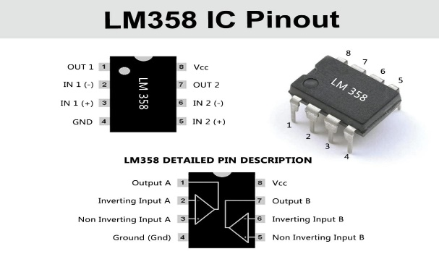
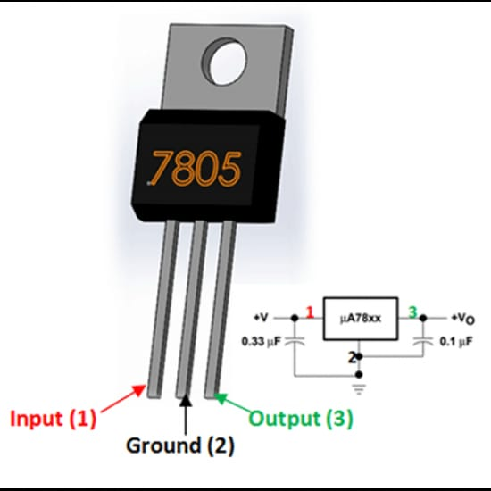
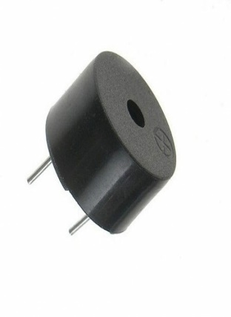
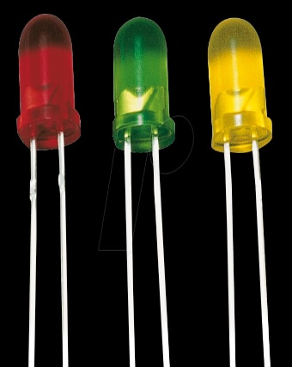
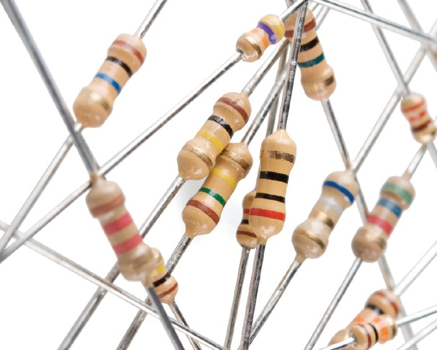
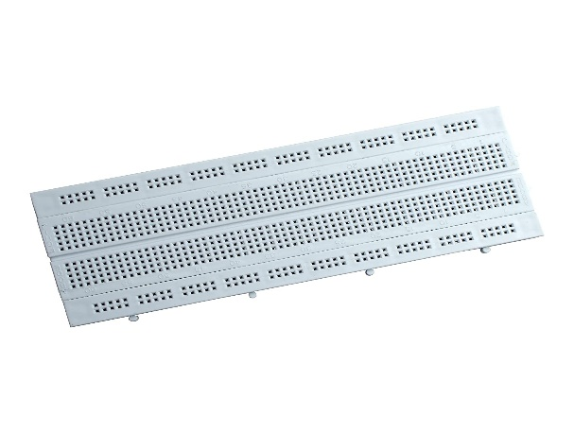
1. Breadboard 2. LM358 IC 3. 100uf/25v 4. 1uf/63v 5. 100k Ohm resistor 6. 2.2M Ohm resistor 7. 220k Ohm resistor 8. 1k ohm resistor 9. LED 10. Buzzer 11. BC547 transistor 12. LM7805 IC
COMPONENTS

Slide 5



Application
Cellphone detector can sense the presence of an activated mobile phone from a distance of one and a half meters. So it can be used to prevent use of mobile phones in examination halls, confidential rooms, etc.
A mobile phone detector can detect the activation of a mobile phone such as :incoming and ongoing phone calls, messages, and things in that nature.
Mobile phone detectors can also be used for spying on someone and for unauthorized video transmission.

Slide 6
TEAM MEMBERS
Bishal Kumar sah (10800320001)
Rishav Gorai (10800320015)
Trisha Kumari (10800320016)
Saurav Kumar (10800321117)
Thank you

