Slide 1
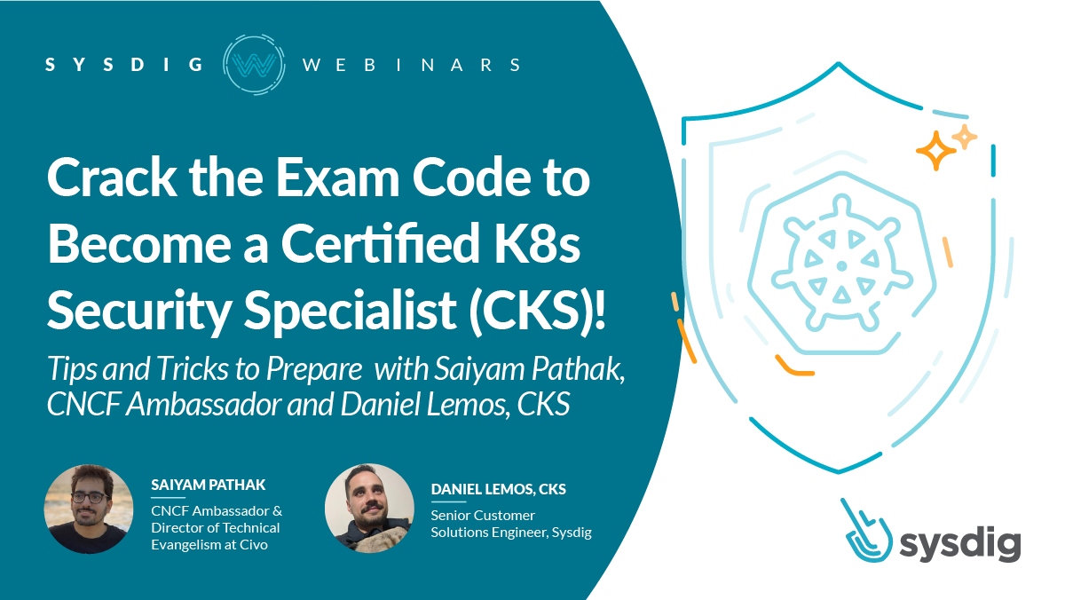

Slide 2
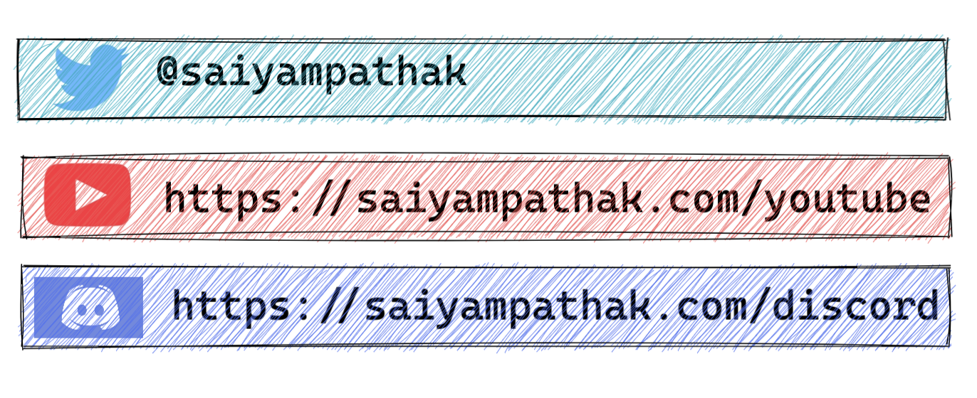

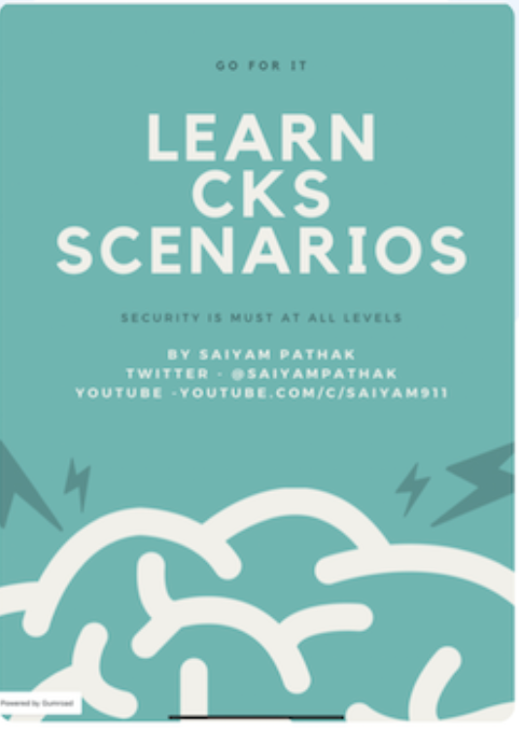
SAIYAM PATEK
Director of Technical Evangelism, Civo
CNCF Ambassador
CK [A, AD, S]
KCNA SME
Author, Learn CKS Scenarios
Kubernetes CKS Certification

Slide 3
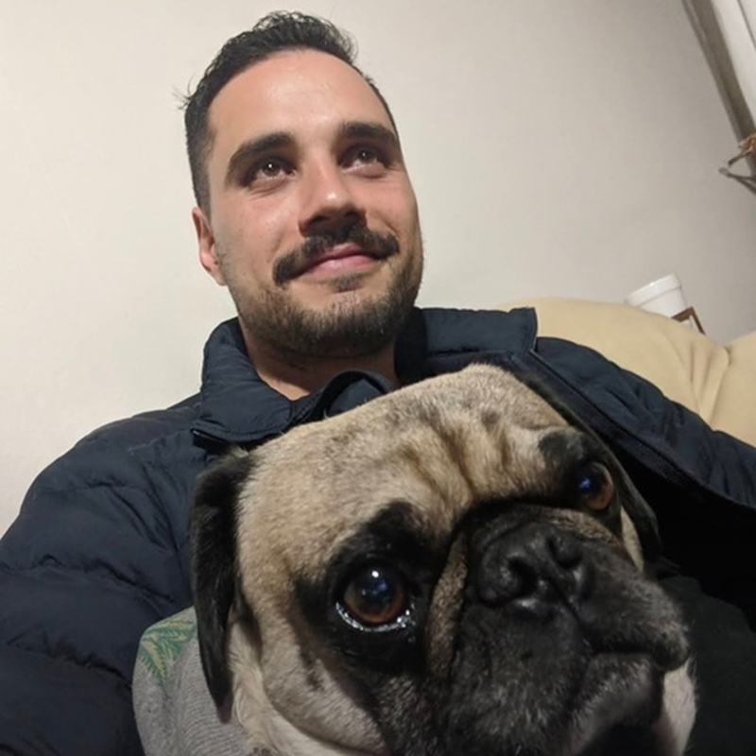
DANIEL LEMOS
Senior Customer Solution Engineer
Sysdig
CK [A,S]

Slide 4


Did you know that there is a new exam terminal?

Slide 5

Tell me…
Effective June 25, 2022, The Linux Foundation migrated the CKA, CKAD and CKS programs from PSI’s ExamsLocal proctoring platform to PSI Bridge. There were no changes to the exam content.

Slide 6
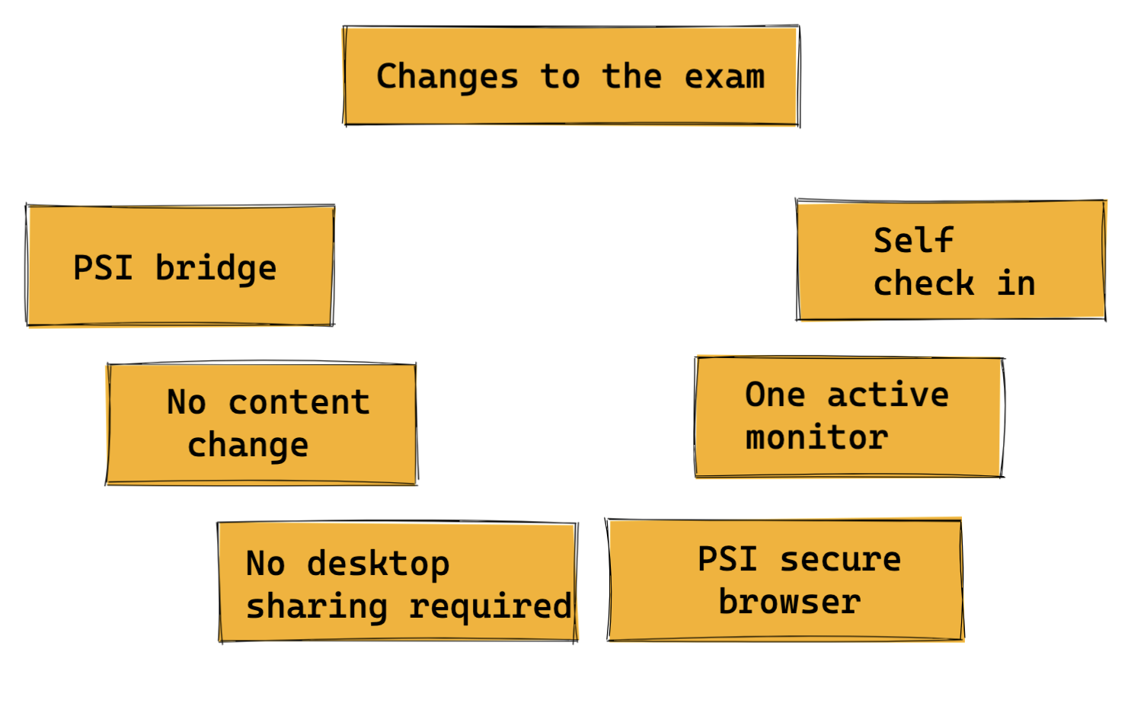
The new CKS Exam Terminal
PSI bridge with remote desktop

Slide 7
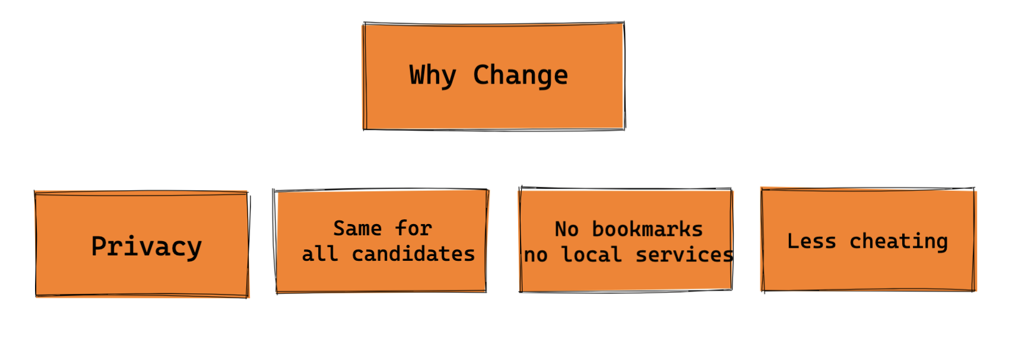
Why Change?

Slide 8
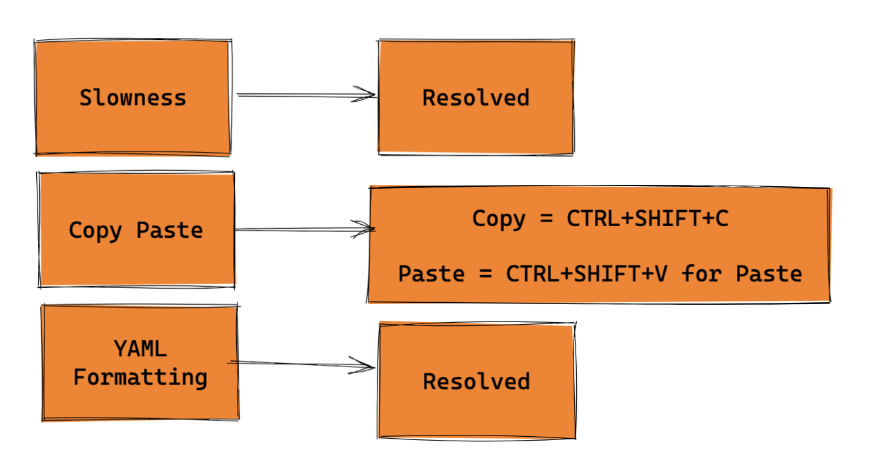
Challenges
Notes:
Kim blog

Slide 9
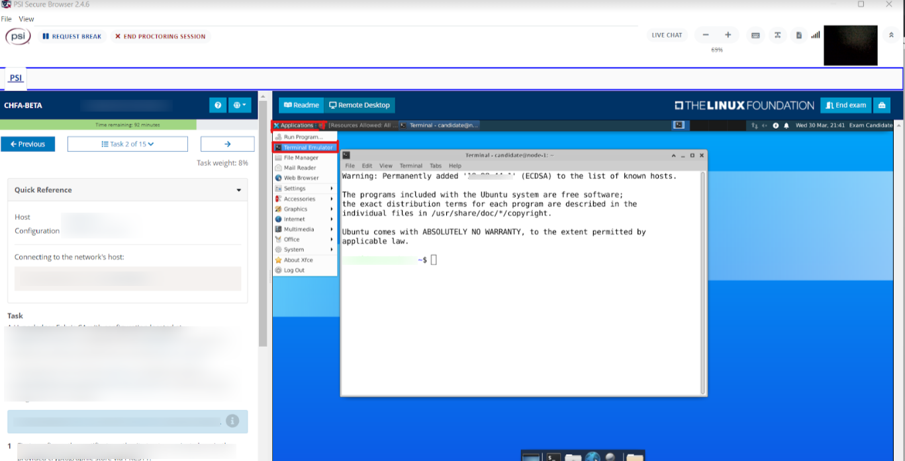

Slide 10

The CKS Exam

Slide 11

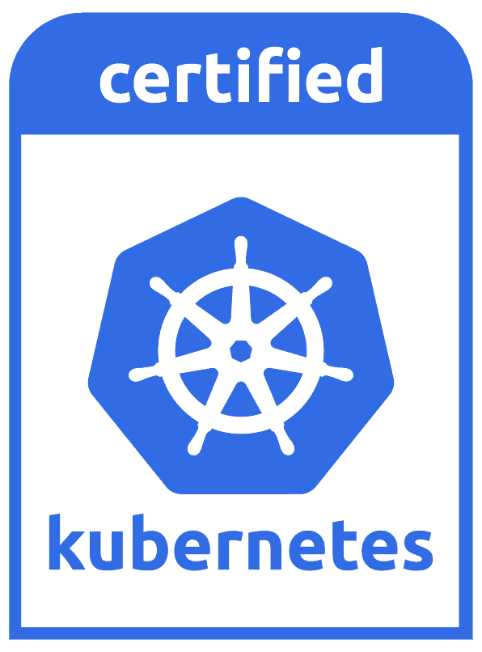
Certified Kubernetes Specialist
The Certified Kubernetes Security Specialist (CKS) program was created by the Cloud Native Computing Foundation (CNCF), in collaboration with The Linux Foundation, to help develop the Kubernetes ecosystem.

Slide 12
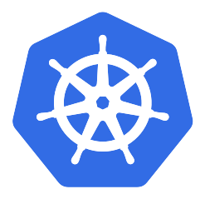

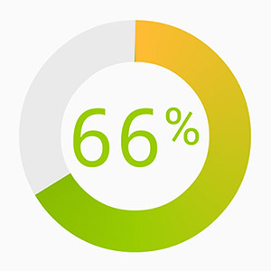
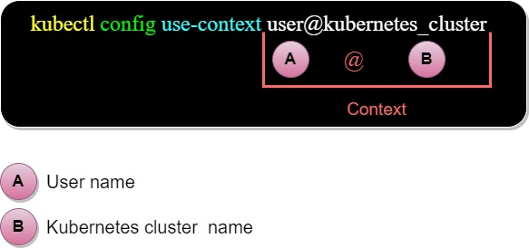

CKS Exam V1.23 details
The exams consist of 15-20 performance-based tasks. - 100 marks
Total of 16 clusters
You have two hours to complete - no count down timer but progress indicator.
Context switch before every question - kubectl config use-context <cluster/context name>
You get your results in 24 hours

Slide 13
CKS Exam outline
From the CKS Exam Curriculum repository, The exam will test domains and competencies including:
Cluster Setup
Monitoring, Logging, and Runtime Security
Cluster Hardening
Supply Chain Security
System Hardening
Minimize Microservice Vulnerabilities

Slide 14
Let’s talk about CKS exam experience

Slide 15
CKS Exam Categories
Control Plane related (API Server, etc., kubelet etc.)
General Kubernetes (Resources)

Slide 16
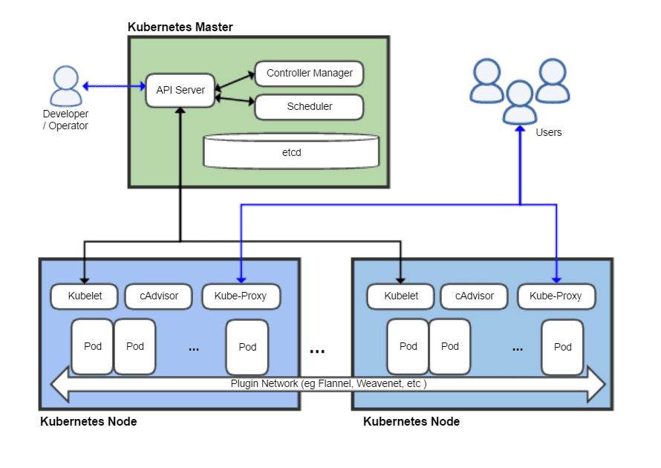
CKS Exam Categories
Control Plane related (API Server, etc., kubelet etc.)
General Kubernetes (Resources)

Slide 17
Control Plane related
1. CIS Benchmarking
2. PodSecurityPolicy
3. ImagePolicyWebhook/AdmissionController 4. AuditPolicy
5. Falco/Sysdig
6. Tracing Container syscall
7. Hardening access to Kubernetes API
8. Troubleshoot API Server

Slide 18
General Resource Related
NetworkPolicy
RBAC
Secret
ServiceAccount
AppArmor
SecComp
RuntimeClass
SecurityContext & Immutable Pods
Static Analysis
Trivy
Ingress TLS
OPA

Slide 19
Exam tips

Slide 20
CKS Tips
Timing is very important***
When possible do not type, copy names, yaml
--dry-run and --force flags
Take a backup of your files before making changes
Careful with YAML (Indentation) - Copy/paste
Know your security tools : Falco, Trivy, Kube-bench.
Setup, Troubleshooting, Tracing
Editor.cilium.io for Network policy
Locally - K3s, Kind
Cloud - managed Kubernetes like Civo, GKE

Slide 21
Practice, Practice, Practice
Killer Shell Simulator sessions - Must do - harder than the actual exam
KodeKloud mock exams
AcloudGuru mock exams
Vagrant cluster - https://github.com/scriptcamp/vagrant-kubeadm-kubernetes
https://www.killershell.com
https://labs.play-with-k8s.com
https://www.katacoda.com
https://www.killercoda.com
Saiyam’s “Learn CKS Scenarios” book

Slide 22
Demo - Falco, Docker best practices, Audit Logs

