Slide 1

PostgreSQL

Slide 2
What is a Database?
A database is a structured collection of data organized for efficient retrieval, storage, and manipulation. It serves as a central repository for storing and managing information in a structured manner.

Slide 3
DBMS (Database Management System)
It is a software system that facilitates the creation, organization, manipulation, and administration of databases. DBMS serves as an interface between users or applications and the database itself, providing a set of tools and functionalities for managing data efficiently

Slide 4
PostgresSQL
PostgreSQL (often abbreviated as Postgres) is a powerful open-source relational database management system (RDBMS).

Slide 5
Relational Database Management System (RDBMS)
In the relational model, data is organized into tables, also known as relations.
Each table consists of rows (tuples) and columns (attributes).
Rows represent individual records or instances, while columns represent attributes or properties of those records.

Slide 6
Structured Query Language
SQL is the standard language for interacting with RDBMS.
It provides a set of commands for defining, querying, manipulating, and managing relational databases.
Common SQL commands include SELECT, INSERT, UPDATE, DELETE, CREATE TABLE, ALTER TABLE, DROP TABLE, and many others

Slide 7
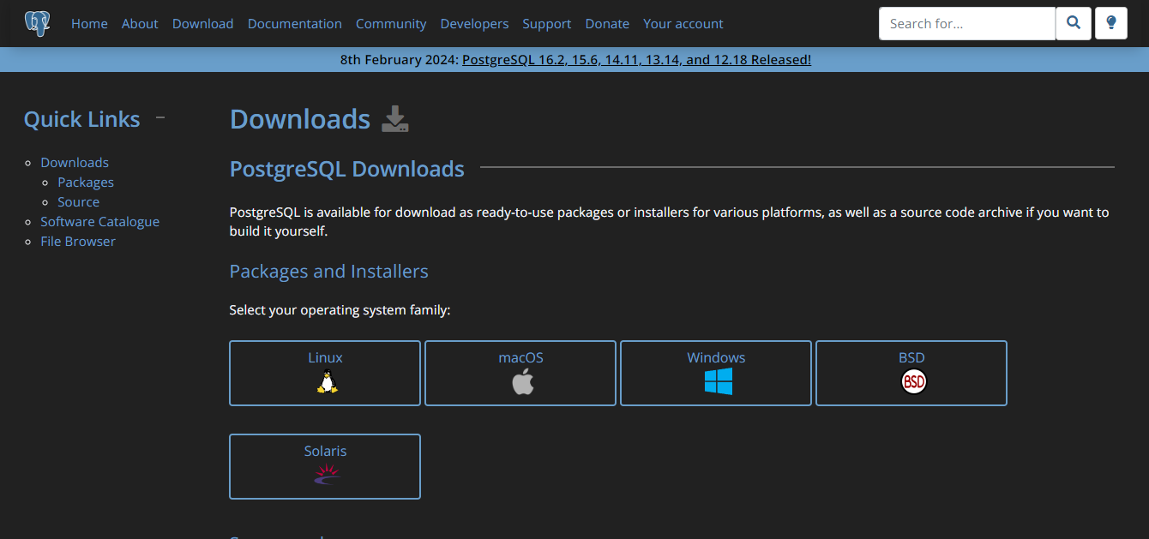
Navigate to https://www.postgresql.org/download/

Slide 8
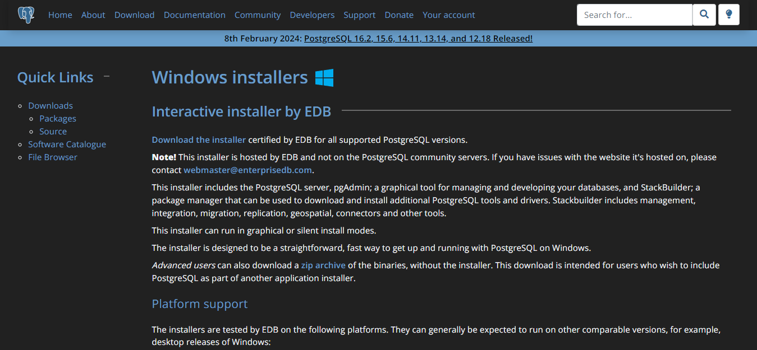

Slide 9
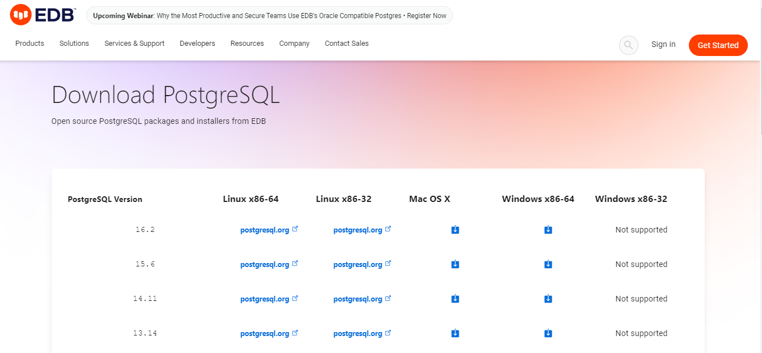

Slide 10
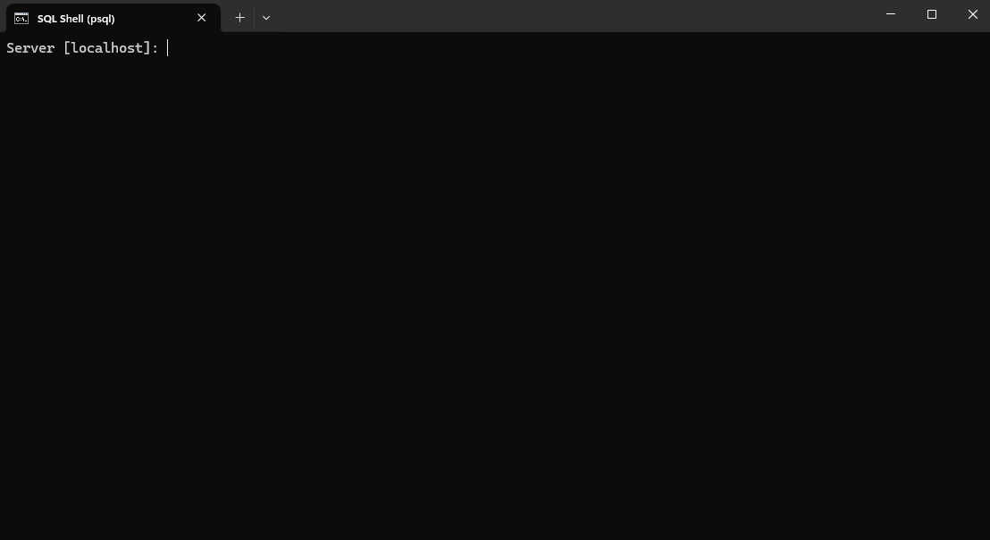
Now, run the installer and complete setup
After that open sql shell

Slide 11
Listing Databases
To list all databases, use the \l command:
\l

Slide 12
Connecting to a Specific Database
To connect to a specific database, use the \c command
\c database_name

Slide 13
Let’s try creating a table
CREATE TABLE todos (
id SERIAL PRIMARY KEY,
title TEXT NOT NULL,
completed BOOLEAN NOT NULL
);
#SERIAL :for auto-increment , Primary key : for uniquely identifying key

Slide 14
Listing Tables
To list all tables in the current database, use the \dt command
\dt

Slide 15
Describing a Table
To describe the structure of a specific table, use the \d command:
\d table_name

Slide 16
Viewing Data
To view data from a table, use a simple SQL query
SELECT * FROM table_name;

Slide 17
Now, let’s install POSTMAN
Postman simplifies the process of testing APIs by providing a user-friendly interface for sending HTTP requests and viewing responses.
It supports various request types such as GET, POST, PUT, DELETE, PATCH, etc., allowing users to test different API endpoints and methods.
https://www.postman.com/downloads/

Slide 18
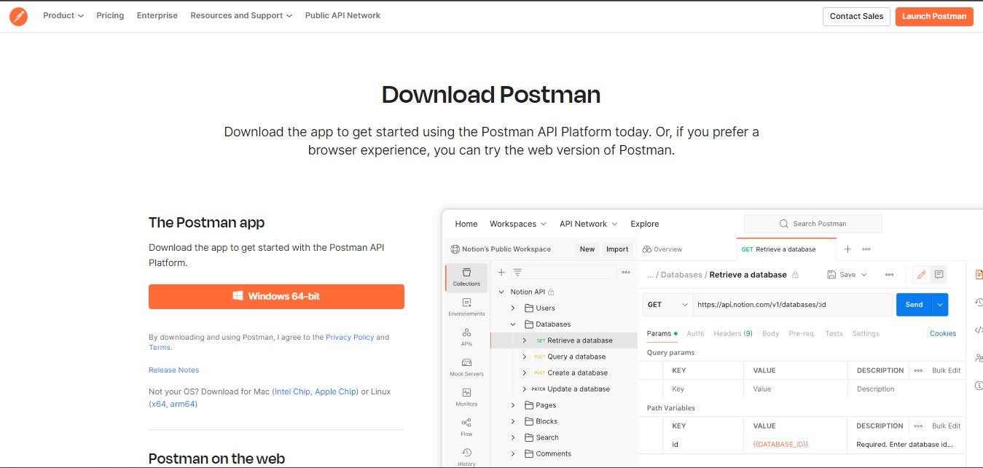
https://www.postman.com/downloads/

Slide 19
Let’s setup a new node project
npm init -y

Slide 20
Install necessary libraries
npm i express pg

Slide 21
Make a new index.js file in the same folder
const express = require('express');
const { Pool } = require('pg');
const app = express();
const port = 3000;
const pool = new Pool({
user: 'postgres',
host: 'localhost',
database: ‘todos',
password: 'root',
port: 5432,
});
app.use(express.json());

Slide 22
// GET all todos
app.get('/todos', (req, res) => {
pool.query('SELECT * FROM todos', (error, result) => {
if (error) {
console.error('Error fetching todos', error);
res.status(500).json({ error: 'Internal server error' });
} else {
res.json(result.rows);
}
});
});

Slide 23
// POST a new todo
app.post('/todos', (req, res) => {
const { title, completed } = req.body;
pool.query('INSERT INTO todos (title, completed) VALUES ($1, $2)', [title, completed], (error) => {
if (error) {
console.error('Error creating todo', error);
res.status(500).json({ error: 'Internal server error' });
} else {
res.status(201).json({ message: 'Todo created successfully' });
}
});
});

Slide 24
// PUT update todo
app.put('/todos/:id', (req, res) => {
const { id } = req.params;
const { title, completed } = req.body;
pool.query('UPDATE todos SET title = $1, completed = $2 WHERE id = $3', [title, completed, id], (error) => {
if (error) {
console.error('Error updating todo', error);
res.status(500).json({ error: 'Internal server error' });
} else {
res.json({ message: 'Todo updated successfully' });
}
});
});

Slide 25
// DELETE todo
app.delete('/todos/:id', (req, res) => {
const { id } = req.params;
pool.query('DELETE FROM todos WHERE id = $1', [id], (error) => {
if (error) {
console.error('Error deleting todo', error);
res.status(500).json({ error: 'Internal server error' });
} else {
res.json({ message: 'Todo deleted successfully' });
}
});
});

Slide 26
Object Relational Mapping
ORM is a programming technique that allows developers to work with relational databases using object-oriented programming languages, enabling them to interact with database entities as if they were ordinary objects in their code.

Slide 27
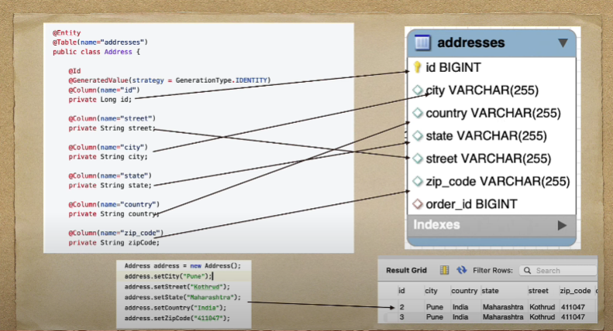

Slide 28
Sequalize
Sequelize is a popular Object-Relational Mapping (ORM) library for Node.js, used with SQL databases such as PostgreSQL, MySQL, MariaDB, SQLite, and MSSQL

Slide 29
Key Features
Model Definition: Sequelize allows developers to define models that map directly to database tables. These models specify the structure of the data and the relationships between different tables.
Querying: Sequelize provides methods for executing SQL queries against the database, including selecting, inserting, updating, and deleting records. It supports various query options and conditions.
Data Validation: Sequelize includes built-in support for data validation, allowing developers to define constraints on the data being saved to the database. This helps ensure data integrity and consistency.
Associations: Sequelize enables developers to define relationships between different models, such as one-to-one, one-to-many, and many-to-many associations. These associations are reflected in the database schema and can be used to navigate between related records.

Slide 30
Create a new directory for your project and navigate into it via the terminal.
mkdir sequelize-postgres
cd sequelize-postgres

Slide 31
Initialize a new Node.js project:
npm init -y

Slide 32
Install Sequelize, PostgreSQL, and the pg driver:
npm install sequelize pg pg-hstore

Slide 33
sequelize: This is the main library itself. Sequelize is an ORM that abstracts away the intricacies of SQL queries and provides a simple API for interacting with your database tables as JavaScript objects.
pg: This is the PostgreSQL client for Node.js. Sequelize uses this package to communicate with PostgreSQL databases.
pg-hstore: This is a module that Sequelize uses for managing JSON data in PostgreSQL.

Slide 34
Set up Sequelize: Create a file named sequelize.js in your project directory:
const { Sequelize } = require('sequelize');
// Initialize Sequelize with your PostgreSQL database credentials
const sequelize = new Sequelize('postgres', 'postgres', 'root', {
host: 'localhost',
dialect: 'postgres', // Specify the dialect for PostgreSQL
});
module.exports = sequelize;

Slide 35
Define a model: Create a folder named models in your project directory, and within it, create a file named Todo.js:
const { DataTypes } = require('sequelize');
const sequelize = require('../sequelize');
const Todo = sequelize.define('Todo', {
id: {
type: DataTypes.INTEGER,
primaryKey: true,
autoIncrement: true
},
title: {
type: DataTypes.STRING,
allowNull: false
},

Slide 36
completed: {
type: DataTypes.BOOLEAN,
allowNull: false,
defaultValue: false
}
}, {
tableName: 'todos', // Match the table name with your existing database table
timestamps: false
});
module.exports = Todo;

Slide 37
Create an index.js file in your project directory to initialize Sequelize and synchronize the models with the database:
const express = require('express');
const sequelize = require('./sequelize');
const Todo = require('./models/Todo');
const app = express();
const PORT = 3000;

Slide 38
// Test the database connection
sequelize.authenticate()
.then(() => {
console.log('Connection has been established successfully.');
// Synchronize defined models with the database
return sequelize.sync({ alter: true });
})
.then(() => {
console.log('All models were synchronized successfully.');
})
.catch((error) => {
console.error('Unable to connect to the database:', error);
});
app.use(express.json());

Slide 39
// Define endpoints
app.get('/todos', (req, res) => {
Todo.findAll()
.then((todos) => {
res.json(todos);
})
.catch((error) => {
res.status(500).json({ error: 'Internal server error' });
});
});

Slide 40
app.post('/todos', (req, res) => {
const { title, completed } = req.body;
Todo.create({ title, completed })
.then((todo) => {
res.status(201).json(todo);
})
.catch((error) => {
res.status(400).json({ error: 'Bad request' });
});
});

Slide 41
// PUT endpoint to update a todo item
app.put('/todos/:id', (req, res) => {
const todoId = req.params.id;
const { title, completed } = req.body;
Todo.findByPk(todoId)
.then(todo => {
if (!todo) {
return res.status(404).json({ error: 'Todo not found' });
}
// Update the todo
todo.title = title;
todo.completed = completed;
// Save the updated todo
return todo.save();
})
.then(updatedTodo => {
res.json(updatedTodo);
})
.catch(error => {
res.status(500).json({ error: 'Internal server error' });
});
});

Slide 42
// DELETE endpoint to delete a todo item
app.delete('/todos/:id', (req, res) => {
const todoId = req.params.id;
Todo.findByPk(todoId)
.then(todo => {
if (!todo) {
return res.status(404).json({ error: 'Todo not found' });
}
// Delete the todo
return todo.destroy();
})
.then(() => {
res.status(204).end(); // No content to send back
})
.catch(error => {
res.status(500).json({ error: 'Internal server error' });
});
});

Slide 43
TEST YOUR SKILLS
You are tasked with building a basic user management system using Node.js, Express.js, Sequelize, and PostgreSQL. The system should have the following features:
User Model: Create a User model with the following fields:
id (Primary Key, Auto-incrementing Integer)
username (String, Unique, Not Null)
email (String, Unique, Not Null)
password (String, Not Null)
Endpoints
POST /users: Create a new user. The request body should contain username, email, and password. Return the created user in the response.
GET /users: Retrieve all users.
GET /users/:id: Retrieve a specific user by ID.
PUT /users/:id: Update a specific user by ID. Allow updating username, email, and password.
DELETE /users/:id: Delete a specific user by ID.
Database Connection: Establish a connection to a PostgreSQL database using Sequelize. Ensure the connection is successful before starting the server.

