Slide 1


Slide 2
MongoDB is a popular open-source NoSQL database program, designed for scalability, flexibility, and high performance.

Slide 3
Database Model
Document-Oriented: MongoDB stores data in flexible, JSON-like documents, called BSON (Binary JSON), allowing fields to vary from document to document.
Collections: Documents are grouped into collections, which are akin to tables in relational databases.

Slide 4
Let’s Compare Relational Database with MongoDB
Relational Database:
Table: A collection of rows and columns.
Row: A single record containing data fields.
Column: Represents a specific attribute or field within a row.
MongoDB:
Collection: A grouping of documents.
Document: A single record containing key-value pairs.
Field: Represents a specific attribute or property within a document.

Slide 5
Let's say we have a table called users with the following structure:
In MongoDB, we would store this data in a collection called users. Each document in the users collection represents a user, and the fields within each document represent the user's attributes.
[
{
"_id": ObjectId("60962b872afe78274016bcdb"),
"name": "Alice",
"age": 30,
"email": "alice@example.com"
},
{
"_id": ObjectId("60962b872afe78274016bcdd"),
"name": "Bob",
"age": 25,
"email": "bob@example.com"
},
{
"_id": ObjectId("60962b872afe78274016bcdf"),
"name": "Charlie",
"age": 35,
"email": "charlie@example.com"
}
]
id | name | age | email
1 | Alice | 30 | alice@example.com
2 | Bob | 25 | bob@example.com
3 | Charlie | 35 | charlie@example.com

Slide 6
Each document is represented by a JSON-like structure.
Each document has a unique identifier _id, which is automatically generated by MongoDB if not provided explicitly.
Each field represents an attribute of the user, such as name, age, and email.

Slide 7
Key Features:
Schema-less Design: Unlike traditional SQL databases, MongoDB doesn't require a predefined schema. Fields can be added or removed on the fly.
High Performance: MongoDB is optimized for high performance, supporting various indexing strategies and sharding for horizontal scalability.
Scalability: It scales horizontally through sharding, distributing data across multiple machines, enabling it to handle large volumes of data and high throughput.
Replication: MongoDB offers automatic replication, ensuring high availability and data redundancy.
Querying: Supports a rich query language with support for ad-hoc queries, indexing, and aggregation framework for complex data aggregation tasks.
Aggregation Pipeline: Allows users to perform complex data transformation and aggregation tasks on the server-side.
Geospatial Queries: MongoDB provides geospatial indexing and queries, allowing efficient storage and querying of geospatial data.
GridFS: MongoDB offers a specification for storing large files, called GridFS, which divides files into smaller chunks for efficient storage and retrieval.

Slide 8
Binary JSON extends the JSON model to include additional data types and to encode documents for storage and data transfer more efficiently
Binary Data
Null
Timestamp
Decimal128
String
Integer
Double
Boolean
Object
Array
ObjectId
Date

Slide 9
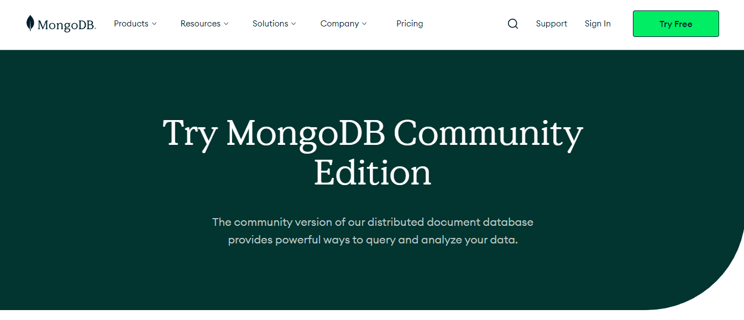
https://www.mongodb.com/try/download/community

Slide 10
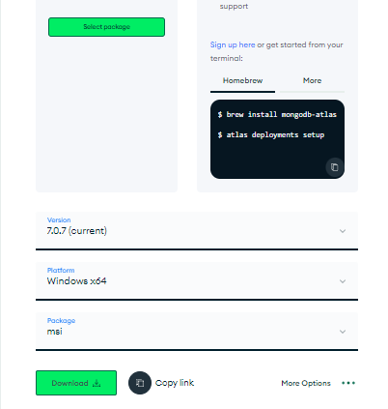
Scroll down and you will land upon this section

Slide 11
Create a new directory for your project and initialize a new node project.
npm init -y

Slide 12
Install Dependencies
npm install express mongoose

Slide 13
Create a new JavaScript file, e.g., app.js, in your project directory.
const express = require('express');
const mongoose = require('mongoose');
const app = express();
const PORT = 3002;
// Middleware
app.use(express.json());

Slide 14
// Connect to MongoDB
mongoose.connect('mongodb://127.0.0.1:27017/user_management_db')
.then(() => console.log('Connected to MongoDB'))
.catch(err => console.error('Error connecting to MongoDB:', err));

Slide 15
// Define User schema
const userSchema = new mongoose.Schema({
name: String,
email: String,
password: String
});
const User = mongoose.model('User', userSchema);

Slide 16
app.get('/users', (req, res) => {
User.find({})
.then(users => res.json(users))
.catch(err => res.status(500).json({ message: err.message }));
});

Slide 17
app.post('/users', (req, res) => {
const user = new User({
name: req.body.name,
email: req.body.email,
password: req.body.password
});
user.save()
.then(newUser => res.status(201).json(newUser))
.catch(err => res.status(400).json({ message: err.message }));
});

Slide 18
app.put('/users/:id', (req, res) => {
const userId = req.params.id;
const updateData = {
name: req.body.name,
email: req.body.email,
password: req.body.password
};
User.findByIdAndUpdate(userId, updateData, { new: true })
.then(updatedUser => {
if (!updatedUser) {
return res.status(404).json({ message: 'User not found' });
}
res.json(updatedUser);
})
.catch(err => res.status(400).json({ message: err.message }));
});

Slide 19
app.delete('/users/:id', (req, res) => {
const userId = req.params.id;
User.findByIdAndDelete(userId)
.then(deletedUser => {
if (!deletedUser) {
return res.status(404).json({ message: 'User not found' });
}
res.json({ message: 'User deleted successfully' });
})
.catch(err => res.status(400).json({ message: err.message }));
});

Slide 20
Adding Simple User Interface Let’s add HTML Structure to our code Make a index.html file in a new public directory in your mongoDB project folder.
<!DOCTYPE html>
<html lang="en">
<head>
<meta charset="UTF-8">
<meta name="viewport" content="width=device-width, initial-scale=1.0">
<title>User Management</title>
</head>
<body>
<h1>Users</h1>
<ul id="userList">
<!-- I will be adding users here -->
</ul>

Slide 21
<h2>Add User</h2>
<form id="addUserForm">
<label for="name">Name:</label>
<input type="text" id="name" name="name">
<br>
<label for="email">Email:</label>
<input type="email" id="email" name="email">
<br>
<label for="password">Password:</label>
<input type="password" id="password" name="password">
<br>
<button type="submit">Add User</button>
</form>

Slide 22
<script>
const fetchUsers = () => {
fetch('/users')
.then(response => {
if (!response.ok) {
throw new Error('Network response was not ok');
}
return response.json();
})
.then(users => {
const userList = document.getElementById('userList');
userList.innerHTML = ''; // Clear previous user list

Slide 23
users.forEach(user => {
const li = document.createElement('li');
li.textContent = `${user.name} - ${user.email}`;
const deleteButton = document.createElement('button');
deleteButton.textContent = 'Delete';
deleteButton.addEventListener('click', () => {
deleteUser(user._id);
});
li.appendChild(deleteButton);
userList.appendChild(li);
});
})
.catch(error => {
console.error('Error fetching users:', error);
});
};

Slide 24
const deleteUser = userId => {
fetch(`/users/${userId}`, {
method: 'DELETE'
})
.then(response => {
if (!response.ok) {
throw new Error('Network response was not ok');
}
return response.json();
})
.then(() => {
fetchUsers(); // Refresh user list after deletion
})
.catch(error => {
console.error('Error deleting user:', error);
});
};

Slide 25
document.getElementById('addUserForm').addEventListener('submit', event => {
event.preventDefault();
const formData = new FormData(event.target);
const newUser = {};
formData.forEach((value, key) => {
newUser[key] = value;
});
fetch('/users', {
method: 'POST',
headers: {
'Content-Type': 'application/json'
},
body: JSON.stringify(newUser)
})
.then(response => {
if (!response.ok) {
throw new Error('Network response was not ok');
}
return response.json();
})

Slide 26
.then(() => {
fetchUsers(); // Refresh user list after addition
document.getElementById('addUserForm').reset(); // Reset form fields
})
.catch(error => {
console.error('Error adding user:', error);
});
});
// Calling fetch User as soon as page loads
window.onload = fetchUsers;
</script>
</body>
</html>

