Slide 1
NEUROVISION‑AI
AI‑Powered Brain Tumor Classification from MRI
Transfer Learning • EfficientNetB0 • Grad‑CAM
A deep‑learning pipeline for 4‑class brain MRI classification
7,200
4
95.31%
MRI images
classes
test accuracy

Slide 2
Project at a Glance
The complete story: input → model → evidence → explainability
PROBLEM
APPROACH
EVIDENCE
XAI
Classify brain MRI images into Glioma, Meningioma, No Tumor and Pituitary categories.
Transfer learning with ImageNet‑pretrained EfficientNetB0, image augmentation and fine‑tuning.
95.31% test accuracy on 1,600 evaluated images.
Grad‑CAM highlights regions contributing to the predicted class.
• End‑to‑end pipeline rather than only a trained model
• Quantitative evaluation: accuracy, precision, recall, F1 and confusion matrix
• Visual evidence: predictions + Grad‑CAM explanation
• Model checkpoint and final .keras model are saved
NeuroVision‑AI • Brain MRI Classification
02

Slide 3
Problem Statement & Objectives
The challenge
Project objectives
Brain MRI classification is a visual recognition task where subtle image patterns can separate tumor categories. The project explores whether a CNN can learn these patterns automatically and consistently.
01
Automate
02
Optimize
Build a model that classifies MRI images into four classes.
Use transfer learning + augmentation to reach strong performance.
03
Evaluate
04
Explain
Measure performance with multiple metrics and a confusion matrix.
Use Grad‑CAM to visualize where the network focuses.
NeuroVision‑AI • Brain MRI Classification
03

Slide 4
Dataset & Input Pipeline
Balanced four‑class evaluation with 224×224 model input
5,600
1,600
224×224
32
training images
test / validation images
input size
batch size
Four classes
Glioma
Meningioma
No Tumor
Pituitary
Training augmentation
Test preprocessing
• Rotation ±15°
• Width / height shift 10%
• Zoom 10%
• Horizontal flip
• Nearest fill
• EfficientNet preprocessing
• Resize to 224×224
• No augmentation
NeuroVision‑AI • Brain MRI Classification
04

Slide 5
End‑to‑End System Workflow
01
02
03
04
05
06
07
MRI INPUT
PREPROCESS
AUGMENT
EFFICIENTNETB0
CLASSIFIER
OUTPUT
GRAD‑CAM
Raw brain MRI
Resize + normalize
Rotation / shift / zoom / flip
Feature extraction
256‑unit head + softmax
Class + confidence
Visual explanation
NeuroVision‑AI • Brain MRI Classification
05

Slide 6
Model Architecture
EfficientNetB0 backbone + lightweight classification head
EfficientNetB0
Global Average Pooling
Dense 256
BatchNorm
Dropout 0.5
Softmax 4
ImageNet pretrained 224×224×3 → 7×7×1280
7×7×1280 → 1280
ReLU
Stabilize activations
Regularization
Final class probabilities
4.38M
329K
16.71 MB
4
total parameters
trainable initially
model size
softmax outputs
NeuroVision‑AI • Brain MRI Classification
06

Slide 7
Training Strategy
Two‑stage learning: learn the head first, then fine‑tune deeper features
STAGE 1 • 30 EPOCHS
STAGE 2 • 10 EPOCHS
BEST CHECKPOINT
EfficientNetB0 frozen Adam 1e‑3 Categorical cross‑entropy Augmented training data
Unfreeze from layer 100 Adam 1e‑4 Fine‑tune upper layers Keep callbacks active
Monitor val_accuracy Save best_model.keras Restore best weights
EARLY STOPPING
REDUCE LR
CHECKPOINT
Monitor validation loss; restore best weights.
Factor 0.2 when validation loss plateaus.
Save only the best validation accuracy.
NeuroVision‑AI • Brain MRI Classification
07

Slide 8
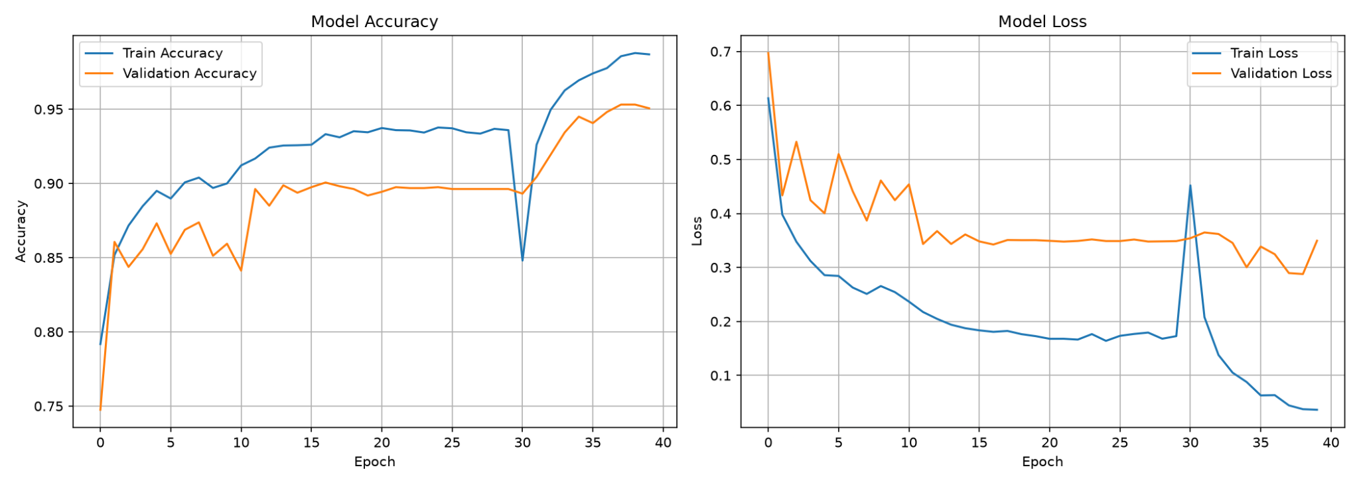
Training Results
Fine‑tuning pushed validation accuracy above 95%
98.79%
peak training accuracy
95.31%
peak validation accuracy
0.2877
best validation loss
NeuroVision‑AI • Brain MRI Classification
Evidence from uploaded notebook outputs / saved project figures
08

Slide 9
Performance Dashboard
Evaluation on 1,600 images
95.31%
95.55%
95.31%
95.23%
accuracy
weighted precision
weighted recall
weighted F1
Per‑class performance
BEST CLASS
Class
Precision
Recall
F1
Pituitary F1 = 0.99 Recall = 0.99 Precision = 0.98
Glioma
99%
84%
91%
Meningioma
92%
97%
95%
No Tumor
93%
100%
96%
Pituitary
98%
99%
99%
NeuroVision‑AI • Brain MRI Classification
09

Slide 10
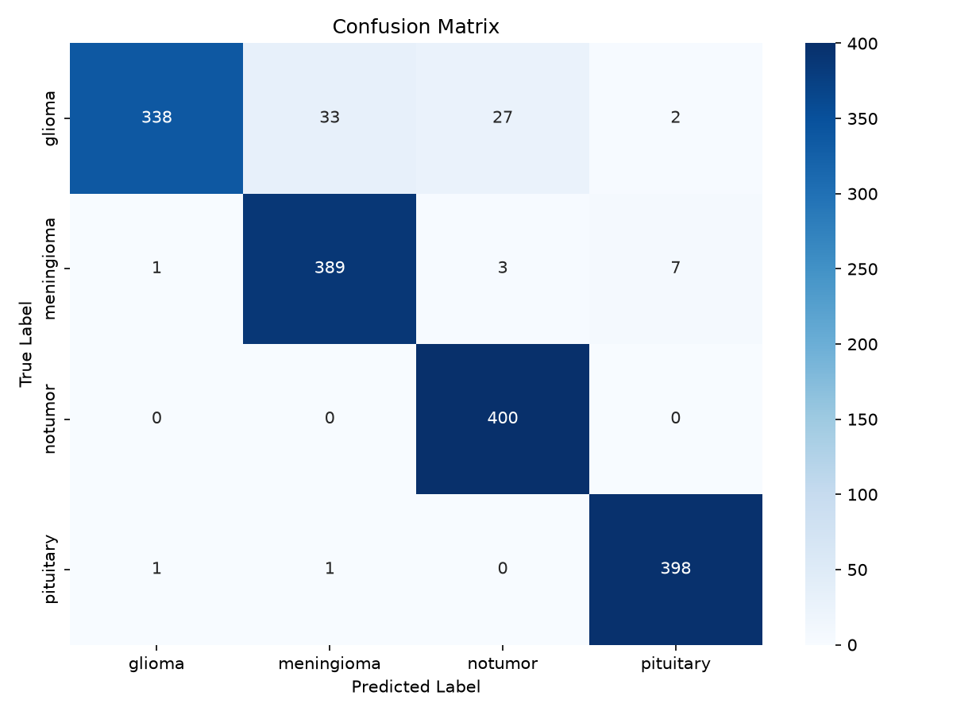
Confusion Matrix
Where the 1,600 predictions succeeded—and where they failed
Matrix
• 338 / 400 glioma images were correctly classified.
• 389 / 400 meningioma images were correct.
• All 400 No Tumor images were correct.
• 398 / 400 pituitary images were correct.
• The largest error pattern is glioma → meningioma / No Tumor.
Glioma recall = 84% — the weakest per‑class recall in the report.
NeuroVision‑AI • Brain MRI Classification
Evidence from uploaded notebook outputs / saved project figures
10

Slide 11
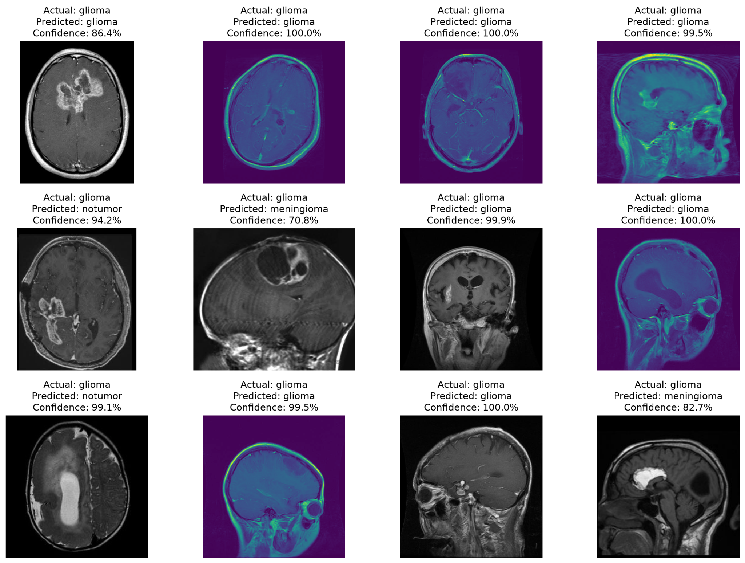
Sample Predictions
Visual examples from the notebook: correct and incorrect cases
• The model outputs a class and a confidence score.
• Several examples are high‑confidence correct predictions.
• Some high‑confidence errors show why confidence ≠ certainty.
• This motivates explainability and stronger external validation.
A confident wrong prediction is more important to analyze than a confident correct one.
NeuroVision‑AI • Brain MRI Classification
Evidence from uploaded notebook outputs / saved project figures
11

Slide 12
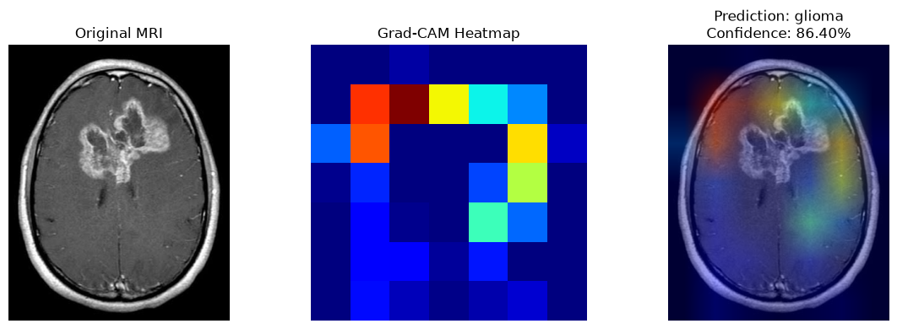
Explainability with Grad‑CAM
Turning a prediction into a visual explanation
Example: predicted Glioma with 86.40% confidence
WHY IT MATTERS
TARGET LAYER
OUTPUT
More transparent model behavior
EfficientNetB0: top_activation
Original + heatmap + overlay
12
NeuroVision‑AI • Brain MRI Classification

Slide 13
Error Analysis & What We Learned
The strongest result is not the 95.31% number—it is understanding the remaining 4.69%.
x
2 • HIGH CONFIDENCE CAN STILL FALL
1 • GLIOMA IS THE HARD CASE
3 • GENERALIZATION MATTERS
Recall is 84%, compared with 97–100% for the other classes. The confusion matrix shows glioma being predicted as meningioma and No Tumor.
The sample predictions include incorrect glioma predictions with high confidence. This is why probability alone should not be treated as certainty.
The training curve is stronger than validation. The next experiment should use a genuinely held‑out test set and ideally external data.
NeuroVision‑AI • Brain MRI Classification
13

Slide 14
Limitations & Future Improvements
What I would change before calling this deployment‑ready
CURRENT LIMITATIONS
NEXT ITERATION
• The notebook passes test_generator as validation_data during training.
• Therefore the 1,600‑image set is not a completely untouched final test set.
• Dataset diversity and external generalization are not established.
• Grad‑CAM is an explanation aid, not proof of clinical correctness.
• Split into train / validation / untouched test sets.
• Evaluate on an independent external MRI dataset.
• Tune augmentation and class‑specific error handling.
• Compare EfficientNetB0 with stronger architectures.
• Add calibration, ROC‑AUC and confidence analysis.
• Package inference into a reproducible application/API.
NeuroVision‑AI • Brain MRI Classification
14

Slide 15
NEUROVISION‑AI
From MRI pixels to measurable AI evidence.
EfficientNetB0 • 4 classes • 7,200 images • 95.31% evaluated accuracy • Grad‑CAM
BUILD
PROVE
EXPLAIN
Transfer learning + augmentation + fine‑tuning
Metrics + confusion matrix + sample predictions
Grad‑CAM + honest limitations + next steps
Thank you
NeuroVision‑AI • Brain MRI Classification
15

