Slide 1

1
Career Guidance System
Presented by: Bishal Ranjitkar, BCA – 8th Semester

Slide 2

2
Introduction to the Platform
Personalized Advice
Web-based platform for Personalized career guidance.
Data-Driven Analysis
Analyzes interests, scores, and skills.
Comprehensive Outputs
Recommends careers, predicts success, suggests skills.
User-Friendly Features
Interactive, resume generation, student-focused.

Slide 3

3
Problem Statement
Generic Methods
Current guidance is often generalized and disconnected.
Key Deficiencies
Lacks personalization, success prediction, skill tracking.
Inefficient Counseling
Manual methods are time-consuming and inconsistent.
Demand for Innovation
Need for a smart, AI-based, all-in-one solution.

Slide 4





4
Scope
Tailored Recommendations
Suggest suitable careers using student data.
Success Prediction
Predict probability in chosen career paths.
Skill Enhancement
Propose new skills for improved employability.
Course Suggestion
Suggest course based on the recommendation

Slide 5
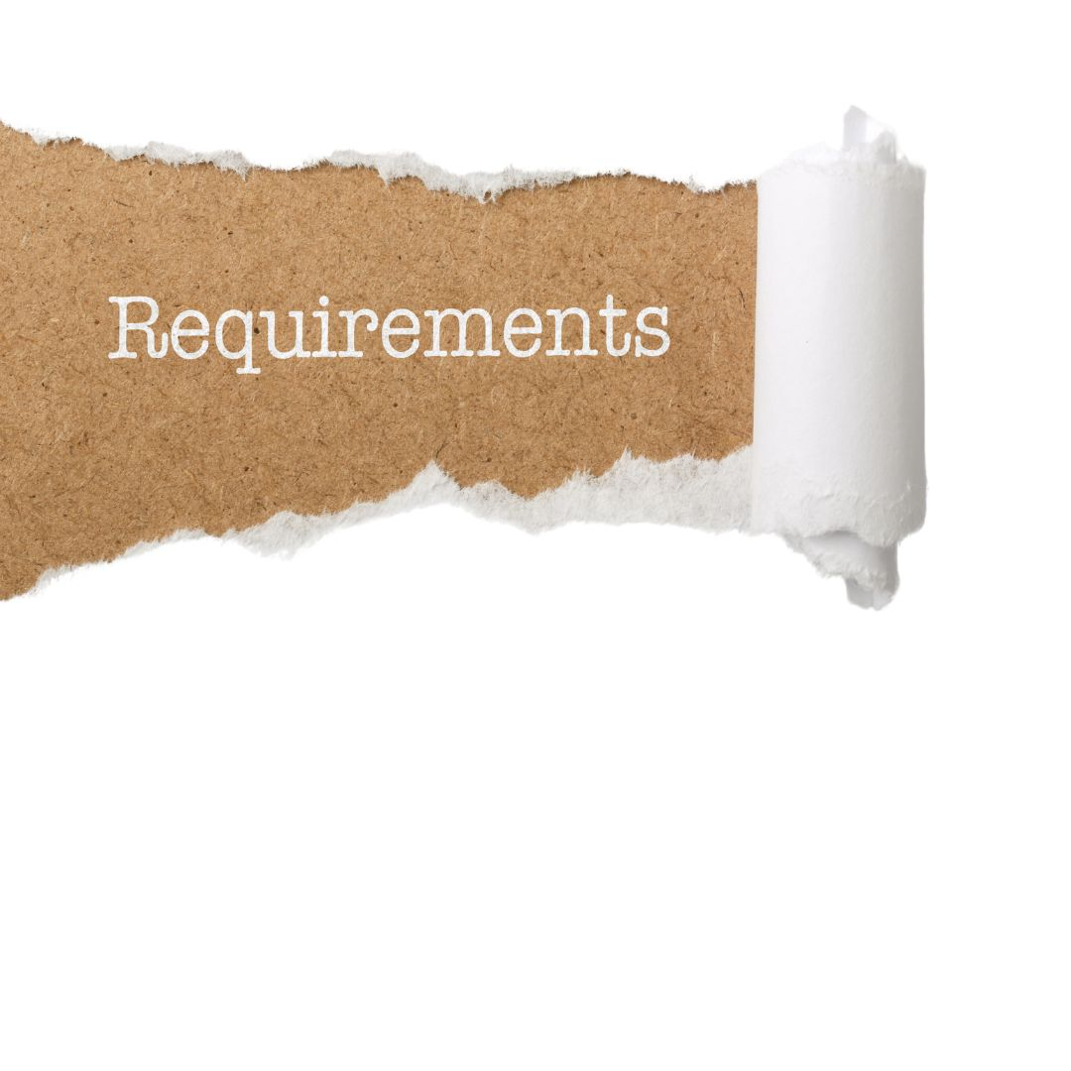
5
Methodology
Functional Requirements
User registration and secure login
Input interests, marks, and skills
Career recommendations based on input
Success prediction for different careers
Skill suggestions for improvement
Resume generation from user data
Non-Functional Requirements
Easy to use interface
Accessible on any device
Secure user data and login
Fast system response
Low maintenance and easy updates
Scalable for more users/features

Slide 6




6
Key System Algorithms
Rule-Based Filtering
Generates career suggestions based on predefined rules.
Linear Regression
Predicts the probability of career success.
Association Rule Mining
Suggests new skills complementing existing ones.
4
Content Based Filtering
Suggests new courses based on recommendation.

Slide 7

7
Rule-Based Filtering
Finds the best career matches for you.
Compares your profile against different career requirements.
Gives "points" for every matching skill and quiz answer.
To see which careers fit you best.
Result: A ranked list of careers (e.g., Web Developer: #1).

Slide 8

8
Linear Regression
Predicts your chance of success in a career.
How it works: Uses a math formula to
calculate a percentage (0-100%).
Logic: Combines your Skills, Quiz Answers, and GPA.
Goal: To show how likely you are to succeed in a specific job.
Result: A success score (e.g., "95% Chance of Success").

Slide 9

9
Association Rule Mining
Suggests new skills for you to learn.
It looks at the skills you already have.
Uses patterns like "If you know Python, you should learn
Data Analysis."
Helps you expand your knowledge with related skills.
A list of new skills you might be interested in.

Slide 10

10
Content-Based Filtering
Recommends specific courses to take.
Looks at the new skills suggested to you.
Finds courses in the database that teach those specific skills.
To give you study materials to improve your skills.
A list of course links and descriptions.

Slide 11

11
Expected Outcomes
Simplified Career Planning
AI support for easier decision-making.
Personalized Insights
Tailored recommendations and success predictions.
Enhanced Employability
Skill-building suggestions to boost career prospects.
Automated Efficiency
Time savings through resume automation.
Improved Guidance
Better student decisions and institutional support.

Slide 12

Thank You!
Any Queries?

