Slide 1

Django Generic Views
Charles Severance
www.dj4e.com

Slide 2

Browser
Linux
D
O
M
N
G
I
N X
WGSIConfig
settings.py
Django
Routing
Click
urls.py
views.py
Parse
Response
Views
Templates
forms.py
Javascript
Database
Shell
Models
models.py
/admin
admin.py

Slide 3
dj4e-samples/gview/urls.py
from django.urls import path
from . import views
from django.views.generic import TemplateView
app_name = 'gview'
# Note use of plural for list view and singular for detail view
urlpatterns = [
path('', TemplateView.as_view(template_name='gview/main.html')),
path('cats', views.CatListView.as_view(), name='cats'),
path('cat/<int:pk_from_url>', views.CatDetailView.as_view(), name='cat'),
path('dogs', views.DogListView.as_view(), name='dogs'),
path('dog/<int:pk>', views.DogDetailView.as_view(), name='dog'),
path('horses', views.HorseListView.as_view(), name='horses'),
path('horse/<int:pk>', views.HorseDetailView.as_view(), name='horse'),
path('cars', views.CarListView.as_view(), name='cars'),
path('car/<int:pk>', views.CarDetailView.as_view(), name='car'),
path('wacky', views.WackyEquinesView.as_view(), name='whatever'),
]

Slide 4
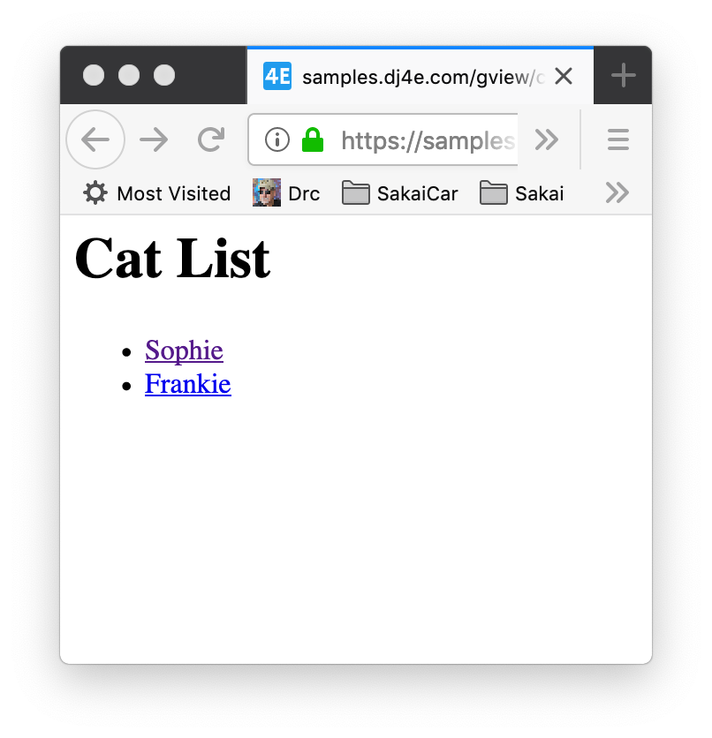
dj4e-samples/gview/views.py
https://samples.dj4e.com/gview/cats
class CatListView(View):
def get(self, request) :
stuff = Cat.objects.all()
cntx = { 'cat_list': stuff }
return render(request, 'gview/cat_list.html', cntx)
dj4e-samples/gview/templates/gview/cat_list.html
<h1>Cat List</h1>
<p>
{% if cat_list %}
<ul>
{% for cat in cat_list %}
<li>
<a href="{% url 'gview:cat' cat.id %}">{{ cat.name }}</a>
</li>
{% endfor %}
</ul>
{% else %}
<p>There are no cats in the database.</p>
{% endif %}
</p>

Slide 5
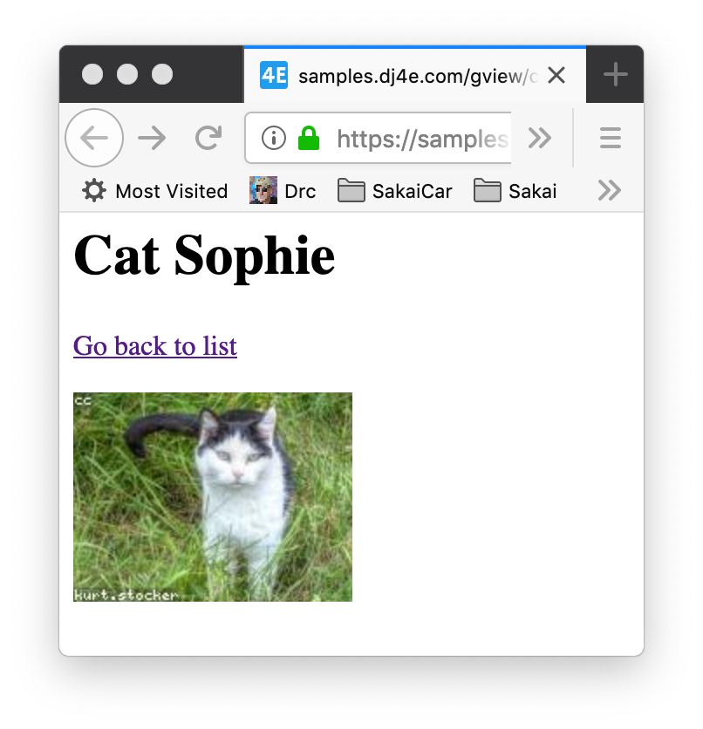
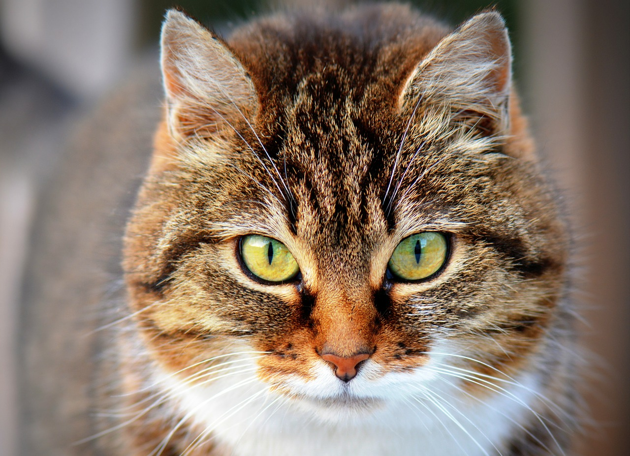
dj4e-samples/gview/templates/gview/cat_detail.html
https://samples.dj4e.com/gview/cat/1
<h1>Cat {{ cat.name }}</h1>
<p>
<a href="{% url 'gview:cats' %}">Go back to list</a>
</p>
<p>
<img src="https://loremflickr.com/160/120/cat"
alt="A random picture of a cat">
</p>
dj4e-samples/gview/views.py
class CatDetailView(View):
def get(self, request, pk_from_url) :
obj = Cat.objects.get(pk=pk_from_url)
cntx = { 'cat': obj }
return render(request, 'gview/cat_detail.html', cntx)

Slide 6
Concept: Don't Repeat Yourself (DRY)
Don't repeat yourself (DRY, or sometimes do not repeat yourself) is a principle of software development aimed at reducing repetition of software patterns] replacing it with abstractions or using data normalization to avoid redundancy. The principle has been formulated by Andy Hunt and Dave Thomas in their book The Pragmatic Programmer.
When the DRY principle is applied successfully, a modification of any single element of a system does not require a change in other logically unrelated elements. Additionally, elements that are logically related all change predictably and uniformly, and are thus kept in sync.
https://en.wikipedia.org/wiki/Don%27t_repeat_yourself

Slide 7
Built-in class-based generic views
Writing Web applications can be monotonous, because we repeat certain patterns again and again. Django’s generic views were developed to ease that pain. They take certain common idioms and patterns found in view development and abstract them so that you can quickly write common views of data without having to write too much repetitive code.
We can recognize certain common tasks, like displaying a list of model objects, and write code that displays a list of any model object. Django ships with generic views to display list and detail pages for a single model object.
https://docs.djangoproject.com/en/3.0/topics/class-based-views/generic-display/

Slide 8
Convention over Configuration
Convention over configuration is a software design paradigm used by software frameworks that attempts to decrease the number of decisions that a developer using the framework is required to make without necessarily losing flexibility.
When the convention matches the desired behavior, it behaves as expected without having to write configuration files. Only when the desired behavior deviates from the implemented convention is explicit configuration required.
https://en.wikipedia.org/wiki/Convention_over_configuration

Slide 9
Convention Over Configuration
If
If the app_name is gview
And the view extends django.views.generic.list.ListView
And the view uses the model Horse
Then
The will automatically render a view named gview/horse_list.html
Passing a list of Horse objects in the variable horse_list into the template
https://docs.djangoproject.com/en/3.0/ref/class-based-views/generic-display/#django.views.generic.list.ListView

Slide 10
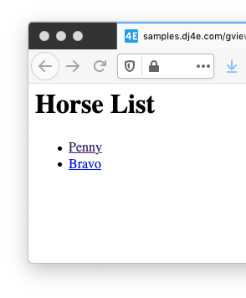
dj4e-samples/gview/views.py
https://samples.dj4e.com/gview/horses
from django.views import generic
class HorseListView(generic.ListView):
model = Horse
dj4e-samples/gview/templates/gview/horse_list.html
<h1>Horse List</h1>
<p>
{% if horse_list %}
<ul>
{% for horse in horse_list %}
<li>
<a href="{% url 'gview:horse' horse.id %}">{{ horse.name }}</a>
</li>
{% endfor %}
</ul>
{% else %}
<p>There are no horses in the database.</p>
{% endif %}
</p>

Slide 11
dj4e-samples/gview/views.py
gview.views.HorseDetailView
model = gviews.models.Horse
from django.views import generic
from gview.models import Cat, Dog, Horse, Car
class HorseDetailView(generic.DetailView):
model = Horse
django.views.generic.DetailView
dj4e-samples/gview/templates/gview/horse_detail.html
<h1>Horse {{ horse.name }}</h1>
<p>
<img src="https://loremflickr.com/160/120/horse"
alt="A random picture of a horse">
</p>
<p>
<a href="{% url 'gview:horses' %}">Go back to list</a>
</p>
https://docs.djangoproject.com/en/3.0/topics/class-based-views/generic-display/

Slide 12
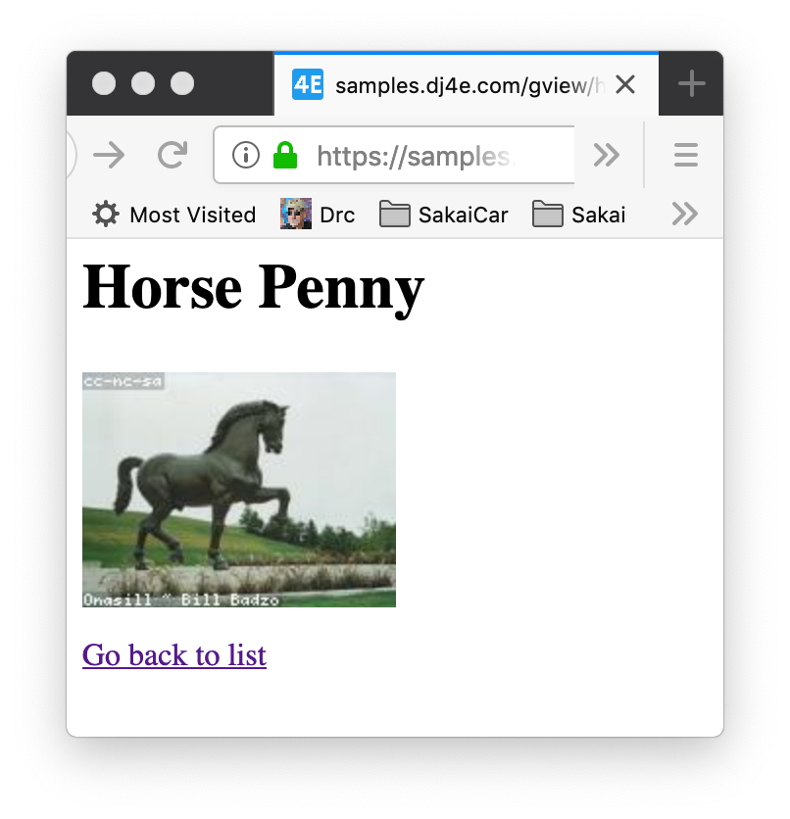
dj4e-samples/gview/views.py
https://samples.dj4e.com/gview/horse/1
from django.views import generic
from gview.models import Cat, Dog, Horse, Car
class HorseDetailView(generic.DetailView):
model = Horse
dj4e-samples/gview/templates/gview/horse_detail.html
<h1>Horse {{ horse.name }}</h1>
<p>
<img src="https://loremflickr.com/160/120/horse"
alt="A random picture of a horse">
</p>
<p>
<a href="{% url 'gview:horses' %}">Go back to list</a>
</p>
Lots of convention – no repetition

Slide 13
dj4e-samples/gview/views.py
class CatListView(View):
def get(self, request) :
stuff = Cat.objects.all()
cntx = { 'cat_list': stuff }
return render(request, 'gview/cat_list.html', cntx)
from django.views import generic
class HorseListView(generic.ListView):
model = Horse
https://docs.djangoproject.com/en/3.0/topics/class-based-views/generic-display/

Slide 14
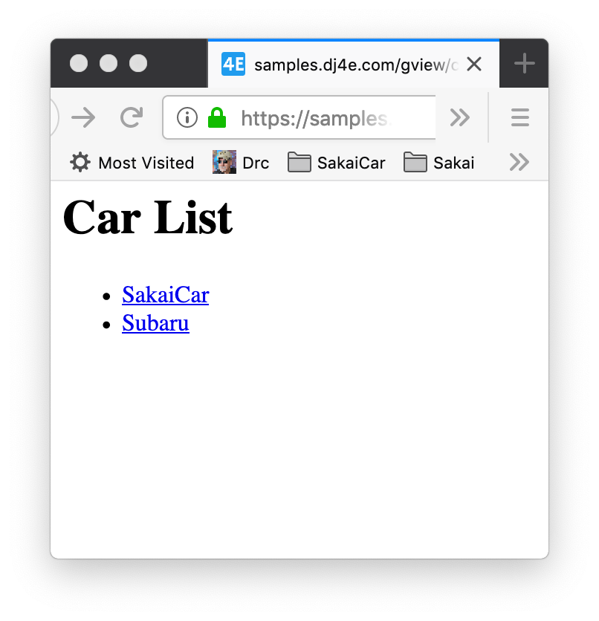
dj4e-samples/gview/views.py
https://samples.dj4e.com/gview/cars
# Lets review how inheritance works to avoid repeating ourselves
# It is all about convention
class DJ4EListView(View):
def get(self, request) :
modelname = self.model._meta.verbose_name.title().lower()
stuff = self.model.objects.all()
cntx = { modelname+'_list': stuff }
return render(request, 'gview/'+modelname+'_list.html', cntx)
# Lets reuse those "generic" classes
class CarListView(DJ4EListView):
model = Car
https://docs.djangoproject.com/en/3.0/topics/class-based-views/generic-display/

Slide 15
Overriding Convention

Slide 16
Convention over Configuration
Convention over configuration is a software design paradigm used by software frameworks that attempts to decrease the number of decisions that a developer using the framework is required to make without necessarily losing flexibility.
When the convention matches the desired behavior, it behaves as expected without having to write configuration files. Only when the desired behavior deviates from the implemented convention is explicit configuration required.
https://en.wikipedia.org/wiki/Convention_over_configuration

Slide 17
Departing from Convention in a View
You can add instance variables to the as_view() in the urls.py
You can add instance variables to the class in views.py
You can override methods in the class in views.py
dj4e-samples/gview/urls.py
app_name = 'gview'
urlpatterns = [
path('', TemplateView.as_view(template_name='gview/main.html')),
path('cats', views.CatListView.as_view(), name='cats'),
...
]

Slide 18
class django.views.generic.list.ListView
A page representing a list of objects. While this view is executing, self.object_list will contain the list of objects (usually, but not necessarily a queryset) that the view is operating upon.
Method Flowchart
setup()
dispatch()
http_method_not_allowed()
get_template_names()
get_queryset()
get_context_object_name()
get_context_data()
get()
render_to_response()
https://docs.djangoproject.com/en/3.0/ref/class-based-views/generic-display/#django.views.generic.list.ListView

Slide 19
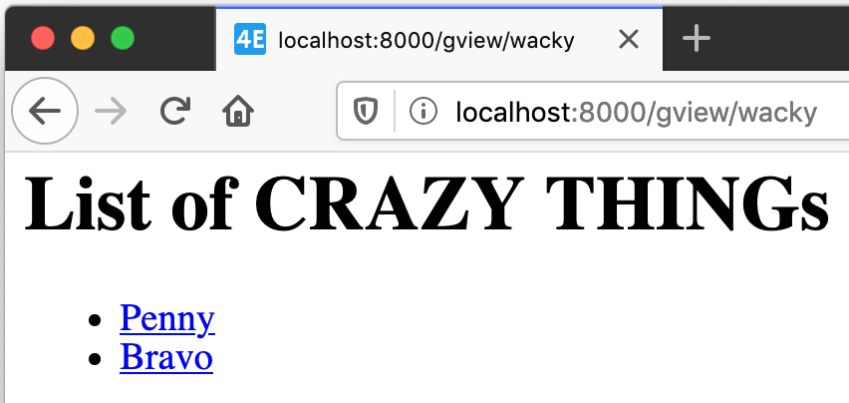
dj4e-samples/gview/views.py
https://samples.dj4e.com/gview/wacky
# Lets explore how (badly) we can override things...
class WackyEquinesView(generic.ListView):
model = Car
template_name = 'gview/wacky.html'
def get_queryset(self, **kwargs):
crazy = Horse.objects.all() # Convention: Car
return crazy
def get_context_data(self, **kwargs):
context = super().get_context_data(**kwargs)
context['crazy_thing'] = 'CRAZY THING'
return context
dj4e-samples/gview/templates/gview/wacky.html
<h1>List of {{ crazy_thing }}s</h1>
<p>
{% if horse_list %}
<ul>
{% for xyz in horse_list %}
<li>
<a href="{% url 'gview:horse' xyz.id %}">{{ xyz.name }}</a>
</li>
{% endfor %}
...

Slide 20
Summary
Generic views allow us to produce lots of similar pages without cutting, pasting and editing boiler plate
Quicker development
Consistent User Experience
Less lines of code means fewer mistakes

Slide 21
Acknowledgements / Contributions
These slides are Copyright 2019- Charles R. Severance (www.dr-chuck.com) as part of www.dj4e.com and made available under a Creative Commons Attribution 4.0 License. Please maintain this last slide in all copies of the document to comply with the attribution requirements of the license. If you make a change, feel free to add your name and organization to the list of contributors on this page as you republish the materials.
Initial Development: Charles Severance, University of Michigan School of Information
Insert new Contributors and Translators here including names and dates
Continue new Contributors and Translators here

