Slide 1
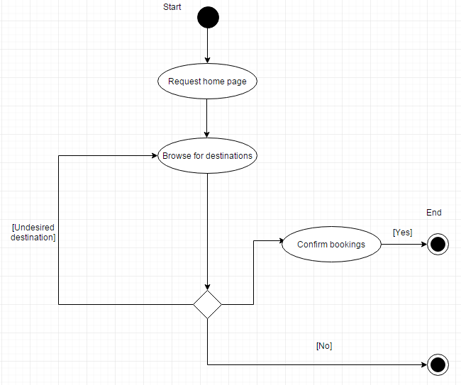

Slide 2
UML Activity Diagram

