Slide 1
ETL Project
U.S. Single Family Home Prices & Federal Home Loan Bank Mortgage Data
Group 6: Mahesh, Shuo, Alfredo, and Dan

Slide 2
Data Sources
Zillow Home Value Index (ZHVI): A smoothed, seasonally adjusted measure of the typical home value and market changes across single-family residences.
Public Use Database - Federal Home Loan Bank System: Census level data relating to mortgages purchased by each Federal Home Loan Bank.
US Zip codes

Slide 3
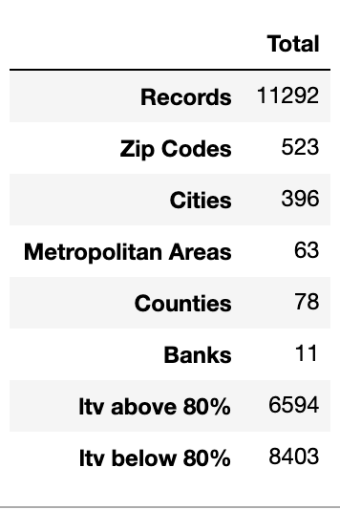
Scope
For our ETL project we elected to compile a database capable of providing insight into mortgages and home prices in the U.S. To do so, we focused on U.S. single family home prices and Federal mortgage data for the years 2016 and 2018. We extracted, transformed, and loaded the data into a production-ready relational database.
LTV: Loan to Value Ratio

Slide 4


ETL Process
Extracted CSV files from web
Read CSV files into Pandas
Cleaned & transformed data in Pandas
Created database in pgAdmin
Loaded tables using SQLalchemy engine into pgAdmin
Used SQL to join Zillow and FHLB data in pgAdmin creating production-ready tables

