Slide 1
U.S. Airport & Airline Delay Analysis

Slide 2
Analysis Summary
Overview: Our project looks to analyze commercial airline flights in the US in order to summarize timeliness of arrivals, and if arriving flights are delayed, the primary reason(s) for this (i.e. weather, carrier, mechanical issues, etc.) including how this varies by both, airline and airport.
Time period: September 2018 – September 2019
Data source(s):
United States Department of Transportation, Bureau of Transportation Statistics,
Google Maps (API)

Slide 3
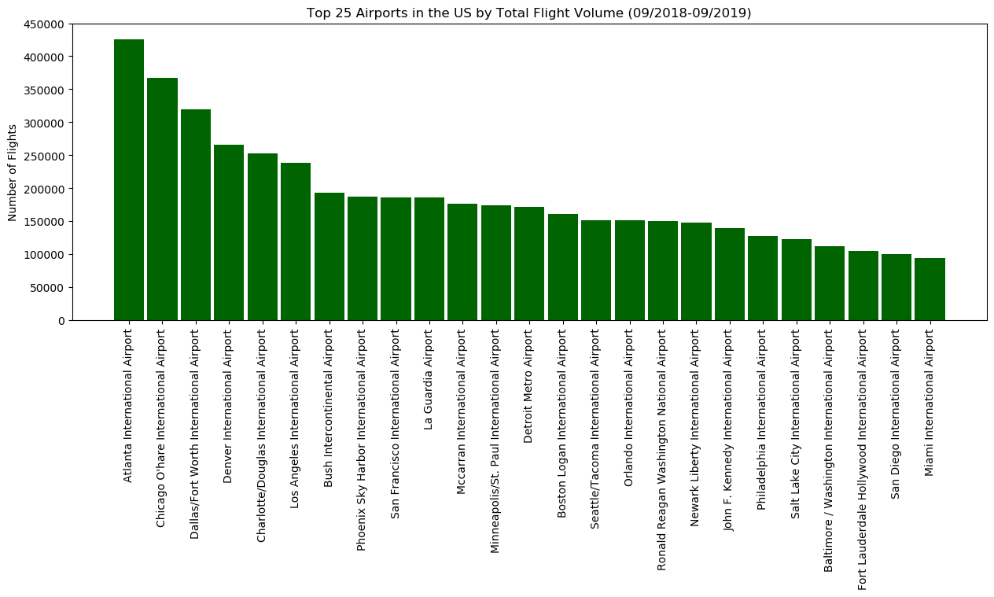

Slide 4
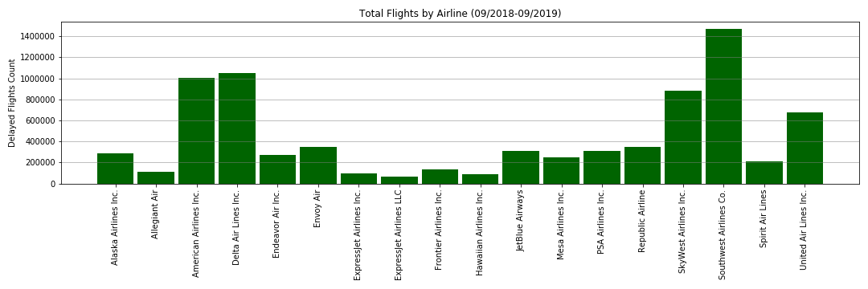

Slide 5
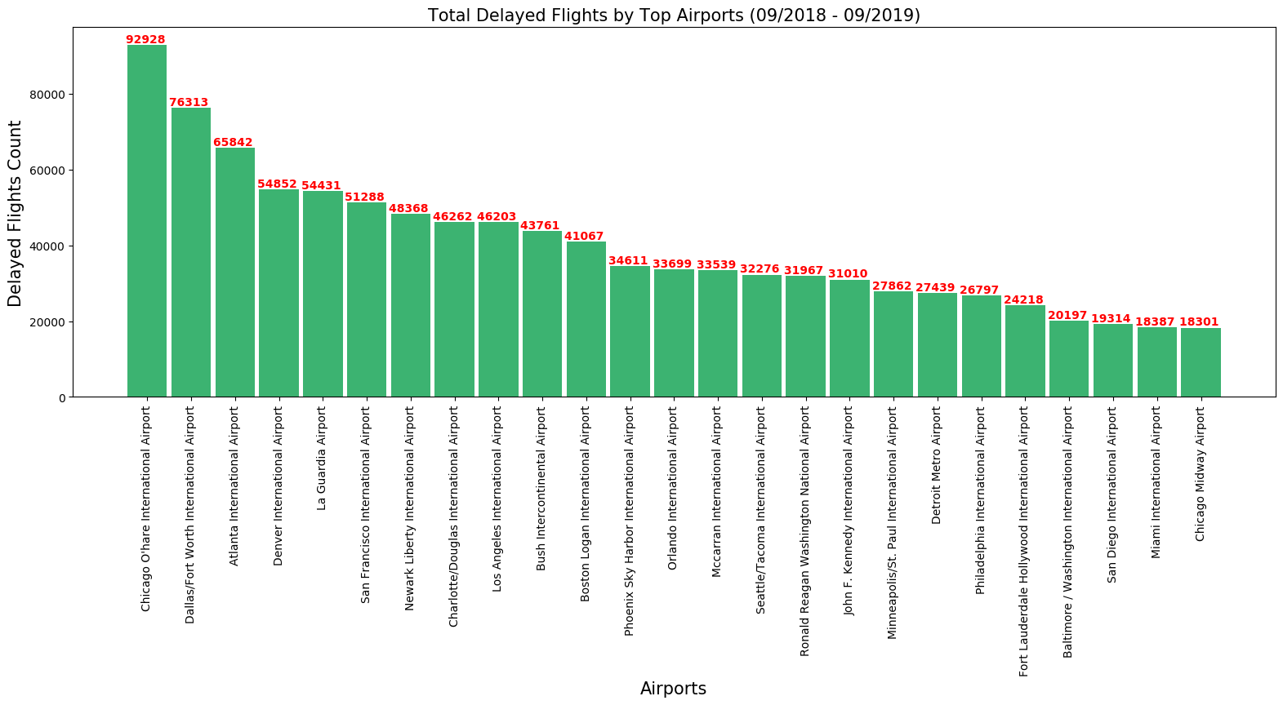

Slide 6
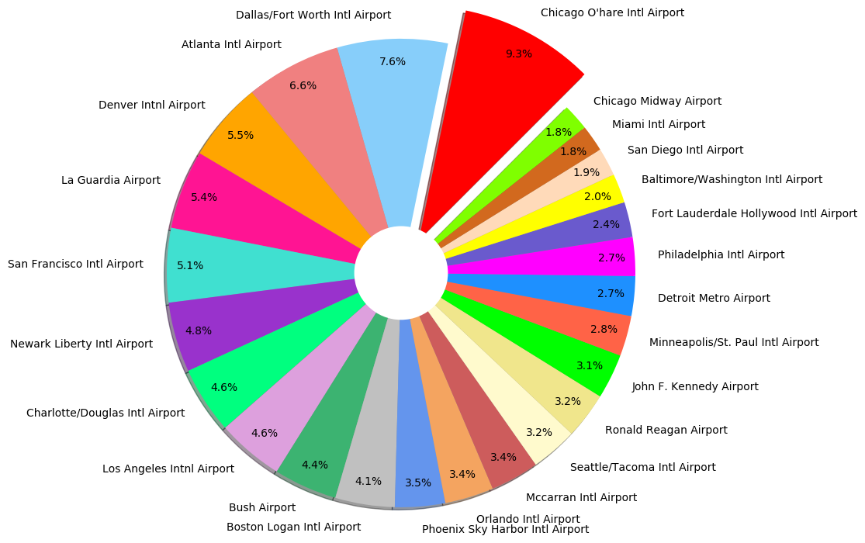
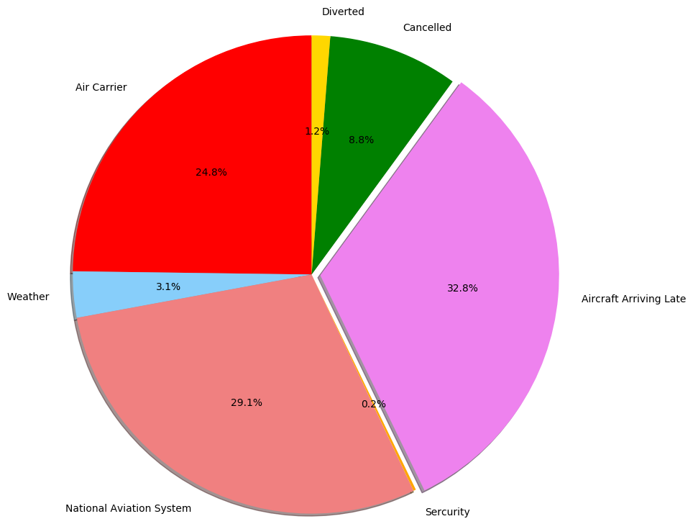
Total Delay Percentage by U.S. Airport
Delay Causes as a Percentage of Total

Slide 7
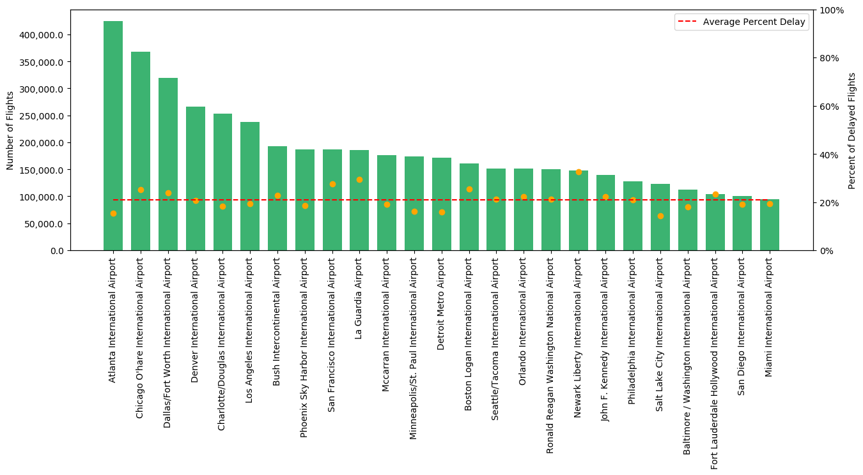
Total number of flights by top 25 U.S. airport including percentage of flight delays for each compared to the median delay percentage.
Delay percentage

Slide 8
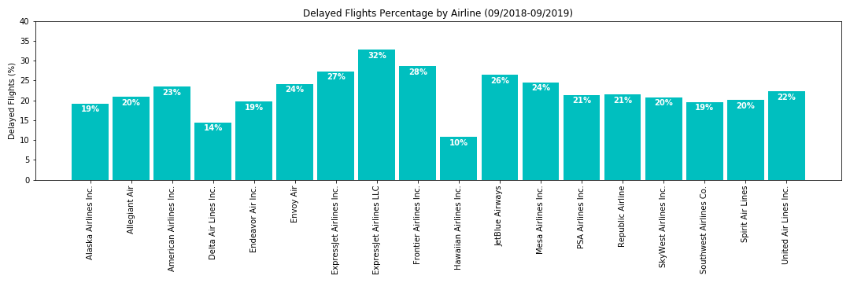
Rank | Airline | Flight Count | Delay Percentage
0 | ExpressJet Airlines LLC | 21086.17 | 32.79%
1 | Frontier Airlines Inc. | 39393.26 | 28.60%
2 | ExpressJet Airlines Inc. | 26378.96 | 27.32%
3 | JetBlue Airways | 81252.91 | 26.39%
4 | Mesa Airlines Inc. | 60502.04 | 24.59%
5 | Envoy Air | 83714.10 | 24.11%

