Slide 2
Medicare

Slide 3
Medicare is federal health insurance program
Not income based
If you paid Medicare taxes on your earnings while working , you will be eligible

Slide 4
Eligibility
All individuals eligible for social security who are aged 65 and over
those eligible for social security because of a disability
those suffering from end-stage renal disease

Slide 5
5
Benefits
Preventive services such as annual wellness exams and flu shots
Hospital and clinic outpatient services
High cost sharing

Slide 6
Diagnoses
Federal Hypertension, osteoporosis, chronic obstructive pulmonary disease, asthma, diabetes, heart disease, and stroke

Slide 7
7
Parts of Medicare
Medicare comes in four parts; Part A, Part B, Part C and Part D

Slide 8
8
Part A
Hospital care or Hospitalization Coverage
covers the cost of being in a medical facility
monthly premiums do not apply, but copays and deductibles for services do apply

Slide 9
9
Part B
Medical Insurance
Those eligible for Medicare Part A also qualify for Part B
covers doctor’s fees, medical tests and procedures
requires monthly premium payments and yearly deductibles
Individuals are not mandated to sign up for Part B, they are eligible if they are still covered by their employer’s insurance

Slide 10
10
Part C
Supplemental Insurance
also known as Medicare Advantage
refers to private insurance plans
Individuals eligible for Medicare Part A and Part B are also eligible for Part C
It may be purchased to help cover expenses such as copayments, coinsurance, and deductibles that are not covered by Parts A and Part B

Slide 11
11
Part D
Prescription drug coverage
D is administered by private insurance companies
required to have it unless you have coverage from another plan
Those enrolled in Medicare Part C are typically eligible for Part D
Participants must pay monthly premiums, yearly deductible, and copayments

Slide 12
Medicaid

Slide 13
a public assistance program(federal+state)
Income based
Pays by funds collected through taxes
Eligible for those whose household income is below138% of the FPL of all ages, works differently in each state

Slide 14
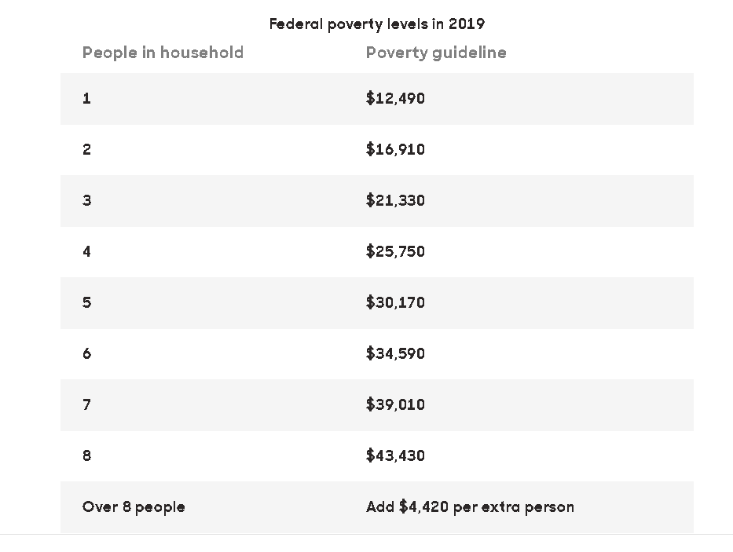
13

Slide 15
Eligibility
PREGNANT:
single or married
you and your child .

Slide 16
PARENT OF A MINOR OR TEENAGER LIVING ALONE:
If you have a child under 18 and household income is below 138% of FPL .
Some states allow for “children” up to 21 years old

Slide 17
AGED,BLIND AND DISABLED
If you are over 65 and can not afford services apply for Medicaid as well
Adults who are old age, vision loss and near to FPL
People with medical may apply regardless of age

Slide 18
WHO PAYS
The Affordable Care Act(SCA)
Health Maintenance Organization(HMO)

Slide 19
Diagnoses
Childbirth, asthma, hypertension, diabetes, congenital neurological and developmental disorders, mental health and substance abuse, tuberculosis, sexually transmitted diseases, and HIV/AIDS

Slide 20
20
Benefits
Although benefits vary by state, each state is required to cover certain types of care
These include inpatient and outpatient hospital services, nursing-home and home healthcare, laboratory and x-ray diagnostic services, transport to a medical facility and tobacco-cessation counseling for pregnant women

Slide 21
21
In addition to paying Medicare-related expenses such as hospitalization, doctors and medicines, Medicaid offers two additional types of care that Medicare does not
Custodial Care
Nursing Home Care

Slide 22
Custodial Care
Custodial or personal care helps you with daily activities
These activities include eating, bathing, dressing and going to the bathroom
Custodial care can be provided in a skilled nursing facility, if you're there for a recuperative stay following a stroke or accident
It can also be provided at home, as a way to avoid being admitted to a nursing home, or for some period before a nursing home becomes the best option

Slide 23
Nursing Home Care
Medicaid is the primary provider of long-term nursing-home care
Medicare will pay for skilled nursing short-term, or rehabilitation in a skilled nursing facility; however, it does not covered extended care.
Nursing home care under Medicaid is a complex subject. Even if you qualify for it in general, you may have to pay part of the cost, depending on your income and tax deductions
The results of the application process will determine how much you have to pay, if anything

Slide 24
Can you have both ?
Yes
If you qualify for both Medicare and Medicaid, you are “dual eligible”
Medicaid will pay for most of your Medicare Parts A and B premiums (if you have premiums), along with deductibles and co-payments you may have
If you are “dual eligible” and receive full Medicaid, your prescription drug coverage (Part D) will go through Medicare but you will automatically qualify for Extra Help paying for your medicines

Slide 25
Other Government Services

Slide 26
STATE CHILDREN’S HEALTH INSURANCE PROGRAM(SCHIP)
Designed as a joint federal-state program
created in 1997 to provide health insurance to poor and near-poor children through age 18 without another source of insurance.
Approximately 4.6 million children were enrolled in SCHIP as of fiscal year 2001
SCHIP is targeted to children with incomes that exceed Medicaid eligibility requirements but remain under 200 percent of the federal poverty level (FPL)

Slide 27
VETERANS HEALTH ADMINISTRATION(VHA)
was established in 1946
as a separate division within the Veterans Administration to meet the health care needs of U.S. veterans
VHA serves as a payer of last resort for treatment not related to service-connected disabilities that is provided through VHA facilities

Slide 28
DOD TRICARE
DOD TRICARE encompasses two health care programs operated by the Department of Defense
TRICARE provides services to active-duty military personnel, their dependents, retirees under the age of 65 and spouses, and survivors
TRICARE for Life, a recent addition to the military health program, provides supplemental coverage (e.g., for prescription drugs) to the population aged 65 and over who enroll in Medicare Part B

Slide 29
INDIAN HEALTH SERVICE(IHS)
an agency within the Department of Health and Human Services
is responsible for providing health services to members of federally recognized American Indian and Alaska Native tribes
currently provides health services to approximately 1.4 million American Indians and Alaska Natives belonging to more than 557 federally recognized tribes in 35 states

Slide 30
QUESTIONS
Are recently migrated lawfully present immigrants eligible for medicare and medicaid?
Out of 4 parts , in which parts do you have to pay deductibles, copay and premiums and in which parts do you no have to ?
What is the income threshold to be eligible for Medicaid ?
Name other government services.
If you are dual eligible , which parts are paid through Medicaid and which parts are paid through medicare ?

Slide 31
REFERENCES
https://www.nap.edu/read/10537/chapter/4
https://www.investopedia.com/articles/personal-finance/081114/medicaid-vs-medicare.asp
https://www.investopedia.com/articles/pf/07/medicare-vs-medicaid.asp

Slide 32
Thank you

