Slide 2
US HEALTHCARE

Slide 3


THESE ARE ALLOWED!

Slide 4

BUT
Stand up, Clap

Slide 5
Day 1 Agenda (1 hr)
Introduction to trainer/trainees – 15 mins
Establish the purpose of the training – 5 mins
Overview: Keywords – 10 mins
US Healthcare Market Players – 20 mins
Classwork – 10 mins

Slide 6
Introduction: Trainer
Anish Gopal Vaidya
~13 years in Cotiviti
12 years in Data Ops
Working in PMO for a few months / Scrum Master

Slide 7
Introduction: Trainees – 15 mins
Form Pairs
Talk for 4 minutes – Name, Hobbies, “If God grants you one wish, what would it be?”
Share your partner’s information

Slide 8
WORKING AGREEMENTS
Take Notes as you learn
If you have any confusion, ask questions during the pause
Full presence: pay full attention to the session – no side talks and working on other stuff

Slide 9
Day 1 Agenda (1 hr)
Introduction to trainer/trainees – 15 mins
Establish the purpose of the training – 5 mins
Overview: Keywords – 10 mins
US Healthcare Market Players – 20 mins
Classwork – 10 mins

Slide 10
WHY US HEALTHCARE?

Slide 11
WHY

Slide 12
Day 1 Agenda (1 hr)
Introduction to trainer/trainees – 15 mins
Establish the purpose of the training – 5 mins
Overview: Keywords – 10 mins
US Healthcare Market Players – 20 mins
Classwork – 10 mins

Slide 13
3 KEYWORDS FOR US HEALTHCARE
BIG
GROWING
COMPLEX

Slide 14

US HEALTHCARE
Mostly Privately Owned
Insurance Driven

Slide 15
Day 1 Agenda (1 hr)
Introduction to trainer/trainees – 15 mins
Establish the purpose of the training – 5 mins
Overview: Keywords – 10 mins
US Healthcare Market Players – 20 mins
Classwork – 10 mins

Slide 16
HEALTHCARE MARKET PLAYERS

Slide 17
RX RETAILERS
REINSURERS
Employees
EMPLOYERS
PROVIDERS
BROKERS
PBMs
INSURERS
Risk
Quality
NETWORK
COTIVITI

Slide 18
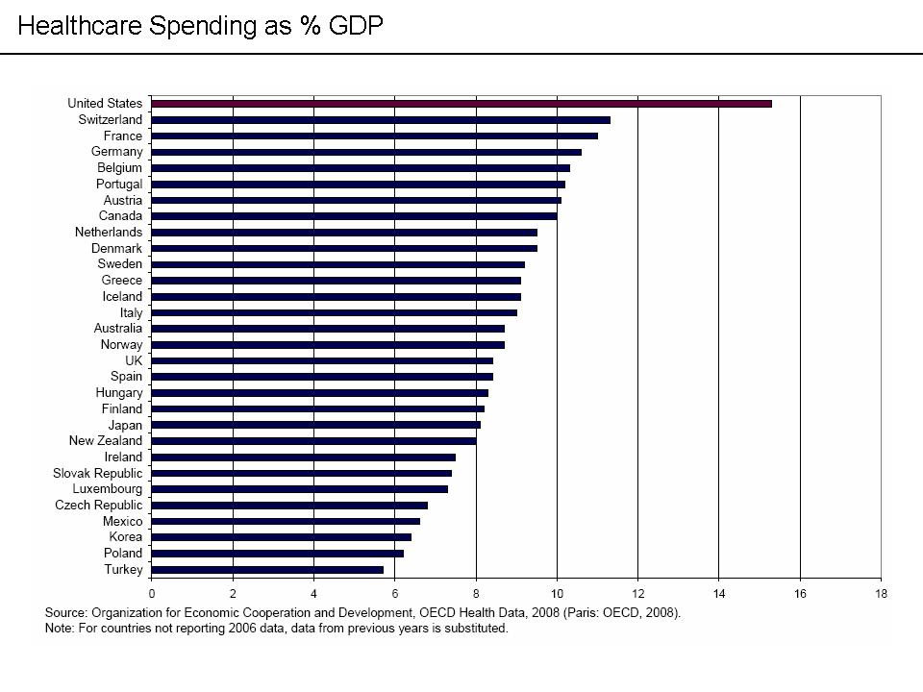
Spending

Slide 19
VIDEOS: BASIC
Healthcare system Overview
https://www.youtube.com/watch?v=LMHxxvbzFqc
Structure and Cost of US Healthcare
https://www.youtube.com/watch?v=KriEIJ0ubh0

Slide 20
Day 1 Agenda (1 hr)
Introduction to trainer/trainees – 15 mins
Establish the purpose of the training – 5 mins
Overview: Keywords – 10 mins
US Healthcare Market Players – 20 mins
Classwork – 10 mins

Slide 21
CLASSWORK – 10 mins
Divide in groups
Take down notes on whatever you have learned

Slide 22
ASSIGNMENT: DAY1
Collect your email address and send to anish.vaidya@cotiviti.com
Divide in Groups
Go through the Introduction to the U.S. Healthcare system and Private Health Insurance videos from the pdf slides (will be shared)
Prepare as many questions as possible on the topics
The questions should be answerable in one sentence or phrase at the most
Tomorrow: 1:30 to 2:30
Sameer’s email address

Slide 23
Day2 Agenda
Quiz - 25 mins
Individual Experience of US Healthcare by AnishV - 15 mins
Group learning notes: 10 mins
Assignment: Medicare, Medicaid, Understanding Medical Bill, Copays and Deductibles
All groups should view all the videos
The other groups should ask question
Those who do not speak in the first presentation will speak in the next one

Slide 24
WORKING AGREEMENTS
Take Notes as you learn
If you have any confusion, ask questions during the pause
Full presence: pay full attention to the session – no side talks and working on other stuff
Just call your seniors ‘Dai’ or ‘Didi’, not ‘sir’ or ‘madam’

Slide 25
An Individual Experience of US Healthcare
Anish Vaidya

Slide 26
Individual Experience: Background
Got issues with hearing: Diagnosed with Otosclerosis
Went to US Office for 4 months in 2013/14
Got medical insurance as a facility
Got the Insurance Card, with member ID and Group ID
Payer/Insurer: Cigna

Slide 27
Individual Experience: Searching and Visiting a Doctor
Searched Cigna’s website
Most of them gave time only after 3 months ☹
Finally found a doctor, who was a primary care physician (PCP), connected through Binod Bhattarai
Made sure that the doctor was within Cigna’s network
Filled up a form and paid copay ($25)
A nurse attended and checked the vitals (BP, Fever, etc)
The PCP suggested to go to a specialist
Search again
Found a surgeon in Mass General Hospital
Visited him, similar initial process, copay of $30
He suggested repeat surgery

Slide 28
Individual Experience: Ensuring the price of the Procedure
When asked how much the surgery would cost, the doctor did not have the answer
Had to call Cigna
The doctor’s office gave 3 CPT codes, which is a code given for the procedure(s), and the TaxID of the doctor
Based on the information, Cigna gave the cost against each of the Codes

Slide 29
Individual Experience: The Cost
Total Billed Amount was around $16,000
I paid around $1500
The total expense from my side was ~$2000

Slide 30
Day2 Agenda
Quiz - 25 mins
Individual Experience of US Healthcare by AnishV - 15 mins
Group learning notes: 10 mins
Assignment

Slide 31
Group Learning: 10 mins
Divide in groups
Take note of your learnings
One person per group: share about one thing that you learned

Slide 32
ASSIGNMENT for Day 3
Group A: Medicare, B: Medicaid, C: Understanding Medical Bill, D: Copays and Deductibles, Allowed and other amounts, E: HMO/PPO/EPO/POS
All groups should view all the videos
The other groups should ask question
Those who do not speak in the first presentation will speak in the next one

Slide 33
Day 3 Agenda
Presentation: 50 min
Recap: 10 mins
Assignment:
More Public Health Insurances
Recent Trends in US Healthcare
Cotiviti US Healthcare slides

Slide 34
Day 4 Agenda
Quiz: Each group tells about one concept they learned from each of the topics: 15 mins
Name one public health insurance (other than medicare/Medicaid)
One item you found in recent trends
One item you learned something new from the slides
Cotiviti Healthcare Slides Walkthrough: 20 mins
Group Recap: 10 mins
Assignment: Cotiviti Products

Slide 35
ASSIGNMENT for Day 5: Cotiviti Products
Quality: Group A
Quality Intelligence
Start Navigator
Medical Record Retrieval
Medical Record Abstraction
Performance Analytics: Group B
Medical Intelligence
DxCG
Network Value

Slide 36
ASSIGNMENT for Day 5: Cotiviti Products
Risk Adjustment: Group C
Suspect Analytics
In-Home Assessments
Medical Record Retrieval
Medical Record Coding
Submissions
Payment Accuracy: Group D
Billing Accuracy
Clinical Validation
Contract Compliance
Payment Responsibility
Clinical Chart Validation
Fraud, Waste, and Abuse Solutions

Slide 37
Day 5 Agenda
Self-Discovery Exercise – 15 mins
How Cotiviti Interacts with Market Players – 10 mins
How does Healthcare data look like – 15 mins
Operations and R&D Department Roles – 10 mins

Slide 38
EXERCISE
2 or more of your strengths
Talents/Skills: “I can sing”
Qualities: “I am honest”
Others
2 or more of your Weaknesses
Qualities/talents you want to have but don’t have
Those you have but don’t want to have
Others
Mark your Greatest Strength (Signature Strength) and your Greatest Weakness
5 mins…

Slide 39
Factors of Happiness
Pleasant Life
Life with events that boost positive emotions
Good Life
A positive match between a person’s strengths and their current task
Meaningful Life
Purpose – link with something greater

Slide 40
Cotiviti and Market Players
Insurance company (payers) or its corresponding vendors maintain the insurance data
Related market players (clients) buy Cotiviti products
Clients tells the Payers/Vendors to send data to us
Payers/Vendors send data to Cotiviti
Cotiviti processes data and delivers products to the client

Slide 41
How does Healthcare Data look like
What information may an insurance company maintain?
Patient/Member Information?
Claim Information?

Slide 42
R&D and Operations Analogy
Building Kitchen and maintaining it: R&D
Actual Cooking: Operations

Slide 43
Day 6 Agenda
Presentations on Cotiviti Products: 50 mins
Parking Lot
Assignment
Fee For Service
Pay for Performance/Value based care/reimbursement
Healthcare Exchange
Accountable Care Organization
Encounter Data: More related to P4P. Capitation Claims Data: related to Fee for Service
Utilization
Health Risk Assessment (HRA)
HEDIS, NCQA
Chase
Recent Trends in US Healthcare
More Public Insurance types

Slide 44
Day 7 Agenda
Retrospective: 10 mins
Quiz: Say One phrase or sentence about each topic
Medical Forms: 15 mins
Medical Intelligence Overview: 10 mins
Revision of all the knowledge: 15 mins

Slide 45
Who and how does Cotiviti Serve in the US Healthcare market
What does Cotiviti do as a business?

Slide 46
Day 9 Agenda
Ops high-level workflow: 10 mins
Other Public Health Insurance
Recent Trends in US Healthcare
Revision

Slide 47
ASSIGNMENT for Day 9 and further
Make as many questions as you can from the learnings that you have done so far

Slide 48
Learnings
Purpose of learning US Healthcare
Keywords
Market Players
How the healthcare in US is complex: Accessibility, cost, information
Amounts: Billed, Allowed, Copay, Coinsurance, Deductible
Short Idea on Standard Codes: Procedure, Diagnosis, Drug
Medicare, Medicaid
Cotiviti Products: Risk Adjustment, Quality and Performance, Payment Accuracy
How Cotiviti interacts with market players
Brief overview on how Healthcare data looks like
Brief on Operations and R&D Department roles
Fee for Service and Pay for Performance (value based care/reimbursement)
Health Risk Assessment (HRA)
Medical Intelligence product: How it looks like
Overview of Ops Workflow

Slide 49


OPERATIONS HIGH LEVEL FLOW
Oracle
Raw Files
AI/HI Tables
Executer/CPD
VH Tables
Engine Dashboard
AIP
Imported Tables
Scrub Tables
Application
Import
Scrub
Processing

Slide 50
Retrospective
What went well in the sessions up to now
What needed improvement
Suggestions

Slide 51
Revision Activity
List Down 3 or more terms you remember from the last session
Stand up and go around the room
Exchange your learnings with 3 other persons, one topic per person
Settle down
Say out loud whatever terms you learned

Slide 52
Hospital-Inpatient/Outpatient
Employer
Patient
Copay
PCP Office/Clinic
Diagnosis
Medical Bill
Specialist Office/Clinic
Procedure
Specialty

Slide 53
Nwk?
Y
Discount
Patient
Medical Bill
Provider
N
Coinsurance
Deductible
No Discount
Bill
Insurer/Payer
Allowed Amt
Paid Amount

Slide 54
Day 3
Retro
PPT Walkthrough continue (Medicare/Medicaid/Self and fully insured/Others missing)
Cotiviti Products in brief
Recent Trend
Need for one more session?

Slide 55
What we have learned so far…
Purpose of learning US Healthcare
Market Players: Employers/Providers/Network/CM-DM/Insurers/Payers
Personal Experience: How a patient interacts with the different players
Private Insurance
Government Insurance: Medicare/Medicaid
Cotiviti Products in brief: MI/EI/DxCG

Slide 56
Today’s Agenda…
Cotiviti Products continued…
A brief on Data: Elig/Claims/Rx
Recent Trend and Future
Open Discussion
Feedback Reminder

Slide 57
Where the market is going…
Focus on Quality/Performance of Healthcare Entities like Providers
More demand of products related to Quality, like Quality Intelligence/Network Value
Value based Payment or Pay for Performance Vs Fee For Service
Market becomes more provider-centric
Changes in the way we receive data
Focus on more Coverage: Healthcare Exchange
Notes:
Pay for Performance Example:
Price of MRI: F4S - 4*200 = 800, which is straightforward
P4P – the value of MRI is determined based on different parameters instead of straight claim by claim basis
Different systems may have different ways of measuring performance
Hence, there won’t be straightforward payment. We need to build systems that support such process

Slide 58
Technological Demand, Advancements and Challenges
Previously the challenge used to be the collection of data
Now, Abundance of data
We can use analytics tools and methodologies like machine learning, AI, etc to enhance our analytics and predict our data
Previously, it used to be reactive
Now, with enough data, we can/should predict and forecast the future happenings
Need to work on more state-of-the-art technologies
With changes in the way we receive data, we need to build systems to support the same

Slide 59
Further…
Cotiviti Website and Products

Slide 60
REFERENCES
https://www.commonwealthfund.org/publications/issue-briefs/2015/oct/us-health-care-global-perspective

Slide 61
TYPES OF HEALTH PLAN
HMO
PPO
EPO
https://www.youtube.com/watch?v=AUmuJIe86dk

Slide 62
ACOs
https://www.youtube.com/watch?v=flYzHZwDH_0

Slide 63
MY OWN EXPERIENCE
Enrolling in the Health Plan
Looking for the doctor
Confirming the cost: Providers and CPT
The Expenses
The procedure
After the procedure

Slide 64
RESEARCH
MEDICARE
MEDICAID
OTHER GOVERNMENT PLANS
ACO
https://www.khanacademy.org/partner-content/brookings-institution/introduction-to-healthcare

Slide 65
KNOW OUR CLIENTS
AON
TOWERS WATSON
WILLIS
HIGHMARK

