Slide 1

Machine Learning Hackathon CG 2022
Team Name - Machine_unlearners
Team Leader Name - Rajat Bishnoi
Team Leader Email Address - bishnoirajat2@gmail.com

Slide 2
Brief description of the problem at hand:
1. The Problem is related to the concern of increasing phishing attacks.
2. We have to read the data and create a model based on the data analysis to identify if the website is legitimate or not
3. Dataset consists of 30 features of a phishing website with values
(1- ,0,1) where, 1 represents the legitimate, 0 represents suspicious and -1 represents phishing.
4. We have to list all the dominant features, then remove top 2 dominant features and compare what changes we saw and how will they impact the predictions.

Slide 3
Solution proposed and description:
1. I have used Gradient Boosting Classifier as it is a robust and most powerful machine learning model for classification and regression.
2.. Hyperparameters are selected using RandomizedSearchCV() with 5- fold cross validation.
3. Metrics used is a classification report with accuracy, recall, precision and f-score.

Slide 4
Technology/Tool Stack Used:
We have used Jupyter Notebook to write and run our code
We used the following packages and libraries for the analysis:-
Tensorflow
Numpy
Pandas
Sklearn

Slide 5
Approach:
First I calculated best hyperparameters using cross-validation on dataset with all features and then divided it into training and testing set to check the performance using classification_report which have all types of metrics including accuracy.
2. After that, I listed all the dominant features in this model, and pointed out 2 top dominant features.
3. Then, the top 2 dominant features were removed and a new dataset was created.
4. I applied cross-validation on this new dataset to find best hyperparameters and then also splitted the data to test the performance of this new model.
5. Then, I compared both results and then using whole dataset with 28 features I predicted the labels for testing dataset provided in the problem statement and saved those as submission.csv file as mentioned.

Slide 6
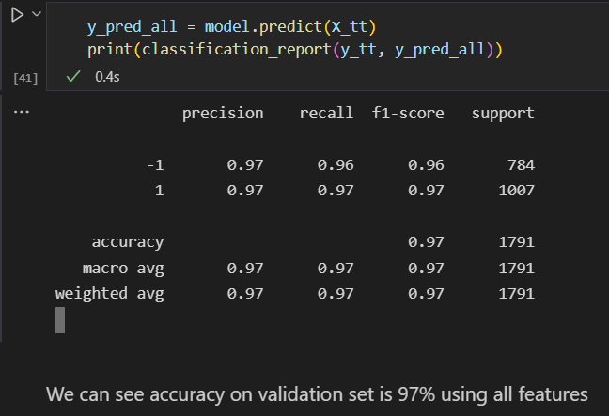
Execution Demo(Video/Screenshots) of the solution:
Classification Report when used all features.

Slide 7
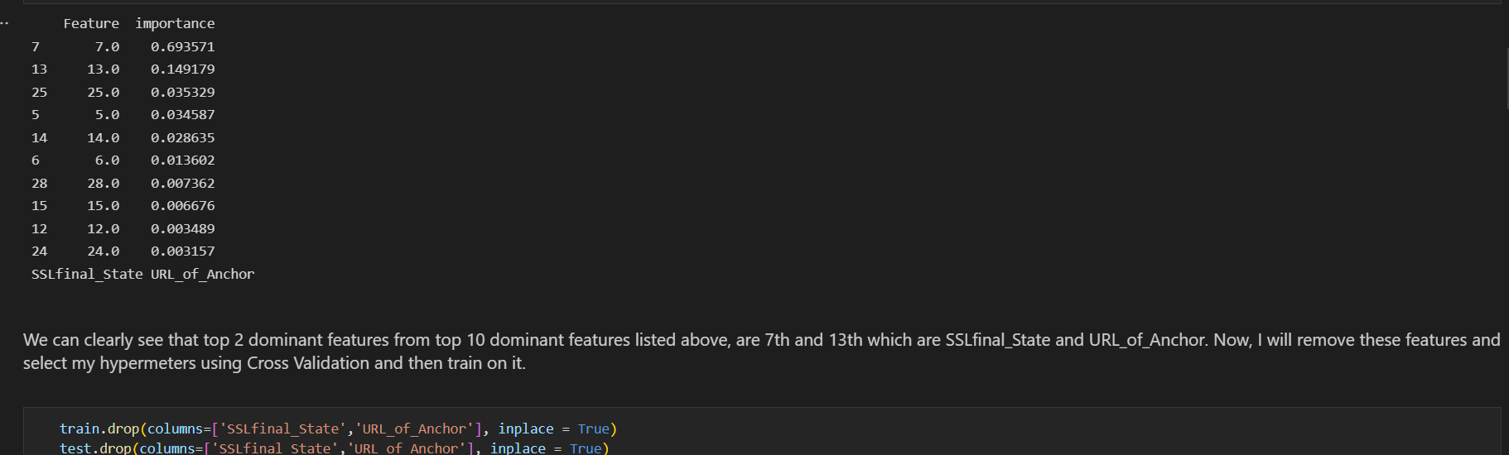
Execution Demo(Video/Screenshots) of the solution:
List of Dominant features and removal of top 2 dominant features

Slide 8
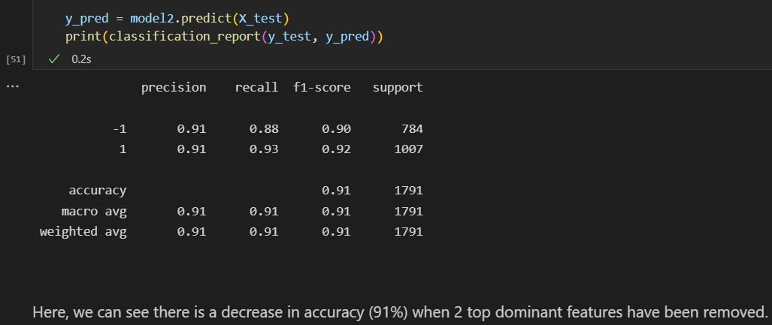
Execution Demo(Video/Screenshots) of the solution:
Classification Report when tested and trained on data excluding top 2 dominant features

Slide 9
Source code as ZIP or Github URL:
Github link :-
https://github.com/bishnoirajat2/HPE_Machine_Learning_Hackathon_Final

Slide 10
THANK YOU

